Slide 1
Figure 1. Response times for the self-descriptiveness judgments as a function of degrees of self-descriptiveness (left ...
Notes:
Figure 1. Response times for the self-descriptiveness judgments as a function of degrees of self-descriptiveness (left panel), certainty in self-views (middle panel), and importance of self-views (right panel). Error bars represent the standard error of the mean.
Unless provided in the caption above, the following copyright applies to the content of this slide: © The Author 2011. Published by Oxford University Press. All rights reserved. For permissions, please e-mail: journals.permissions@oup.com

Slide 2
Figure 2. Brain regions in which neural activity was positively correlated with ratings of self-descriptiveness. ...
Notes:
Figure 2. Brain regions in which neural activity was positively correlated with ratings of self-descriptiveness. Displayed at P < 0.001 (uncorrected) on the mean structural MRI of all participants. The right panel shows the signal change in the peak voxel in the ventral MPFC.
Unless provided in the caption above, the following copyright applies to the content of this slide: © The Author 2011. Published by Oxford University Press. All rights reserved. For permissions, please e-mail: journals.permissions@oup.com

Slide 3
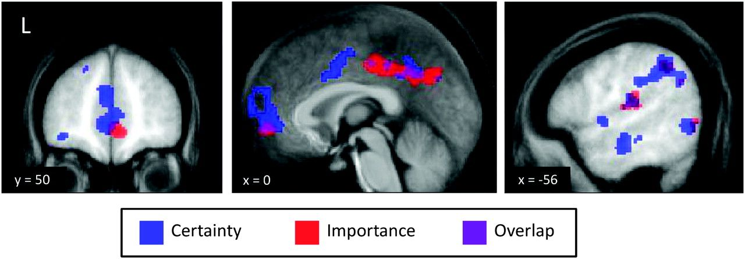
Figure 3. Brain regions that responded to epistemic and emotive investments in self-views. The brain areas in which ...
Notes:
Figure 3. Brain regions that responded to epistemic and emotive investments in self-views. The brain areas in which activity was correlated with the certainty of self-views (epistemic investments) are displayed in blue, whereas the brain areas in which activity was correlated with the importance of self-views (emotive investments) are displayed in red; the overlap between the 2 activation maps is shown in purple. Displayed at P < 0.001 (uncorrected) on the mean structural MRI of all participants.
Unless provided in the caption above, the following copyright applies to the content of this slide: © The Author 2011. Published by Oxford University Press. All rights reserved. For permissions, please e-mail: journals.permissions@oup.com

Slide 4
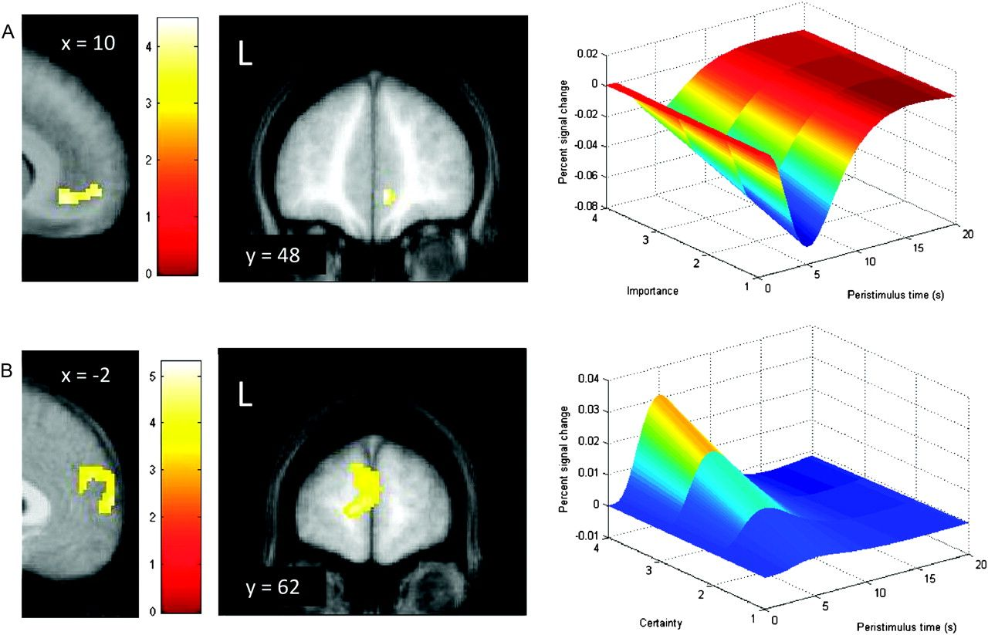
Figure 4. Medial prefrontal areas that were specifically related to epistemic and emotive investments in self-views ...
Notes:
Figure 4. Medial prefrontal areas that were specifically related to epistemic and emotive investments in self-views (exclusive masking analyses). (A) A region of the ventral MPFC responded specifically to the importance of self-views (emotive investments). As can be seen from the right panel, the signal change in this area took the form of deactivations relative to resting baseline. (B) The dorsal MPFC responded specifically to the certainty of self-views (epistemic investments). This area showed signal increases relative to baseline (right panel). The maps are displayed at P < 0.001 (uncorrected) on the mean structural MRI of all participants.
Unless provided in the caption above, the following copyright applies to the content of this slide: © The Author 2011. Published by Oxford University Press. All rights reserved. For permissions, please e-mail: journals.permissions@oup.com

