Slide 1
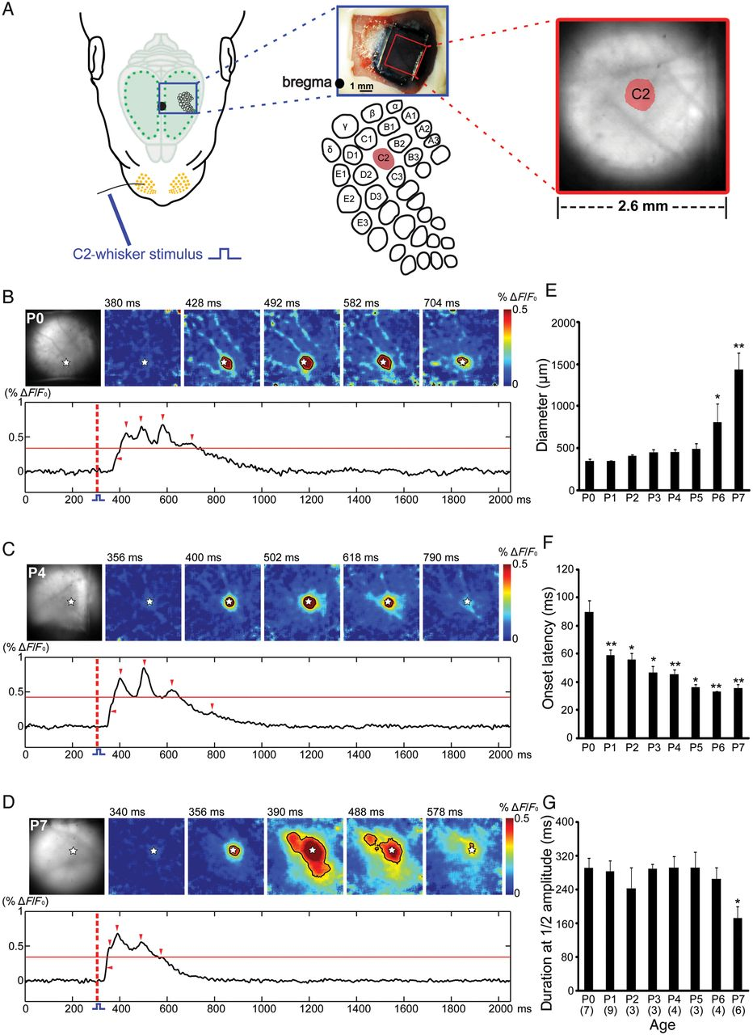
Figure 1. Whisker stimulation elicits a local response in the newborn rat barrel cortex. (A) The schematic illustration ...
Notes:
Figure 1. Whisker stimulation elicits a local response in the newborn rat barrel cortex. (A) The schematic illustration of the experimental set-up for selective mechanical stimulation of the C2 whisker (left) and simultaneous VSDI in the barrel cortex. The image of the somatosensory cortex stained with the VSD RH1691 (upper middle); the schematic illustration of the barrel-field map with localization of the C2 barrel (lower middle) and microscopic picture of the cortical surface with the evoked response in the C2 barrel-related column after mechanical stimulation of the C2 whisker (right). Black dot indicates bregma position. (B–D) VSDI in the barrel cortex of a P0 (B), P4 (C), and P7 (D) rat following C2-whisker stimulation at the time point of 300 ms (red-dotted line). The localization of the C2-whisker representation in the barrel cortex and 5 successive poststimulus VSDI responses are shown in the upper rows. White stars indicate the center of the C2-whisker-evoked response. Lower rows show 2-s long optical recordings in which the time points of the 5 successive frames are marked by red arrow heads. Red horizontal line indicates the half-maximal response amplitude. Note the large area of the response in the P7 rat at 390 and 488 ms when compared with the smaller responses in the P0 and P4 rat, where the activity is restricted to the C2 barrel. (E–G) Average diameter (E), onset latency (F), and duration at the half-maximal amplitude (G) of the C2-evoked VSDI response in P0–P7 rats. The number of animals is given in parentheses in (G). In this and the subsequent figures, the data are expressed as mean ± SEM. Statistical significant differences (Mann–Whitney–Wilcoxon test) versus the P0 age group are indicated by *P < 0.05 and **P < 0.01.
Unless provided in the caption above, the following copyright applies to the content of this slide: © The Author 2012. Published by Oxford University Press. All rights reserved. For Permissions, please e-mail: journals.permissions@oup.com

Slide 2
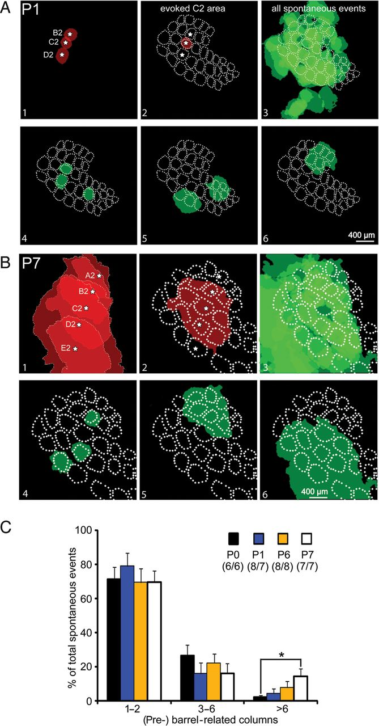
Figure 2. Spontaneously occurring activity assembles barrel-related columnar networks. (A,B) Spontaneously occurring ...
Notes:
Figure 2. Spontaneously occurring activity assembles barrel-related columnar networks. (A,B) Spontaneously occurring and whisker stimulation-induced activity recorded in the somatosensory cortex of one P1 (A) and one P7 (B) rat. Color-coded spots represent the area of evoked VSDI responses or spontaneous VSDI events with at least half-maximal ΔF/F0 amplitude. Panel 1 shows the cortical representation of 3 or 5 whiskers of arc 2 as determined by selective mechanical stimulation of a single whisker. White star marks the center of each activated barrel. Panel 2 illustrates the response to C2-whisker stimulation in the map of the whole barrel field. A barrel field map was generated on the basis of a cytochrome oxidase stained horizontal section and aligned according to the evoked responses. In panel 3, all spontaneous events (n = 75 in [A] and n = 71 in [B]) recorded in this P1 or P7 rat are superimposed on the barrel field map. Single spontaneous events localized in a single (pre-)barrel-related column (panel 4) or in more than one (pre-)barrel-related column (panels 5 and 6) are shown. (C) The percentage distribution of spontaneous events, which are restricted to 1–2, 3–6, or >6 (pre-)barrel-related columns. The number of animals/litters investigated for in each age group is given in parentheses. Statistical significant differences (Mann–Whitney–Wilcoxon test) versus the P0 age group are indicated by *P < 0.05.
Unless provided in the caption above, the following copyright applies to the content of this slide: © The Author 2012. Published by Oxford University Press. All rights reserved. For Permissions, please e-mail: journals.permissions@oup.com

Slide 3
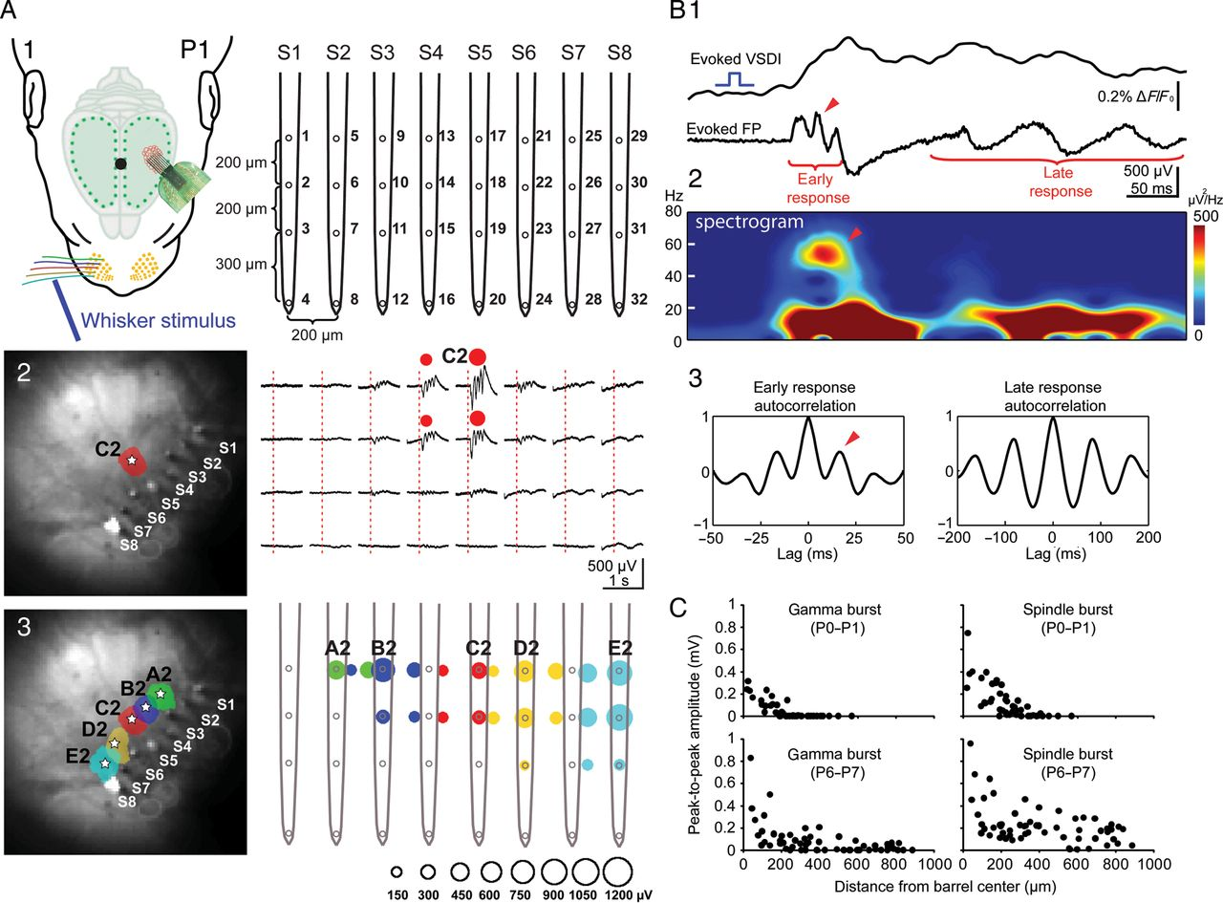
Figure 3. Gamma and spindle bursts synchronize functional cortical columns. (A) The simultaneous VSDI and the ...
Notes:
Figure 3. Gamma and spindle bursts synchronize functional cortical columns. (A) The simultaneous VSDI and the multi-electrode recording of stimulus evoked the local cortical responses. The schematic illustration of the experimental set-up combining selective single-whisker stimulation, VSDI, and cortical 32-channel recordings using an 8-shank electrode (S1–S8) with shank spacing of 200 µm (A1). Mechanical stimulation of the C2 whisker in a P1 rat elicits a local VSDI (left) and local electrophysiological (right) response in the C2 barrel (A2). Color-coded localization of the evoked cortical VSDI (left) and electrophysiological (right) responses to stimulation of single whiskers in arc 2 (A3). The first negative peak amplitude of the electrophysiological response corresponds to the size of the color-coded circles as shown below the graph. Ten times baseline standard deviation was used as the threshold (∼150 µV) to define the spatial extent of the electrical response. (B) VSDI and FP response recorded simultaneously in the cortical E2 barrel following mechanical stimulation of the E2 whisker in a P1 rat. The corresponding spectrogram plot of the evoked FP response and autocorrelograms of early- and late-evoked FP response are shown below. Note the the early response with a period of ∼20 ms (arrowheads in B1–3) corresponding to a ∼50-Hz gamma burst discharge, while the late component showed a slower frequency. (C) The relationship between the peak-to-peak amplitude and the distance from the center of the (pre-) barrel-related column for evoked gamma bursts (left) and spindle bursts (right) in P0–P1 (upper panels, n = 44 recordings in 4 animals from 4 litters) and P6–P7 rats (lower panels, n = 59 recordings in 5 animals from 4 litters).
Unless provided in the caption above, the following copyright applies to the content of this slide: © The Author 2012. Published by Oxford University Press. All rights reserved. For Permissions, please e-mail: journals.permissions@oup.com

Slide 4
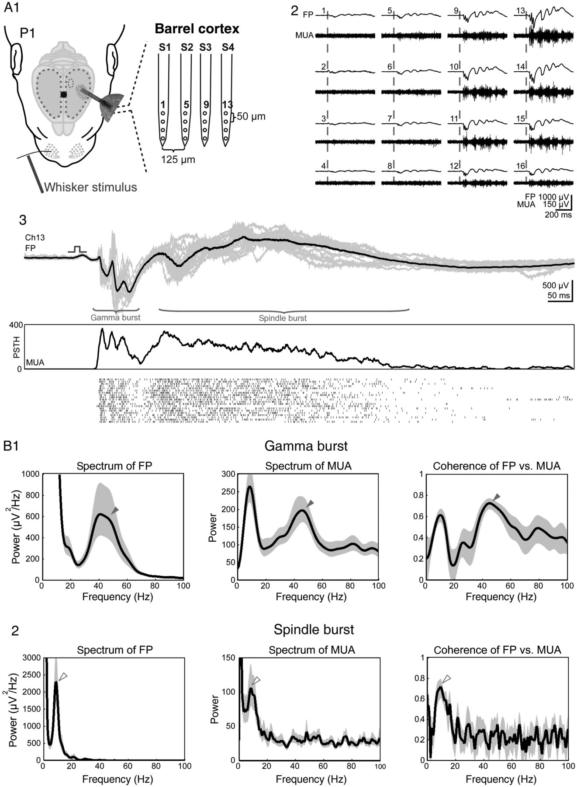
Figure 4. Cortical bursts correlate with MUA. (A) FP and multi-unit recordings of single-whisker-evoked responses in ...
Notes:
Figure 4. Cortical bursts correlate with MUA. (A) FP and multi-unit recordings of single-whisker-evoked responses in the barrel cortex. The schematic illustration of the experimental set-up with a 4-shank 16-channel electrode (A1). FP (upper traces) and MUA responses (lower traces) to single-whisker stimulation recorded in a P1 rat with the electrodes shown in panel 1 (A2). Average (black trace) and superimposed 20 single (shaded area) cortical FP responses and corresponding poststimulus time histogram (PSTH) of 20 succeeding whisker stimulations every 20 s (A3). Note the presence of gamma activity in the early response in the FP and MUA. (B) Average spectrum and coherence analyses of evoked gamma burst (B1) and spindle burst (B2) responses recorded in 9 P0–P1 rats. Black traces show averages and the shaded area represents the 95% CI. Note the prominent 40–50 Hz activity in the averaged gamma burst (filled arrowheads) and ∼10 Hz peak in the spindle burst response (open arrowheads). Shaded areas in (B) represent 95% CI.
Unless provided in the caption above, the following copyright applies to the content of this slide: © The Author 2012. Published by Oxford University Press. All rights reserved. For Permissions, please e-mail: journals.permissions@oup.com

Slide 5
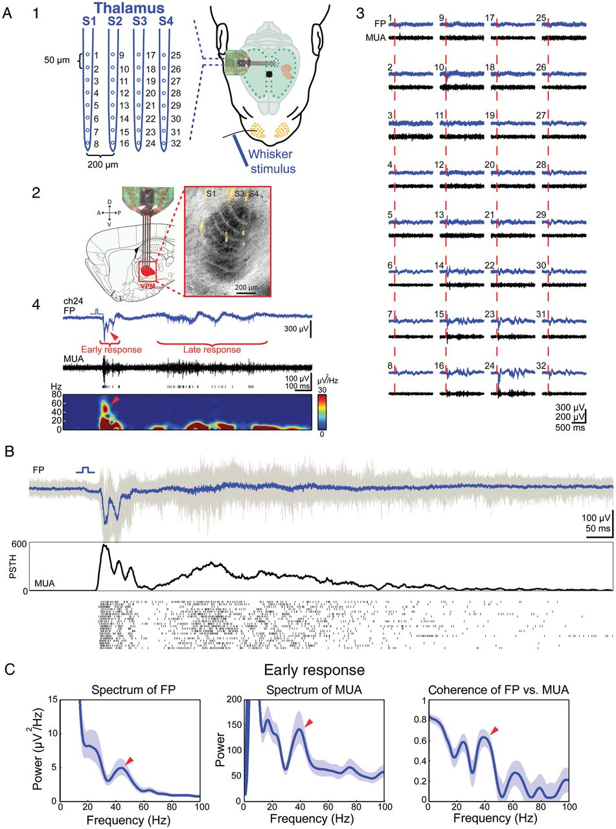
Figure 5. Whisker stimulation elicits gamma activity in the thalamus. (A) Electrophysiological recordings of the ...
Notes:
Figure 5. Whisker stimulation elicits gamma activity in the thalamus. (A) Electrophysiological recordings of the whisker-evoked FP and MUA responses in the thalamic VPM of the newborn rat. The schematic illustration of the experimental set-up with a 4-shank 32-channel electrode located in the thalamus (A1). The schematic illustration of a sagittal brain section showing the location of the recording electrodes in the VPM thalamus (left picture taken from Paxinos and Watson 1998) (A2). The image of cytochrome oxidase stained section from the newborn rat showing 3 DiI-stained electrode tracks S1, S3, and S4 (right). Representative thalamic responses to single-whisker stimulation recorded with multi-electrode S1–S4 in a P0 rat (A3). The enlargement of response recorded at channel 24 with the corresponding spectrogram plot (A4). Note the gamma component in early response (arrowhead in A4). (B) Average (blue trace) and 20 superimposed single (shaded area) FP responses with corresponding poststimulus time histogram (PSTH) of 20 succeeding whisker stimulations every 30 s in a P1 rat. (C) Average spectrum and coherence analyses of evoked early thalamic responses recorded in 10 P0–P1 rats. Note the prominent gamma activity in the averaged FP and MUA spectrum and in the coherence plot (arrowheads). Shaded areas in (C) represent 95% CIs.
Unless provided in the caption above, the following copyright applies to the content of this slide: © The Author 2012. Published by Oxford University Press. All rights reserved. For Permissions, please e-mail: journals.permissions@oup.com

Slide 6
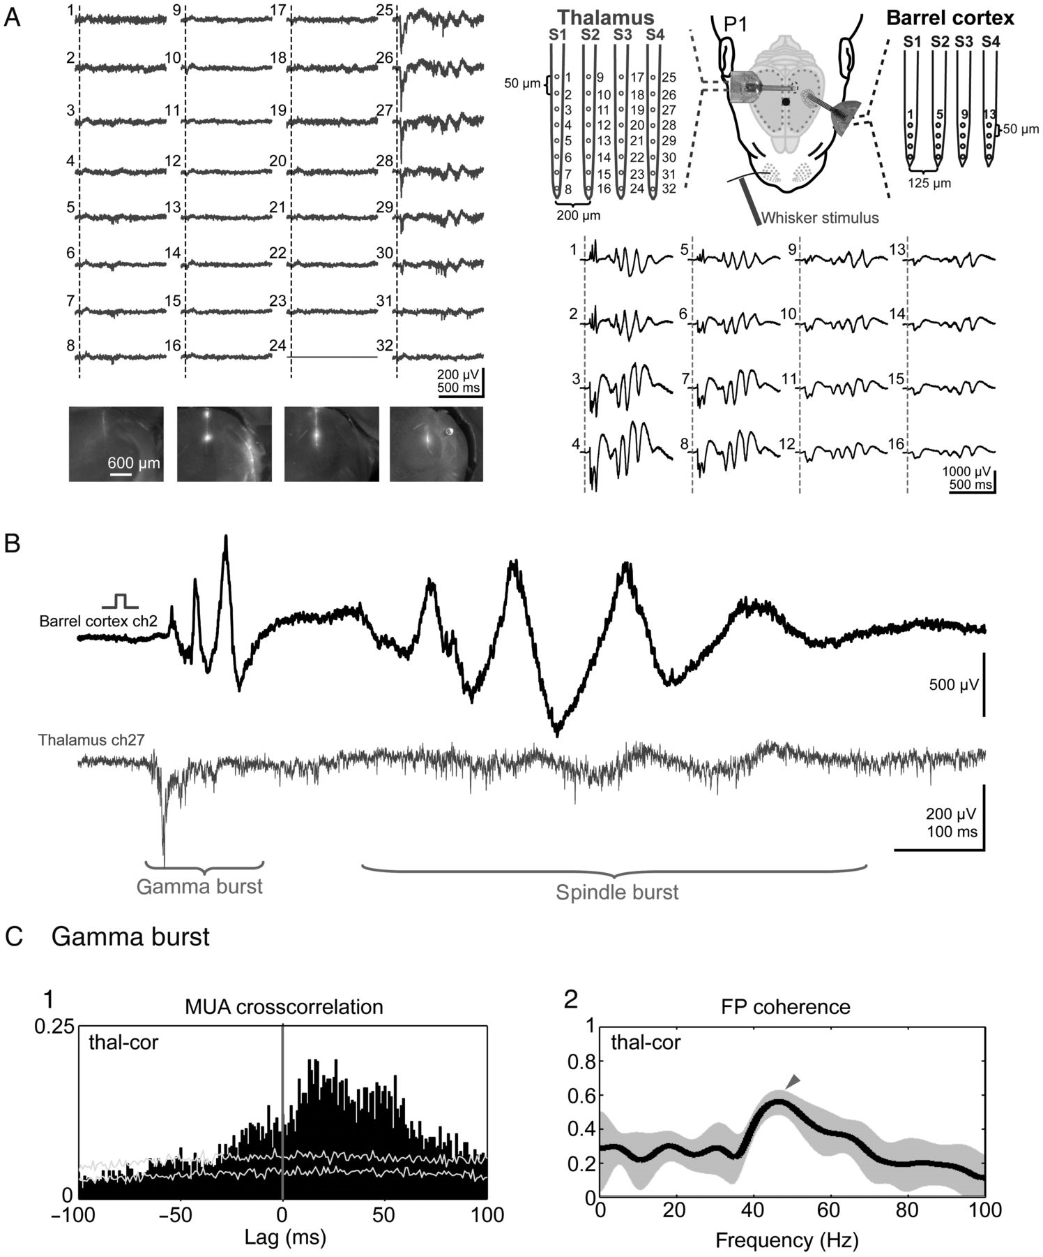
Figure 6. Whisker stimulation evoked cortical gamma bursts are preceded by the local thalamic activity. (A) ...
Notes:
Figure 6. Whisker stimulation evoked cortical gamma bursts are preceded by the local thalamic activity. (A) Simultaneous multi-channel recordings of sensory-evoked responses to single-E5-whisker stimulation in both the VPM thalamus and barrel cortex of a P1 rat. The schematic illustration of the experimental set-up with a 4-shank 32-channel electrode located in the thalamus (blue) and a 4-shank 16-channel electrode in the cortex (black). The images show electrode tracks of the 4 DiI-stained electrodes S1–S4 in the thalamus. (B) Whisker stimulation evoked gamma and spindle burst response recorded simultaneously with cortical channel 2 and thalamic channel 27 in the P1 rat. (C) Cross-correlation of the MUA (C1) and coherence analysis (C2) of 20 evoked FP responses recorded simultaneously in both the thalamus and barrel cortex. Note that the thalamic MUA precedes cortical MUA (C1) and that the FP coherence plot reveals a clear gamma component (arrowhead in C2). Shaded area in C2 represents 95% CI.
Unless provided in the caption above, the following copyright applies to the content of this slide: © The Author 2012. Published by Oxford University Press. All rights reserved. For Permissions, please e-mail: journals.permissions@oup.com

Slide 7
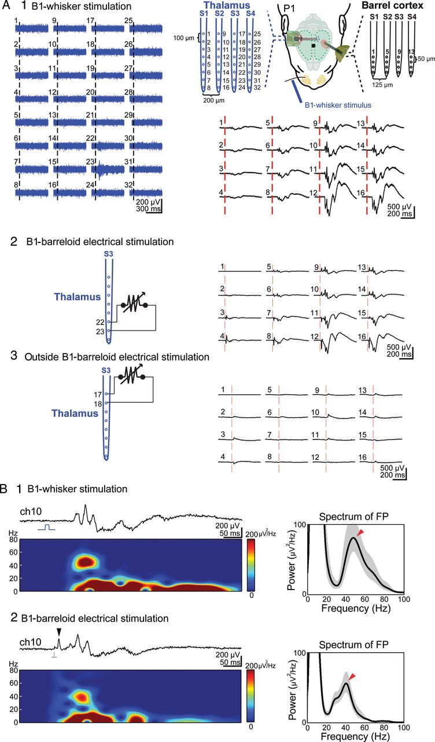
Figure 7. Local electrical stimulation of the thalamus elicits cortical gamma and spindle bursts. (A) Simultaneous ...
Notes:
Figure 7. Local electrical stimulation of the thalamus elicits cortical gamma and spindle bursts. (A) Simultaneous multi-channel recordings of the thalamic (blue traces) and cortical responses (black traces) to B1-whisker stimulation in a P1 rat (A1). The schematic illustration of the experimental set-up with a 4-shank 32-channel electrode located in the thalamus (blue) and a 4-shank 16-channel electrode in the barrel cortex (black) is shown in the upper right panel. Note that the thalamic MUA responses to B2-whisker stimulation are located at channels 22 and 23. Bipolar electrical stimulation (120 μA, 100 μs duration) of the B1 thalamic barreloid at channels 22 and 23 elicits the local cortical responses in the B1 barrel (A2). No cortical responses were elicited when the electrical stimulation was performed outside the B1 thalamic barreloid (A3). (B) The cortical responses recorded at electrode number 10 to B1-whisker stimulation (B1) and thalamic B1 barreloid (B2) electrical stimulation. Both responses reveal a prominent gamma component in spectrogram and FP spectrum analysis (marked by the arrowheads). Note the antidromic population spike (arrowhead) upon thalamic stimulation. Shaded areas in right panels of (B) represent 95% CI.
Unless provided in the caption above, the following copyright applies to the content of this slide: © The Author 2012. Published by Oxford University Press. All rights reserved. For Permissions, please e-mail: journals.permissions@oup.com

Slide 8
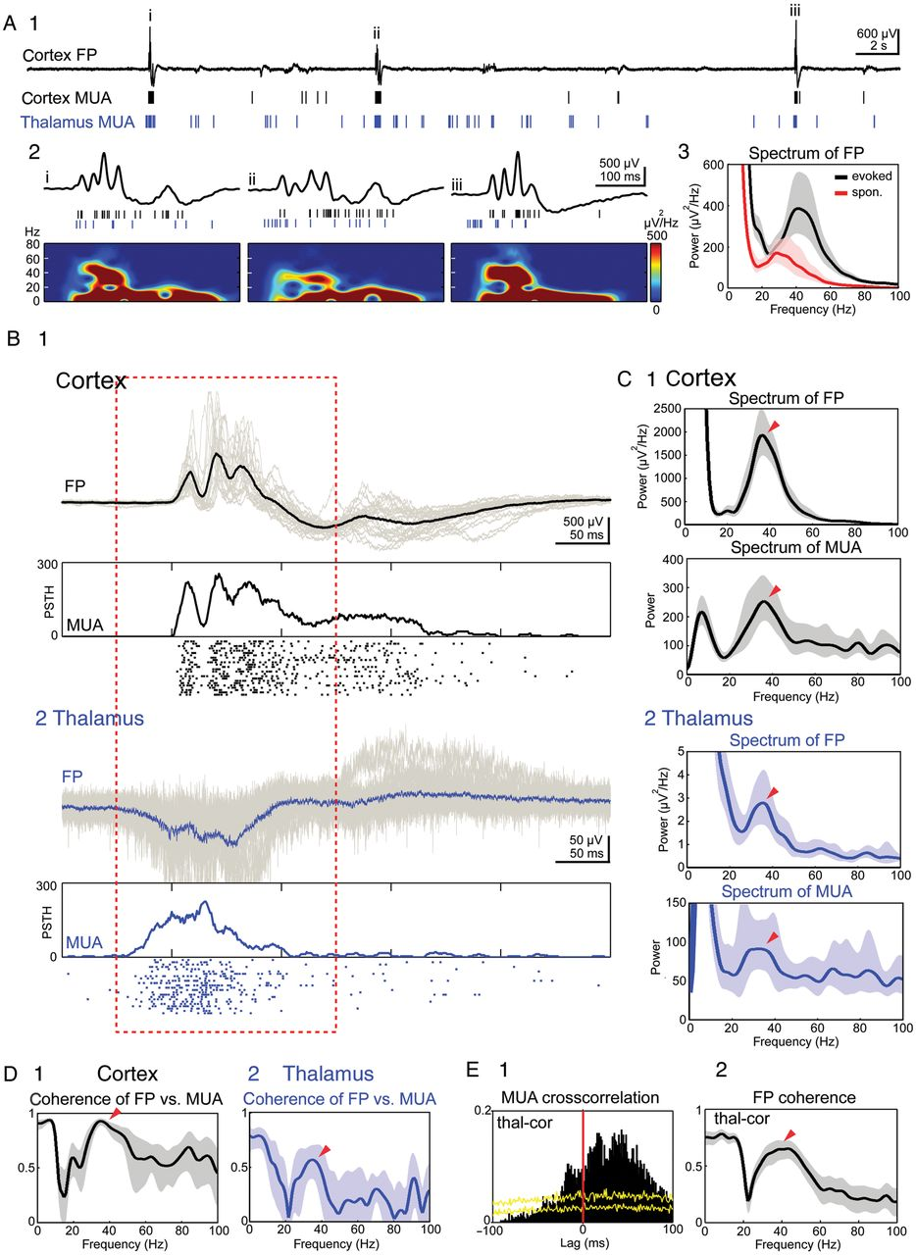
Figure 8. The spontaneous cortical gamma activity arises in the thalamus. (A) Simultaneous 40 s recording of ...
Notes:
Figure 8. The spontaneous cortical gamma activity arises in the thalamus. (A) Simultaneous 40 s recording of spontaneously occurring activity in the barrel cortex and VPM thalamus of a P1 rat. Upper trace represents the cortical FP recording; cortical (black bars) and thalamic MUA (blue bars) are presented below (A1). The 3 spontaneous events i–iii marked in A1 are shown at higher resolution with corresponding spectrograms (A2). Note the gamma activity in (i) and (iii). An averaged spectrogram of 140 evoked (black) and 140 spontaneous (red) cortical gamma bursts in 14 simultaneous recordings with a functional thalamocortical connection from 13 P0–P1 rats (A3). Shaded areas represent 95% CI. (B) Average (black trace) and 24 superimposed single (shaded area) spontaneous FP events and MUA recorded simultaneously in the cortex (B1) and in the thalamus (B2). Thalamic and cortical recordings were aligned to the onset of the cortical spontaneous FP events. (C) Spectrum analyses of the cortical (C1) and thalamic (C2) spontaneous FP and MUA events shown in (B). (D) Coherence analyses of spontaneous FP events versus MUA recorded simultaneously in the cortex (D1) and thalamus (D2). (E) Cross-correlation of the spontaneous MUA (E1) and coherence analysis of the FP (E2) recorded simultaneously in the thalamus and barrel cortex. Arrowheads in (C–E) point to the gamma component. Diagrams in (C–E) were calculated from the data marked by red dashed line in (B). Shaded areas in (C–E) represent 95% CI.
Unless provided in the caption above, the following copyright applies to the content of this slide: © The Author 2012. Published by Oxford University Press. All rights reserved. For Permissions, please e-mail: journals.permissions@oup.com

Slide 9
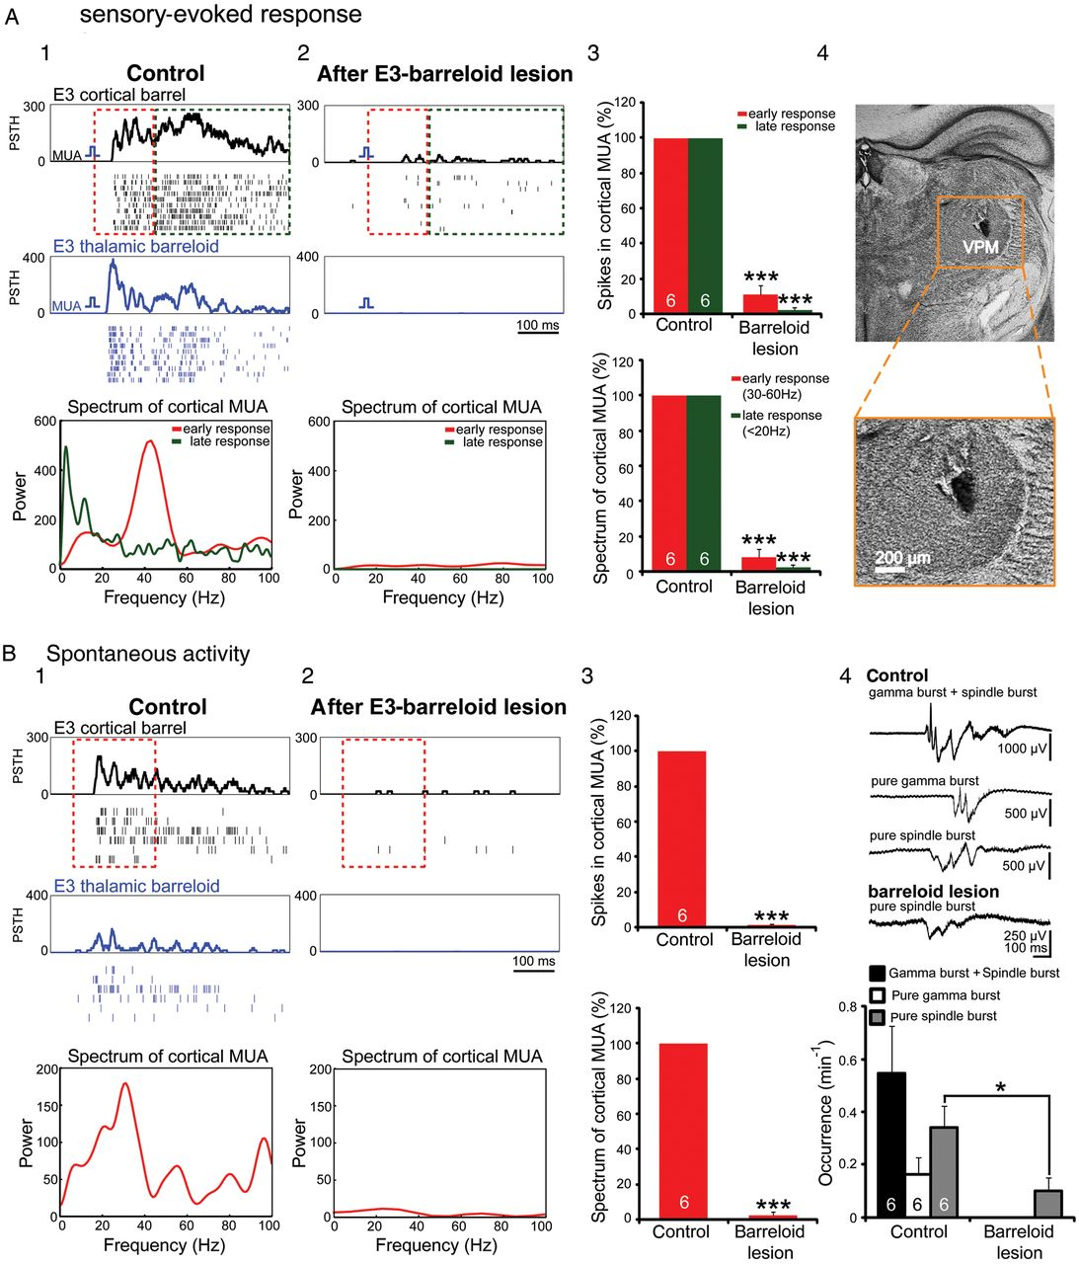
Figure 9. Local lesioning of the thalamus blocks whisker stimulation-induced and spontaneously occurring cortical gamma ...
Notes:
Figure 9. Local lesioning of the thalamus blocks whisker stimulation-induced and spontaneously occurring cortical gamma burst activity. (A) Control recordings of the MUA responses in the E3 cortical barrel (black) and thalamic barreloid (blue) to single-E3-whisker stimulation in a P1 rat with corresponding cortical MUA spectrum (early and late response) calculated from the data marked by red and green dashed line, respectively (A1). After an electrolytic lesion of the E3 thalamic barreloid, the cortical and thalamic responses to E3-whisker stimulation are almost completely blocked (A2). The pooled data from 6 P1 rats illustrating the relative number of cortical MUA spikes (top, shown as the proportion of MUA spikes relative to the value in the control period) and the power of the cortical MUA spectrum in the early (30–60 Hz) and late (<20 Hz) response (below) (A3). Note that both parameters were significantly reduced after local lesioning of the thalamus (***P < 0.001, paired t-test). The image of Nissl-stained coronal section from the same P1 rat showing the location and size of the electrolytic lesion in the VPM (A4). (B) Control recordings of spontaneous MUA in the barrel cortex and VPM of the same P1 rat as in panel A with corresponding cortical MUA spectrum calculated from the data marked by red dashed line (B1). The thalamic and cortical MUA raster plots and their corresponding poststimulus time histogram (PSTHs) were aligned to the onset of the cortical spontaneous events. After E3 barreloid lesioning, the MUA activity was markedly reduced in both the E3-pre-barrel-related column and the thalamic barreloid (B2), as also demonstrated in the power of the cortical MUA spectrum (bottom). The pooled data from 6 P1 rats illustrating the relative number of MUA spikes and the power of the MUA spectrum in the 30–60 Hz range (B3). Note that both parameters were significantly reduced after barreloid lesioning (***P < 0.001, paired t-test). Representative FPs of gamma and spindle bursts before and after barreloid lesioning (traces in top panel 4). After barreloid lesioning, the gamma containing spindle bursts and pure gamma bursts were completely blocked, and only pure spindle bursts were observed. The occurrence of pure spindle bursts was significantly (*P ≤ 0.05, paired t-test) reduced (lower panel 4).
Unless provided in the caption above, the following copyright applies to the content of this slide: © The Author 2012. Published by Oxford University Press. All rights reserved. For Permissions, please e-mail: journals.permissions@oup.com

Slide 10
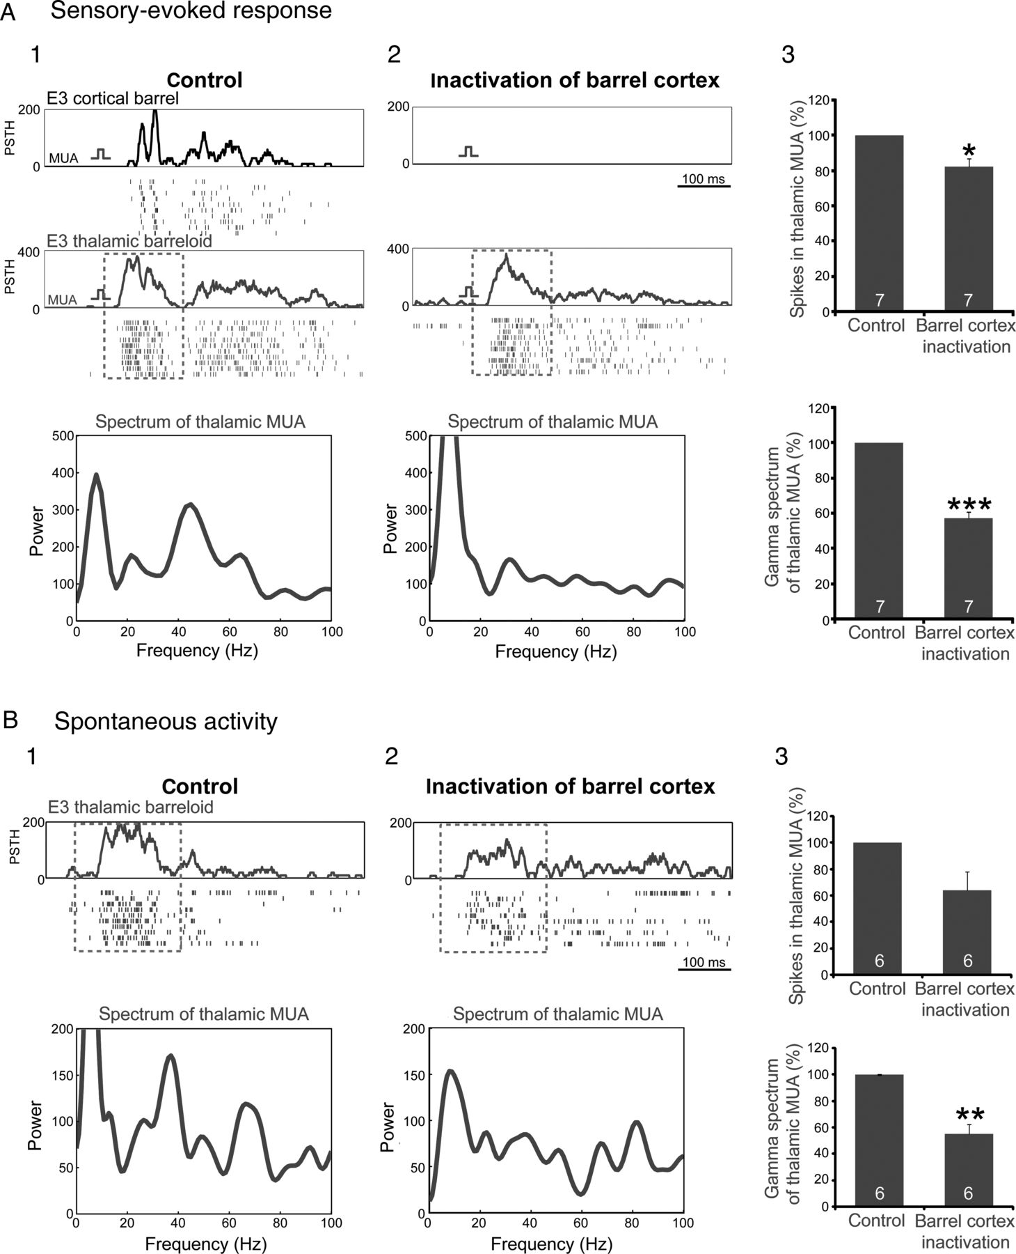
Figure 10. The cortical activity modulates thalamic gamma bursts. (A) MUA responses in the E3 cortical barrel (black) ...
Notes:
Figure 10. The cortical activity modulates thalamic gamma bursts. (A) MUA responses in the E3 cortical barrel (black) and thalamic barreloid (blue) to single-E3-whisker stimulation in a P1 rat with corresponding thalamic MUA spectrum and spike number calculated from the data marked by red dashed line (A1). After local inactivation of the barrel cortex with 1% lidocaine, the evoked MUA activity in the E3 barrel was completely blocked, whereas the activity in the thalamic barreloid was only slightly altered (A2). Note the prominent reduction of the gamma activity in the thalamus after inactivation of the cortex. The pooled data from 7 P0–P1 rats summarizing the effect of cortical inactivation on the number of thalamic MUA spikes (top) and gamma power (below) of evoked thalamic MUA activity (A3). Note the significant reduction of spike number and gamma activity in thalamic MUA after inactivation of the cortex (*P < 0.05, ***P < 0.001, paired t-test). (B) Control recordings of spontaneous MUA in the VPM of the same P1 rat as in panel A before (B1) and after local inactivation of the cortex with 1% lidocaine (B2). The thalamic MUA raster plots were aligned to the onset of the thalamic spontaneous events. The thalamic MUA spectrum was calculated from the data marked by red dashed line. Note the reduction in the 30–60 Hz range of the MUA spectrum after cortical inactivation. The pooled data from 6 P1 rats illustrating the effect of cortical inactivation on the number of spikes within the burst (top) and gamma power (below) of the spontaneous thalamic MUA activity (B3). Note that the power of the thalamic MUA spectrum in the 30–60 Hz range was significantly reduced (**P < 0.01, paired t-test).
Unless provided in the caption above, the following copyright applies to the content of this slide: © The Author 2012. Published by Oxford University Press. All rights reserved. For Permissions, please e-mail: journals.permissions@oup.com

