Slide 1
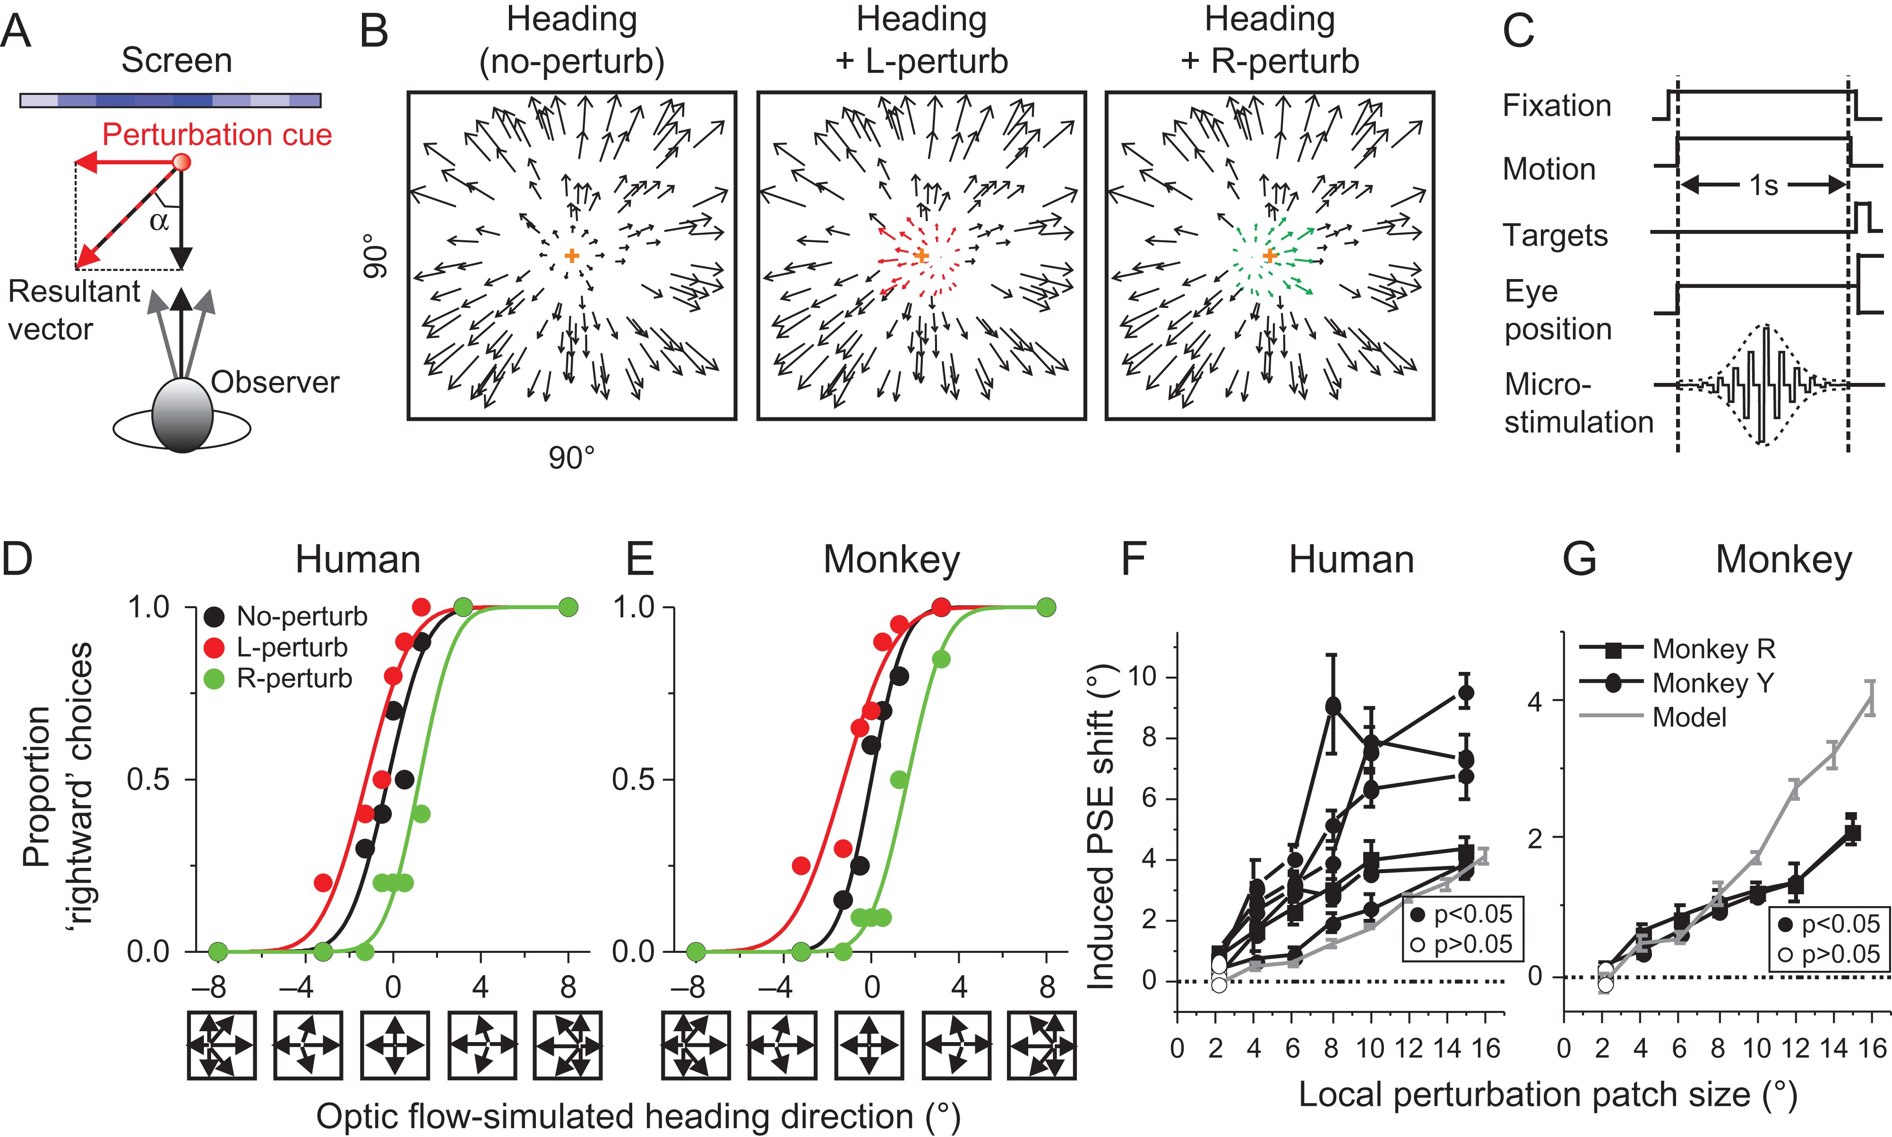
Figure 1. Behavioral paradigms. (A) Cartoon illustrates the motion vector when the observer moves (black arrow) or when ...
Notes:
Figure 1. Behavioral paradigms. (A) Cartoon illustrates the motion vector when the observer moves (black arrow) or when the object moves (red arrow). The resultant vector is depicted by the dashed red arrow, which represents the vector summation of the 2 motion components. In the experiment, the ratio between the red and black arrow is 1/10, leading to the deviated angle (α) about 6°. (B) Optic flow pattern used to simulate self-motion, i.e., heading of the observer in the forward direction (left panel), and self-motion with a central patch of leftward (middle panel) or rightward deviated flow (right panel). The color in the plots is for demonstration only. (C) Flow chart of events in psychophysical and electrical microstimulation experiments. Monkeys reported the perceived heading (“left” vs. “right”) by making a saccadic eye movement to one of 2 lateral targets (left and right, respectively), while human observers pressed a key on the keyboard. In one half of the trials electrical microstimulation was randomly interleaved with non-stimulation control trials (Gu et al. 2012). (D, E) Psychometric functions plotting proportion of rightward responses (corresponding to “rightward” heading) as a function of heading direction for one human and one monkey subject, respectively. Black: self-motion; red: self-motion with leftward (L) component added; green: self-motion with rightward (R) component added. The size of the central window within which a directional bias of object motion was added to the optic flow pattern was 6° × 6°.The arrows underneath the x-axis represent the optic flow patterns associated with each heading directions. Positive values in the abscissa represent rightward heading and negative values represent leftward heading. (F, G) Population results of the induced PSE shift as a function of the perturbed area size for 6 human and 2 monkey subjects (black curves), and from the model prediction (grey curves, see detail in Supplementary Fig. 8). The positive value of the y-axis refers to the PSE shift in the expected direction from the perturbation vector. Error bars: standard error of the mean, SEM.
Unless provided in the caption above, the following copyright applies to the content of this slide: © The Author 2017. Published by Oxford University Press. All rights reserved. For Permissions, please e-mail: journals.permissions@oup.com

Slide 2
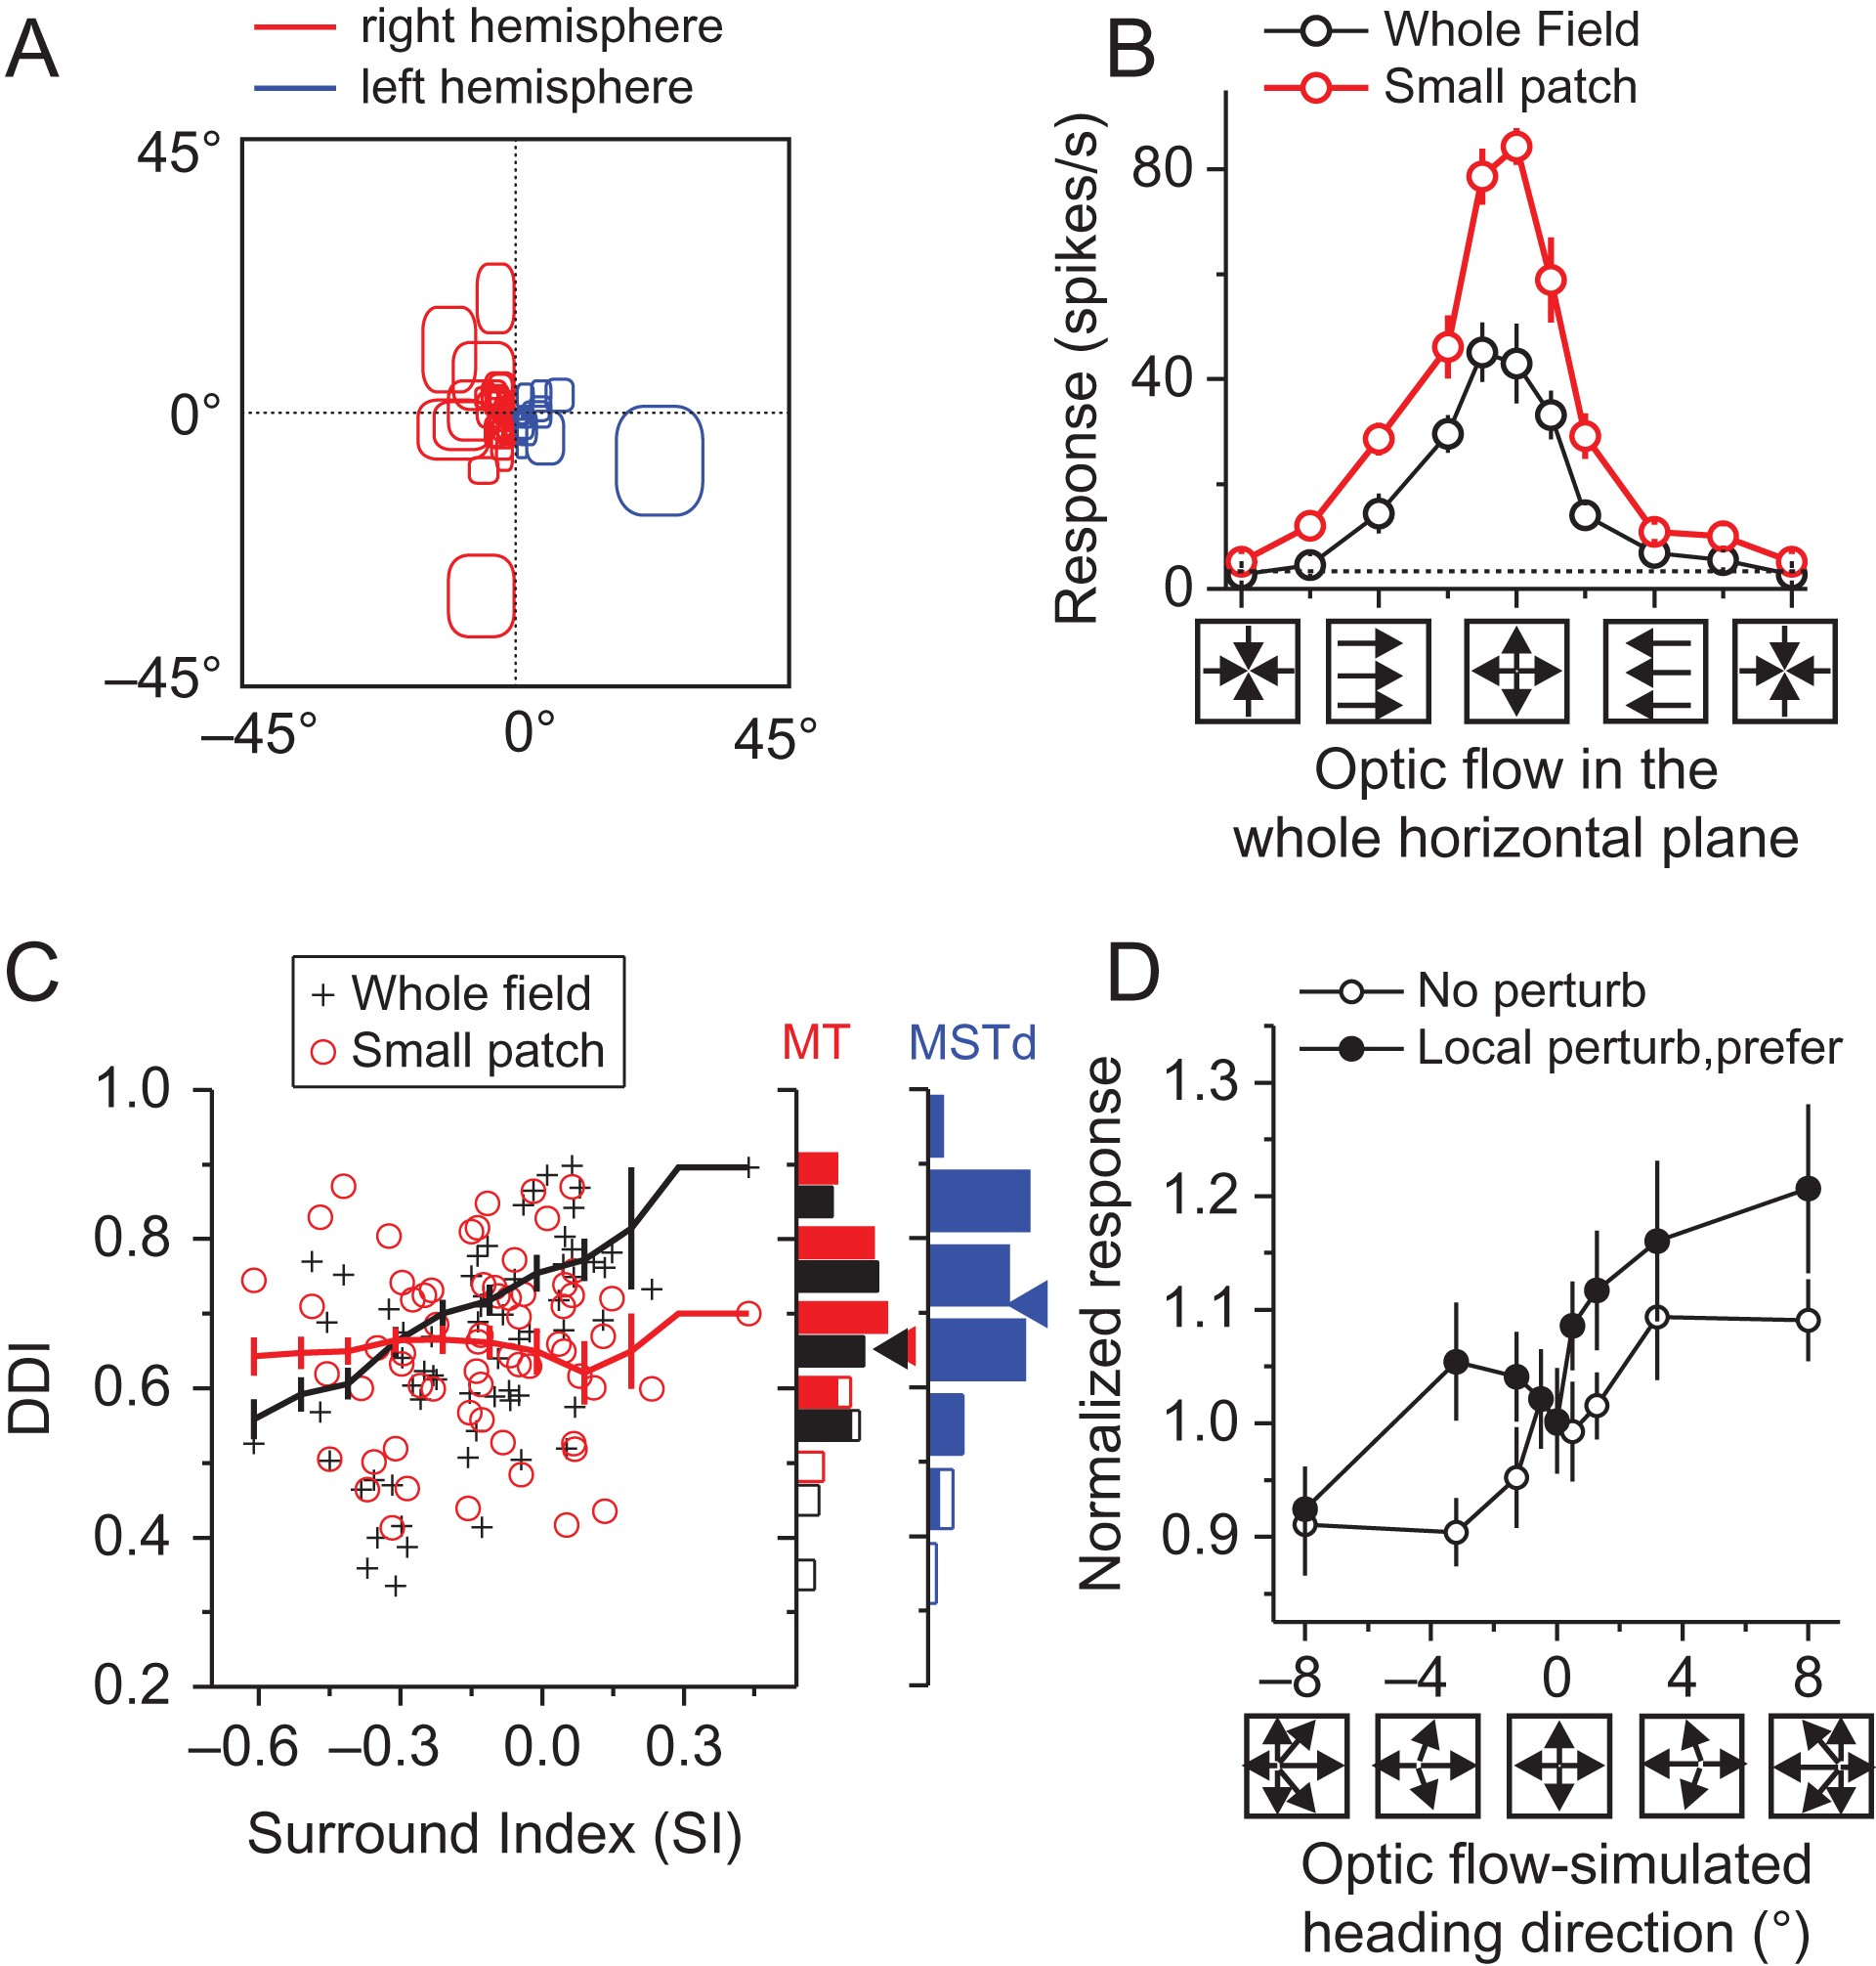
Figure 2. Responses of MT single units to optic flow. (A) Distribution of recorded MT single neurons’ receptive fields ...
Notes:
Figure 2. Responses of MT single units to optic flow. (A) Distribution of recorded MT single neurons’ receptive fields (RFs). Red color represents units recorded in the right hemisphere whereas the blue represents units recorded in the left hemisphere. (B) An example MT unit's responses to optic flow with FOE varied in the whole horizontal plane (arrows underneath the abscissa indicate the flow motion directions). (C) Population results for 64 neurons of the relationship between the direction discrimination index (DDI) and the surround index (SI) for small patch (red symbols) and whole-field stimulation (black symbols). Neurons with excitatory surrounds tend to be more sharply tuned (larger DDI) to whole-field stimuli. The red and black curves represent running mean values with standard error bars. (D) Population tuning curves (n = 21) of MT neuronal responses in the heading discrimination task without perturbation (open symbols) and with perturbation signals in the neurons’ preferred direction (black solid symbols). Error bars: SEM.
Unless provided in the caption above, the following copyright applies to the content of this slide: © The Author 2017. Published by Oxford University Press. All rights reserved. For Permissions, please e-mail: journals.permissions@oup.com

Slide 3
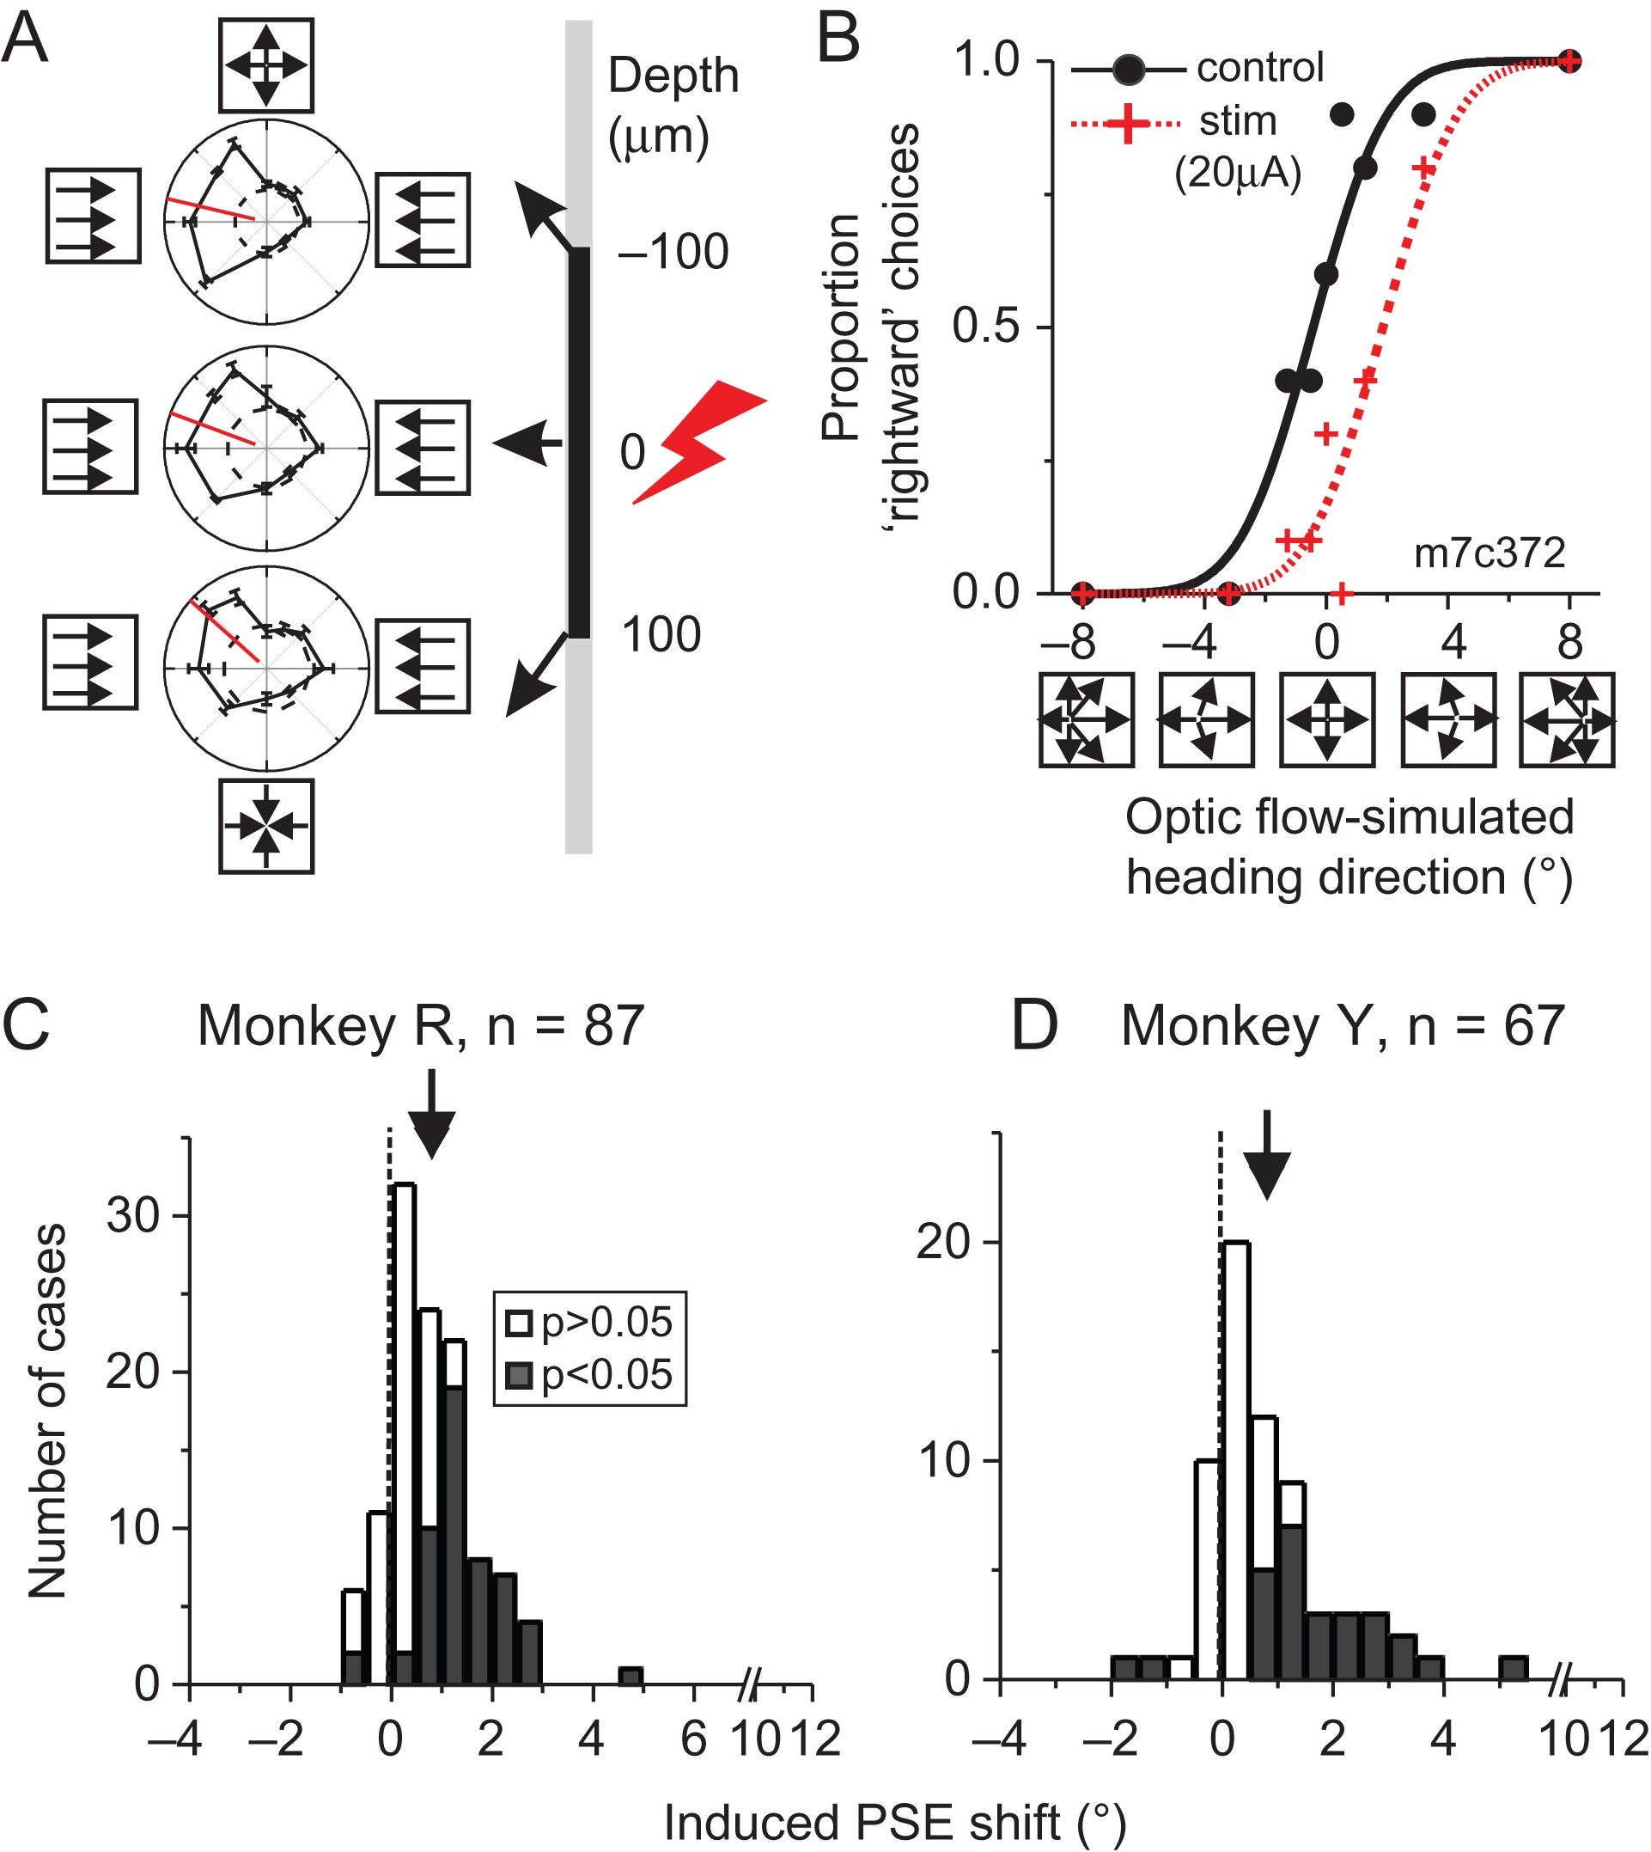
Figure 3. Effects of microstimulation of MT units (peak amplitude = 20 μA). (A) Examples of tuning curves during one ...
Notes:
Figure 3. Effects of microstimulation of MT units (peak amplitude = 20 μA). (A) Examples of tuning curves during one penetration. Each penetration mapped the direction selectivity of 3 MU sites at an interval of 100 µm. These MUs consistently preferred rightward flow (indicated by the arrows in the left panels), that is, simulating leftward heading. (B) One example of microstimulation experiments as derived from the middle sites in (A). Proportion of rightward responses plotted as a function of heading direction. Red: trials using microstimulation; Black: trials without microstimulation. (C, D) Population distribution of induced PSE shift of MT neurons for monkey R and monkey Y, respectively. Positive values represent shifts in the direction predicted from the heading tuning of the stimulated neurons. Filled columns represent significant and open columns insignificant PSE shifts as assessed by probit fit regression. Arrows, Mean PSE shift. The dashed vertical lines mark a zero PSE shift.
Unless provided in the caption above, the following copyright applies to the content of this slide: © The Author 2017. Published by Oxford University Press. All rights reserved. For Permissions, please e-mail: journals.permissions@oup.com

Slide 4
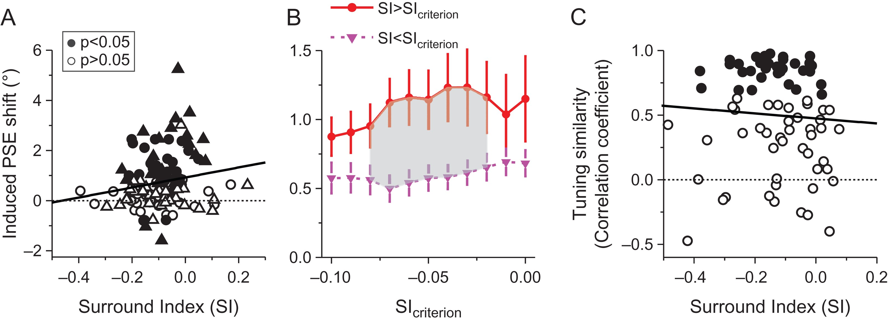
Figure 4. Correlation between microstimulation effect and the surround properties of MT. (A) Induced PSE shift plotted ...
Notes:
Figure 4. Correlation between microstimulation effect and the surround properties of MT. (A) Induced PSE shift plotted as a function of the surround index. Solid line is the type II linear regression. Horizontal dashed line: no PSE shift. Filled and open symbols represent significant and insignificant PSE shifts as before. This analysis was conducted on 126 stimulated sites which were also tested the surround property during the experiment. Circle symbol: monkey R, triangle: monkey Y. (B) Mean induced PSE shift for 2 groups of MT units: neurons with more facilitated surrounds (red symbols) and with more inhibitory surrounds (purple symbols). The 2 groups of neurons were defined according to SI value explored under a broad range (from −0.1 to 0) rather than just 0. In such a case, there could be similar numbers of cells in each group. For both groups, the mean induced PSE shift was significantly > 0 for all data (t-test). In the gray area, the mean PSE shift from the SI > SIcriterion group was significantly larger than from the SI < SIcriterion group (P < 0.05, t-test). (C) Tuning similarity between the stimulated sites and the neighboring sites as a function of the surround property. Tuning similarity was measured by the correlation coefficient of the 2 tuning curves. Filled symbols: P 0.05. Solid line indicates linear regression fit. Dashed line indicates correlation coefficient = 0.
Unless provided in the caption above, the following copyright applies to the content of this slide: © The Author 2017. Published by Oxford University Press. All rights reserved. For Permissions, please e-mail: journals.permissions@oup.com

Slide 5
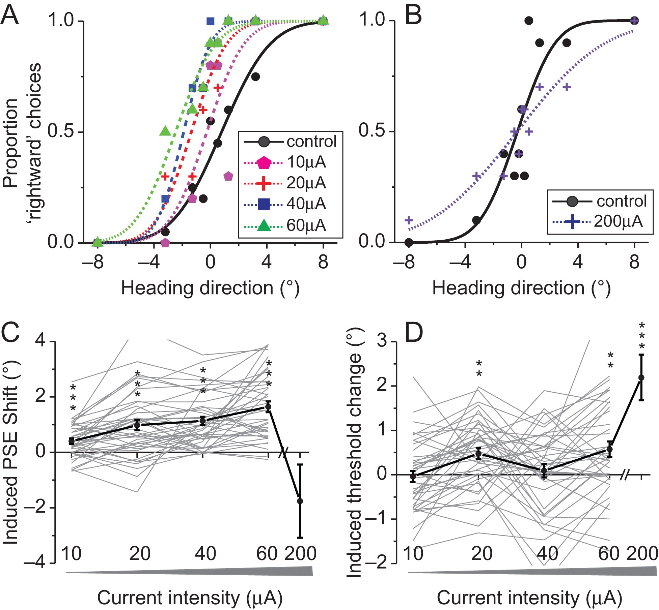
Figure 5. Microstimulation effects with a broader range of electrical current intensities. (A) Psychometric functions ...
Notes:
Figure 5. Microstimulation effects with a broader range of electrical current intensities. (A) Psychometric functions plotting the proportion of rightward responses as a function of heading direction and current intensity as the parameter: 0 uA (i.e., control, black), 10 uA (pink), 20 uA (red), 40 uA (blue), and 60 uA (green). (B) Psychometric functions for current intensity of 0 uA (i.e., control, solid black) and 200 uA (dotted blue). (C) Induced PSE shift as a function of current intensity for all neurons tested (10–60 μA: n = 41; 200 μA: n = 18). The black solid curve represents the average response. Positive values indicate a shift in direction consistent with the preferred direction of the stimulated neurons. (D) Averaged induced threshold change across the population of neurons (10–60 μA: n = 41; 200 μA: n = 18). Positive values indicate an increase in threshold with current intensity. Error bars: SEM. *0.01 < P < 0.05; **0.001 < P < 0.01; ***P < 0.001.
Unless provided in the caption above, the following copyright applies to the content of this slide: © The Author 2017. Published by Oxford University Press. All rights reserved. For Permissions, please e-mail: journals.permissions@oup.com

Slide 6
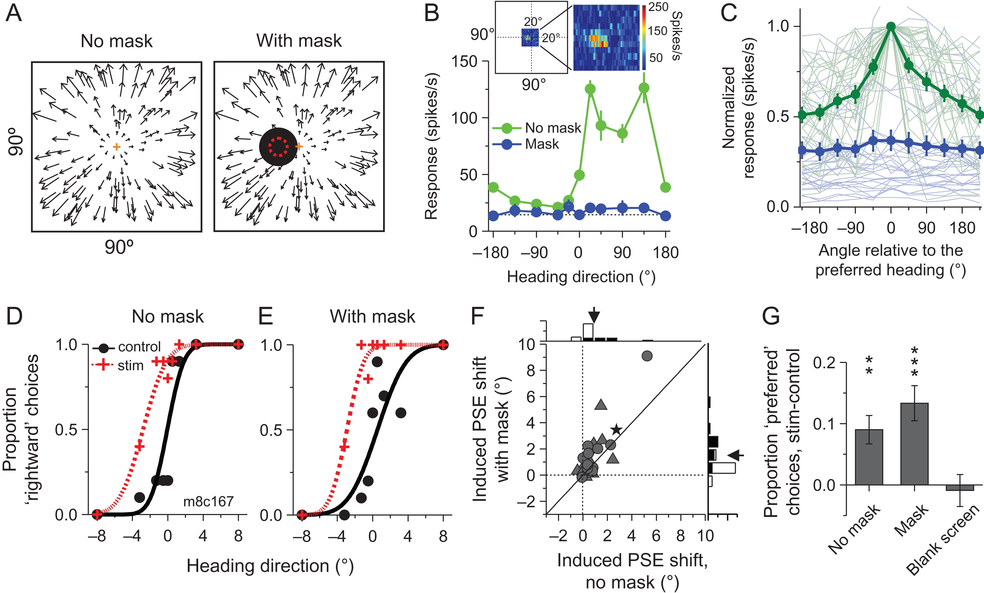
Figure 6. Microstimulation effects with masks excluding the flow field within the receptive field. (A) Schematic ...
Notes:
Figure 6. Microstimulation effects with masks excluding the flow field within the receptive field. (A) Schematic illustration of the no-mask condition (left panel) and the mask condition (right panel). The black square illustrates the location of the mask. The dashed red circle illustrates the location of the mapped receptive field. The size of the mask is always slightly larger than the size of the receptive field so as to completely exclude any visual stimulation within the receptive fields. (B) Example of neuronal response as a function of heading direction for the no-mask condition (green curve) and mask condition (blue curve). Error bars: SEM. (C) Population neuronal response plotted as a function of angle relative to the preferred heading direction for the no-mask condition (green curve) and mask condition (blue curve) (M1: n = 15; M2: n = 13). Responses normalized to the maximum response. Error bars: SEM. (D, E) Psychometric functions showing the proportion of rightward responses are plotted as a function of heading direction, when the mask was present (D) or absent (E). Black: no electrical stimulation. Red: electrically stimulated trials. (F) Comparison between induced PSE shifts with (y-axis) and without mask (x-axis). Arrows indicate the mean values. Filled bars: P 0.05, probit regression. The asterisk represented for the example electrical stimulation case in (D, E). (G) Statistics for 13 sites from the population under no mask, mask, and blank conditions. In the blank condition, the mask covered the whole screen (except for the fixation point). For this condition, the psychometric functions are nearly flat and cannot be fit to reliably extract PSE (see Supplementary Fig. 5C). So we compute the difference in the proportion of responses towards the preferred direction of the stimulated neurons, for trials with and without electrical microstimulation. Error bars: SEM. *0.01 < P < 0.05; **0.001 < P < 0.01; ***P < 0.001.
Unless provided in the caption above, the following copyright applies to the content of this slide: © The Author 2017. Published by Oxford University Press. All rights reserved. For Permissions, please e-mail: journals.permissions@oup.com

Slide 7
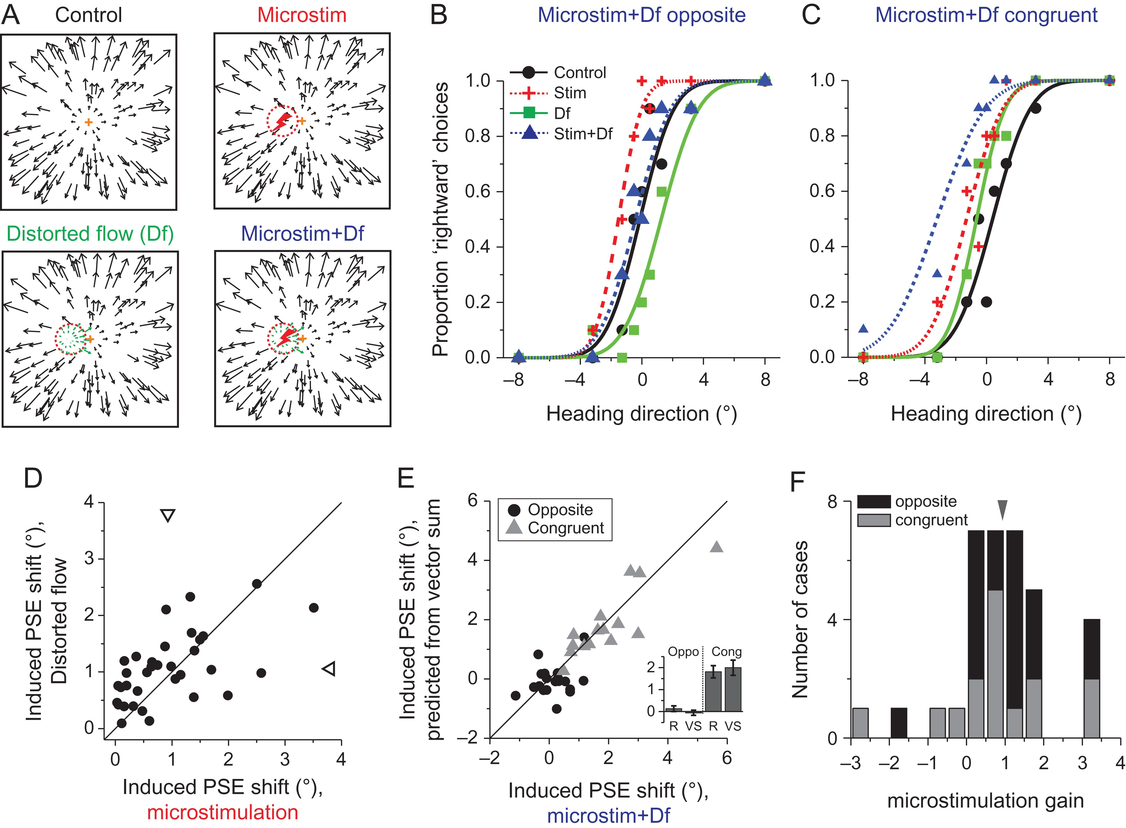
Figure 7. Interactions between microstimulation and visual perturbation effects. (A) Illustration of 4 experimental ...
Notes:
Figure 7. Interactions between microstimulation and visual perturbation effects. (A) Illustration of 4 experimental conditions interleaved randomly within one block. Upper left: normal self-motion condition without visual perturbation; upper right: perturbation induced by electrical microstimulation; lower left: perturbation by local object motion; lower right: combined effect of simultaneously introducing external (visual perturbation) and internal (microstimulation) perturbations; the red dashed circle represents the receptive field of the recorded/electrically stimulated MU. (B, C) Psychometric functions plotting the proportion of rightward responses as a function of heading direction, when microstimulation and local perturbation caused opposite (B) or congruent (C) effects. (D) Comparison between the PSE shift induced by local visual perturbation (y-axis) and microstimulation (x-axis). Open triangles indicate the mean values. (E) Comparison between the PSE shifts induced by vector summation (ordinate) and combined local perturbation and microstimulation (abscissa). Black: opposite condition; Grey: congruent condition. The inset bar graph gives the average values for congruent and opposite conditions. R: real PSE shift in combined condition. VS: PSE shift predicted by vector summation. (F) Number of cases showing different gains from microstimulation for opposite (black) and congruent (grey) conditions.
Unless provided in the caption above, the following copyright applies to the content of this slide: © The Author 2017. Published by Oxford University Press. All rights reserved. For Permissions, please e-mail: journals.permissions@oup.com

