Slide 1
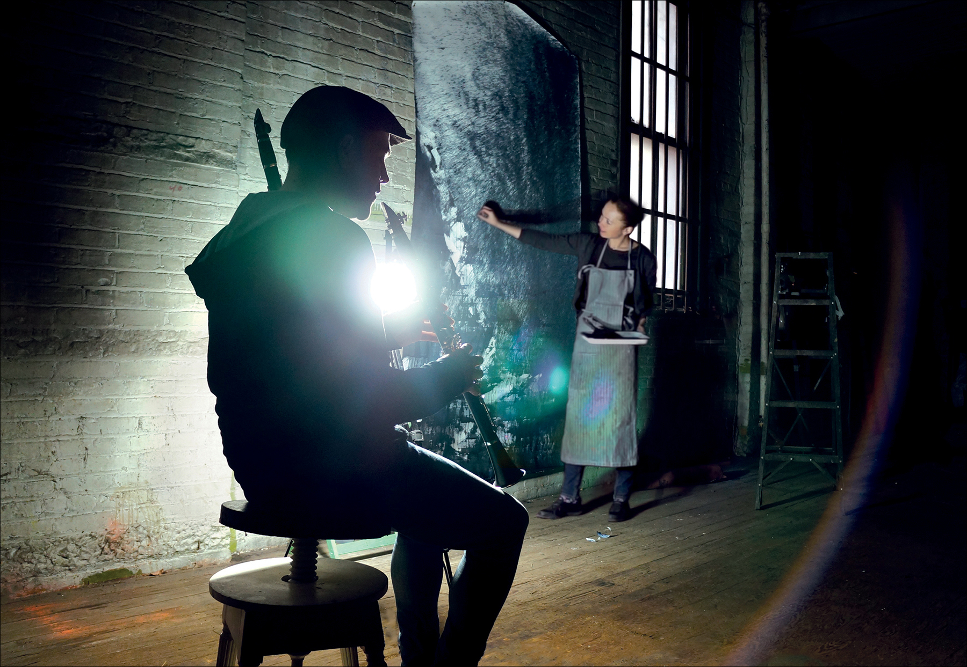
1 Lee Mottram plays clarinet while Ekaterina Smirnova paints. (Brian Schmitz)
Notes:
1 Lee Mottram plays clarinet while Ekaterina Smirnova paints. (Brian Schmitz)
Unless provided in the caption above, the following copyright applies to the content of this slide: © 2016 Royal Astronomical Society

Slide 2
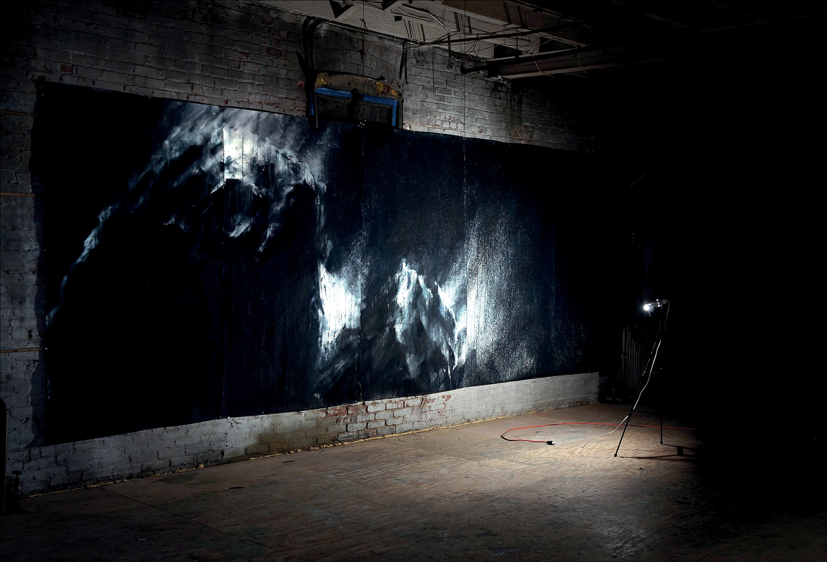
2 67P at Ekaterina's art studio. Watermedia on paper, 90″ × 258″, 2015. (E Smirnova)
Notes:
2 67P at Ekaterina's art studio. Watermedia on paper, 90″ × 258″, 2015. (E Smirnova)
Unless provided in the caption above, the following copyright applies to the content of this slide: © 2016 Royal Astronomical Society

Slide 3
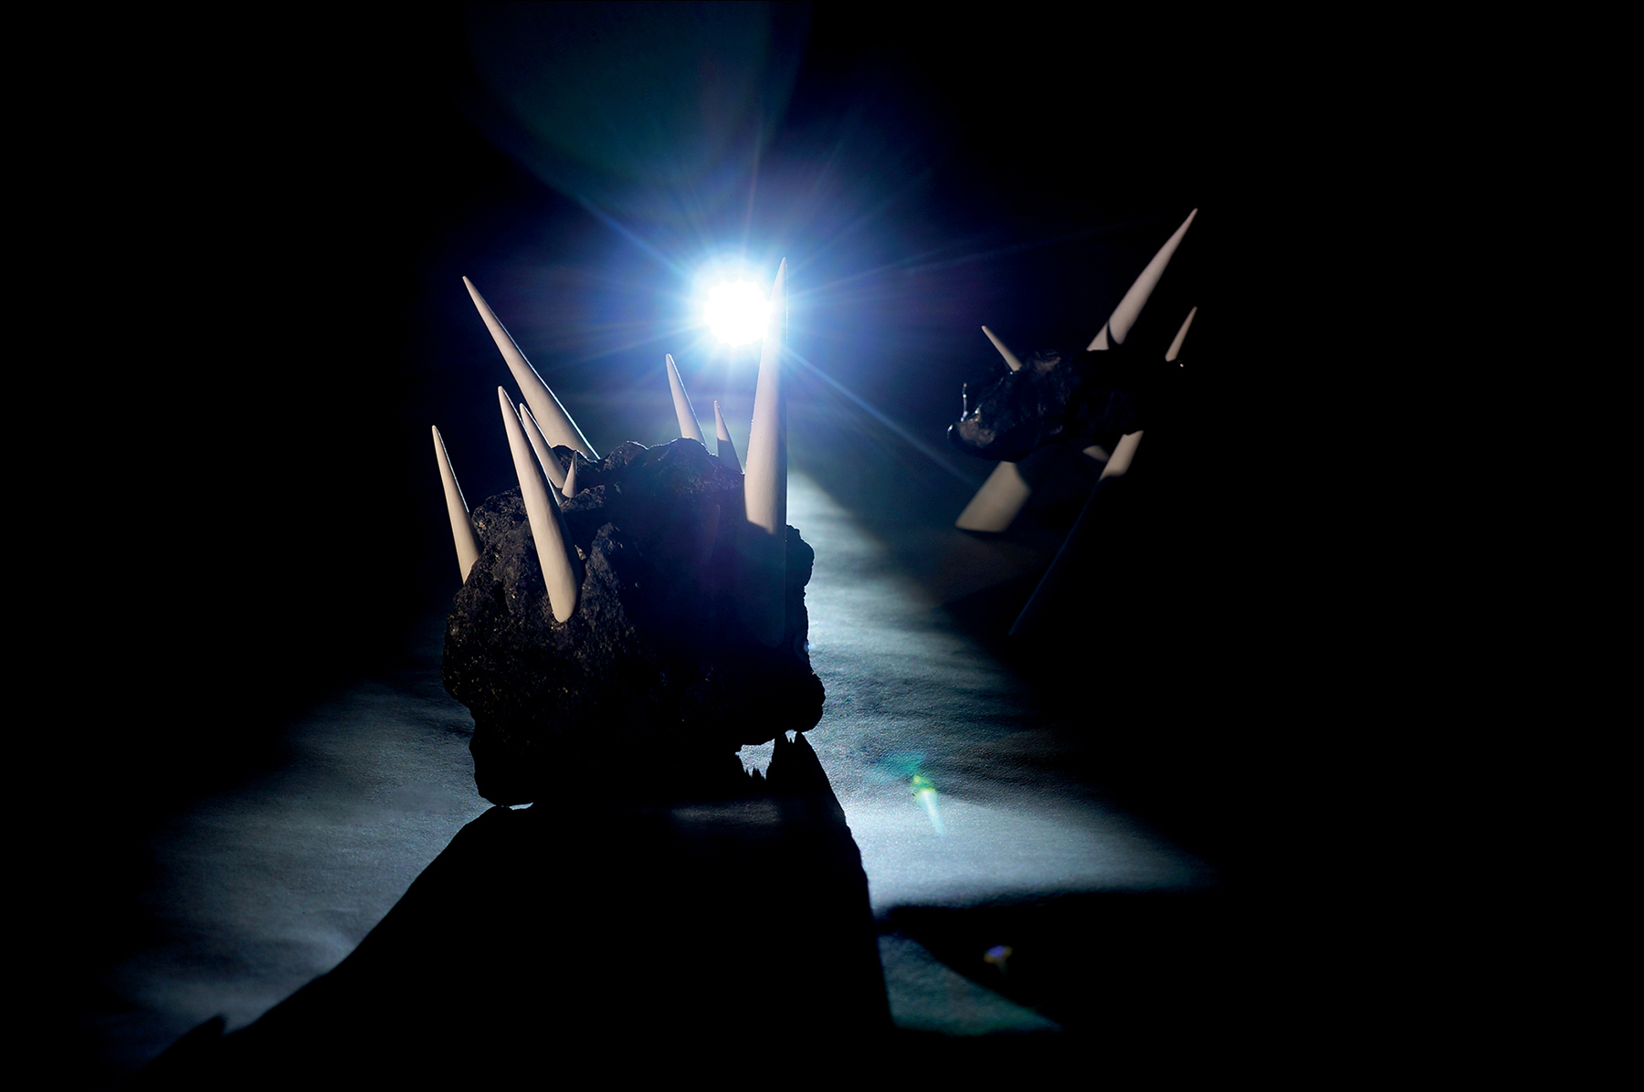
3 67P I, III, stoneware, porcelain, rock, 6″ × 6″ × 6″, 2015. (E Smirnova)
Notes:
3 67P I, III, stoneware, porcelain, rock, 6″ × 6″ × 6″, 2015. (E Smirnova)
Unless provided in the caption above, the following copyright applies to the content of this slide: © 2016 Royal Astronomical Society

