Slide 1
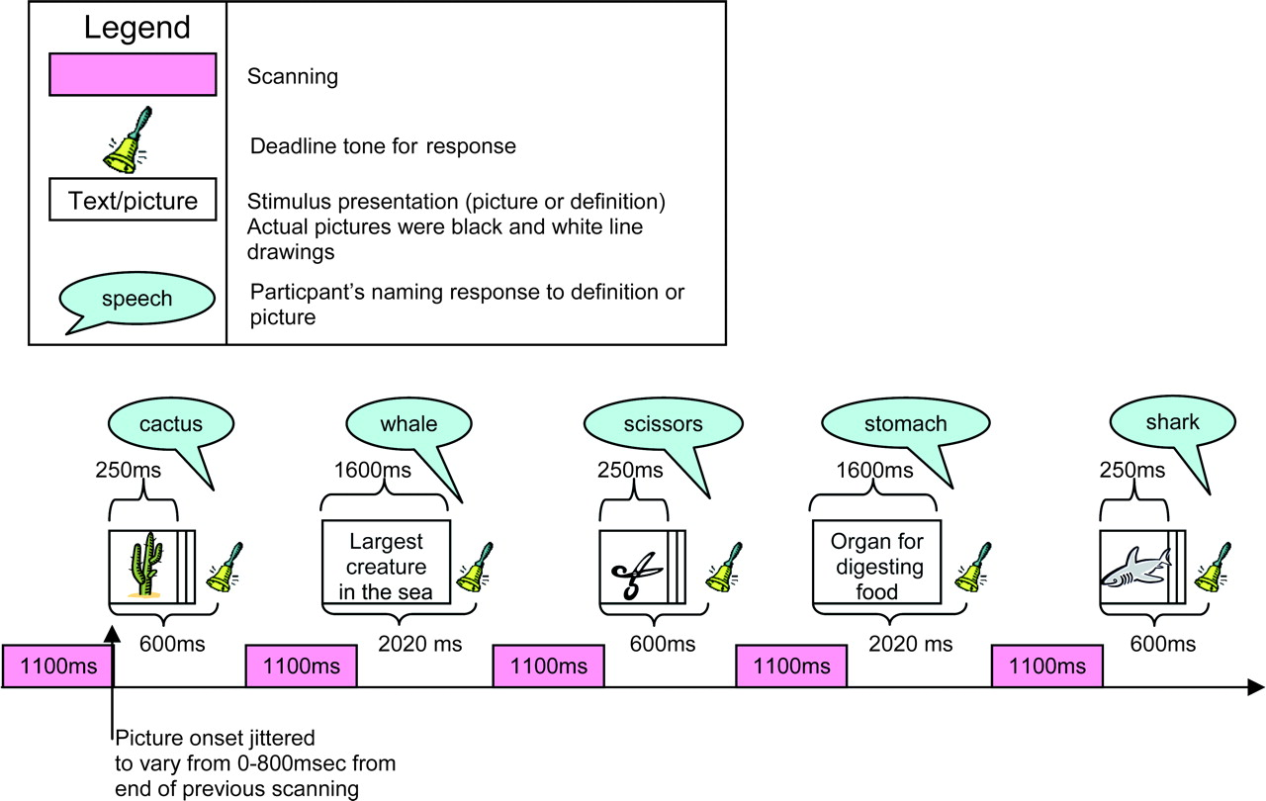
Figure 1. Illustration of timing of stimulus presentation and scan acquisition for a sample of trials. Scanning phases ...
Notes:
Figure 1. Illustration of timing of stimulus presentation and scan acquisition for a sample of trials. Scanning phases are timed not to overlap with participants' naming responses to avoid head movement artefacts.
Unless provided in the caption above, the following copyright applies to the content of this slide: © The Author 2005. Published by Oxford University Press. All rights reserved. For permissions, please e-mail: journals.permissions@oupjournals.org

Slide 2
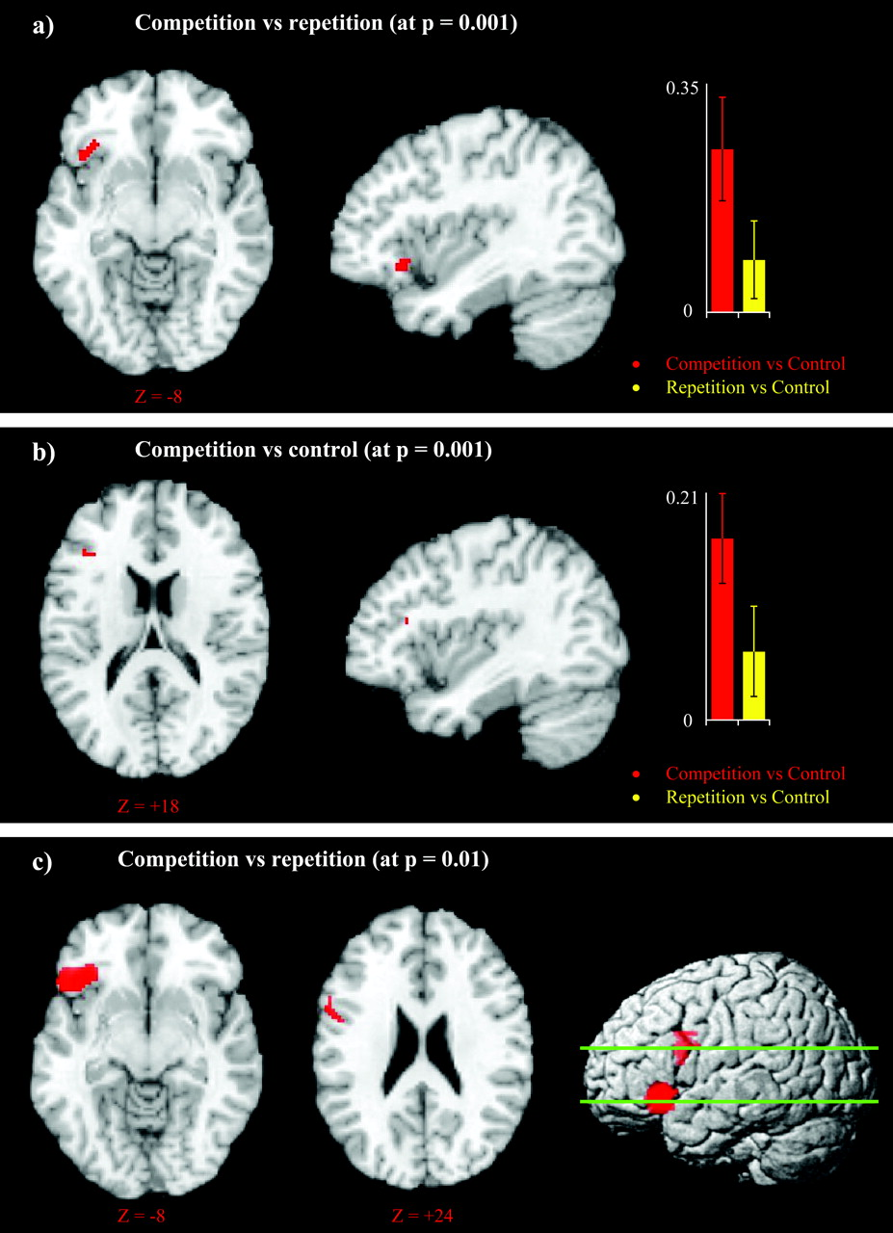
Figure 2. (a) Plot showing LIFG activation for competition minus repetition contrast. The colour bars indicate strength ...
Notes:
Figure 2. (a) Plot showing LIFG activation for competition minus repetition contrast. The colour bars indicate strength of activation (beta values). The areas shown survived P < 0.05 correction for multiple comparisons at the cluster level and were thresholded at 0.001. Coordinates presented in MNI space. (b) Plot showing LIFG activation for competition minus control contrast. The colour bars indicate strength of activation (beta values). The areas shown survived P < 0.05 correction for multiple comparisons at the cluster level and were thresholded at 0.001. Coordinates presented in MNI space. (c) LIFG activation for competition minus repetition contrast at a lower threshold (P = 0.01). Coordinates presented in MNI space.
Unless provided in the caption above, the following copyright applies to the content of this slide: © The Author 2005. Published by Oxford University Press. All rights reserved. For permissions, please e-mail: journals.permissions@oupjournals.org

Slide 3
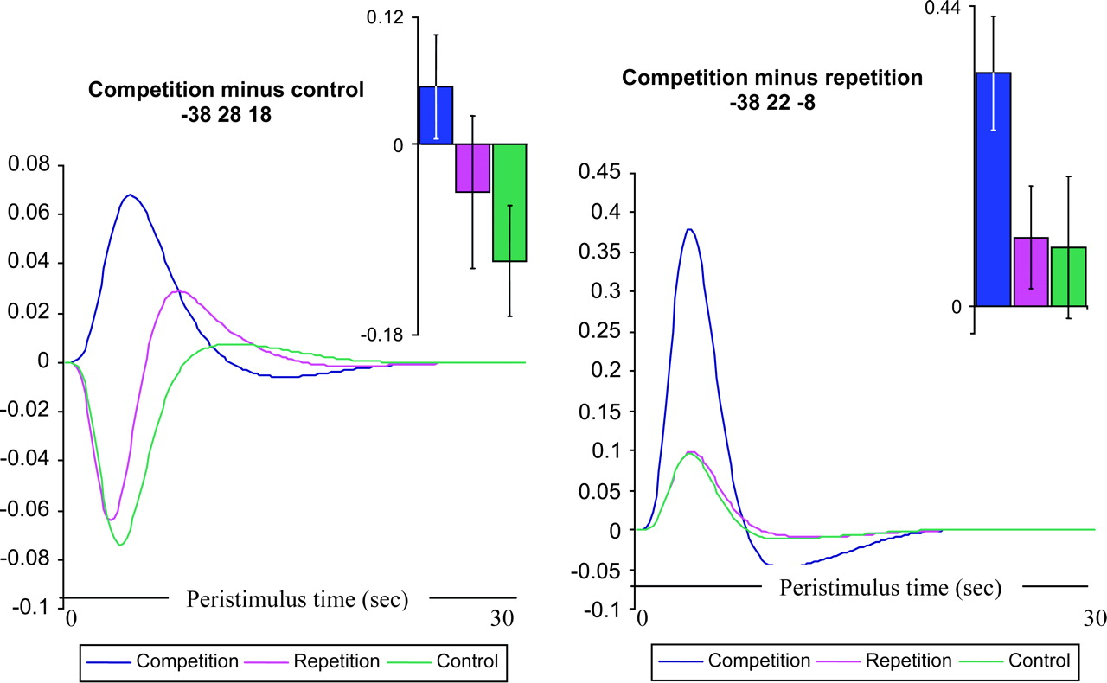
Figure 3. Fitted responses averaged across all subjects showing a simple plot of mean (fitted) response against ...
Notes:
Figure 3. Fitted responses averaged across all subjects showing a simple plot of mean (fitted) response against peristimulus time (PST) at activation peaks for the competition versus control and competition versus repetition contrasts. Note: The fitted response is not corrected for confounds (global flow and high pass filtering). Individual (adjusted) data were not available in all conditions at these peaks. Also shown are plots of raw parameter estimates (plus standard error to indicate variability in response across individuals) in the three conditions.
Unless provided in the caption above, the following copyright applies to the content of this slide: © The Author 2005. Published by Oxford University Press. All rights reserved. For permissions, please e-mail: journals.permissions@oupjournals.org

Slide 4
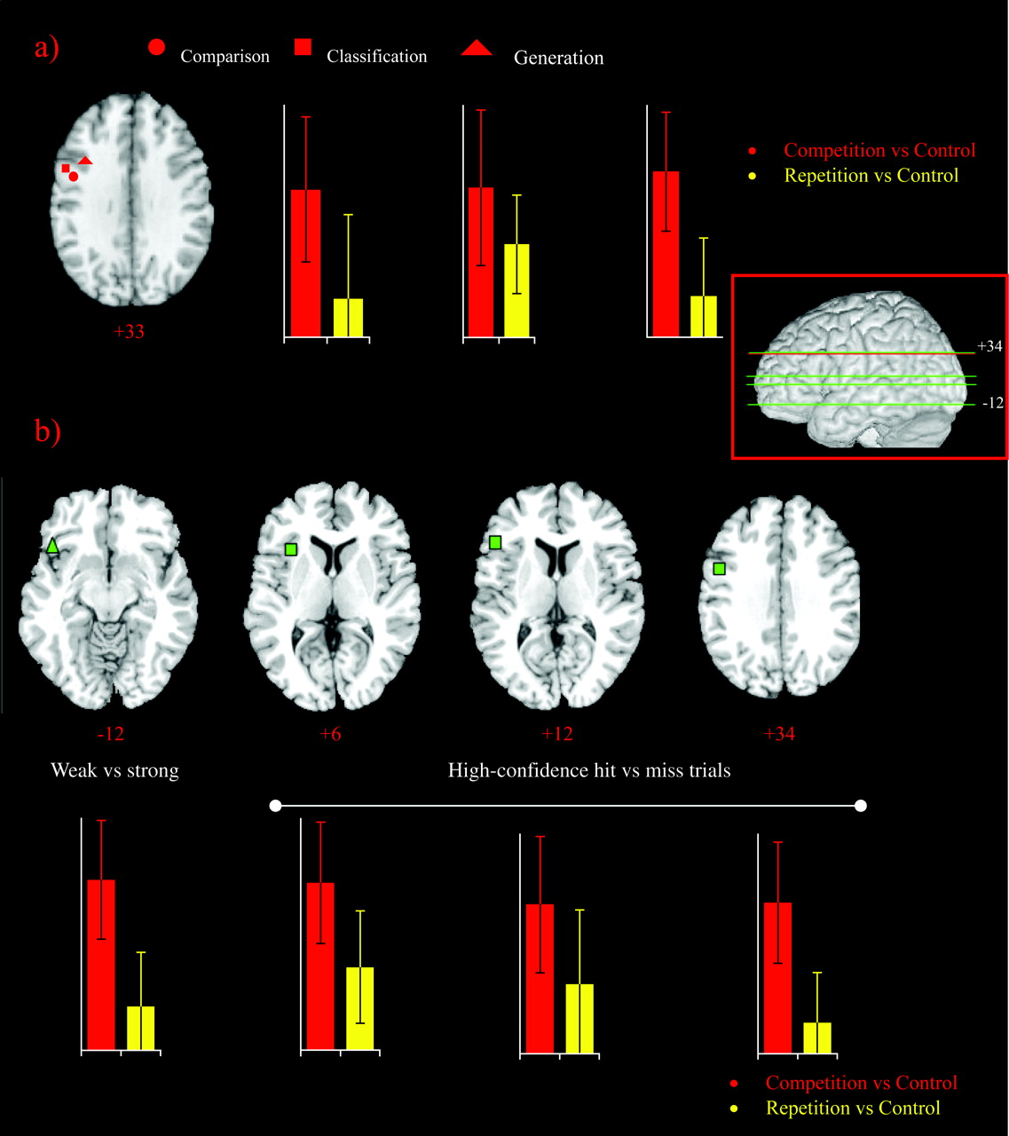
Figure 4. (a) Location of peak LIFG activations reported in Thompson Schill et al. (1997) superimposed on an axial ...
Notes:
Figure 4. (a) Location of peak LIFG activations reported in Thompson Schill et al. (1997) superimposed on an axial brain slice. The plots show the results of competition minus control and repetition minus control contrasts from the present study at each location. Coordinates presented in MNI space. Approximate slice location indicated by red line on the three-dimensional rendered brain. (b) Plots show the results of competition minus control and repetition minus control contrasts from the present study at earlier reported activation peaks for words with weak versus strong semantic associations (Wagner et al., 2001) and semantic classification of words subsequently remembered (high confidence hits) versus words subsequently forgotten (misses; Wagner et al., 1998). Coordinates of axial brain slices. presented in MNI space. Approximate slice locations indicated by green lines on the three-dimensional rendered brain.
Unless provided in the caption above, the following copyright applies to the content of this slide: © The Author 2005. Published by Oxford University Press. All rights reserved. For permissions, please e-mail: journals.permissions@oupjournals.org

