Slide 1
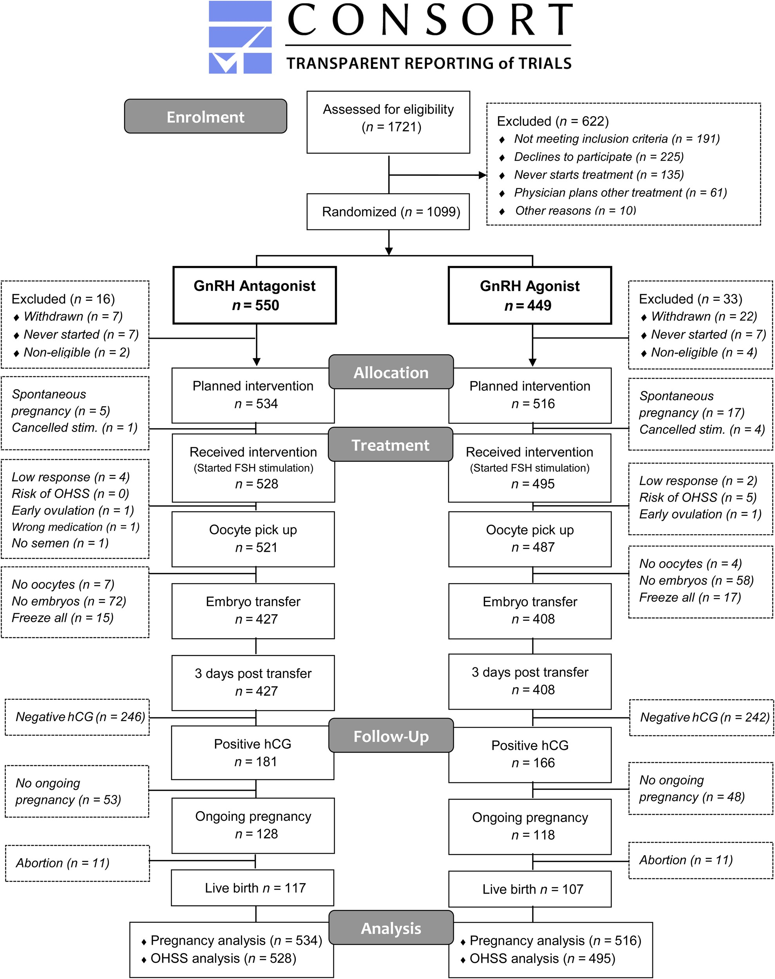
Figure 1 Flowchart of patients’ allocation and overview of trial visits. Clinical parameters related to ovarian ...
Notes:
Figure 1 Flowchart of patients’ allocation and overview of trial visits. Clinical parameters related to ovarian hyperstimulation syndrome (OHSS) were evaluated on three fixed days. Visit I: the day of oocyte retrieval; Visit II: 3 days after embryo transfer; Visit III: the day of the pregnancy test 13–15 days after embryo transfer. All clinical OHSS parameters were also registered at baseline cycle days 1–3 (visit 0).
Unless provided in the caption above, the following copyright applies to the content of this slide: © The Author 2016. Published by Oxford University Press on behalf of the European Society of Human Reproduction and Embryology. All rights reserved. For Permissions, please email: journals.permissions@oup.com

