Slide 1
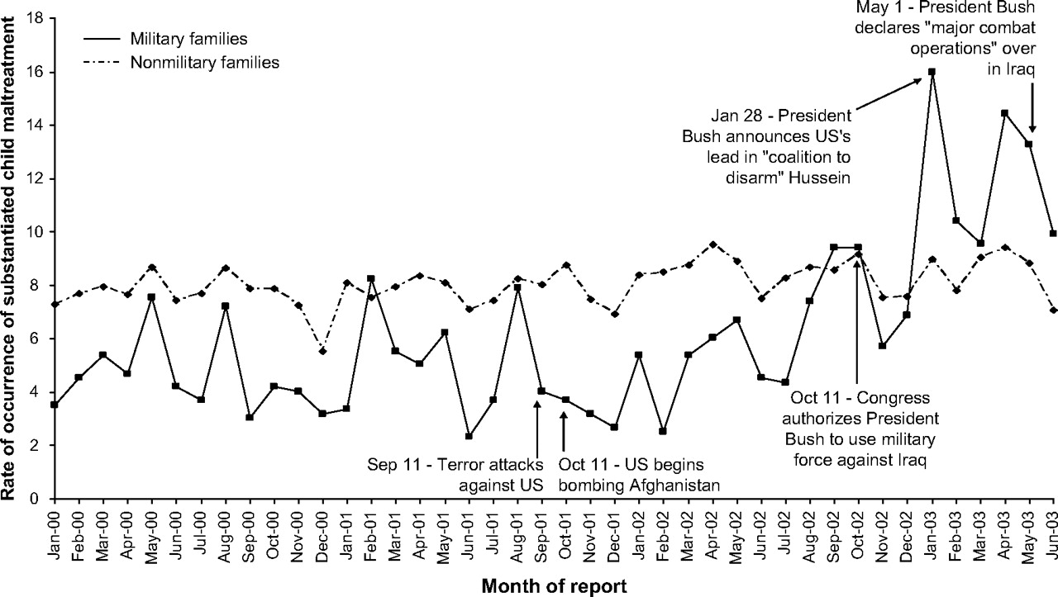
FIGURE 1. Rate of occurrence of substantiated child maltreatment by report month for children of military and ...
Notes:
FIGURE 1. Rate of occurrence of substantiated child maltreatment by report month for children of military and nonmilitary families, Texas, 2000–2003. Months are indicated by their first three letters; years, by the last two numbers. US, United States.
Unless provided in the caption above, the following copyright applies to the content of this slide: American Journal of Epidemiology Copyright © 2007 by the Johns Hopkins Bloomberg School of Public Health All rights reserved; printed in U.S.A.

Slide 2
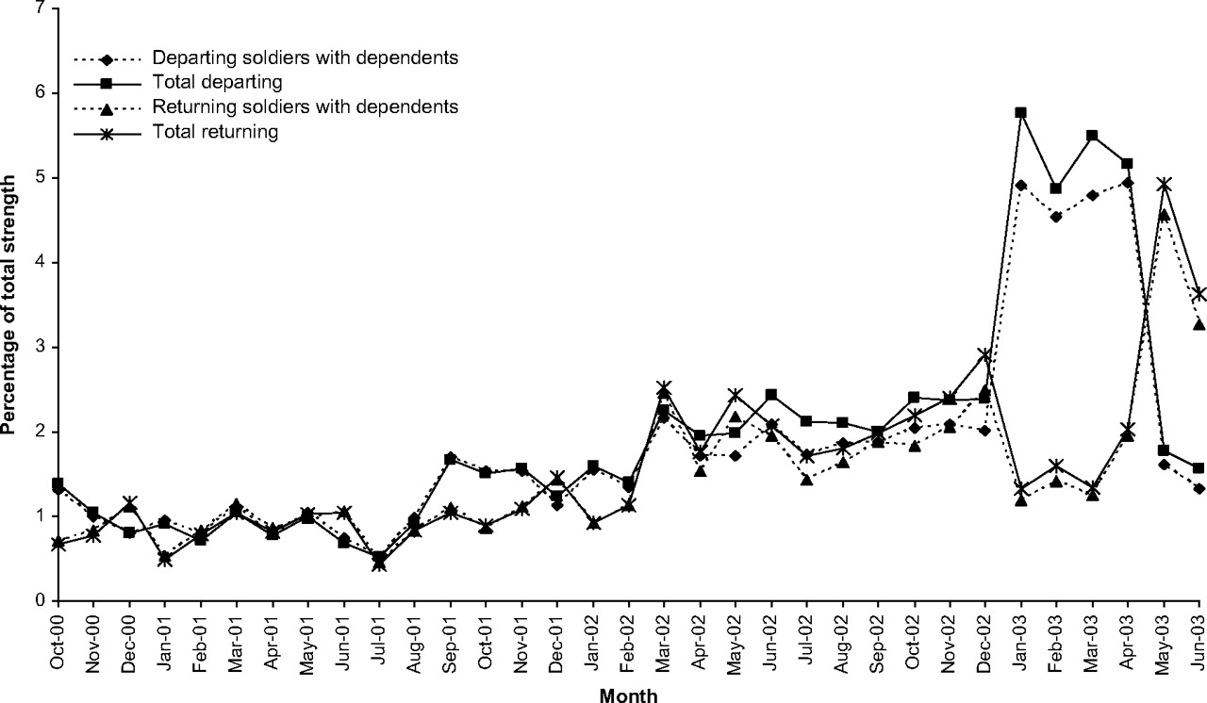
FIGURE 2. Percentage of resident soldiers departing for or returning from operational deployments within each month of ...
Notes:
FIGURE 2. Percentage of resident soldiers departing for or returning from operational deployments within each month of the study period, Texas, 2000–2003. Months are indicated by their first three letters; years, by the last two numbers.
Unless provided in the caption above, the following copyright applies to the content of this slide: American Journal of Epidemiology Copyright © 2007 by the Johns Hopkins Bloomberg School of Public Health All rights reserved; printed in U.S.A.

