Slide 1
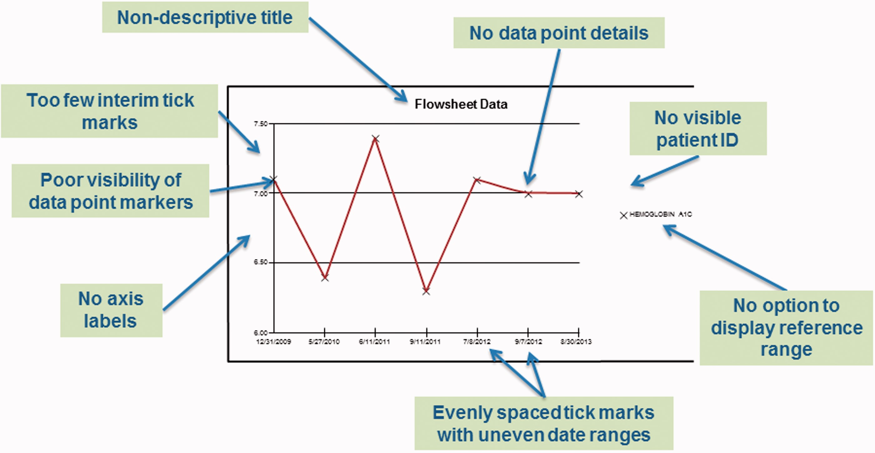
Figure 1: A stylized graph used to illustrate the criteria we developed and used to evaluate the various EHRs.
Notes:
Figure 1: A stylized graph used to illustrate the criteria we developed and used to evaluate the various EHRs.
Unless provided in the caption above, the following copyright applies to the content of this slide: © The Author 2015. Published by Oxford University Press on behalf of the American Medical Informatics Association.This is an Open Access article distributed under the terms of the Creative Commons Attribution Non-Commercial License (http://creativecommons.org/licenses/by-nc/4.0/), which permits non-commercial re-use, distribution, and reproduction in any medium, provided the original work is properly cited. For commercial re-use, please contact journals.permissions@oup.com

Slide 2
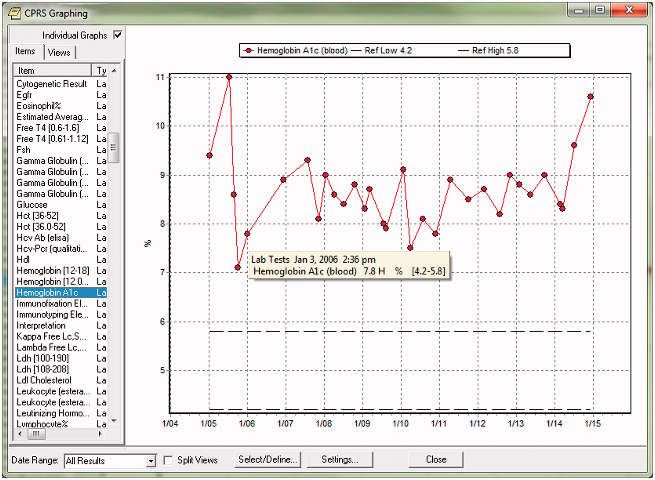
Figure 2. A screen shot from the Veteran’s Affairs Computerized Patient Record System showing a graph of a patient’s ...
Notes:
Figure 2. A screen shot from the Veteran’s Affairs Computerized Patient Record System showing a graph of a patient’s hemoglobin A1c levels over time.
Unless provided in the caption above, the following copyright applies to the content of this slide: © The Author 2015. Published by Oxford University Press on behalf of the American Medical Informatics Association.This is an Open Access article distributed under the terms of the Creative Commons Attribution Non-Commercial License (http://creativecommons.org/licenses/by-nc/4.0/), which permits non-commercial re-use, distribution, and reproduction in any medium, provided the original work is properly cited. For commercial re-use, please contact journals.permissions@oup.com

Slide 3
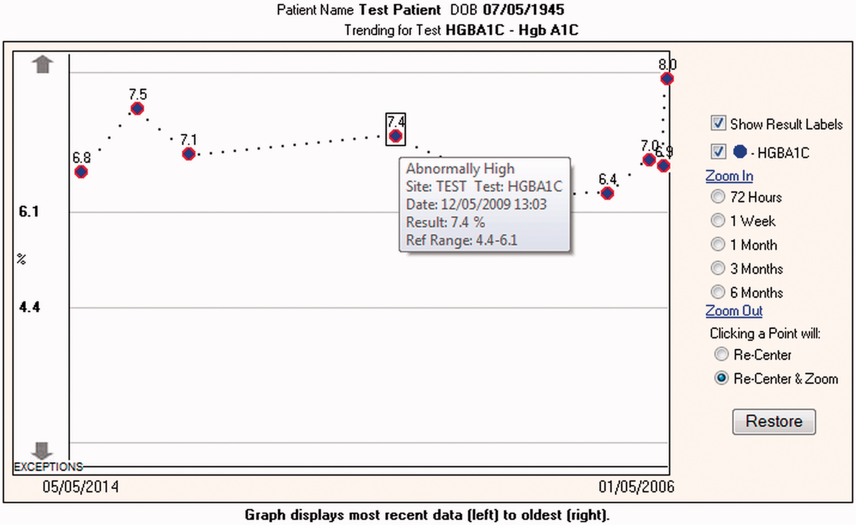
Figure 3: A screen shot from Partners Healthcare System’s Office of the National Coordinator for Health Information ...
Notes:
Figure 3: A screen shot from Partners Healthcare System’s Office of the National Coordinator for Health Information Technology authorized testing and certification bodies certified Longitudinal Medical Record system. Note that the x-axis displays results in reverse chronological order.
Unless provided in the caption above, the following copyright applies to the content of this slide: © The Author 2015. Published by Oxford University Press on behalf of the American Medical Informatics Association.This is an Open Access article distributed under the terms of the Creative Commons Attribution Non-Commercial License (http://creativecommons.org/licenses/by-nc/4.0/), which permits non-commercial re-use, distribution, and reproduction in any medium, provided the original work is properly cited. For commercial re-use, please contact journals.permissions@oup.com

