Slide 1
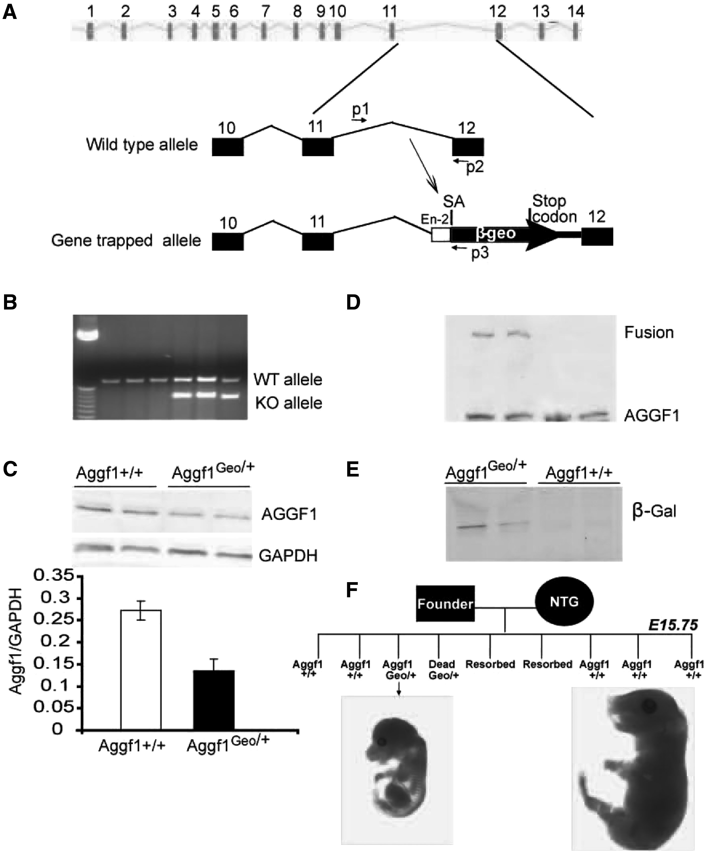
Figure 1. Generation of an Aggf1^{Geo/+} KO mouse line using a gene-trapping strategy. (A) Diagram of the ...
Notes:
Figure 1. Generation of an Aggf1Geo/+ KO mouse line using a gene-trapping strategy. (A) Diagram of the genomic structure of Aggf1 showing that the lacZ-neomycin fusion reporter gene (β-geo) located downstream of an engrailed-2 gene donor intron (En-2) and splice acceptor site (SA) was inserted into intron 11 of Aggf1. P1, P2, and P3 are PCR primers for genotyping: P1 and P2 for detecting the Aggf1 wild type allele, and P1 and P3 for identifying the KO allele. (B) PCR analysis was effective in distinguishing wild type mice (P1/P2) and KO mice (P1/P3). (C) Western blotting analysis using an antibody against the C-terminus of AGGF1 revealed about 2-fold reduction in the expression level of AGGF1 protein in Aggf1Geo/+ embryos (E12.5). (D) Western blotting analysis using an antibody against the N-terminus of AGGF1 revealed the presence of the AGGF1-β-geo fusion protein in addition to the wild type AGGF1 band in Aggf1Geo/+ mice. (E) Western blotting analysis using an antibody against β-Gal detected the AGGF1-β-Geo fusion protein expression only in samples obtained from Aggf1Geo/+ mice. (F) Detection of heterozygous lethality of Aggf1Geo/+ embryos by genotyping analysis of embryos derived from breeding a chimerical Aggf1Geo/+ founder mouse to a wild type mouse.
Unless provided in the caption above, the following copyright applies to the content of this slide: © The Author 2016. Published by Oxford University Press. All rights reserved. For Permissions, please email: journals.permissions@oup.com

Slide 2
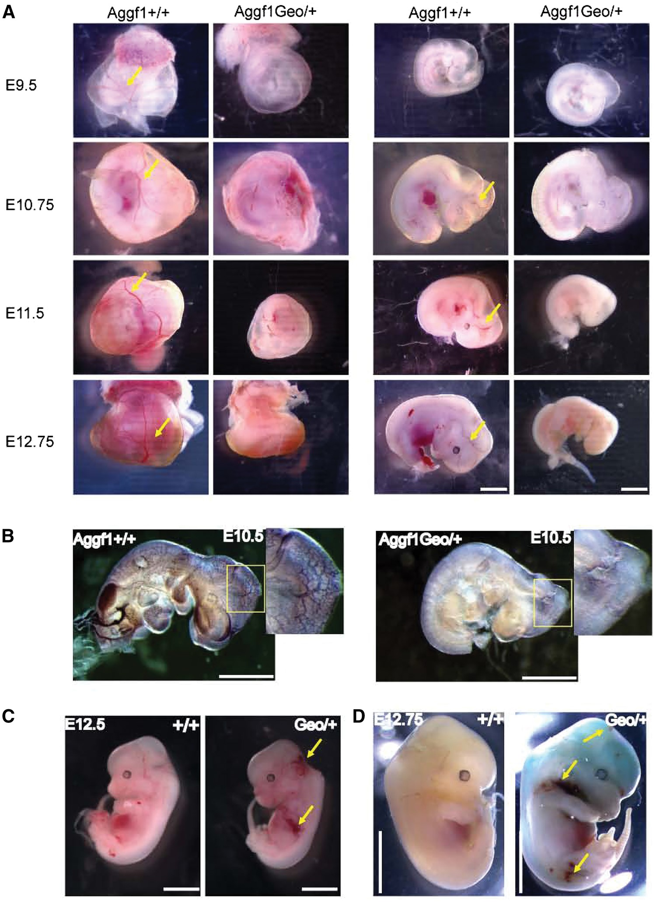
Figure 2. Aggf1 haploinsufficiency results in defective vascular development during embryogenesis. (A) Images from ...
Notes:
Figure 2. Aggf1 haploinsufficiency results in defective vascular development during embryogenesis. (A) Images from Aggf1+/+ and Aggf1Geo/+ yolk sacs (left panel) and embryos (right panel) at different development stages of E9.5 to E12.75. Blood vessels are clearly visible with the red colour of blood. Note that 43.9% of Aggf1Geo/+ KO embryos showed the abnormal vascular phenotype, whereas the rest of 56.1% of embryos was indistinguishable from wild type embryos (data not shown). (B) Whole mount immunostaining for PECAM-1 (CD31) in Aggf1+/+ and Aggf1Geo/+ embryos at E10.5. (C) Haemorrhages are frequently observed in Aggf1Geo/+ embryos and marked with yellow arrows. (D) Whole mount staining for β-Gal revealed a high expression level of Aggf1 in the cranial and dorsal regions. Haemorrhages are indicated by yellow arrows. Scale bar = 300 μm.
Unless provided in the caption above, the following copyright applies to the content of this slide: © The Author 2016. Published by Oxford University Press. All rights reserved. For Permissions, please email: journals.permissions@oup.com

Slide 3
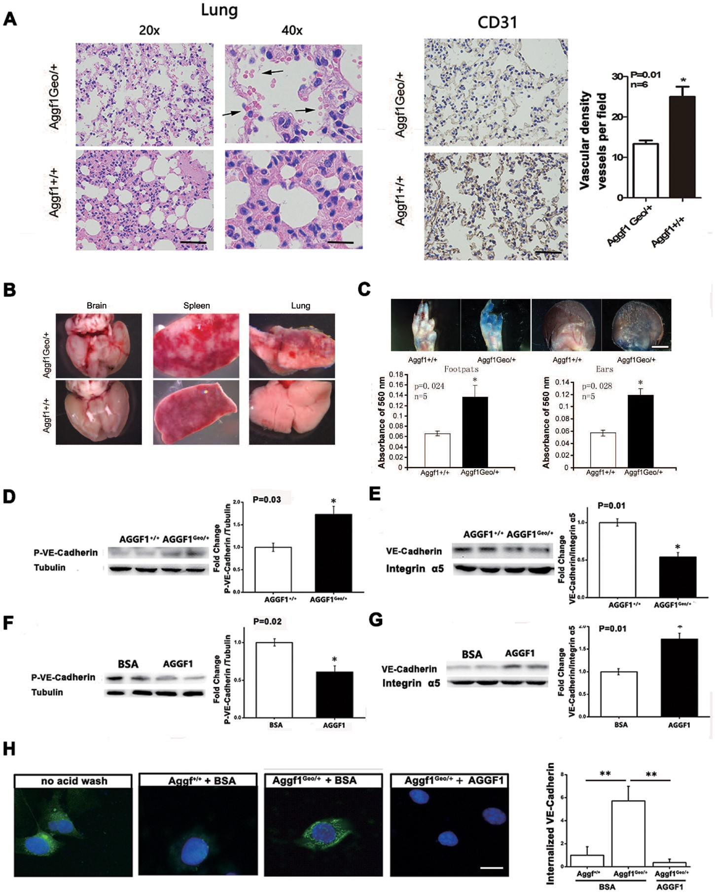
Figure 3. Aggf1 haploinsufficiency results in vascular defects and increases vascular permeability in ...
Notes:
Figure 3. Aggf1 haploinsufficiency results in vascular defects and increases vascular permeability in Aggf1Geo/+ KO mice by regulating VE-cadherin phosphorylation and membrane localization. (A) Hematoxylin and eosin-stained sections of lungs showed leakage of blood cells Aggf1Geo/+ mice but not in wild type control mice (left panel; scale bar = 100/50 μm). The right panel shows immunostaining analysis with a pan-vessel-specific marker CD31 and showed significantly less vessel density in Aggf1Geo/+ organs (lungs) than in wild type mice (scale bar = 100 μm). (B) Macroscopic examinations of the brain, spleen and lungs identified haemorrhages in Aggf1Geo/+ mice older than 32 weeks of age, but not in age-matched Aggf1+/+ mice (scale bar = 2 mm). (C) Vascular permeability assays revealed significantly increased vascular permeability in Aggf1Geo/+ mice compared to age-matched Aggf1+/+ control mice at the age of 50-60 weeks. Top panels are images of Evans blue stain (scale bar = 2 mm). Bottom panels are graphs showing the amount of Evans blue extracted from respective tissues. (D) Phosphorylation of VE-cadherin was increased in Aggf1Geo/+ ECs compared to Aggf1+/+ ECs. (E) The protein expression level of VE-cadherin in cellular membranes was decreased in Aggf1Geo/+ ECs compared to Aggf1+/+ ECs. (F) Phosphorylation of VE-cadherin was decreased in HUVECs treated with AGGF1 compared to control BSA. (G) Membrane VE-cadherin expression was increased in HUVECs treated with AGGF1 compared to control BSA. (H) AGGF1 decreases the internalization of cell-surface-labelled VE-cadherin. MECs were incubated with the BV6 antibody at 4 °C. VE-cadherin internalization was monitored by uptake of the BV6 antibody-labelled signal (green). The remaining cell-surface antibody was visible under a ‘no acid wash ’ condition (left image) and washed away with a mild acid solution (other images). Blue, DAPI staining for the nucleus. Scale bars = 20 µm.
Unless provided in the caption above, the following copyright applies to the content of this slide: © The Author 2016. Published by Oxford University Press. All rights reserved. For Permissions, please email: journals.permissions@oup.com

Slide 4
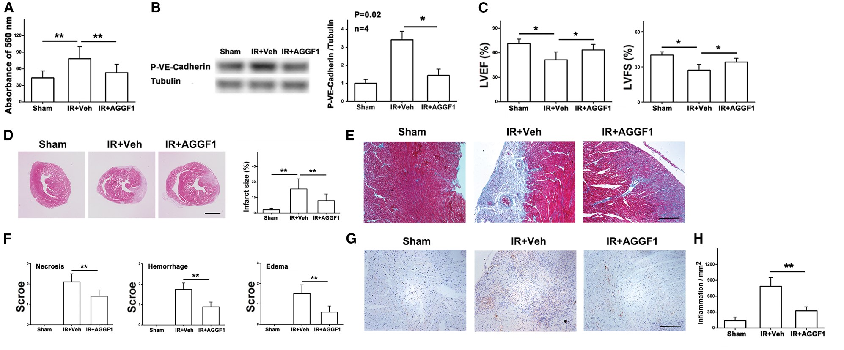
Figure 4. AGGF1 protein therapy attenuates cardiac fibrosis, decreases infarct sizes, necrosis, haemorrhages, edema, ...
Notes:
Figure 4. AGGF1 protein therapy attenuates cardiac fibrosis, decreases infarct sizes, necrosis, haemorrhages, edema, and density of macrophages induced by ischaemia-reperfusion (IR). IR injury was performed on wild type mice using a standard protocol. Mice were randomly divided into two groups to receive either vehicle or human recombinant AGGF1. Mice with sham operation were used as negative controls. (A) Vascular permeability assays with Evans blue dye in the hearts of mice subject to 45 min of ischaemia and 4 h of reperfusion (n = 10/group, *P < 0.05, **P < 0.01). AGGF1 treatment significantly inhibited the vascular leakage induced by IR. (B) IR-induced phosphorylation of VE-cadherin was decreased in mouse hearts after AGGF1 treatment compared with PBS treatment. (C) Echocardiographic data on LVEF and LVFS (n = 10/group, *P < 0.05, **P < 0.01). AGGF1 dramatically improved cardiac functions at 3 days after IR. (D) Representative images from Masson trichrome staining of cross-sections in the infarct area of hearts 3 days after IR surgery. IR mice were treated with recombinant AGGF1 protein or control PBS. AGGF1 protein therapy inhibited anterior wall fibrosis after IR. Scale bar = 1 mm. The images from Masson trichrome-stained sections in the area of infarction 3 days after IR surgery were quantified and the data are shown on the right. (E) Amplified images from (D). Scale bar = 100 μm. (F) IR-induced cardiac necrosis, haemorrhages, and edema were reduced by AGGF1 administration compared with PBS treatment. (G) Sections from infarcted hearts were immunostained for inflammatory cells using an anti-CD45 antibody. (H) The images from (G) were quantified and plotted.
Unless provided in the caption above, the following copyright applies to the content of this slide: © The Author 2016. Published by Oxford University Press. All rights reserved. For Permissions, please email: journals.permissions@oup.com

Slide 5
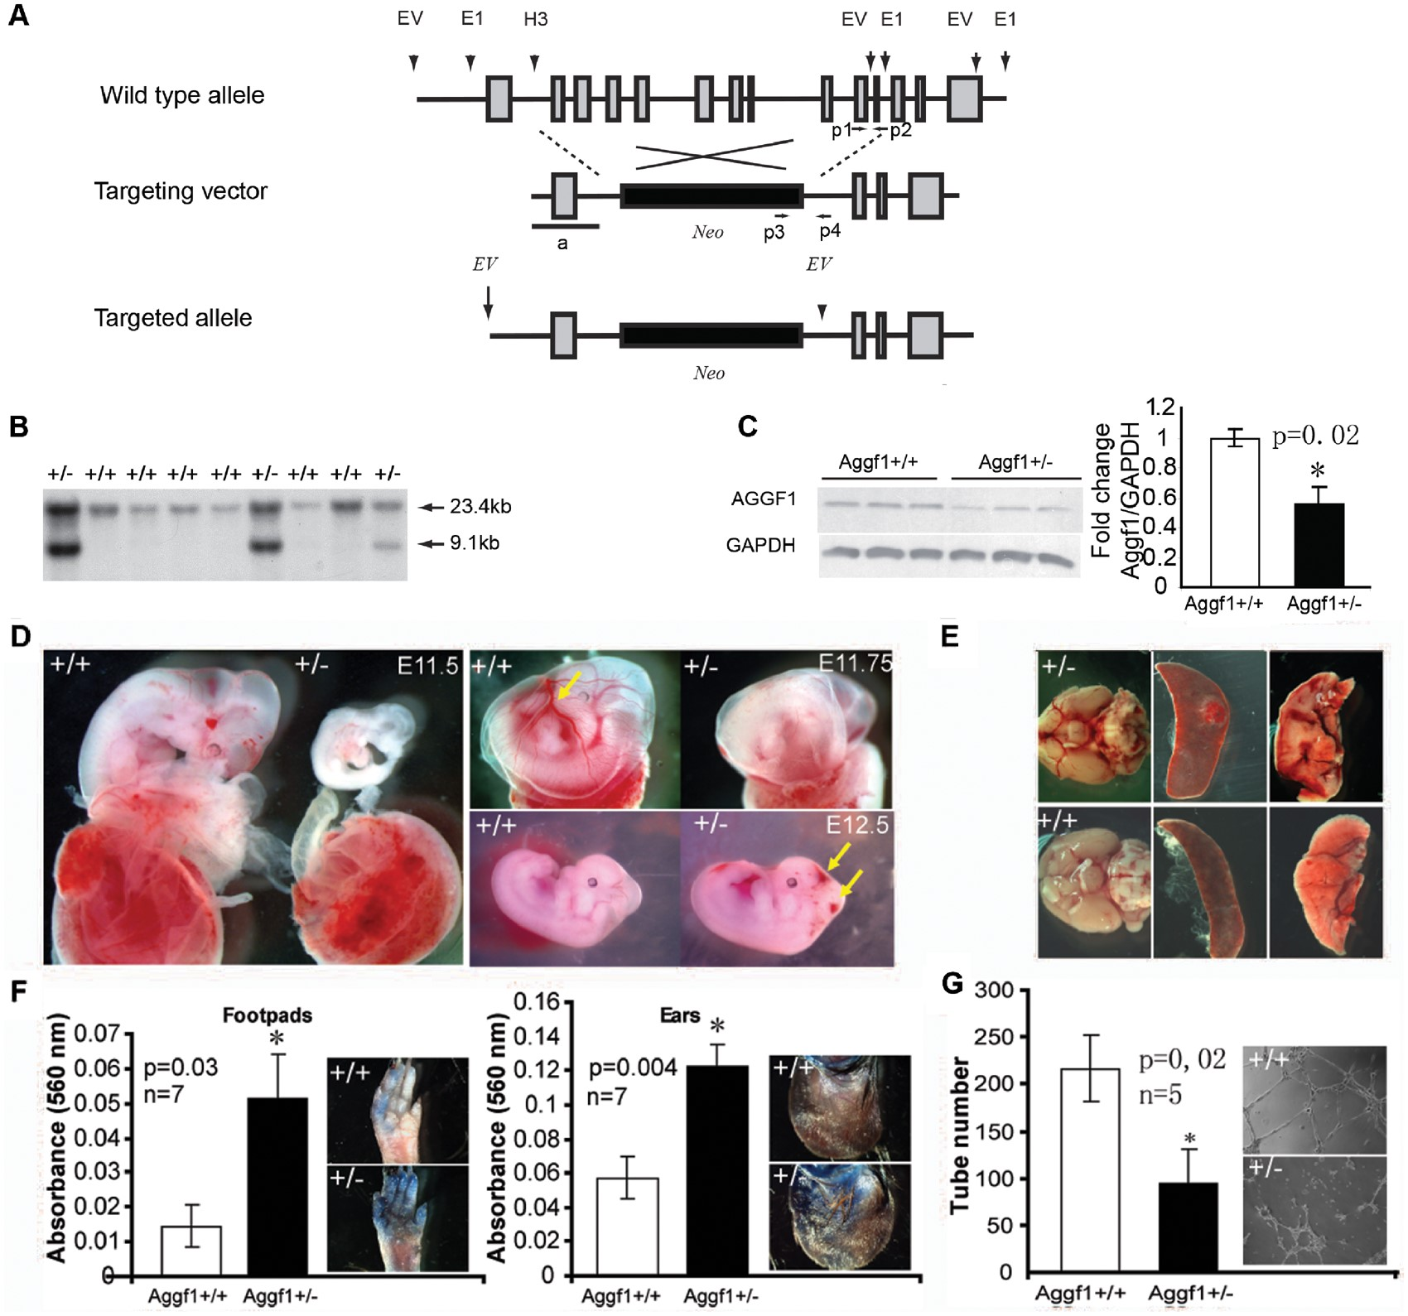
Figure 5. Aggf1 haploinsufficiency results in vascular defects and increases vascular permeability in ...
Notes:
Figure 5. Aggf1 haploinsufficiency results in vascular defects and increases vascular permeability in Aggf1+/− KO mice. (A) Strategy for developing a classical KO mouse line targeting Aggf1 by homologous recombination. The wild type allele represents the genomic organization of the mouse Aggf1 gene. The vertical gray colour-filled boxes indicate the exons of Aggf1. EV, E1, and H1 stand for restriction enzymes EcoR V, EcoR 1 and Hind 3, respectively. The targeting vector was built on pGT-N38 with insertions of the E1-H3 and the E1-E1 (3-end) fragments as the left and right arm, respectively. The horizontal black line (a) represents a probe used for Southern blotting analysis. The targeted allele shows the genomic organization of Aggf1 after exons 2-11 are replaced with Neo. PCR analysis was later developed for genotyping KO mice. The positions of PCR primers for genotyping are indicated as P1, P2 and P3, P4. (B) Southern blot analysis was performed to detect the correctly targeted ES cell clones. The genomic DNA from the targeted ES cells produces two bands of 23.4 kb and 9.1 kb, whereas non-targeted ES cells produce a single band of 23.4 kb. (C) Western blotting analysis using an antibody against AGGF1 revealed about 50% reduction of AGGF1 expression in heterozygous Aggf1+/− embryos (E12.5). (D) Representative images showing defective vasculature in Aggf1+/− yolk sacs and embryos. Haemorrhages were also seen in 35% of developing Aggf1+/− embryos. (E) Detection of haemorrhages in the brain, lung and spleen of 35% of Aggf1+/− mice at 50 to 60 weeks of age. (F) Significantly increased vascular permeability in Aggf1+/− mice at 50 to 60 weeks of age compared to that of age-matched Aggf1+/+ controls. (G) Matrigel-based endothelial tube formation assays revealed a decreased angiogenesis by microvascular ECs isolated from lungs of Aggf1+/− mice as compared to that from Aggf1+/+ control mice at the age of 20 to 30 weeks. Scale bar = 50 μm.
Unless provided in the caption above, the following copyright applies to the content of this slide: © The Author 2016. Published by Oxford University Press. All rights reserved. For Permissions, please email: journals.permissions@oup.com

Slide 6
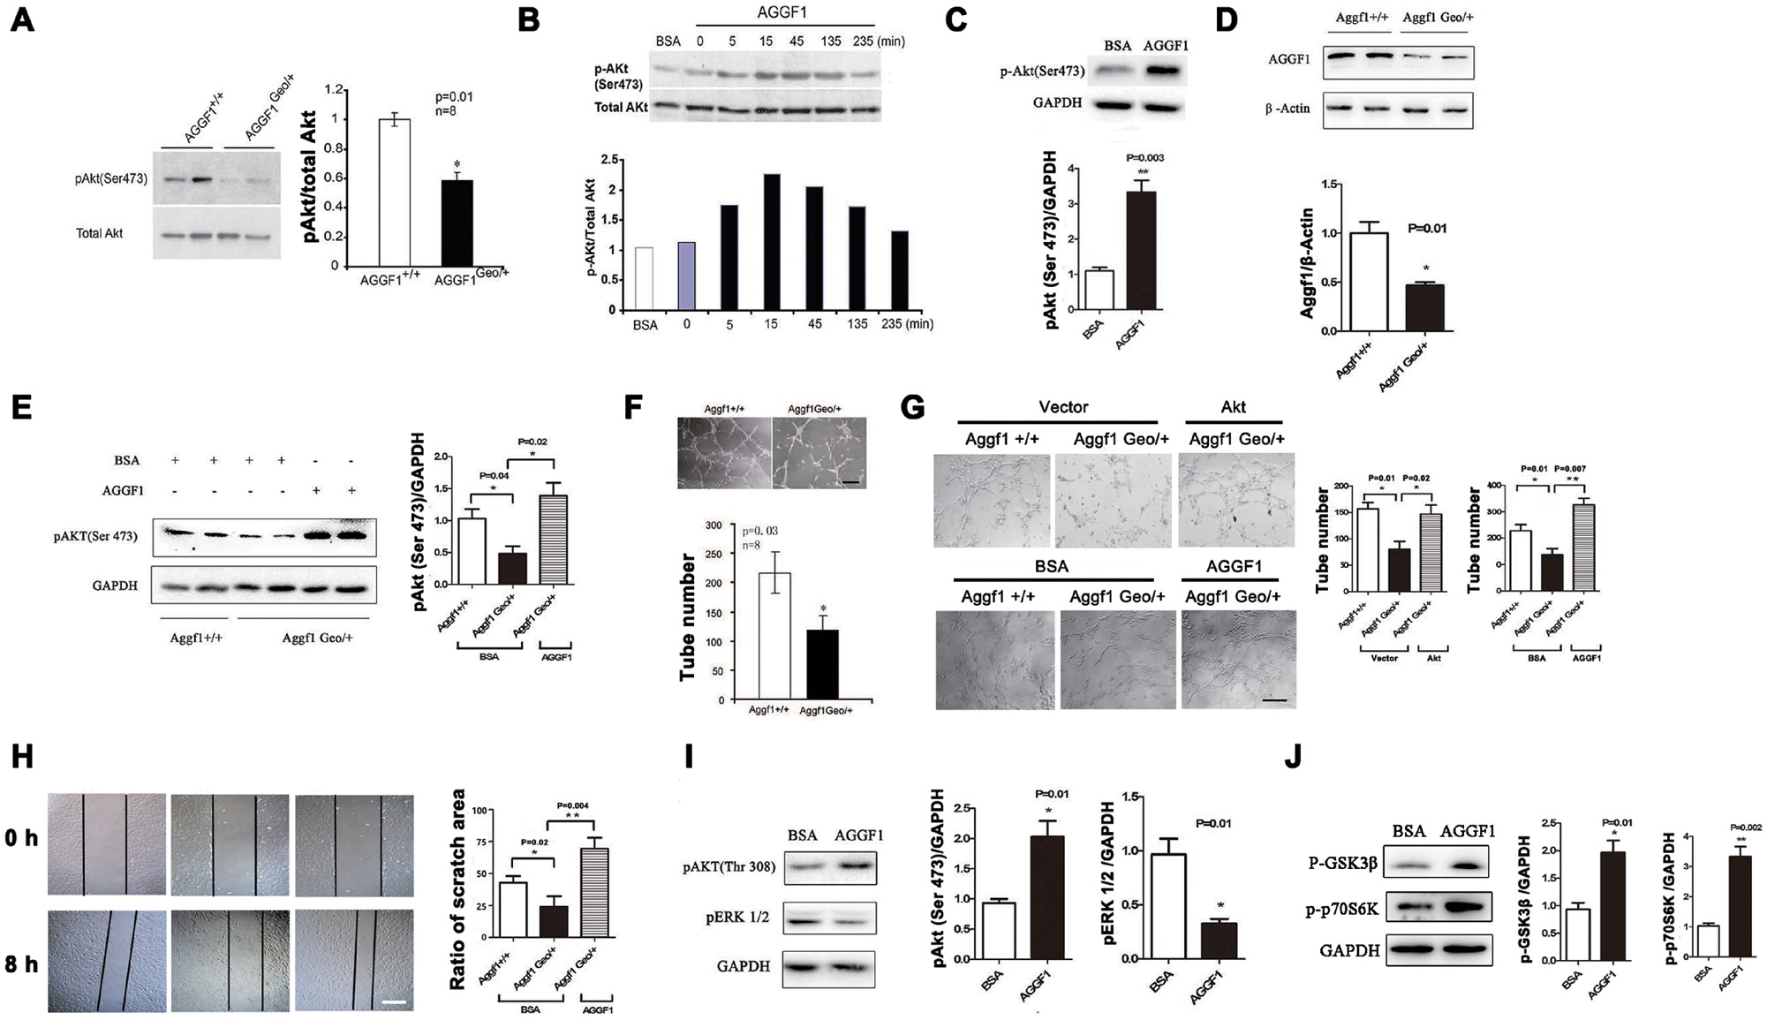
Figure 6. AGGF promotes angiogenesis and mediates vascular development by activating PI3K, AKT, GSK3-β and S6K. (A) ...
Notes:
Figure 6. AGGF promotes angiogenesis and mediates vascular development by activating PI3K, AKT, GSK3-β and S6K. (A) Aggf1 haploinsufficiency inhibits activation of AKT in Aggf1Geo/+ KO embryos compared to wild type embryos. (B) Phosphorylation of AKT was induced by stimulating HUVECs with AGGF1. HUVECs were collected with EDTA dissociation buffer (Invitrogen) and plated into dishes coated with purified AGGF1 (6.4 μg/ml) or with BSA (control). Cells were allowed to attach to AGGF1 for 5, 15, 45, 135, and 235 min at 37 °C. HUVECs were then lysed in standard lysis buffer. Cell lyates were used for Western blotting analysis with indicated antibodies for phosphorylated AKT (pAkt) or total Akt. (C) Activation of AKT by incubating HUVECs in media containing recombinant AGGF1. (D) Western blotting analysis with an antibody against the C-terminus of AGGF1 revealed about 2-fold reduction of the expression level of the AGGF1 protein in microvascular ECs isolated from lungs of Aggf1Geo/+ mice as compared to that from WT Aggf1+/+ ECs . (E) Phosphorylation of AKT at Ser473 was decreased in Aggf1Geo/+ ECs compared to wild type ECs, but the reduction was fully rescued by treatment of ECs with purified AGGF1 protein. (F) Matrigel-based endothelial tube formation assays revealed a decrease of angiogenesis by microvascular ECs isolated from lungs of Aggf1Geo/+ mice as compared to that from Aggf1+/+ control mice at the age of 20 to 30 weeks. Scale bar = 50 μm. (G) MECs from 8 week old Aggf1Geo/+ mice showed reduced capillary tube formation compared with Aggf1+/+ control mice, but the reduction was rescued with overexpression of constitutive active AKT or treatment with recombinant AGGF (5 μg/ml). Scale bar = 50 μm. (H) Reduced migration of Aggf1Geo/+ MECs as compared with wild type Aggf1+/+ MECs and rescue by treatment with recombinant AGGF (5 μg/ml). Scale bar = 100 μm. (I) Western blotting analysis revealed that AGGF1 protein (5 μg/ml) activated phosphorylation of AKT at Thr308, but decreased phosphorylation of ERK1/2. (J) Western blotting analysis revealed that AGGF1 protein (5 μg/ml) activated phosphorylation of GSK3-β at Ser9 and p70S6K at Thr389.
Unless provided in the caption above, the following copyright applies to the content of this slide: © The Author 2016. Published by Oxford University Press. All rights reserved. For Permissions, please email: journals.permissions@oup.com

Slide 7
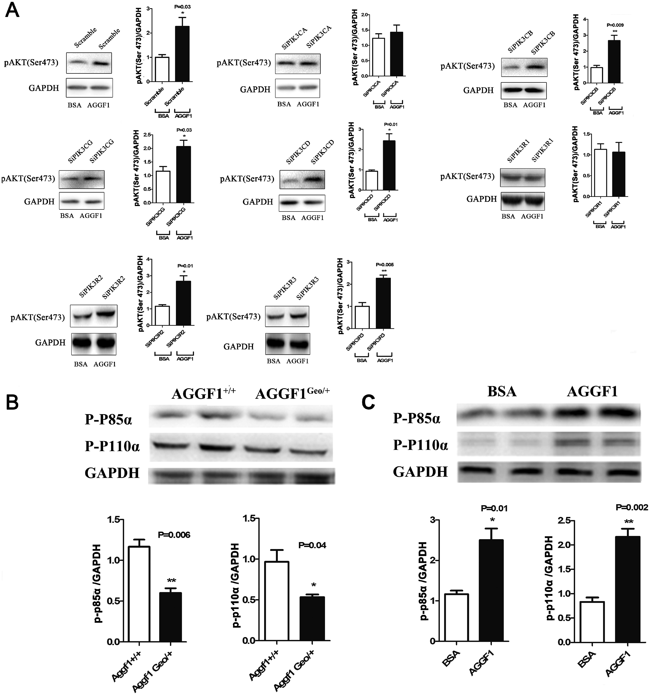
Figure 7. AGGF activates AKT by activating PI3K. (A) Effects of knockdown of 7 different genes encoding different PI3K ...
Notes:
Figure 7. AGGF activates AKT by activating PI3K. (A) Effects of knockdown of 7 different genes encoding different PI3K subunits on AGGF1-mediated AKT activation. (B) Phosphorylation of P85α and p110α was decreased in Aggf1Geo/+ ECs compared to Aggf1+/+ ECs. (C) Phosphorylation of P85α and p110α was increased in HUVECs treated with AGGF1 compared to control BSA.
Unless provided in the caption above, the following copyright applies to the content of this slide: © The Author 2016. Published by Oxford University Press. All rights reserved. For Permissions, please email: journals.permissions@oup.com

Slide 8
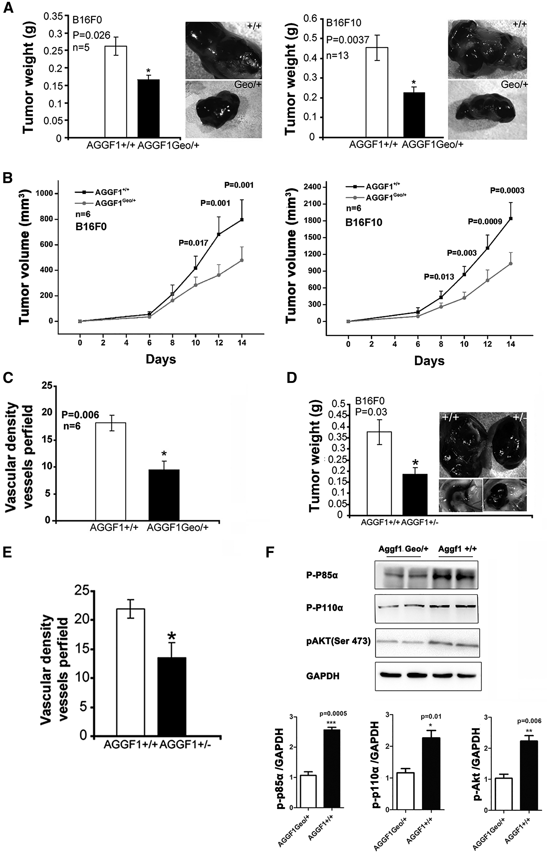
Figure 8. Aggf1 haploinsufficiency inhibits tumor angiogenesis and growth. (A) The weight of subcutaneous tumors grown ...
Notes:
Figure 8. Aggf1 haploinsufficiency inhibits tumor angiogenesis and growth. (A) The weight of subcutaneous tumors grown in mice. Both murine melanoma B16F0 (left) and B16F10 tumor weight (right) was significantly reduced in Aggf1Geo/+ mice as compared to Aggf1+/+ controls. (B) Growth curves for B16F0 and B16F10 tumors in Aggf1Geo/+ and Aggf1+/+ mice. (C) CD31 staining revealed significantly reduced blood vessel density in tumors grown in Aggf1Geo/+ mice compared to that from Aggf1+/+ controls. (D-E) Identical results as in (A) and (C) from gene-trapping Aggf1Geo/+ KO mice were found for classical Aggf1+/− KO mice. (F) Western blot analysis for p-P110α, p-P85α, and pAKT with protein extracts from tumors from Aggf1Geo/+ mice and Aggf1+/+ controls.
Unless provided in the caption above, the following copyright applies to the content of this slide: © The Author 2016. Published by Oxford University Press. All rights reserved. For Permissions, please email: journals.permissions@oup.com

