Slide 1
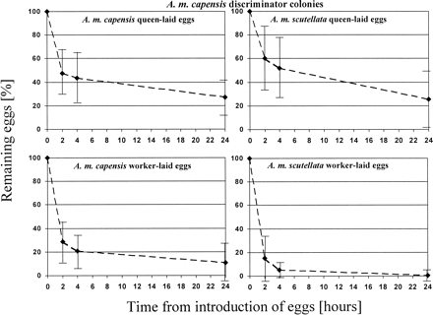
Figure 1 Numbers (\batchmode \documentclass[fleqn,10pt,legalpaper]{article} \usepackage{amssymb} \usepackage{amsfonts} ...
Notes:
Figure 1 Numbers (\batchmode \documentclass[fleqn,10pt,legalpaper]{article} \usepackage{amssymb} \usepackage{amsfonts} \usepackage{amsmath} \pagestyle{empty} \begin{document} \(mean\ {\pm}\ SD\) \end{document}) of queen-laid and worker-laid eggs of Apis mellifera capensis and A. m. scutellata remaining after 0, 2, 4, and 24 h in queenright Apis mellifera capensis discriminator colonies
Unless provided in the caption above, the following copyright applies to the content of this slide: International Society for Behavioral Ecology

Slide 2
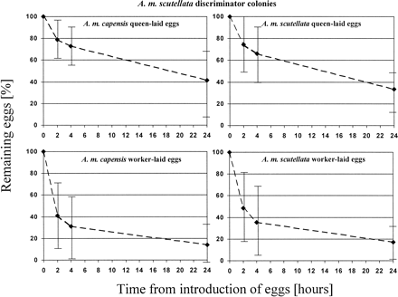
Figure 2 Numbers (\batchmode \documentclass[fleqn,10pt,legalpaper]{article} \usepackage{amssymb} \usepackage{amsfonts} ...
Notes:
Figure 2 Numbers (\batchmode \documentclass[fleqn,10pt,legalpaper]{article} \usepackage{amssymb} \usepackage{amsfonts} \usepackage{amsmath} \pagestyle{empty} \begin{document} \(mean\ {\pm}\ SD\) \end{document}) of queen-laid and worker-laid eggs of Apis mellifera capensis and A. m. scutellata remaining after 0, 2, 4, and 24 h in queenright A. m. scutellata discriminator colonies
Unless provided in the caption above, the following copyright applies to the content of this slide: International Society for Behavioral Ecology

