Slide 1
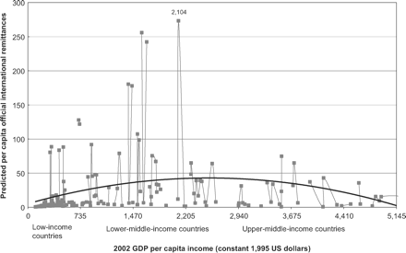
Figure 1: Relationship Between Per Capita Official Remittances and GDP Per Capita Income
Notes:
Figure 1: Relationship Between Per Capita Official Remittances and GDP Per Capita Income
Unless provided in the caption above, the following copyright applies to the content of this slide: © The author 2006. Published by Oxford University Press on behalf of the Centre for the Study of African Economies. All rights reserved. For permissions, please email: journals.permissions@oxfordjournals.org

