Slide 1
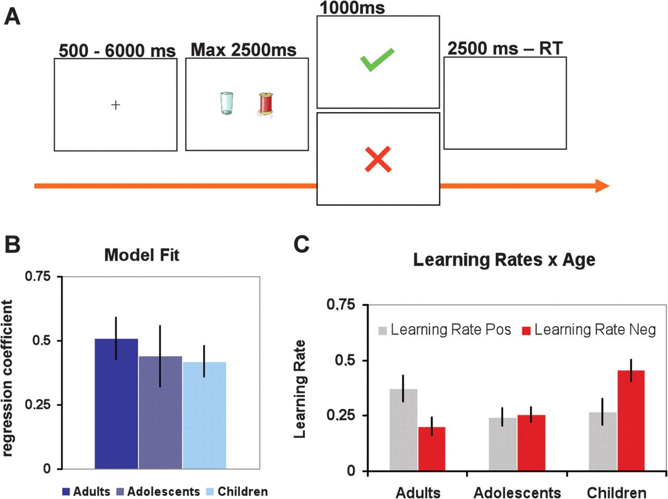
Figure 1. (A) Participants chose one stimulus by pressing the left or right button and received positive or negative ...
Notes:
Figure 1. (A) Participants chose one stimulus by pressing the left or right button and received positive or negative feedback according to probabilistic rules. Two pairs of stimuli were presented to the participants: (1) the AB pair with 80% positive feedback for A and 20% for B and (2) the CD pair with 70% positive feedback for Cand 30% for D. (B) Estimated model fits per age group. (C) Estimated learning rates for positive and negative feedback per age group. Error bars represent standard errors in all graphs.
Unless provided in the caption above, the following copyright applies to the content of this slide: © The Author 2011. Published by Oxford University Press. All rights reserved. For permissions, please e-mail: journals.permissions@oup.com

Slide 2
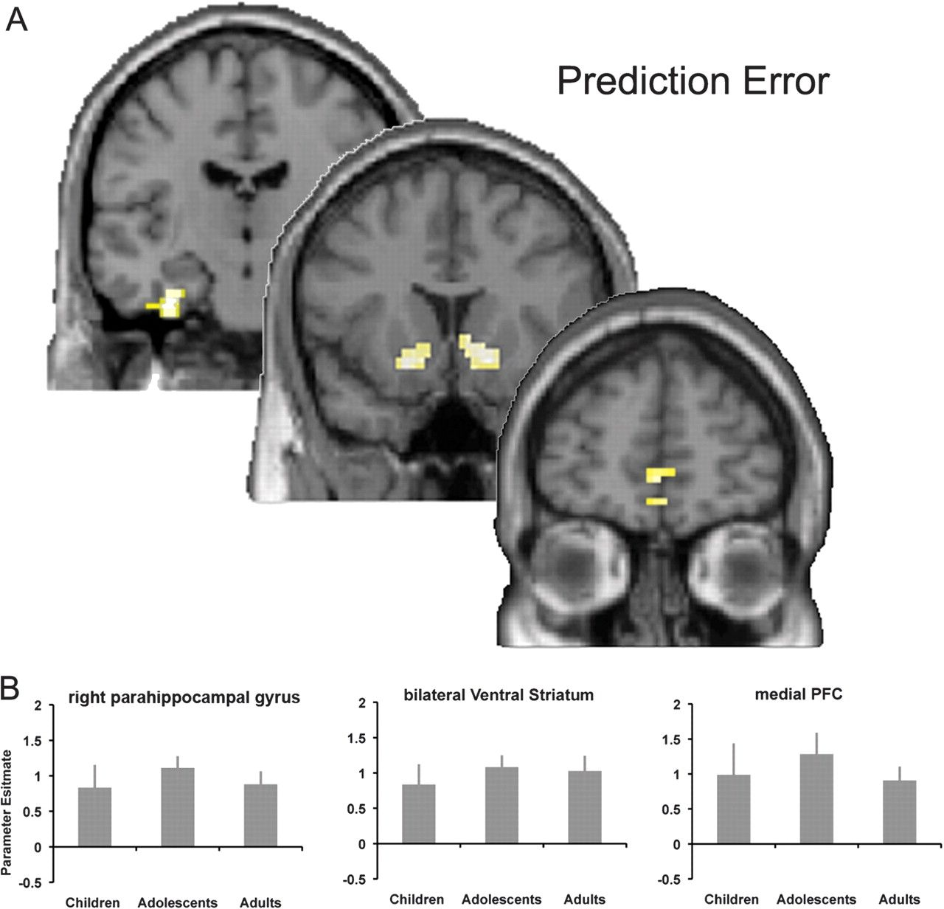
Figure 2. (A) Regions in the mPFC, ventral striatum, and parahippocampal gyrus in which BOLD signal was significantly ...
Notes:
Figure 2. (A) Regions in the mPFC, ventral striatum, and parahippocampal gyrus in which BOLD signal was significantly correlated with prediction errors. Thresholded at P 10. (B) Parameter estimates of the prediction errors per age group in the functionally defined ROIs for the mPFC, ventral striatum, and parahippocampal gyrus.
Unless provided in the caption above, the following copyright applies to the content of this slide: © The Author 2011. Published by Oxford University Press. All rights reserved. For permissions, please e-mail: journals.permissions@oup.com

Slide 3
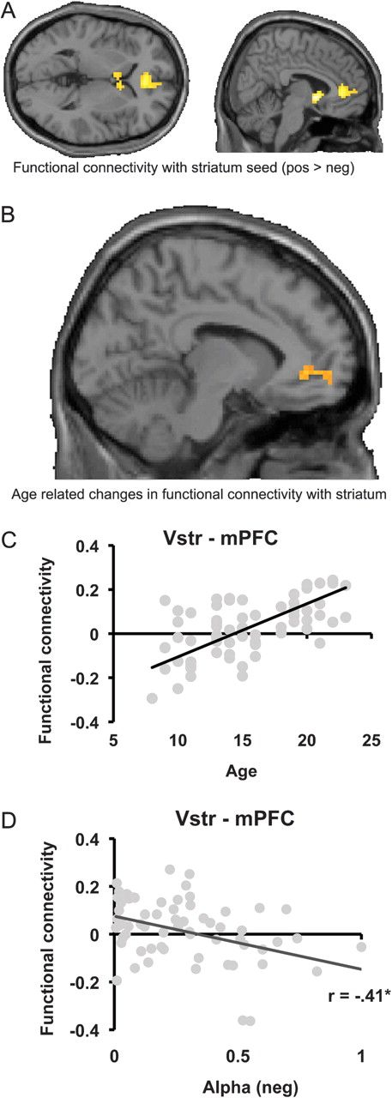
Figure 3. (A) Regions that showed increased functional connectivity with the striatal seed region after positive ...
Notes:
Figure 3. (A) Regions that showed increased functional connectivity with the striatal seed region after positive compared with negative feedback. Thresholded at P 10. (B) Region in the mPFC that revealed age-related changes in functional connectivity with the striatal seed region. Thresholded at P 20. (C) Scatterplot depicting the relationship between the functional connectivity measure of the striatum–mPFC (positive > negative feedback) and age. (D) Scatterplot depicting the relationship between the functional connectivity measure of the striatum–mPFC (positive > negative feedback) and learning rate (αneg).
Unless provided in the caption above, the following copyright applies to the content of this slide: © The Author 2011. Published by Oxford University Press. All rights reserved. For permissions, please e-mail: journals.permissions@oup.com

