Slide 1
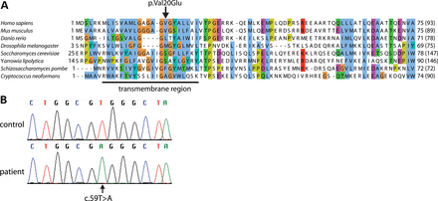
Table 1. Patient mitochondrial respiratory chain enzyme activities in cultured skin fibroblasts and muscle ...
Notes:
Table 1. Patient mitochondrial respiratory chain enzyme activities in cultured skin fibroblasts and muscle biopsies Control ranges from healthy individuals are indicated between parenthesis. aValues are given in mU per U citrate synthase. bValues are given in mU per U cytochrome c oxidase. cnot determined. Figure 1.Sequence analysis of UQCC3. (A) Sequence alignment of the Cbp4/UQCC3 family, including the predicted transmembrane region and the location of the Val20Glu mutation. The homology and alignment between fungal and human complex III assembly factors was inferred using the iterative orthology pipeline Ortho-Profile (21) and visualized using JalView with the ClustalX color scheme (24). (B) Electropherograms of cloned RT–PCR products from the complex III-deficient patient fibroblast and control HEK293 cells showing the c.59T>A mutation in UQCC3 cDNA.
Unless provided in the caption above, the following copyright applies to the content of this slide: © The Author 2014. Published by Oxford University Press. All rights reserved. For Permissions, please email: journals.permissions@oup.com

Slide 2
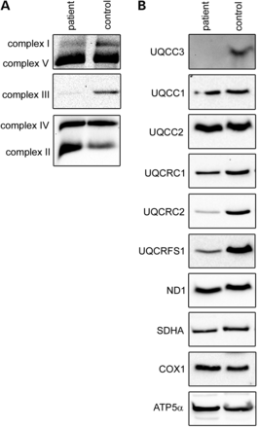
Figure 2. Protein levels of Oxphos complexes. (A) BN-PAGE analysis of patient and control fibroblasts. Complexes were ...
Notes:
Figure 2. Protein levels of Oxphos complexes. (A) BN-PAGE analysis of patient and control fibroblasts. Complexes were solubilized with lauryl maltoside and visualized using anti-NDUFB8 (complex I), SDHB (complex II), UQCRC1 and UQCRC2 (complex III), COX2 (complex IV) and ATP5a antibody for complex V. (B) SDS–PAGE analysis of patient and control fibroblasts. Used antibodies are indicated at the left.
Unless provided in the caption above, the following copyright applies to the content of this slide: © The Author 2014. Published by Oxford University Press. All rights reserved. For Permissions, please email: journals.permissions@oup.com

Slide 3
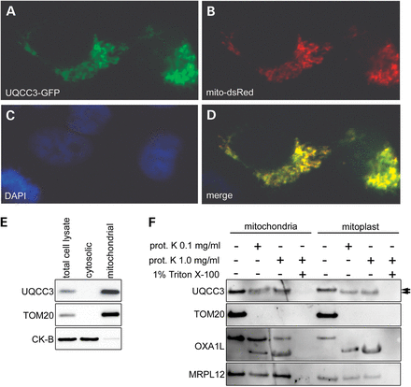
Figure 3. UQCC3 is a mitochondrial inter-membrane space-localized protein. HeLa cells were transfected with UQCC3-GFP ...
Notes:
Figure 3. UQCC3 is a mitochondrial inter-membrane space-localized protein. HeLa cells were transfected with UQCC3-GFP (A) and mito-dsRed (B) and analyzed with fluorescence microscopy. Nuclei are counterstained with DAPI (C). Merged image is shown in (D). (E) HEK293 cells were fractionated and subjected to SDS–PAGE followed by western blot analysis. Used antibodies are indicated at the left. UQCC3 is found in the mitochondrial enriched fraction like outer membrane-localized TOM20. Cytosolic creatine kinase b-type (CK-B) was used as control. (F) Proteinase K protection assay using mitochondria and mitochondria with digitonin permeabilized outer membranes (mitoplasts). Like the inter-membrane-localized part of OXA1L, UQCC3 is partially degraded after outer membrane permeabilization, becoming apparent from the small shift in size (indicated with the arrow heads). Only upon dissolving the inner membrane with Triton X-100, UQCC3 and OXA1L and the matrix protein MRPL12 have become susceptible for degradation. Outer membrane-localized TOM20 was used as control.
Unless provided in the caption above, the following copyright applies to the content of this slide: © The Author 2014. Published by Oxford University Press. All rights reserved. For Permissions, please email: journals.permissions@oup.com

Slide 4
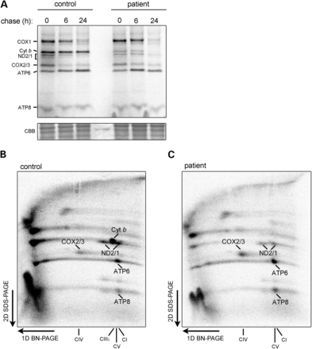
Figure 4. UQCC3 is necessary for cytochrome b stability and/or incorporation in complex III. (A) SDS–PAGE analysis of ...
Notes:
Figure 4. UQCC3 is necessary for cytochrome b stability and/or incorporation in complex III. (A) SDS–PAGE analysis of [35S]-methionine and [35S]-cysteine pulse chase-labeled mitochondrial-encoded proteins in control and patient fibroblasts. Patient cells have severely reduced levels of cytochrome b protein already after 0 h of chase compared with the control suggesting immediate compromised cytochrome b stability. Staining with Coomassie Brilliant Blue (CBB) was used to verify equal loading. Pulse-chase radiolabeling followed by 2D native PAGE analysis of control (B) and UQCC3 patient (C) fibroblasts after 6 h of chase. Compared with control cells, cytochrome b (indicated at the right, with arrow) is not detected in high-molecular-weight complexes in patient cells. Other OXPHOS-detected subunits ND1/2 (complex I), COX1, COX2/3 (complex IV) and complex V subunits ATP6 and ATP8 are indicated. Assignment of these subunits was based on their mobility in the first dimension and on the literature, e.g. (33).
Unless provided in the caption above, the following copyright applies to the content of this slide: © The Author 2014. Published by Oxford University Press. All rights reserved. For Permissions, please email: journals.permissions@oup.com

Slide 5
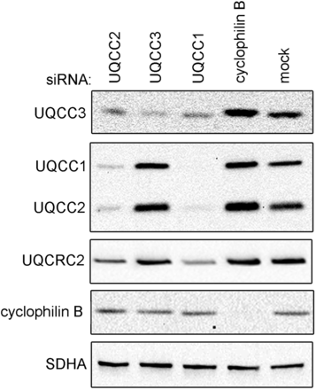
Figure 5. UQCC3 protein stability depends on the presence of complex III assembly chaperones UQCC1 and UQCC2. SDS–PAGE ...
Notes:
Figure 5. UQCC3 protein stability depends on the presence of complex III assembly chaperones UQCC1 and UQCC2. SDS–PAGE analysis of mitochondrial lysates from HEK293 cells transfected with siRNAs targeting UQCC2, UQCC3, UQCC1, cyclophilin-B and mock control. Incubation with specific antibodies revealed reduced levels of UQCC3 in cells depleted for UQCC1 and/or UQCC2 but not vice versa. Used antibodies are indicated at the left. SDHA was used as loading control.
Unless provided in the caption above, the following copyright applies to the content of this slide: © The Author 2014. Published by Oxford University Press. All rights reserved. For Permissions, please email: journals.permissions@oup.com

