Slide 1
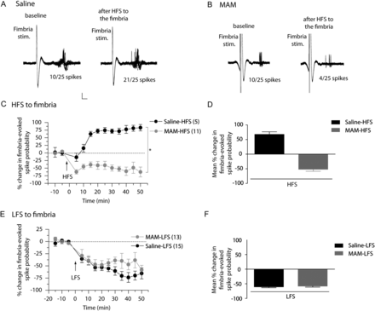
Figure 1. HFS, but not LFS of the fimbria has opposite effect on accumbens plasticity in saline- and MAM-treated ...
Notes:
Figure 1. HFS, but not LFS of the fimbria has opposite effect on accumbens plasticity in saline- and MAM-treated animals. (A and B) Representative example of extracellular recordings from NAc neuron activity evoked by fimbria stimulation before and after HFS to the fimbria in saline-treated animals (A) and MAM-treated animals (B). Twenty-five overlaid consecutive traces are shown with the numbers demonstrating the number of evoked spikes for 25 stimulations. Scale: 10 mV, 2 ms. (C) Mean percent change (±SEM) in fimbria-evoked spike probability, normalized to the baseline, after HFS to the fimbria in saline-treated (black circles) and MAM-treated (gray circles) animals (*P < 0.05; arrow indicates the time of stimulation). (D) Mean percent change in fimbria-evoked responses (±SEM) following HFS in saline-treated (black bar) and MAM-treated (gray bar) animals. (E) Mean percent change (±SEM) in fimbria-evoked spike probability, normalized to the baseline, after LFS to the fimbria in saline-treated (black circles) and MAM-treated (gray circles) animals (arrow indicates time of stimulation). (F) Mean percent change in fimbria-evoked responses (±SEM) following LFS in saline-treated (black bar) and MAM-treated (gray bar) animals.
Unless provided in the caption above, the following copyright applies to the content of this slide: © The Author 2012. Published by Oxford University Press. All rights reserved. For Permissions, please e-mail: journals.permissions@oup.com

Slide 2
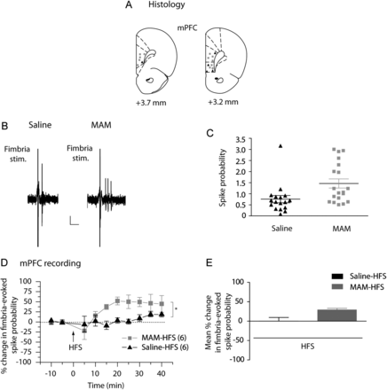
Figure 2. HFS of fimbria induces abnormal plasticity in the mPFC in MAM-treated animals. (A) Schematic showing the ...
Notes:
Figure 2. HFS of fimbria induces abnormal plasticity in the mPFC in MAM-treated animals. (A) Schematic showing the placements of recording electrodes in the mPFC for saline-treated (black triangles) and MAM-treated (gray squares) rats, shown as coronal sections of the rat brain, taken from Paxinos and Watson (Paxinos and Watson 1996). (B) Representative example of extracellular mPFC recordings showing the response of pyramidal neurons to single fimbria stimulation (1 mA) in saline-treated animals (left) and MAM-treated animals (right). Scale: 10 mV, 10 ms (C) Scatterplot showing the spike probability over 5min in saline- and MAM-treated rats (black triangles and gray squares, respectively) evoked by 1 mA stimulation. (D) Mean percent change (±SEM) in fimbria-evoked spike probability, normalized to baseline, following HFS to the fimbria in saline-treated (black triangles) and MAM-treated (gray squares) animals (*P < 0.05; arrow indicates time of stimulation). (E) Mean of the percent change in fimbria-evoked responses (±SEM) following HFS in saline-treated (black bar) and MAM-treated (gray bar) animals.
Unless provided in the caption above, the following copyright applies to the content of this slide: © The Author 2012. Published by Oxford University Press. All rights reserved. For Permissions, please e-mail: journals.permissions@oup.com

Slide 3
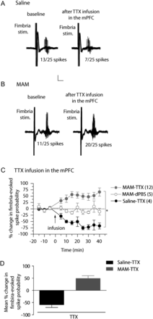
Figure 3. Inactivation of the mPFC has opposite effect in the NAc of saline- and MAM-treated animals. (A and B) ...
Notes:
Figure 3. Inactivation of the mPFC has opposite effect in the NAc of saline- and MAM-treated animals. (A and B) Representative example of extracellular recordings from accumbens neurons evoked by fimbria stimulation before and after infusion of tetrodotoxin (TTX) in the mPFC in saline-treated animals (A) and MAM-treated animals (B). Twenty-five overlaid consecutive traces are shown with the numbers demonstrating the number of evoked spikes for 25 stimulations. Scale: 10 mV, 5 ms. (C) Mean percent change (±SEM) of the fimbria-evoked spike probability, normalized to the baseline, after infusion of TTX (filled circle) or dPBS (open circles) into mPFC in saline-treated (black circles) and MAM-treated (gray circles) animals (*P < 0.05; arrow indicates the time of infusion). (D) Mean of the percent change in fimbria-evoked responses (±SEM) following infusion of TTX in saline-treated (black bar) and MAM-treated (gray bar) animals.
Unless provided in the caption above, the following copyright applies to the content of this slide: © The Author 2012. Published by Oxford University Press. All rights reserved. For Permissions, please e-mail: journals.permissions@oup.com

Slide 4
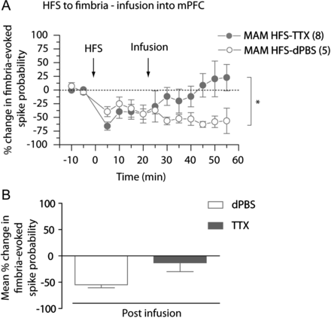
Figure 4. Abnormal accumbens plasticity following HFS to fimbria is reversed in MAM-treated animals by inactivating the ...
Notes:
Figure 4. Abnormal accumbens plasticity following HFS to fimbria is reversed in MAM-treated animals by inactivating the mPFC. (A) Mean percent change (±SEM) in fimbria-evoked spike probability, normalized to baseline, following tetanization of the fimbria and infusion of TTX (closed circles) or vehicle, dPBS (open circles) in the mPFC in MAM-treated animals (*P < 0.05; arrows indicate time of stimulation and infusion). (B) Mean of the percent change in fimbria-evoked responses (±SEM) following infusion of vehicle, dPBS (white bar), or TTX (gray bar) in MAM-treated animals.
Unless provided in the caption above, the following copyright applies to the content of this slide: © The Author 2012. Published by Oxford University Press. All rights reserved. For Permissions, please e-mail: journals.permissions@oup.com

Slide 5
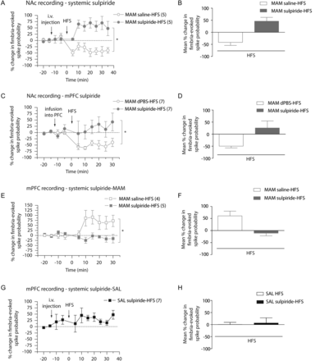
Figure 5. Administration of the D2 antagonist, sulpiride, reverses vSub–NAc LTD, and vSub–mPFC LTP in MAM-treated rats. ...
Notes:
Figure 5. Administration of the D2 antagonist, sulpiride, reverses vSub–NAc LTD, and vSub–mPFC LTP in MAM-treated rats. (A) Mean percent change (±SEM) in fimbria-evoked spike probability in NAc neurons, normalized to baseline, following i.v. injection of sulpiride (closed circles) or saline (open circles) and tetanization of the fimbria in MAM-treated animals (*P < 0.05; arrows indicate time of injection and stimulation). (B) Mean of the percent change in fimbria-evoked responses (±SEM) after HFS to fimbria following an injection of sulpiride (gray bar) or saline (white bar) in MAM-treated animals. (C) Mean percent change (±SEM) in fimbria-evoked spike probability in NAc neurons, normalized to baseline, following local infusion of sulpiride (closed circles) or dPBS (open circles) in the mPFC and tetanization of the fimbria in MAM-treated animals (*P < 0.05; arrows indicate time of infusion and stimulation). (D) Mean of the percent change in fimbria-evoked responses (±SEM) after HFS to fimbria following local infusion of sulpiride (gray bar) or dPBS (white bar) in mPFC in MAM-treated animals. (E) Mean percent change (±SEM) in fimbria-evoked spike probability in mPFC neurons, normalized to baseline, following i.v. injection of sulpiride (closed squares) or saline (open squares) and HFS to the fimbria in MAM-treated animals (*P < 0.05; arrows indicate time of injection and stimulation). (F) Mean of the percent change in fimbria-evoked responses (±SEM) following HFS of the fimbria after injection of sulpiride (gray bar) or saline (white bar) in MAM-treated animals. (G) Mean percent change (±SEM) in fimbria-evoked spike probability in mPFC neurons, normalized to baseline, following i.v. injection of sulpiride and HFS to the fimbria in Saline-treated animals SAL; arrows indicate time of injection and stimulation). (H) Mean of the percent change in fimbria-evoked responses in saline animals (±SEM) following HFS of the fimbria alone (white bar) or after injection of sulpiride (black bar).
Unless provided in the caption above, the following copyright applies to the content of this slide: © The Author 2012. Published by Oxford University Press. All rights reserved. For Permissions, please e-mail: journals.permissions@oup.com

Slide 6
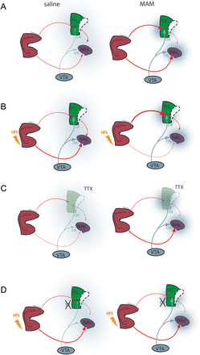
Figure 6. Schematic illustrating vSub–mPFC–NAc interactions in saline-and MAM-treated animals. (A) In saline rats, ...
Notes:
Figure 6. Schematic illustrating vSub–mPFC–NAc interactions in saline-and MAM-treated animals. (A) In saline rats, there is a balance between vSub and mPFC inputs to the NAC modulated by dopamine afferents from the VTA. In the MAM rats, there is a disruption of this balance due to hyperactivity in the vSub, leading to a hyperdopaminergic state and hypofunctional mPFC. (B) Tetanization of the fimbria increases the vSub–NAc pathway in saline animals (left) but induced a decrease in vSub–NAc drive and a hyperactive vSub–mPFC pathway in MAM rats (right). (C) Inactivation of the mPFC reduces the vSub drive of NAc neurons in saline rats (left) whereas in MAM rats, it increases the drive, demonstrating pathological phasic antagonistic action of the vSub and the mPFC on NAc neurons in our model. (D) Infusion of antipsychotic drug has no effect on the vSub–NAc HFS-induced synaptic plasticity in saline rats (Belujon and Grace 2008) (left) but normalizes the vSub–NAc and vSub–mPFC pathological synaptic plasticity in MAM rats (right). vSub, ventral subiculum of the hippocampus; PL, prelimbic area of the mPFC; IL, infralimbic area of the mPFC; NAc, nucleus accumbens; VTA, ventral tegmental area; DA, dopamine; TTX, tetrodotoxin; HFS, high-frequency stimulation.
Unless provided in the caption above, the following copyright applies to the content of this slide: © The Author 2012. Published by Oxford University Press. All rights reserved. For Permissions, please e-mail: journals.permissions@oup.com

