Slide 1
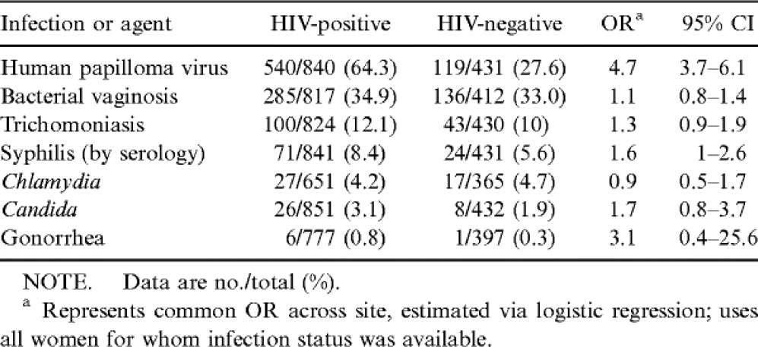
Table 2 Proportions of women in a study of HIV and lower genital tract infections reporting each infection, by HIV ...
Notes:
Table 2 Proportions of women in a study of HIV and lower genital tract infections reporting each infection, by HIV status.
Unless provided in the caption above, the following copyright applies to the content of this slide: © 1999 by the Infectious Diseases Society of America

Slide 2
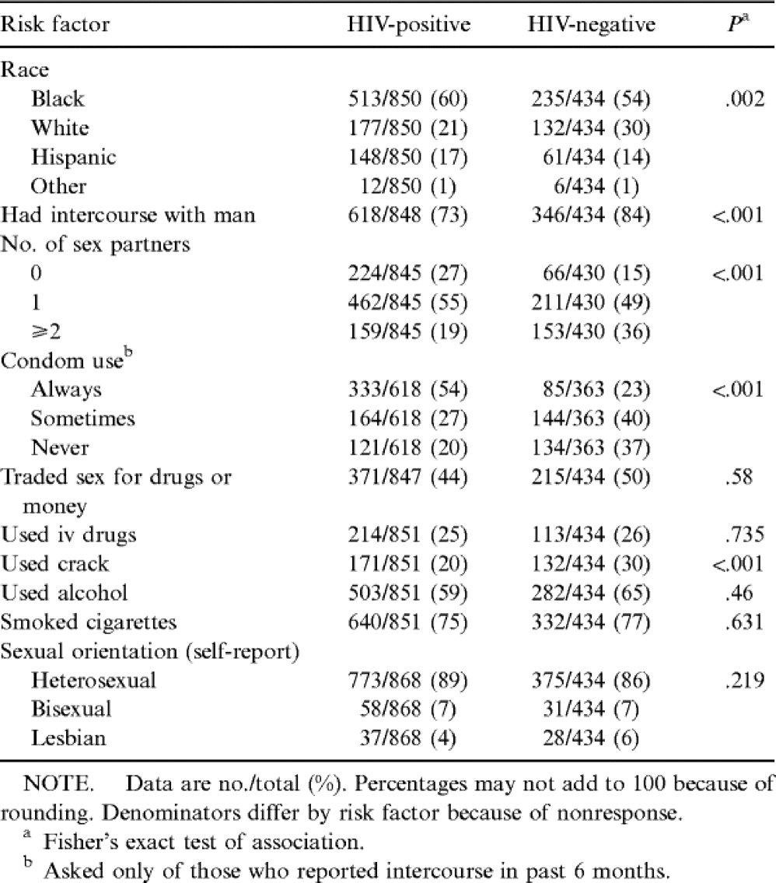
Table 1 Distribution of race and self-reported risk factors (in previous 6 months) by HIV status in study of lower ...
Notes:
Table 1 Distribution of race and self-reported risk factors (in previous 6 months) by HIV status in study of lower genital tract infections.
Unless provided in the caption above, the following copyright applies to the content of this slide: © 1999 by the Infectious Diseases Society of America

Slide 3
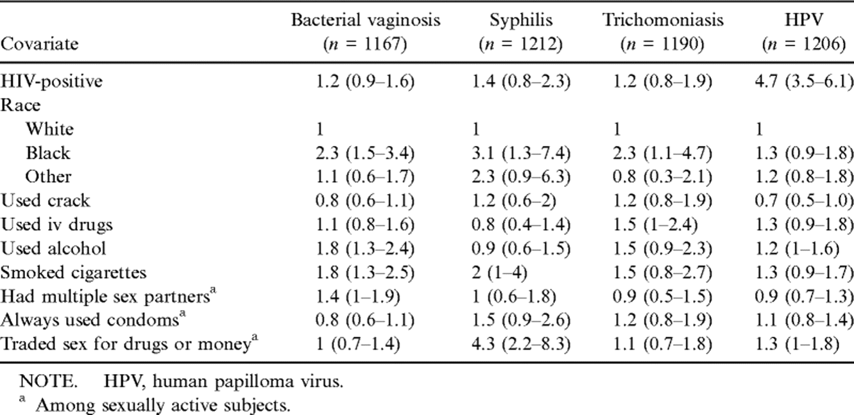
Table 3 Conditional ORs and 95% CIs estimated via logistic regression, using only subjects with complete covariate ...
Notes:
Table 3 Conditional ORs and 95% CIs estimated via logistic regression, using only subjects with complete covariate data, in a study of HIV infection and lower genital tract infection.
Unless provided in the caption above, the following copyright applies to the content of this slide: © 1999 by the Infectious Diseases Society of America

