Slide 1
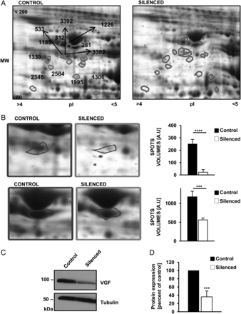
Figure 1. VGF expression in SH-SY5Y cells. (A) 2D gel areas containing most spots corresponding to VGF in ...
Notes:
Figure 1. VGF expression in SH-SY5Y cells. (A) 2D gel areas containing most spots corresponding to VGF in representative DISC1 silenced (right) and control (left) 2D-PAGE gels. (B) Volumetric quantification of two representative spots, spot 3382, with a fold-negative change of 11.52, P < 0.0001, and spot 281, with a fold change of 2.09, P < 0.001. (C) VGF western blot analysis of control and silenced cells. (D) Quantification of data presented in C (n = 6 independent experiments). Total protein was normalized to tubulin. Error bars represent SD. Statistical analysis was carried out by the (paired) two-tailed Student's t-test. ***P < 0.001, ****P < 0.001.
Unless provided in the caption above, the following copyright applies to the content of this slide: © The Author 2014. Published by Oxford University Press. All rights reserved. For Permissions, please email: journals.permissions@oup.com

Slide 2
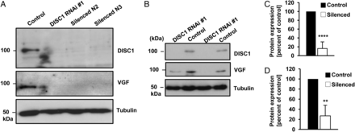
Figure 2. DISC1 and VGF expression in primary neuron cell cultures. (A) DISC1 and VGF expression in neuron cells ...
Notes:
Figure 2. DISC1 and VGF expression in primary neuron cell cultures. (A) DISC1 and VGF expression in neuron cells infected with three different shRNA constructs to knock-down DISC1. A non-target shRNA was used as control. (B) Expression of DISC1and VGF in cells infected with lentiviral particles containing the construct ‘DISC1 RNAi #1’. (C) Quantification of DISC1 knockdown shown in (B). (D) Quantification of VGF expression shown in B. (C, D): n = 8 independent experiments. Error bars represent SD. Statistical analysis was carried out by the (paired) two-tailed Student's t-test. Data were normalized to tubulin. **P < 0.01, ****P < 0.0001.
Unless provided in the caption above, the following copyright applies to the content of this slide: © The Author 2014. Published by Oxford University Press. All rights reserved. For Permissions, please email: journals.permissions@oup.com

Slide 3
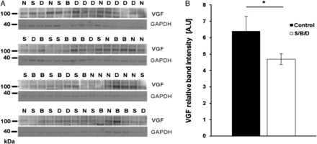
Figure 3. Expression of VGF in brains of patients with mental disease. (A) Western blot analysis of the SMRI samples ...
Notes:
Figure 3. Expression of VGF in brains of patients with mental disease. (A) Western blot analysis of the SMRI samples [normal controls (N), patients with bipolar disorder (B), major depression (D) and schizophrenia (S)] (B) Densitometric analysis of the normalized VGF signal of SMRI collection brains. VGF signal intensity is decreased in patients with psychiatric illnesses (n = 44) compared with normal controls (n = 15); error bars represent SEM. Statistical analysis was carried out by using unpaired one-tailed Mann–Whitney U-test; P = 0.031) (B: bipolar disorder/D: major depression/ S: schizophrenic patients)
Unless provided in the caption above, the following copyright applies to the content of this slide: © The Author 2014. Published by Oxford University Press. All rights reserved. For Permissions, please email: journals.permissions@oup.com

Slide 4
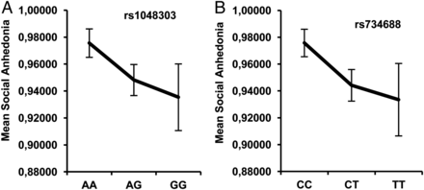
Figure 4. Average performance on the social anhedonia scale for: (A) each genotype of SNP rs1048303; (B) each genotype ...
Notes:
Figure 4. Average performance on the social anhedonia scale for: (A) each genotype of SNP rs1048303; (B) each genotype of SNP rs734688. Graphs show the mean scores for the logarithmically transformed scales of the Revised Social Anhedonia Scale. 95% Confidence intervals are shown.
Unless provided in the caption above, the following copyright applies to the content of this slide: © The Author 2014. Published by Oxford University Press. All rights reserved. For Permissions, please email: journals.permissions@oup.com

