Slide 1
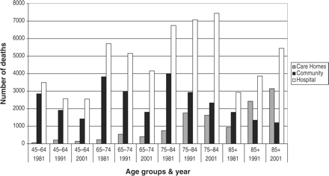
Figure 2. Deaths in various age groups, by year and location.
Notes:
Figure 2. Deaths in various age groups, by year and location.
Unless provided in the caption above, the following copyright applies to the content of this slide: © The Author 2005. Published by Oxford University Press on behalf of the Association of Physicians. All rights reserved. For Permissions, please email: journals.permissions@oxfordjournals.org

Slide 2
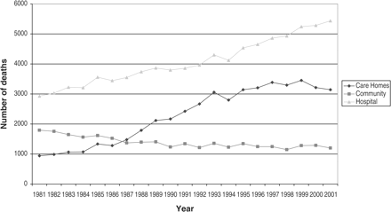
Figure 1. Deaths in those aged 85+ years, by location.
Notes:
Figure 1. Deaths in those aged 85+ years, by location.
Unless provided in the caption above, the following copyright applies to the content of this slide: © The Author 2005. Published by Oxford University Press on behalf of the Association of Physicians. All rights reserved. For Permissions, please email: journals.permissions@oxfordjournals.org

