Slide 1
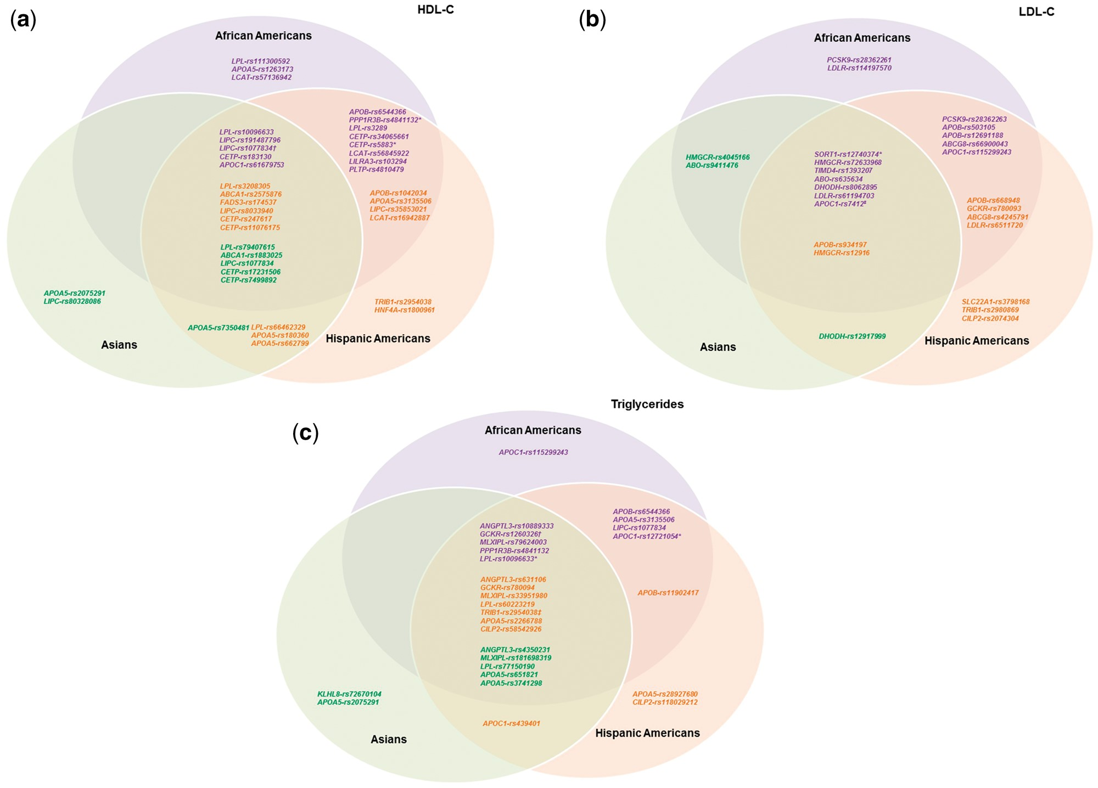
Figure 1 Overlap of HDL-C, LDL-C, and triglyceride signals among different races/ethnicities. Venn diagrams ...
Notes:
Figure 1 Overlap of HDL-C, LDL-C, and triglyceride signals among different races/ethnicities. Venn diagrams illustrating the overlap of signals associated with (A) HDL-C, (B) LDL-C, and (C) triglycerides among different races/ethnicities. Purple SNPs are lead independent signals in African Americans (P < 1 × 10−6); orange SNPs are lead independent signals in Hispanic Americans (P < 1 × 10−6); green SNPs are lead independent signals in Asians (P < 1 × 10−6). A lead independent signal with evidence of association in other races/ethnicities (consistent direction of effect and P < 0.05) was shown in the intersections of the Venn diagram. Some SNPs were lead independent signals for multiple races/ethnicities as indicated by the following: *lead independent signal in AA and HA; †lead independent signal in AA and AS; ‡lead independent signal in HA and AS; #lead independent signal in AA, HA, and AS.
Unless provided in the caption above, the following copyright applies to the content of this slide: © The Author 2016. Published by Oxford University Press. All rights reserved. For Permissions, please email: journals.permissions@oup.com

Slide 2
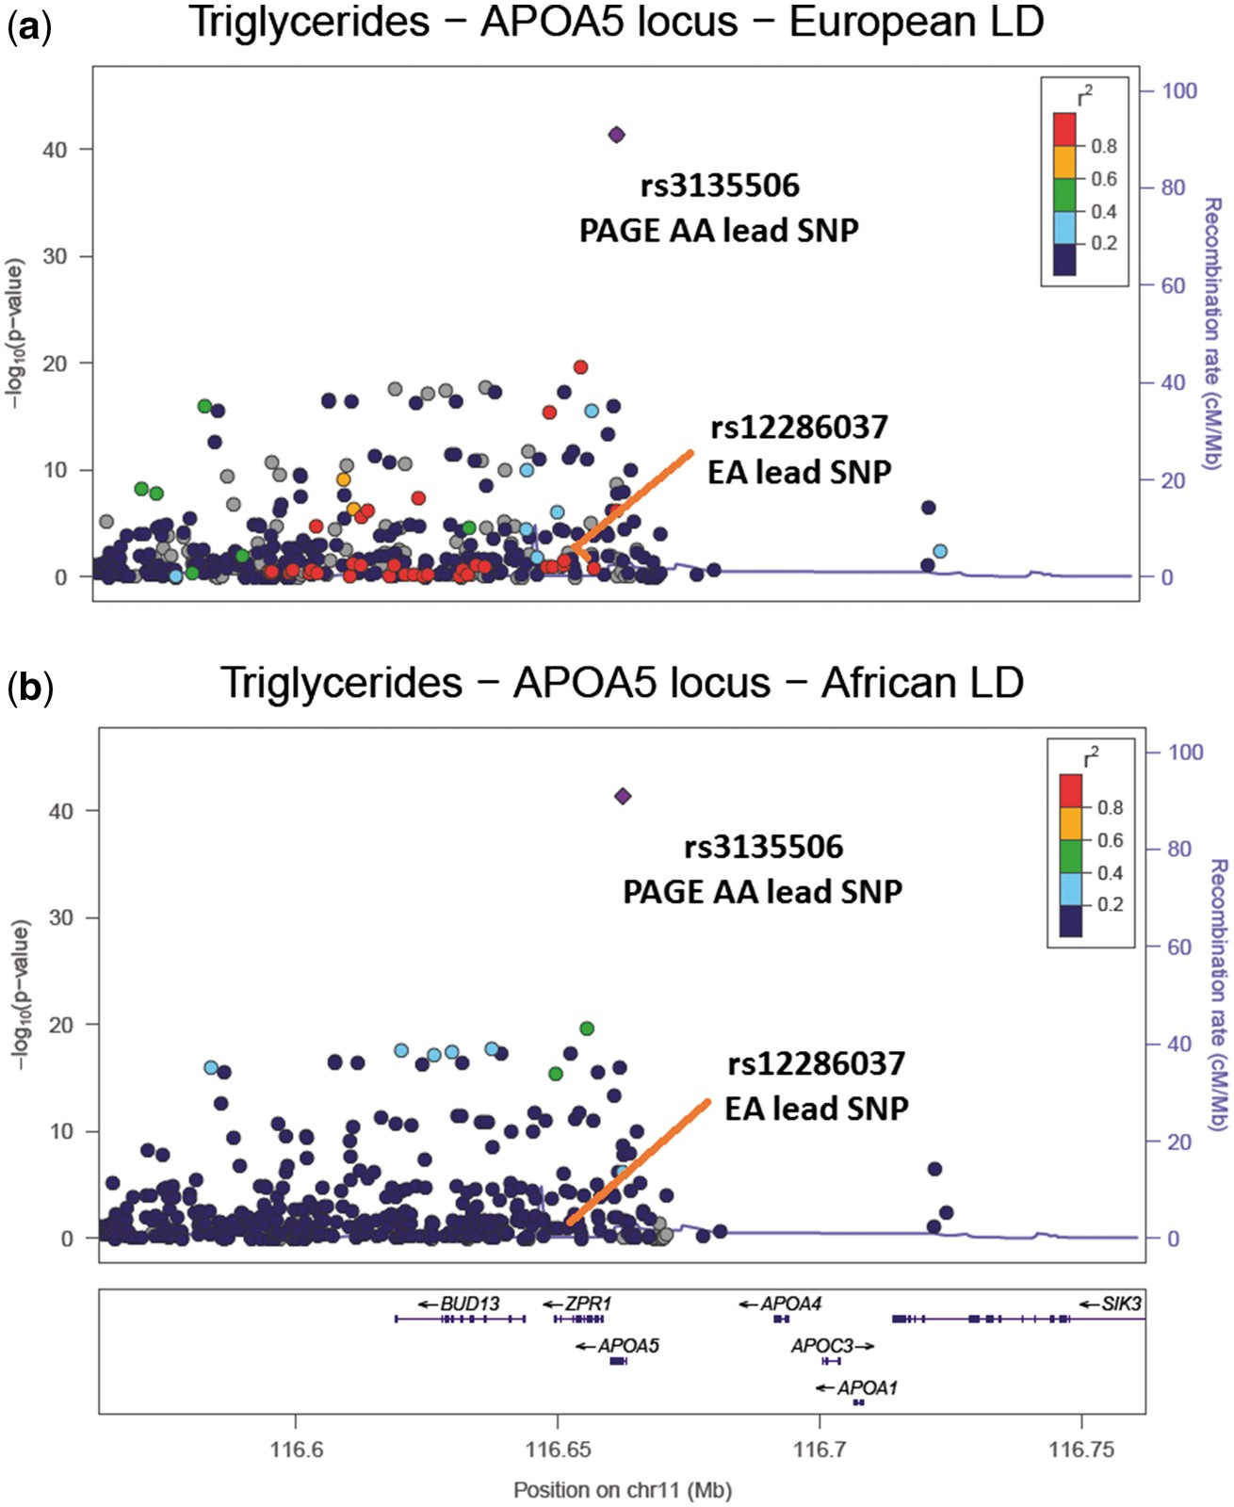
Figure 2 LocusZoom plots of the APOA5 region associated with triglycerides. (A) The PAGE African American (AA) results ...
Notes:
Figure 2 LocusZoom plots of the APOA5 region associated with triglycerides. (A) The PAGE African American (AA) results coloured with European ancestry (EA) LD structure, supplied by 1000 Genomes EUR LD. The EA lead SNP is in high LD (r2 > 0.8) with the PAGE AA lead SNP and there are 37 other SNPs in high LD with the PAGE AA lead SNP (r2 > 0.8); (B) The PAGE AA results coloured with PAGE AA LD structure. The EA lead SNP is now in low LD with the PAGE AA lead SNP (r2 < 0.2) and there are no SNPs in high LD with the PAGE AA lead SNP (r2 > 0.8). Refinement of previously identified lipid association signals using African Americans LocusEA lead SNPaEA A1/ A2CAF of EA lead SNP (EA/AA)AA lead SNPbAA A1/ A2CAF of AA lead SNP (EA/AA)LDEA (r2)c#SNPs in LDEA with AA leaddLDAA (r2)e#SNPs in LDAA with AA leadf% reduction of SNPs in LDgHDL-CPPP1R3Brs9987289A/G0.04/0.18rs4841132A/G0.04/0.121.0040.58325.00LPLrs12678919A/G0.88/0.89rs10096633A/G0.15/0.410.78750.09297.33LIPCrs2043085A/G0.39/0.71rs191487796C/G0.67/0.640.8490.400100.00CETPrs3764261A/G0.32/0.32rs247616A/G0.32/0.261.0090.74455.56LCATrs16942887A/G0.11/0.20rs56845922A/G0.90/0.790.941390.882582.01LILRA3rs386000A/G0.82/0.82rs103294A/G0.17/0.090.84180.21383.33PLTPrs6065906A/G0.81/0.84rs4810479A/G0.72/0.600.6240.260100.00LDL-CABOrs495828A/C0.21/0.14rs635634A/G0.19/0.110.9570.75528.57LDLRrs6511720A/C0.09/0.14rs61194703A/T0.09/0.211.00130.50192.31SORT1rs646776A/G0.70/0.65rs12740374A/C0.31/0.251.0080.61625.00TGANGPTL3rs2131925A/C0.31/0.35rs10889333A/G0.31/0.350.931180.252777.12APOA5rs12286037A/G0.07/0.19rs3135506C/G0.06/0.940.79460.040100.00GCKRrs1260326A/G0.39/0.15rs1260326A/G0.39/0.151.0061.00516.67LPLrs12678919A/G0.88/0.89rs10096633A/G0.15/0.410.78750.09297.33MLXIPLrs17145738A/G0.12/0.09rs79624003A/G0.88/0.930.95460.741176.09PPP1R3Brs9987289A/G0.08/0.18rs4841132A/G0.08/0.121.0040.58325.00EA: European ancestry, AA: African American, HA: Hispanic American, AS: Asian, AI: American Indian, A1: coded allele, A2: non-coded allele, CAF: coded allele frequency, β: beta estimate, HDL-C: high density lipoprotein cholesterol, LDL-C: low density lipoprotein cholesterol, TG: triglycerides. aLead SNP in GLGC for specified region; *when EA lead was not present in MetaboChip, a proxy for this SNP (LD >0.80 in 1000 Genomes CEU LD structure) was used. bLead SNP in our AA population for specified region. cLinkage disequilibrium (LD) between EA lead and AA lead using 1000 Genomes CEU LD structure; NA if AA lead is monomorphic in EA. dUsing data from AA in PAGE and 1000 Genomes CEU LD structure, the number of SNPs in high LD (r2 > 0.6) with AA lead SNP; NA if AA lead is monomorphic in EA. eLinkage disequilibrium (LD) between EA lead and AA lead using PAGE AA LD structure. fUsing data from AA in PAGE and PAGE AA LD structure, the number of MetaboChip SNPs in high LD (r2 > 0.6) with AA lead SNP. gThe percentage reduction in the number of SNPs in high LD (r2>0.6) with AA lead SNP, when using 1000 Genomes CEU LD structure vs. PAGE AA LD structure (in data from AA in PAGE); NA if AA lead is monomorphic in EA.
Unless provided in the caption above, the following copyright applies to the content of this slide: © The Author 2016. Published by Oxford University Press. All rights reserved. For Permissions, please email: journals.permissions@oup.com

