Slide 1
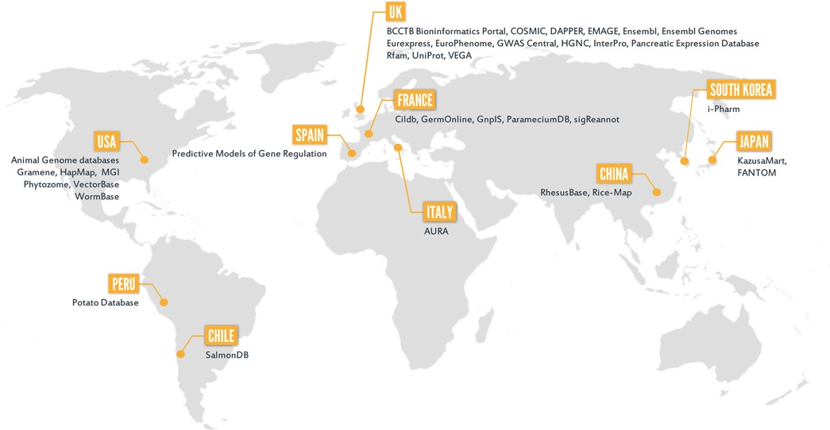
Figure 1. BioMart community databases and their host countries.
Notes:
Figure 1. BioMart community databases and their host countries.
Unless provided in the caption above, the following copyright applies to the content of this slide: © The Author(s) 2015. Published by Oxford University Press on behalf of Nucleic Acids Research.This is an Open Access article distributed under the terms of the Creative Commons Attribution License (http://creativecommons.org/licenses/by/4.0/), which permits unrestricted reuse, distribution, and reproduction in any medium, provided the original work is properly cited.

Slide 2
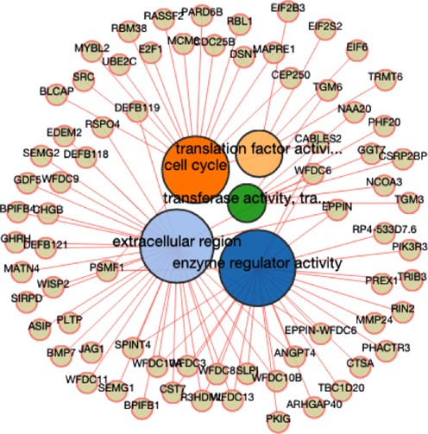
Figure 2. The network graphic output of the BioMart enrichment tool. The Gene Ontology (GO) enrichment analysis was ...
Notes:
Figure 2. The network graphic output of the BioMart enrichment tool. The Gene Ontology (GO) enrichment analysis was performed using BED file containing human data. This tool is also accessible through web services (Java version only). The programmatic access complies with a standard BioMart interface: dataset, filter and attribute.
Unless provided in the caption above, the following copyright applies to the content of this slide: © The Author(s) 2015. Published by Oxford University Press on behalf of Nucleic Acids Research.This is an Open Access article distributed under the terms of the Creative Commons Attribution License (http://creativecommons.org/licenses/by/4.0/), which permits unrestricted reuse, distribution, and reproduction in any medium, provided the original work is properly cited.

Slide 3
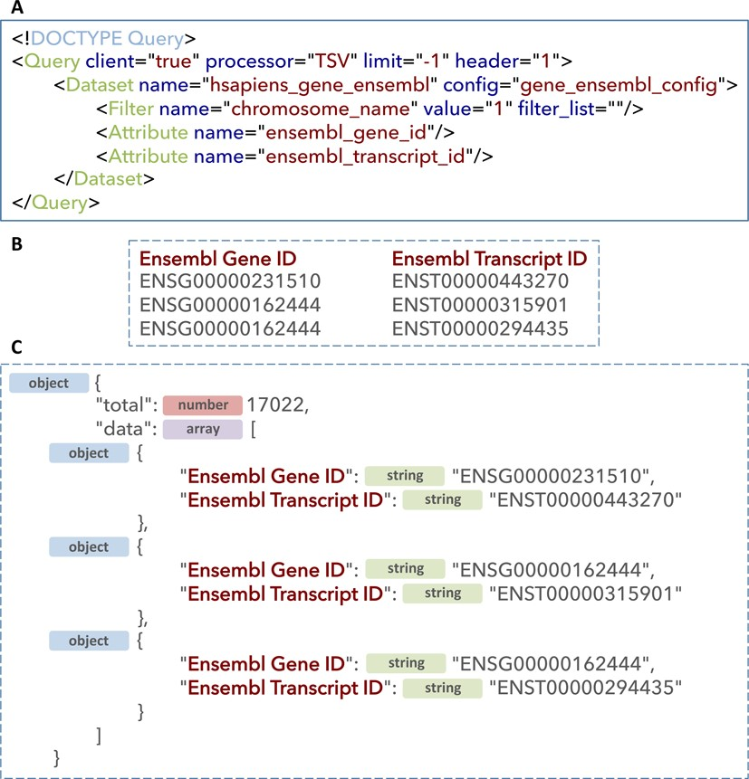
Figure 3. The XML web service query (A) and the corresponding two types of output: tab delimited following setting a ...
Notes:
Figure 3. The XML web service query (A) and the corresponding two types of output: tab delimited following setting a processor to ‘TSV’ (B) and JSON following setting processor to ‘JSON’.
Unless provided in the caption above, the following copyright applies to the content of this slide: © The Author(s) 2015. Published by Oxford University Press on behalf of Nucleic Acids Research.This is an Open Access article distributed under the terms of the Creative Commons Attribution License (http://creativecommons.org/licenses/by/4.0/), which permits unrestricted reuse, distribution, and reproduction in any medium, provided the original work is properly cited.

