Slide 1
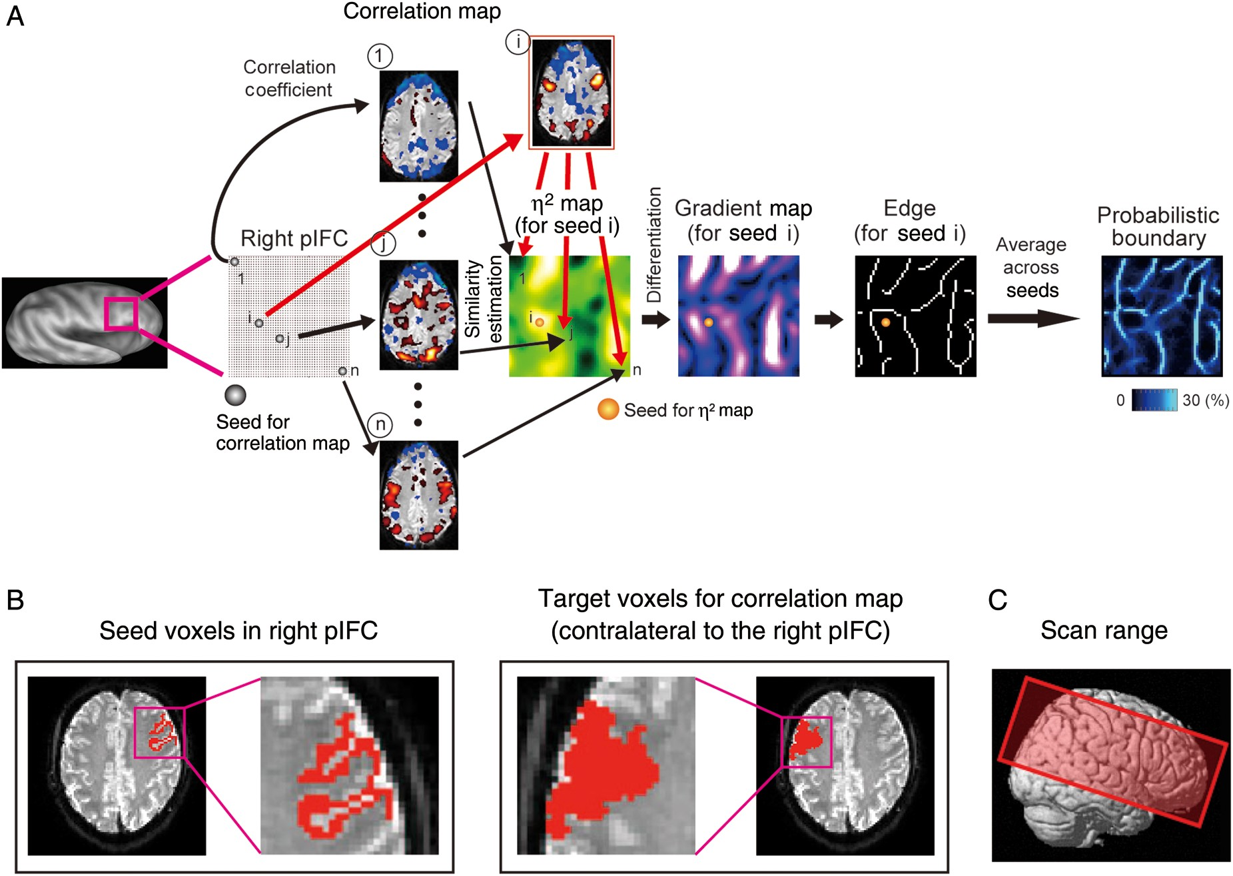
Figure 1. (A) A flow chart of the Boundary Mapping method. Pixels 1, i, j and n indicate the seed for the correlation ...
Notes:
Figure 1. (A) A flow chart of the Boundary Mapping method. Pixels 1, i, j and n indicate the seed for the correlation maps, and the pixel i was further used as the seed for η2 map in this case. (B) Seed voxels placed in the right pIFC (left panel) and target voxels of correlation calculation in the left pIFC (right panel). (C) Range of slice coverage of the MRI scans. The center of the range was placed in the IFC.
Unless provided in the caption above, the following copyright applies to the content of this slide: © The Author 2012. Published by Oxford University Press. All rights reserved. For Permissions, please e-mail: journals.permissions@oup.com

Slide 2
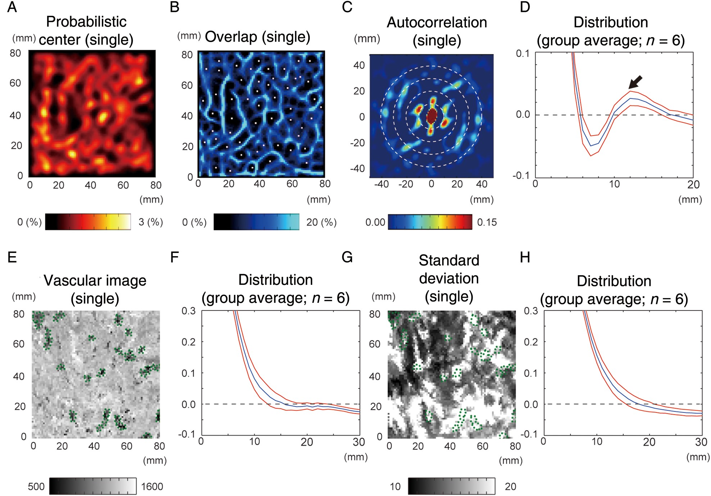
Figure 2. Estimation of distance between adjacent probabilistic centers. (A) A probabilistic center map of a single ...
Notes:
Figure 2. Estimation of distance between adjacent probabilistic centers. (A) A probabilistic center map of a single subject (case 5). (B) A probabilistic boundary map of the same subject. White dots indicate the local maxima of the probabilistic center map. (C) Autocorrelogram of the probabilistic center map in the same subject. White dotted circles indicate 10, 20, 30, or 40 mm radius. (D) Average of the magnitude of autocorrelation of all 6 subjects after averaging across the same radius of the autocorrelogram. Red curves indicate standard error of means. A black arrow indicates a local peak (∼12 mm). (E) Vascular images of the same region of interest in one subject (case 1). Imaged veins were indicated by green dots. (F) Average of the magnitude of autocorrelation of all 6 subjects after averaging across the same radius of the autocorrelogram. The format is similar to D. (G) Standard deviation images of the fMRI data in the same subject (case 1). Green dots that indicate the veins in E were superimposed. (H) Average of the magnitude of autocorrelation of all 6 subjects after averaging across the same radius of the autocorrelogram. The format is similar to D.
Unless provided in the caption above, the following copyright applies to the content of this slide: © The Author 2012. Published by Oxford University Press. All rights reserved. For Permissions, please e-mail: journals.permissions@oup.com

Slide 3
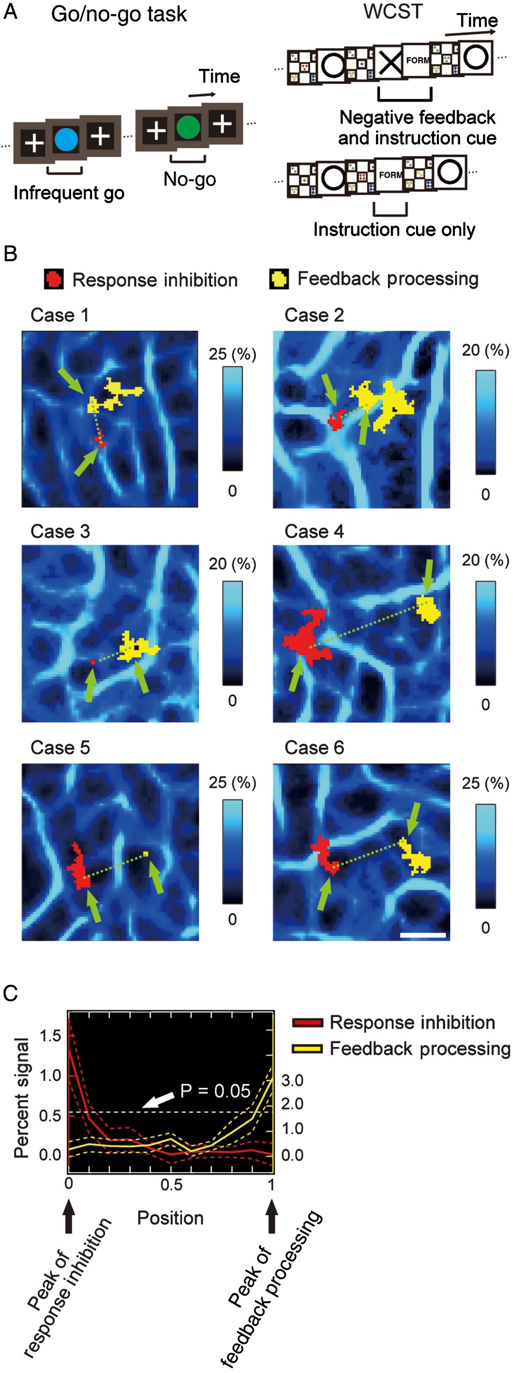
Figure 3. (A) The go/no-go task and the modified WCST. (B) Two activations associated with RI and FP overlaid on to the ...
Notes:
Figure 3. (A) The go/no-go task and the modified WCST. (B) Two activations associated with RI and FP overlaid on to the probabilistic boundary maps in all 6 subjects. Green arrows indicate the peak of the activations. A white scale bar indicates 1 cm. (C) The profile of the percent signal of activation from the RI peak to the FP peak. The distance was normalized to average across subjects. The dashed horizontal line indicates the percent signal that commonly corresponds to the significance level t = 2 (P = 0.05) at both of the peak voxels. Note that the left ordinate indicates the percent signal for RI, whereas the right ordinate indicates the percent signal for FP. The dashed curves in red and yellow indicate standard error of means.
Unless provided in the caption above, the following copyright applies to the content of this slide: © The Author 2012. Published by Oxford University Press. All rights reserved. For Permissions, please e-mail: journals.permissions@oup.com

Slide 4
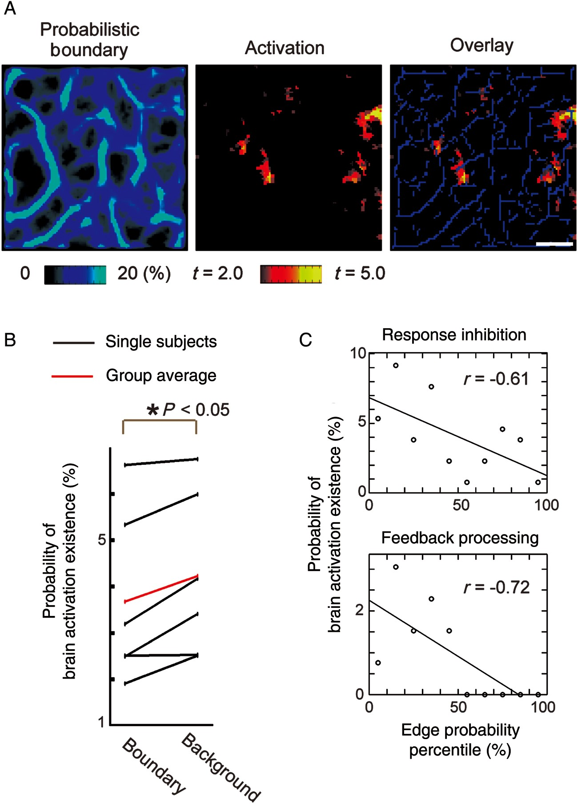
Figure 4. (A) The probabilistic boundaries and the brain activations from a single subject (case 5), and their overlay ...
Notes:
Figure 4. (A) The probabilistic boundaries and the brain activations from a single subject (case 5), and their overlay map. A white scale bar indicates 1 cm. Blue lines in the right panel indicate Boundary pixels. (B) The probability of brain activation existence in Boundary/Background pixels from 6 subjects. (C) Anticorrelation in the Boundary pixels between probability of activation and edge probability percentile in one subject.
Unless provided in the caption above, the following copyright applies to the content of this slide: © The Author 2012. Published by Oxford University Press. All rights reserved. For Permissions, please e-mail: journals.permissions@oup.com

