Slide 1
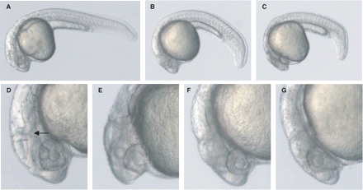
Fig. 1 Morphological alterations in FKRP morphant embryos. Embryos injected with Control MO (A) and FKRP MO (B and ...
Notes:
Fig. 1 Morphological alterations in FKRP morphant embryos. Embryos injected with Control MO (A) and FKRP MO (B and C) at 24 hpf. FKRP morphant embryos of increasing degrees of phenotypic severity (B and C). Morphological alterations in eye and developing neuronal structures in FKRP morphant embryos at 25 hpf. Control MO (D). FKRP morphant embryos of increasing degrees of severity (E–G). FKRP morphant embryos show defects in the midbrain-hindbrain boundary (arrow) and alterations in eye size and morphology.
Unless provided in the caption above, the following copyright applies to the content of this slide: © The Author (2008). Published by Oxford University Press on behalf of the Guarantors of Brain. All rights reserved. For Permissions, please email: journals.permissions@oxfordjournals.org

Slide 2
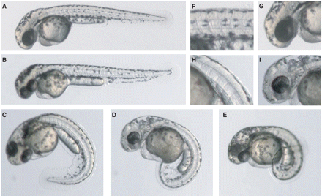
Fig. 2 Morphological alterations in FKRP morphant embryos at 48 hpf. Embryos injected with Control MO (A, F and G) ...
Notes:
Fig. 2 Morphological alterations in FKRP morphant embryos at 48 hpf. Embryos injected with Control MO (A, F and G) and the range of phenotypic severity observed with FKRP MO (B–E, H and I). Alterations in somitic (H), eye and neuronal structures (I) develop in FKRP morphant embryos but not in control (F and G).
Unless provided in the caption above, the following copyright applies to the content of this slide: © The Author (2008). Published by Oxford University Press on behalf of the Guarantors of Brain. All rights reserved. For Permissions, please email: journals.permissions@oxfordjournals.org

Slide 3
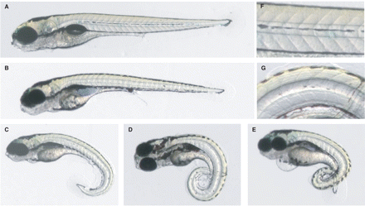
Fig. 3 Morphological alterations in FKRP morphant larvae at 5 dpf. Larvae injected with Control MO (A and F) and the ...
Notes:
Fig. 3 Morphological alterations in FKRP morphant larvae at 5 dpf. Larvae injected with Control MO (A and F) and the range of phenotypic severity observed with FKRP MO (B–E and G). Alterations in somitic structure (G) in FKRP morphant larvae compared to somitic structure in control (F).
Unless provided in the caption above, the following copyright applies to the content of this slide: © The Author (2008). Published by Oxford University Press on behalf of the Guarantors of Brain. All rights reserved. For Permissions, please email: journals.permissions@oxfordjournals.org

Slide 4
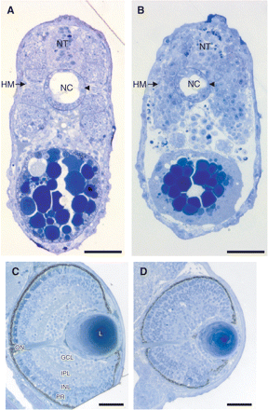
Fig. 4 Histological analysis of control and FKRP morphant embryos. (A and B) Toluidine blue-stained transverse ...
Notes:
Fig. 4 Histological analysis of control and FKRP morphant embryos. (A and B) Toluidine blue-stained transverse sections of proximal regions of the trunk showing cellular morphology in Control MO (A) and FKRP morphant embryos (B) at 24 hpf. The structures of the neural tube (NT), notochord (NC) and horizontal myoseptum (HM) are clearly defined in control embryos. FKRP morphant embryos have disorganized muscle fibres, lack the horizontal myoseptum (arrow) and have a disrupted notochord (arrowhead). (C and D) Toluidine blue-stained transverse sections showing eye morphology in FKRP morphant (D) and control embryos (C) at 3 dpf. FKRP morphants have disrupted layering of the retina. L = lens; ON = optic nerve; GCL = ganglion cell layer; IPL = inner plexiform layer; INL = inner nuclear cell layer; PR = photoreceptor cell layer. Scale bars = 50 μm.
Unless provided in the caption above, the following copyright applies to the content of this slide: © The Author (2008). Published by Oxford University Press on behalf of the Guarantors of Brain. All rights reserved. For Permissions, please email: journals.permissions@oxfordjournals.org

Slide 5
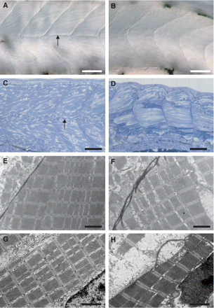
Fig. 5 Analysis of somitic structure and muscle morphology in control and FKRP morphant embryos. (A and B) ...
Notes:
Fig. 5 Analysis of somitic structure and muscle morphology in control and FKRP morphant embryos. (A and B) Differential interference contrast (DIC) images of proximal regions of the trunk at 48 hpf. FKRP morphant embryos (B) show alterations in somite shape and a loss of the horizontal myoseptum (arrow in A) in comparison to control (A). (C and D) Toluidine blue-stained parasagittal sections of proximal regions of the trunk in FKRP morphant (D) and control (C) embryos at 3 dpf. FKRP morphant embryos have an altered somitic structure with disorganized muscle fibres and lack the horizontal myoseptum (arrow in C). (E–H) Electron micrographs of parasagittal sections through muscle fibres at 3 dpf. FKRP morphants have disrupted vertical myosepta (F) and basement membranes (H) in comparison to control embryos (E and G). Scale bars = 50 μm (A–D), 2 μm (E–H).
Unless provided in the caption above, the following copyright applies to the content of this slide: © The Author (2008). Published by Oxford University Press on behalf of the Guarantors of Brain. All rights reserved. For Permissions, please email: journals.permissions@oxfordjournals.org

Slide 6
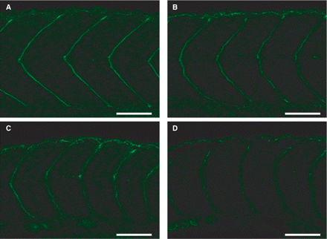
Fig. 6 Altered somitic structure and decreased immunoreactivity to glycosylated -dystroglycan in FKRP morphant ...
Notes:
Fig. 6 Altered somitic structure and decreased immunoreactivity to glycosylated -dystroglycan in FKRP morphant embryos at 24 hpf. Anti-glycosylated -dystroglycan antibody IIH6 reactivity in Control MO (A) and FKRP morphant embryos of mild (B), moderate (C) and severe (D) phenotypes. Increased phenotypic severity and disruption in somite structure correlates with decreased IIH6 immunoreactivity in FKRP morphant embryos. Scale bars = 50 μm.
Unless provided in the caption above, the following copyright applies to the content of this slide: © The Author (2008). Published by Oxford University Press on behalf of the Guarantors of Brain. All rights reserved. For Permissions, please email: journals.permissions@oxfordjournals.org

Slide 7
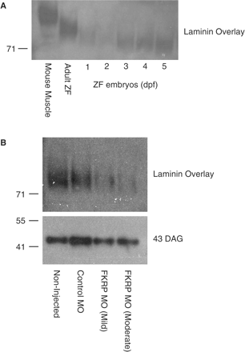
Fig. 7 Characterization of laminin binding to α-dystroglycan purified from developing zebrafish and FKRP morphant ...
Notes:
Fig. 7 Characterization of laminin binding to α-dystroglycan purified from developing zebrafish and FKRP morphant embryos. (A) Increased laminin binding to species of α-dystroglycan purified from developing zebrafish embryos between 1 and 5 dpf, which show different binding profiles to α-dystroglycan from adult zebrafish and adult mouse muscle although all species of α-dystroglycan are capable of laminin binding. (B) Decreased laminin binding to α-dystroglycan purified from FKRP morphant embryos of mild and moderate severity compared to control and non-injected embryos at 3 dpf. Anti-β-dystroglycan (43 DAG) reactivity demonstrates protein loading.
Unless provided in the caption above, the following copyright applies to the content of this slide: © The Author (2008). Published by Oxford University Press on behalf of the Guarantors of Brain. All rights reserved. For Permissions, please email: journals.permissions@oxfordjournals.org

