Slide 1
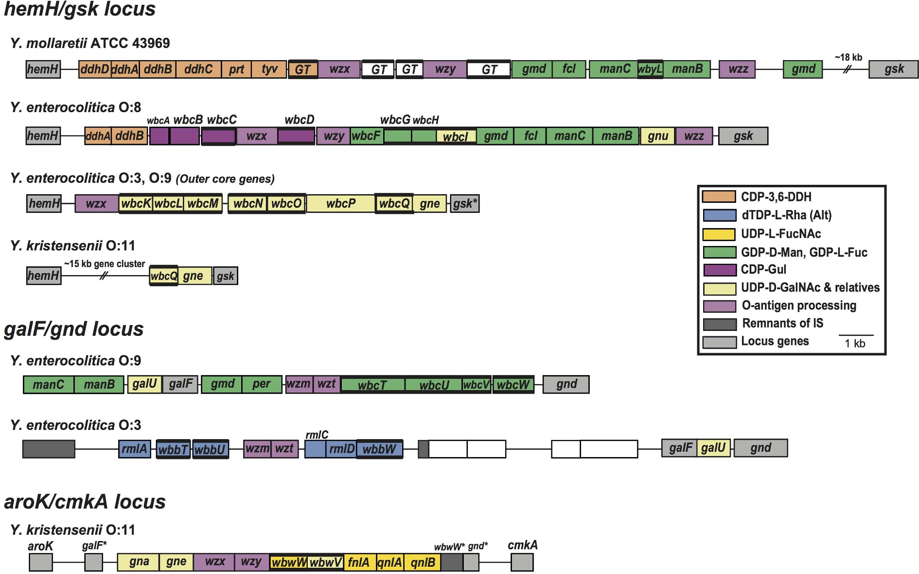
Figure 1. O-antigen gene clusters of Yersinia spp. outside of Y. pseudotuberculosis. Genes are coloured according to ...
Notes:
Figure 1. O-antigen gene clusters of Yersinia spp. outside of Y. pseudotuberculosis. Genes are coloured according to the respective pathways of their products, and the scheme is shown on the right. Figure is drawn to scale and the scale is shown below. Bold lines bordering genes indicate that the gene encodes a GT.
Unless provided in the caption above, the following copyright applies to the content of this slide: © FEMS 2017.This is an Open Access article distributed under the terms of the Creative Commons Attribution Non-Commercial License (http://creativecommons.org/licenses/by-nc/4.0/), which permits non-commercial re-use, distribution, and reproduction in any medium, provided the original work is properly cited. For commercial re-use, please contact journals.permissions@oup.com

Slide 2
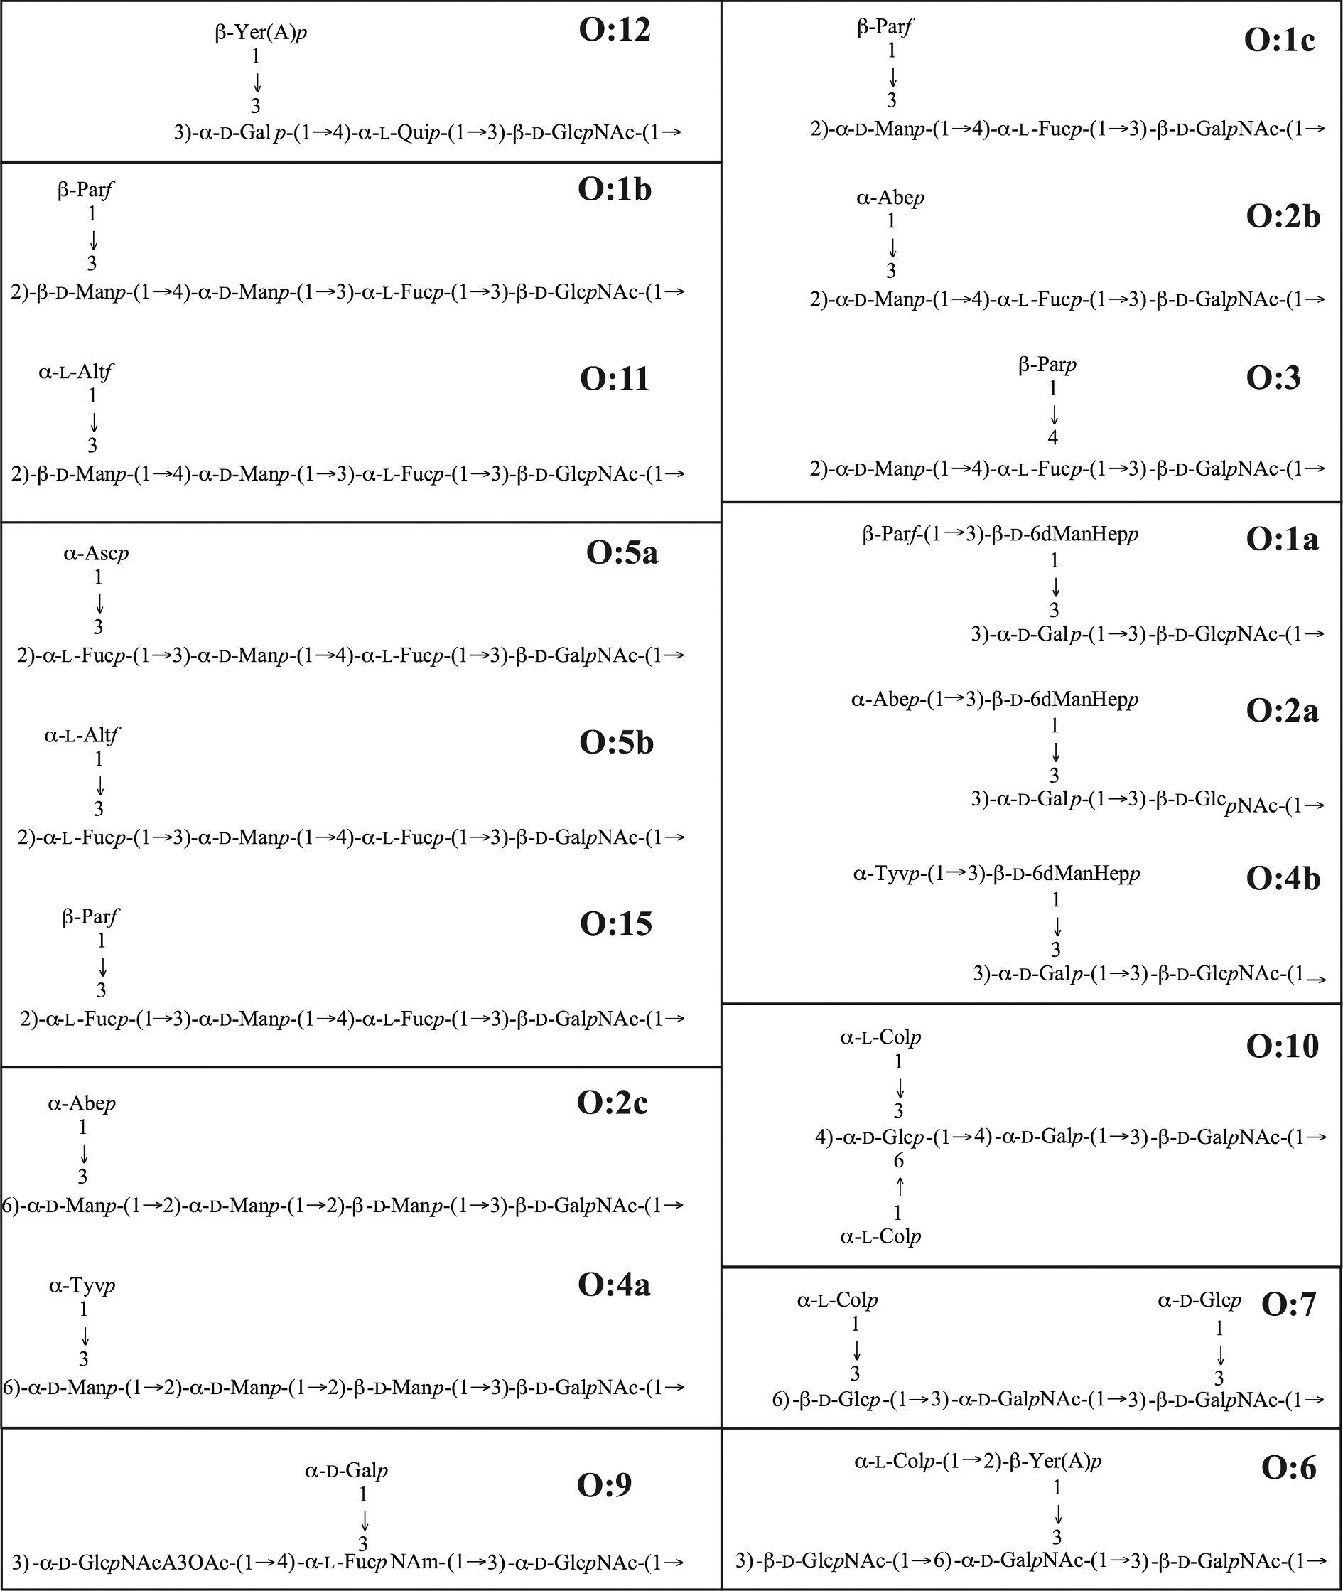
Figure 2. Yersinia pseudotuberculosis O-unit structures. Serotype names are shown above each O unit, and structures are ...
Notes:
Figure 2. Yersinia pseudotuberculosis O-unit structures. Serotype names are shown above each O unit, and structures are grouped according to common main-chain features. References for structures are in Table 1.
Unless provided in the caption above, the following copyright applies to the content of this slide: © FEMS 2017.This is an Open Access article distributed under the terms of the Creative Commons Attribution Non-Commercial License (http://creativecommons.org/licenses/by-nc/4.0/), which permits non-commercial re-use, distribution, and reproduction in any medium, provided the original work is properly cited. For commercial re-use, please contact journals.permissions@oup.com

Slide 3
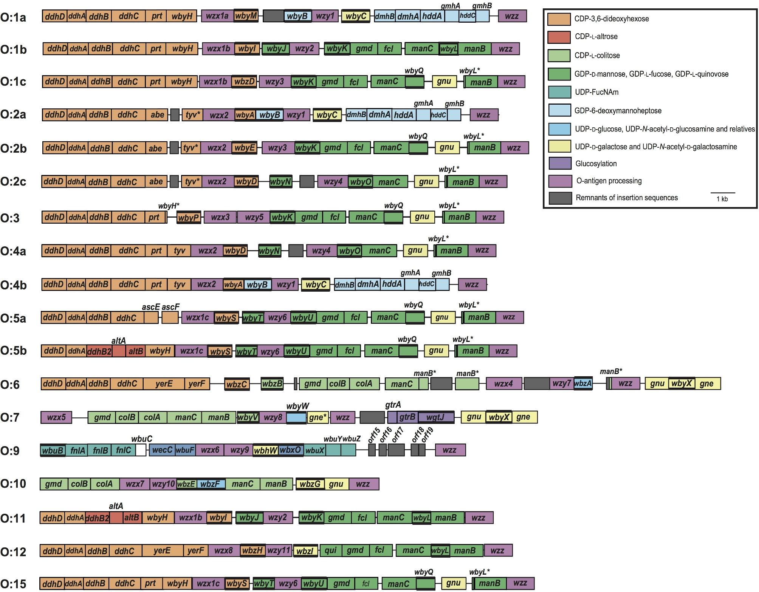
Figure 3. Yersinia pseudotuberculosis O-antigen gene clusters. Gene clusters are drawn to scale using published ...
Notes:
Figure 3. Yersinia pseudotuberculosis O-antigen gene clusters. Gene clusters are drawn to scale using published sequences (GenBank accession numbers in Table 1). Gene clusters are numerically ordered by serotype name indicated on the left. Genes are coloured according to the respective pathways of their products, and the scheme is shown on the right. Figure is drawn to scale and the scale is shown below. All genes are transcribed from left to right. Bold lines bordering genes indicate that the gene encodes a GT.
Unless provided in the caption above, the following copyright applies to the content of this slide: © FEMS 2017.This is an Open Access article distributed under the terms of the Creative Commons Attribution Non-Commercial License (http://creativecommons.org/licenses/by-nc/4.0/), which permits non-commercial re-use, distribution, and reproduction in any medium, provided the original work is properly cited. For commercial re-use, please contact journals.permissions@oup.com

Slide 4
Figure 4. Synthesis pathways of activated sugar precursors that are incorporated into Y. pseudotuberculosis O units. ...
Notes:
Figure 4. Synthesis pathways of activated sugar precursors that are incorporated into Y. pseudotuberculosis O units. Pathways with experimental data are the CDP-DDH (Chen, Guo and Liu 1998 and reviewed in Samuel and Reeves 2003), GDP-l-Colp (Alam, Beyer and Liu 2004), GDP-l-Fucp and GDP-d-Manp (reviewed in Samuel and Reeves 2003) and GDP-6dManHepp (Butty et al. 2009) synthesis pathways. Predicted pathways are for CDP-l-Altf (Cunneen et al. 2009) and GDP-l-Quip (De Castro et al. 2012) synthesis. Substrates and products are shown, and enzymes are in bold face type. Boxed sugars are those incorporated into O units shown in Fig. 1. Sugar abbreviations are expanded in the text.
Unless provided in the caption above, the following copyright applies to the content of this slide: © FEMS 2017.This is an Open Access article distributed under the terms of the Creative Commons Attribution Non-Commercial License (http://creativecommons.org/licenses/by-nc/4.0/), which permits non-commercial re-use, distribution, and reproduction in any medium, provided the original work is properly cited. For commercial re-use, please contact journals.permissions@oup.com

Slide 5
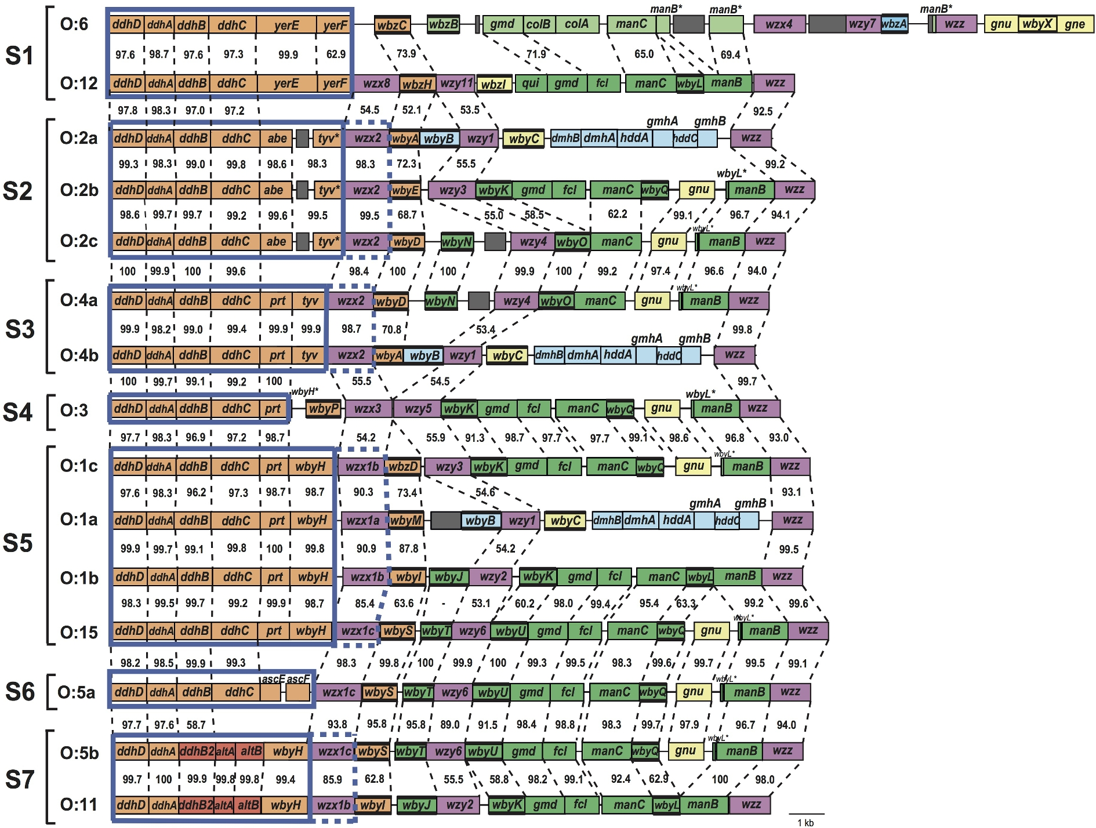
Figure 5. Gene modules for O-unit side-branch synthesis in Y. pseudotuberculosis O-antigen gene clusters. Gene cluster ...
Notes:
Figure 5. Gene modules for O-unit side-branch synthesis in Y. pseudotuberculosis O-antigen gene clusters. Gene cluster details as in legend for Fig. 3. Boxes highlight the gene modules required for the synthesis of side-branch sugars. Names of modules and serotypes are shown on the left. The length of some of these modules can be extended to include the wzx and/or the GT gene, as indicated by the dashed boxes.
Unless provided in the caption above, the following copyright applies to the content of this slide: © FEMS 2017.This is an Open Access article distributed under the terms of the Creative Commons Attribution Non-Commercial License (http://creativecommons.org/licenses/by-nc/4.0/), which permits non-commercial re-use, distribution, and reproduction in any medium, provided the original work is properly cited. For commercial re-use, please contact journals.permissions@oup.com

Slide 6
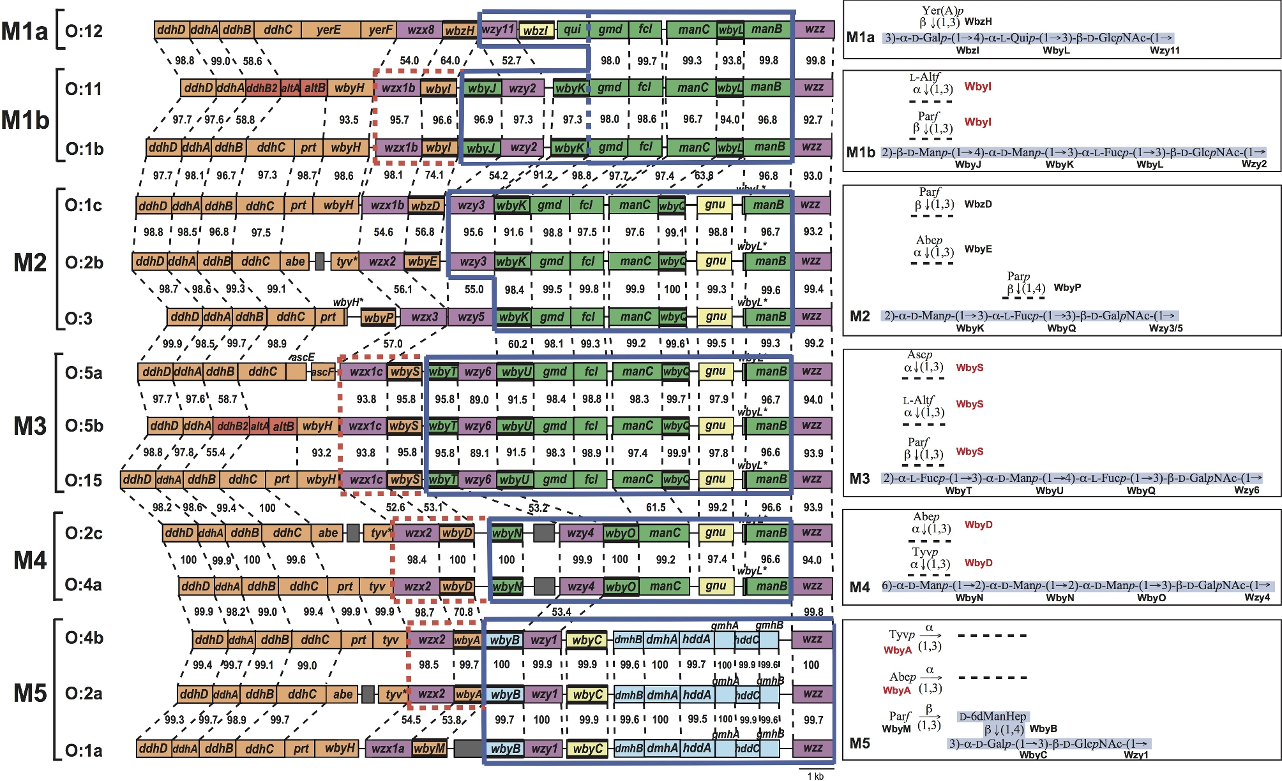
Figure 6. Gene modules for O-unit main-chain synthesis in Y. pseudotuberculosis O-antigen gene clusters. Gene cluster ...
Notes:
Figure 6. Gene modules for O-unit main-chain synthesis in Y. pseudotuberculosis O-antigen gene clusters. Gene cluster details as in legend for Fig. 3. Boxes highlight the gene modules required for the synthesis of main-chain sugars. Names of modules and serotypes are shown on the left. The length of some of these modules can be extended to include the wzx and/or the GT gene, as indicated by the dashed boxes.
Unless provided in the caption above, the following copyright applies to the content of this slide: © FEMS 2017.This is an Open Access article distributed under the terms of the Creative Commons Attribution Non-Commercial License (http://creativecommons.org/licenses/by-nc/4.0/), which permits non-commercial re-use, distribution, and reproduction in any medium, provided the original work is properly cited. For commercial re-use, please contact journals.permissions@oup.com

Slide 7
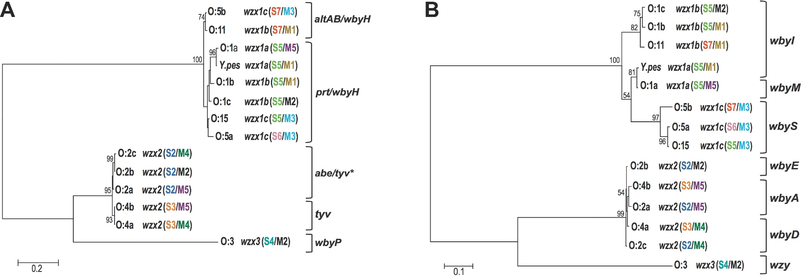
Figure 7. Phylogenies of Y. pseudotuberculosis wzx ends partitioned at base position 575. Neighbour-joining tree with ...
Notes:
Figure 7. Phylogenies of Y. pseudotuberculosis wzx ends partitioned at base position 575. Neighbour-joining tree with and bootstrap values based on 100 replicate trees. Serotype names, module groups and wzx names are shown, along with scale bar. Groupings indicated on the right of each phylogeny denote gene immediately upstream or downstream of wzx.
Unless provided in the caption above, the following copyright applies to the content of this slide: © FEMS 2017.This is an Open Access article distributed under the terms of the Creative Commons Attribution Non-Commercial License (http://creativecommons.org/licenses/by-nc/4.0/), which permits non-commercial re-use, distribution, and reproduction in any medium, provided the original work is properly cited. For commercial re-use, please contact journals.permissions@oup.com

Slide 8
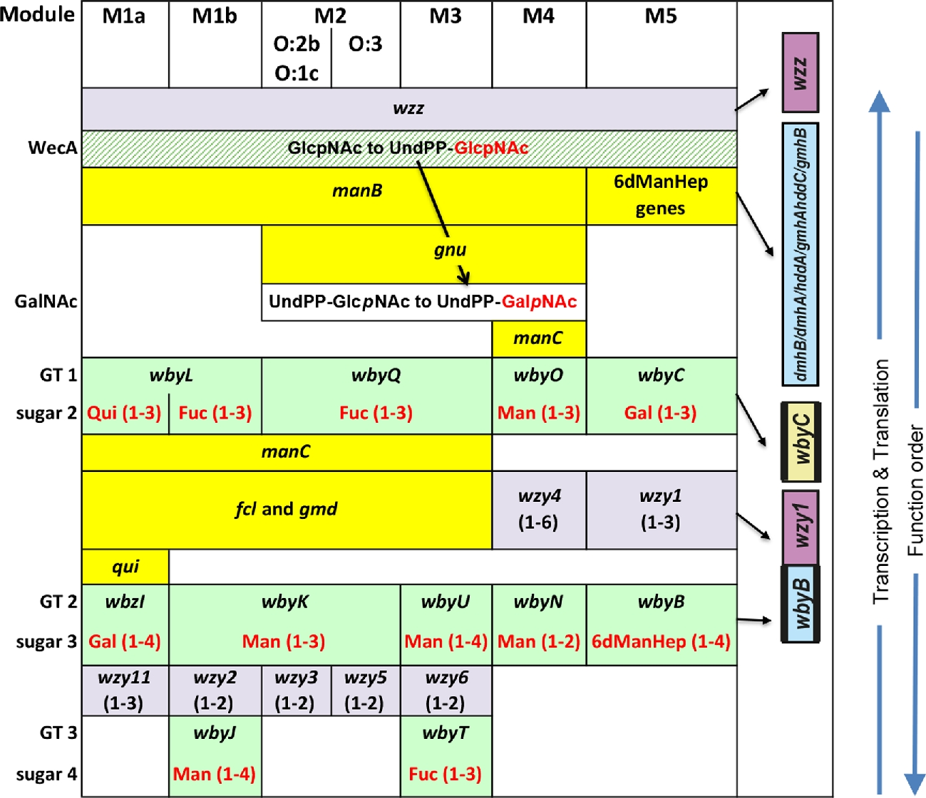
Figure 8. Pattern representation of the main-chain sugars and their transferases. Each column shows the genes for one ...
Notes:
Figure 8. Pattern representation of the main-chain sugars and their transferases. Each column shows the genes for one of the seven main chains in map order from bottom to top, which puts most of the genes close to function order from top to bottom. The sugars and their linkages are shown in red, below the corresponding GT gene name. GlcpNAc, the first sugar, is shown attached to UndPP at the top, although the wecA gene is not in the gene cluster, followed by rows for the GT genes for the second, third and fourth sugars, which all occur in inverse map order. Intermingled in ascending map order are the other genes in each module. Cells for the initial sugar transferase gene and GT genes are coloured green and cells for other genes are coloured yellow. The significance of the gene order is discussed in the text.
Unless provided in the caption above, the following copyright applies to the content of this slide: © FEMS 2017.This is an Open Access article distributed under the terms of the Creative Commons Attribution Non-Commercial License (http://creativecommons.org/licenses/by-nc/4.0/), which permits non-commercial re-use, distribution, and reproduction in any medium, provided the original work is properly cited. For commercial re-use, please contact journals.permissions@oup.com

Slide 9
Figure 9. Comparison of the Y. pseudotuberculosis O:6, O:7 and O:10 gene clusters. Gene cluster details as in legend ...
Notes:
Figure 9. Comparison of the Y. pseudotuberculosis O:6, O:7 and O:10 gene clusters. Gene cluster details as in legend for Fig. 3. Nucleotide sequence identities are shown between clusters, and the serotype is indicated on the left.
Unless provided in the caption above, the following copyright applies to the content of this slide: © FEMS 2017.This is an Open Access article distributed under the terms of the Creative Commons Attribution Non-Commercial License (http://creativecommons.org/licenses/by-nc/4.0/), which permits non-commercial re-use, distribution, and reproduction in any medium, provided the original work is properly cited. For commercial re-use, please contact journals.permissions@oup.com

