Slide 1
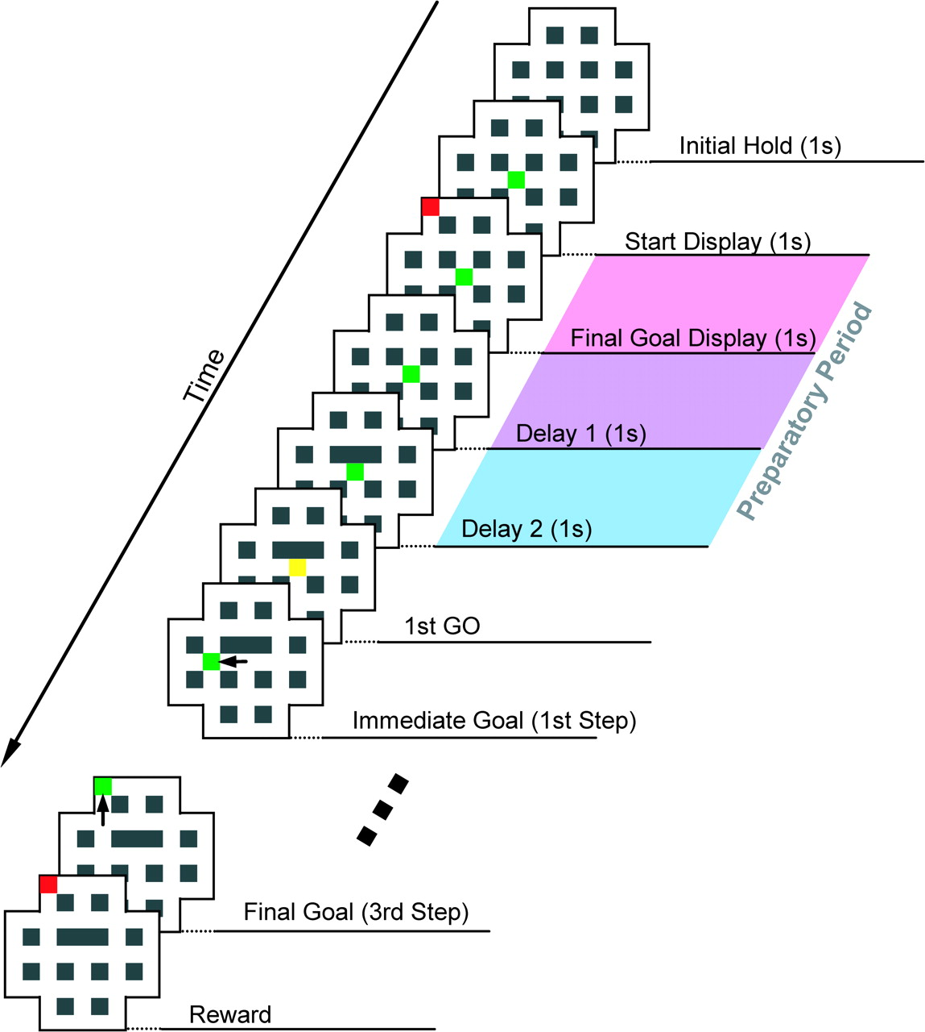
Figure 1. Temporal sequence of events in the behavioral task. The behavioral sequence is depicted from the top right to ...
Notes:
Figure 1. Temporal sequence of events in the behavioral task. The behavioral sequence is depicted from the top right to the bottom left. Each panel represents a maze displayed on a monitor, with green squares denoting current cursor positions and red squares indicating the positions of the final goal. Yellow squares represent movement initiation (GO) signals. Black arrows delineate cursor movements. Light red, purple, and blue bands to the right of the panels indicate the task periods defined as Final Goal Display, Delay 1, and Delay 2, respectively, constituting the preparatory period.
Unless provided in the caption above, the following copyright applies to the content of this slide: © 2008 The AuthorsThis is an Open Access article distributed under the terms of the Creative Commons Attribution Non-Commercial License (http://creativecommons.org/licenses/by-nc/2.0/uk/) which permits unrestricted non-commercial use, distribution, and reproduction in any medium, provided the original work is properly cited.

Slide 2
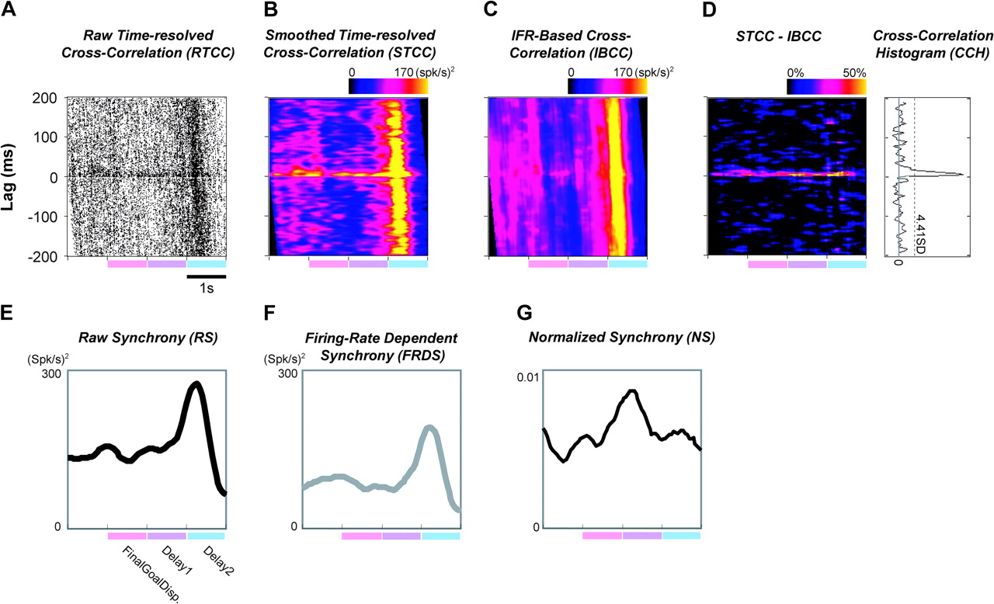
Figure 2. Time-resolved cross-correlation analysis of synchrony in the firing of a neuron pair. (A) RTCC for a neuron ...
Notes:
Figure 2. Time-resolved cross-correlation analysis of synchrony in the firing of a neuron pair. (A) RTCC for a neuron pair, where each dot represents a single spike. The abscissa represents time during task performance, with light red, purple, and blue bands indicating the task periods defined as Final Goal Display, Delay 1, and Delay 2, respectively. The ordinate represents the time lag between response and trigger spikes. (B) STCC, obtained by smoothing the RTCC in (A) using a Gaussian kernel. (C) Cross-correlation based on the IFR, termed IBCC. (D) Genuine cross-correlation, calculated as STCC − IBCC (left panel), and the standard CCH (right panel). (E) RS, calculated by averaging the magnitudes of synchrony in the STCC. (F) FRDS, obtained from the IBCC in the same manner as for the RS. (G) NS, calculated by subtracting FRDS from RS.
Unless provided in the caption above, the following copyright applies to the content of this slide: © 2008 The AuthorsThis is an Open Access article distributed under the terms of the Creative Commons Attribution Non-Commercial License (http://creativecommons.org/licenses/by-nc/2.0/uk/) which permits unrestricted non-commercial use, distribution, and reproduction in any medium, provided the original work is properly cited.

Slide 3
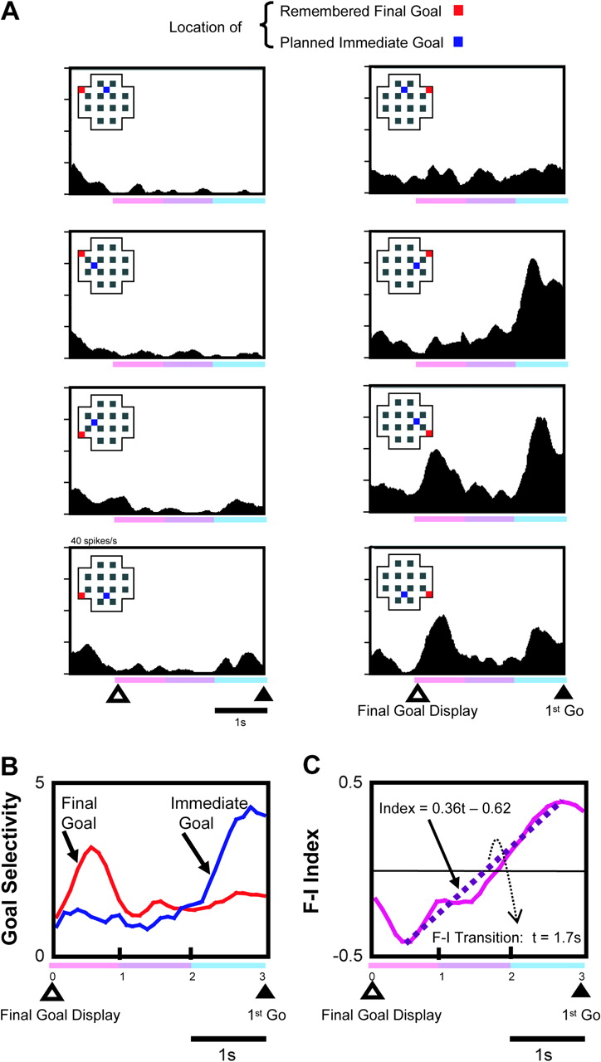
Figure 3. Discharge properties of an lPFC neuron that represented the final goal position followed by the immediate ...
Notes:
Figure 3. Discharge properties of an lPFC neuron that represented the final goal position followed by the immediate goal position during the preparatory period. (A) Spike-density histograms of neuronal activity under task conditions, showing each combination of final and immediate goals. A red square indicates the location of the final goal remembered during the preparatory period; a blue square indicates the planned immediate goal. In the early phase of the preparatory period, this neuron was selectively active when the final goal was located at the bottom right of the maze; in the late phase, selectivity was most prominent when the immediate goal was at the right of the starting position. (B) The time course of modulation of the FGS and IGS during the preparatory period. The regression coefficient is normalized and plotted for the FG (red) and IG (blue), calculated for consecutive time frames of 100 ms. (C) The F–I index, calculated for consecutive 100-ms time frames, was initially negative but became positive during the late phase. The time course of the F–I index was linearly approximated by a regression analysis (dashed line). The F–I transition was defined as the zero-cross point of the linear approximation (see Materials and Methods).
Unless provided in the caption above, the following copyright applies to the content of this slide: © 2008 The AuthorsThis is an Open Access article distributed under the terms of the Creative Commons Attribution Non-Commercial License (http://creativecommons.org/licenses/by-nc/2.0/uk/) which permits unrestricted non-commercial use, distribution, and reproduction in any medium, provided the original work is properly cited.

Slide 4
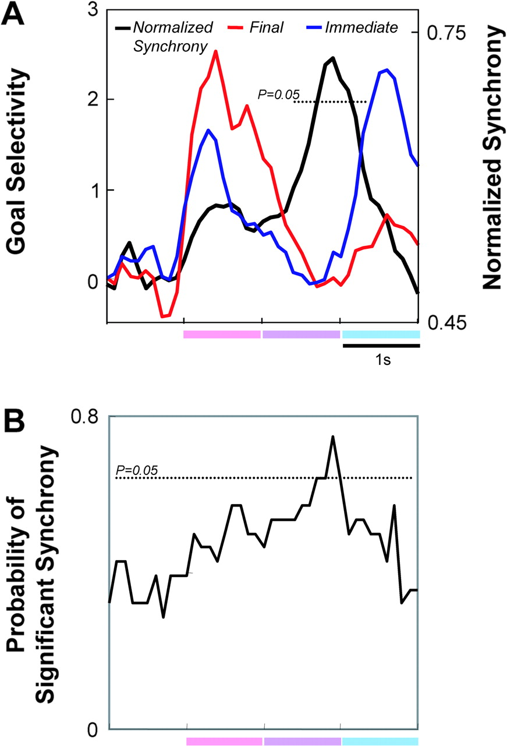
Figure 4. Temporal relationship between synchrony and goal selectivity of neuronal activity analyzed for neuron pairs ...
Notes:
Figure 4. Temporal relationship between synchrony and goal selectivity of neuronal activity analyzed for neuron pairs with F–I transition neurons. (A) Selectivity for final (red line) and immediate (blue line) goals calculated for the population of neurons with F–I transitions (see Materials and Methods). NS of each neuron pair was calculated by taking the peak value as 1, and values were then averaged over the preparatory period (black line). (B) The time course of the probability of synchrony among neuron pairs, based on unitary event analysis (Grammont and Riehle 2003). For each neuron pair, the statistical significance of the RS value at each time frame was assessed using a Poisson distribution estimated from the FRDS. The probability of significant synchrony in consecutive time frames of 100 ms is plotted. The dotted lines signify the level of statistical significance (at P = 0.05 by a bootstrapping test).
Unless provided in the caption above, the following copyright applies to the content of this slide: © 2008 The AuthorsThis is an Open Access article distributed under the terms of the Creative Commons Attribution Non-Commercial License (http://creativecommons.org/licenses/by-nc/2.0/uk/) which permits unrestricted non-commercial use, distribution, and reproduction in any medium, provided the original work is properly cited.

Slide 5
Figure 5. Temporal relationship between the synchrony peak and the transition of goal representations for individual ...
Notes:
Figure 5. Temporal relationship between the synchrony peak and the transition of goal representations for individual neurons. (A) The peak in NS is plotted against the F–I transition time (purple dot) and its standard error (bars). The straight line represents the linear regression fit to the correlation between the 2 variables (r = 0.53, P < 0.05). (B) A peri-event time histogram of selectivity for final and immediate goals aligned to the peak in NS. The selectivity for final (red line) and immediate goals (blue line) of each neuron, calculated for 100-ms time frames, were aligned to the NS peak and averaged across neurons. A bootstrapping test was used to assess whether the peak amplitudes of FGS and IGS for synchronous pairs were significant, based on statistical estimation of the temporal profile of goal selectivity using 10 000 randomly selected pairs. The asterisks signify a statistical significance of P < 0.01. (C) The F–I transition time is plotted against the onset of significant synchrony. A great majority of data points are above the diagonal dotted line (P < 0.001, binomial test), indicating that the significant synchrony begins before the F–I transition. The mean values for F–I transition time, synchrony peak, and the onset of significant synchrony were 1540 ± 590 ms, 1620 ± 670 ms, and 1400 ± 650 ms, respectively.
Unless provided in the caption above, the following copyright applies to the content of this slide: © 2008 The AuthorsThis is an Open Access article distributed under the terms of the Creative Commons Attribution Non-Commercial License (http://creativecommons.org/licenses/by-nc/2.0/uk/) which permits unrestricted non-commercial use, distribution, and reproduction in any medium, provided the original work is properly cited.

Slide 6
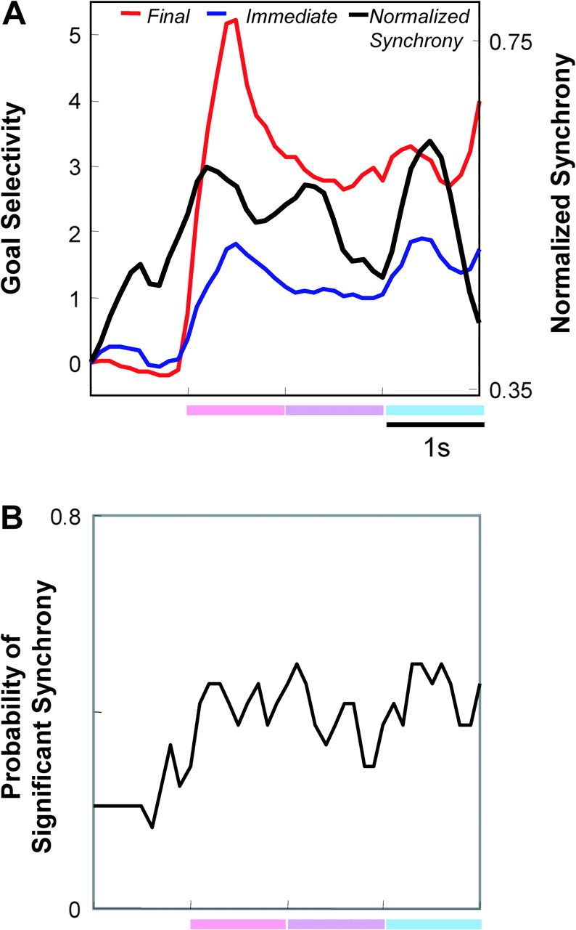
Figure 6. Analysis of synchrony for neuron pairs without F–I transition. (A) Temporal relationship between synchrony ...
Notes:
Figure 6. Analysis of synchrony for neuron pairs without F–I transition. (A) Temporal relationship between synchrony and goal selectivity of neuronal activity calculated for the population of neuron pairs that exhibited significant synchrony and included neurons that represented the final goal continuously during the delay periods. The format of the display is the same as in Figure 4A. (B) The time course of the probability of significant synchrony calculated on the basis of unitary event analysis, similarly plotted as in Figure 4B.
Unless provided in the caption above, the following copyright applies to the content of this slide: © 2008 The AuthorsThis is an Open Access article distributed under the terms of the Creative Commons Attribution Non-Commercial License (http://creativecommons.org/licenses/by-nc/2.0/uk/) which permits unrestricted non-commercial use, distribution, and reproduction in any medium, provided the original work is properly cited.

Slide 7
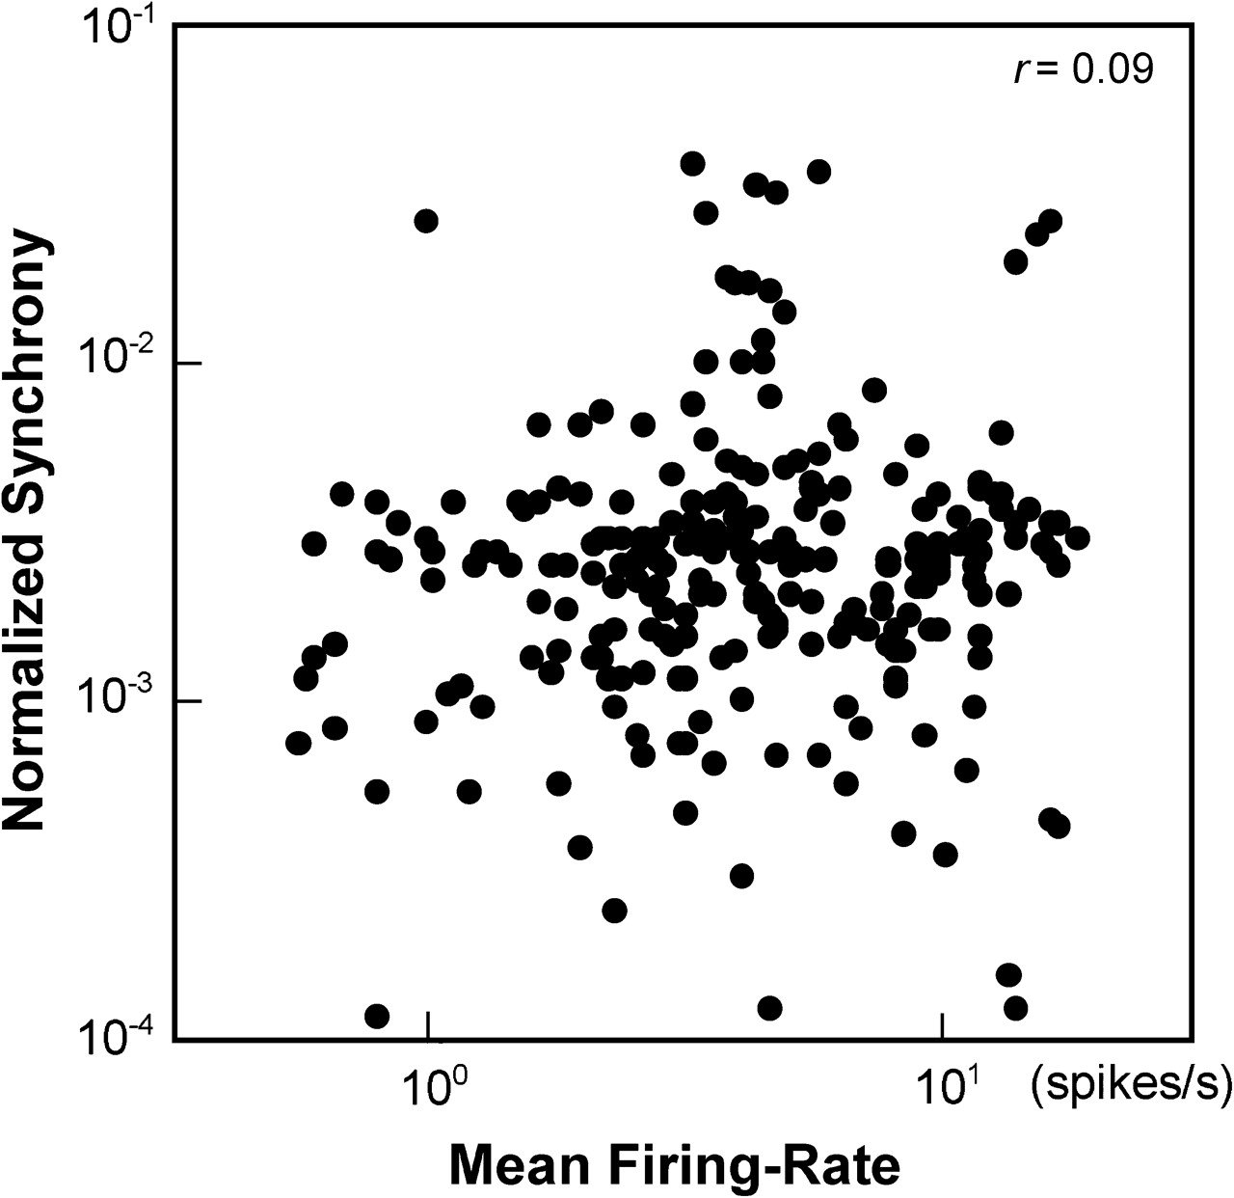
Figure 7. Relationship between the NS and the mean firing rate of the 2 neurons included in individual neuron pairs ...
Notes:
Figure 7. Relationship between the NS and the mean firing rate of the 2 neurons included in individual neuron pairs during the 3-s preparatory period, analyzed for the neuron pairs showing significant synchrony (n = 45). Six data points were obtained for each neuron pair at 500-ms intervals during the 3-s time period. NS was not significantly correlated with the mean firing rate of the pair (r = 0.09), confirming independence between the 2 measures.
Unless provided in the caption above, the following copyright applies to the content of this slide: © 2008 The AuthorsThis is an Open Access article distributed under the terms of the Creative Commons Attribution Non-Commercial License (http://creativecommons.org/licenses/by-nc/2.0/uk/) which permits unrestricted non-commercial use, distribution, and reproduction in any medium, provided the original work is properly cited.

