Slide 1
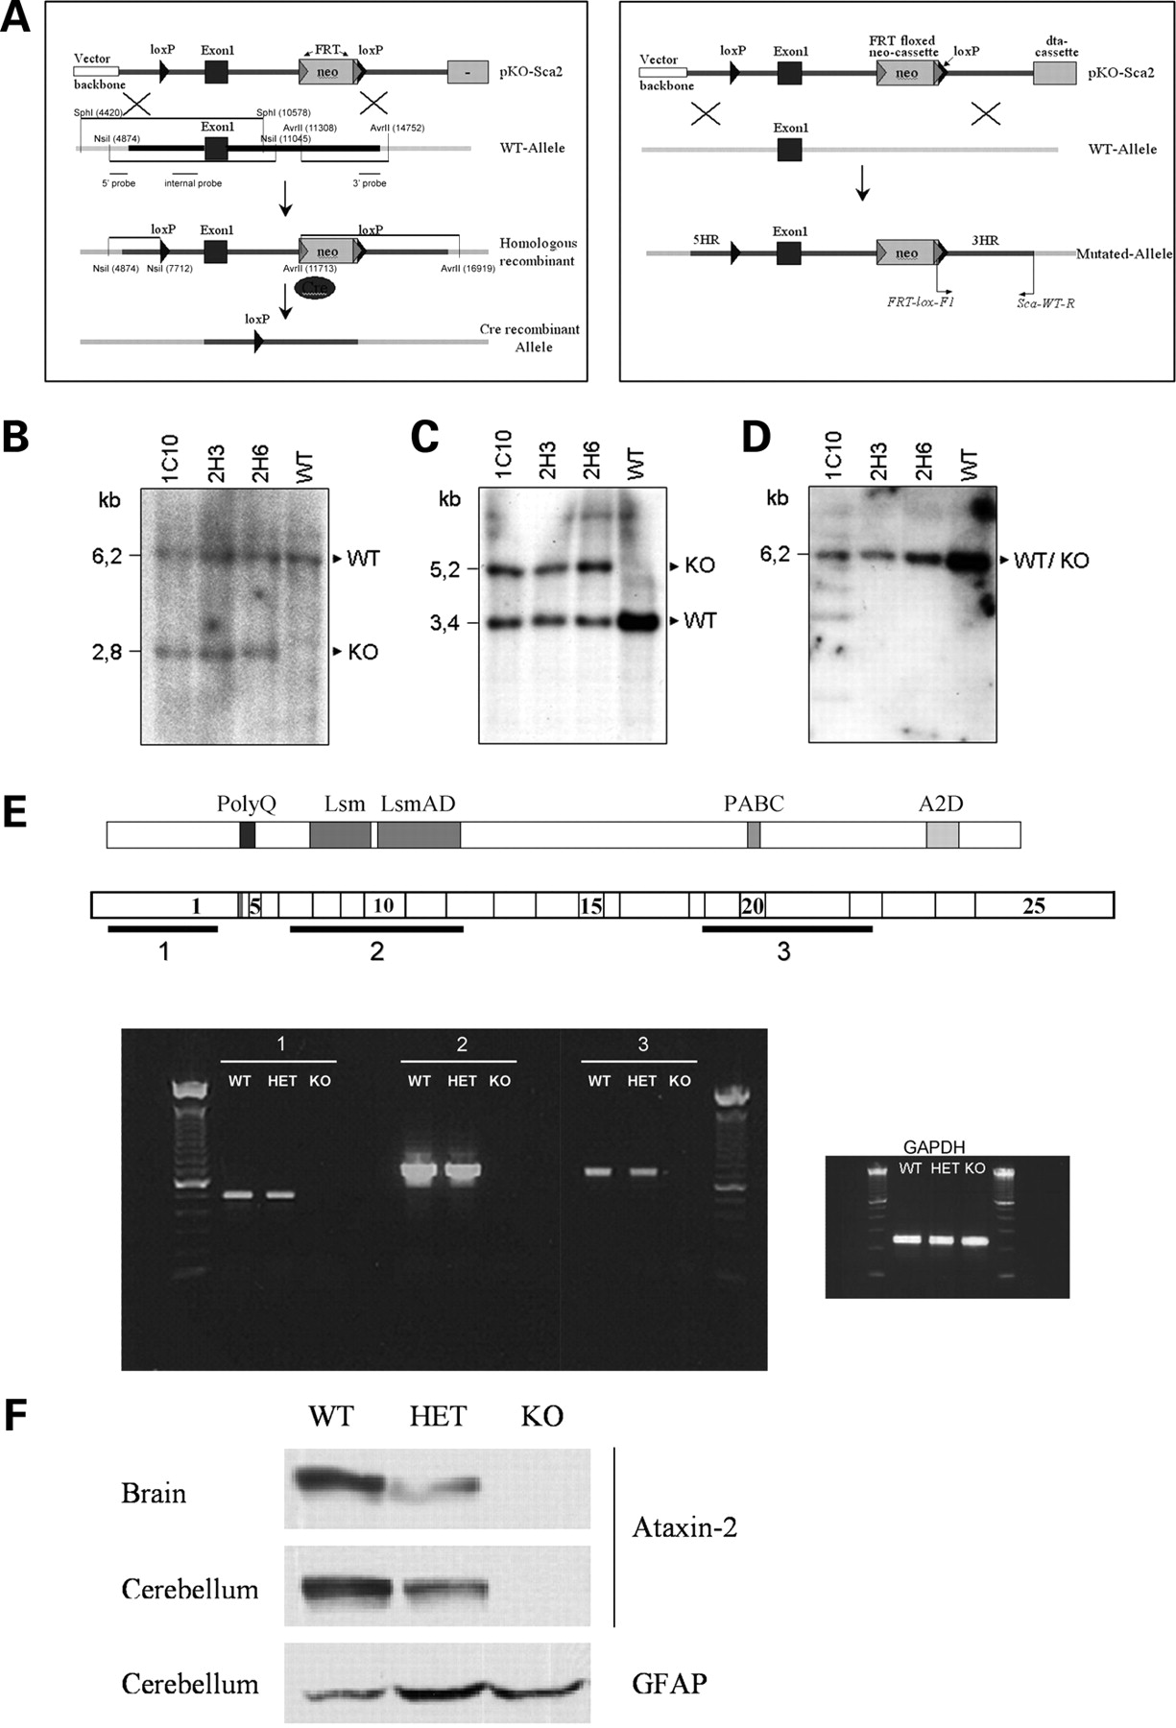
Figure 1. Targeting strategy for constitutive and conditional Sca2 KO. (A) Graphic representation of the targeting ...
Notes:
Figure 1. Targeting strategy for constitutive and conditional Sca2 KO. (A) Graphic representation of the targeting strategy employed to generate constitutive (left panel) and conditional KO mice (right panel). (B-D) Proper targeting into ES cell lines 1C10, 2H3 and 2H6 was assessed with Southern blots documenting (B) 5′-homologous recombination with an NsiI restriction digest, (C) 3′-homologous recombination with an AvrII digest and (D) lack of non-homologous recombination with a SphI digest to generate the predicted restriction fragments for constitutive KO in comparison to wild-type (WT) alleles. (E) Above: scheme of ataxin-2 protein domain structure and Sca2 transcript exon structure with representation of the PCR fragments 1, 2 and 3 used for the validation of wild-type, heterozygous (HET) and homozygous KO mice. Below: 1% agarose gel showing representative RT–PCR results from cerebellum. Amplification product 1 is representative for exon 1, product 2 for exons 7–12, product 3 for exons 19–22. GAPDH was used as loading control. The absence of amplification products 1 to 3 in each KO lane demonstrates the absence of the respective Sca2 transcript fragments beyond the targeted exon 1 in Sca2−/− mice. The amplification products in each HET lane have similar intensity as in the WT lanes, as to be expected from saturation PCRs. (F) Western-blot analysis of protein extracts from cerebellum and cerebrum (brain) showed the expected loss of ataxin-2 immunoreactivity in KO tissue and a reduced intensity of ataxin-2 immunoreactivity in HET tissue, in contrast to similar intensities of the loading control glial fibrillary acidic protein (GFAP). Blots were stained with anti-ataxin-2 antibody from BD Bioscience, which recognizes an epitope between the LsmAD and the PABC domains shown in (B).
Unless provided in the caption above, the following copyright applies to the content of this slide: © The Author 2008. Published by Oxford University Press. All rights reserved. For Permissions, please email: journals.permissions@oxfordjournals.org

Slide 2
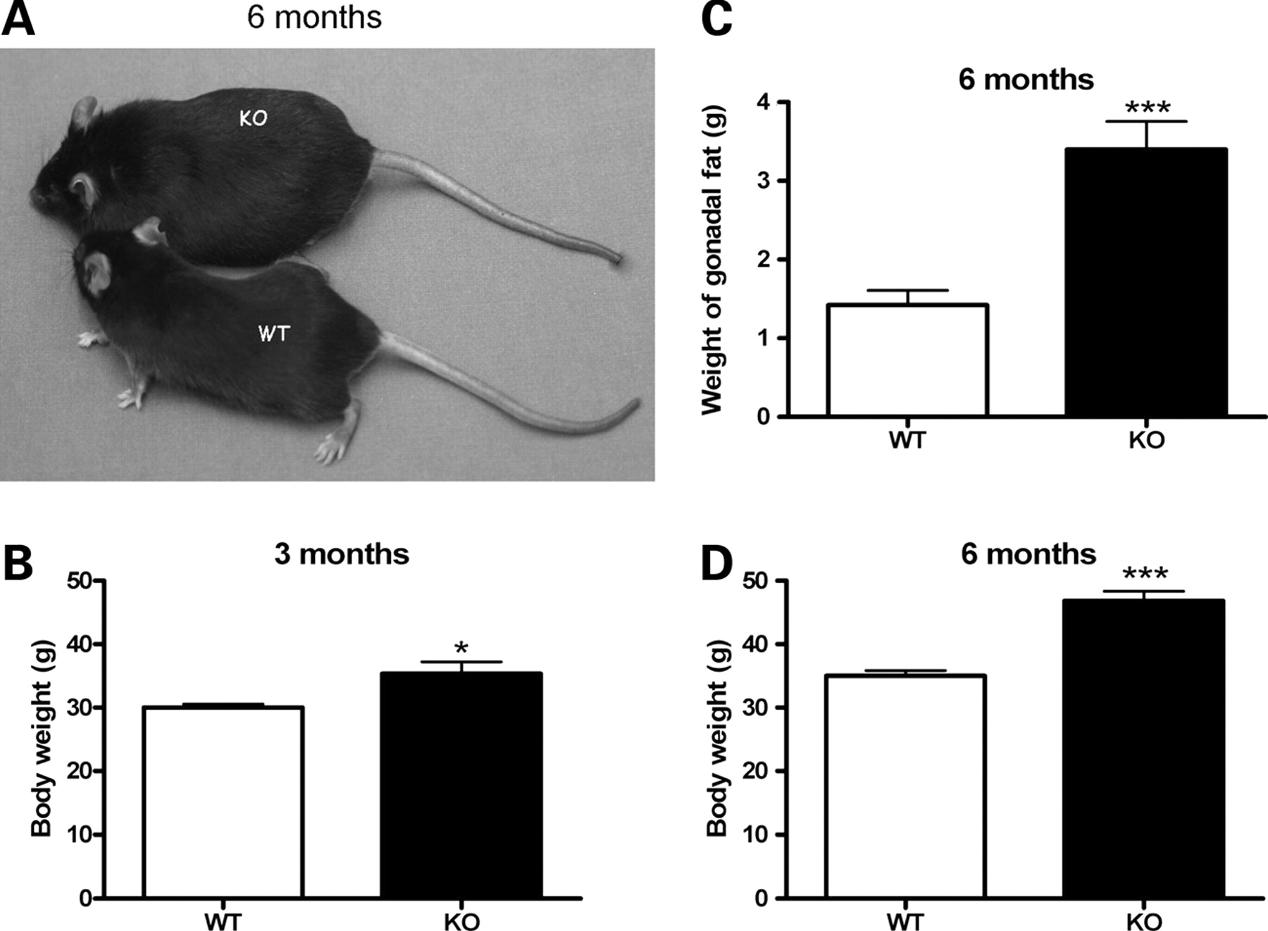
Figure 2. Body weight is increased progressively from age 3 months. A progressive relative increase in body weight of ...
Notes:
Figure 2. Body weight is increased progressively from age 3 months. A progressive relative increase in body weight of Sca2−/− in comparison to the WT animals is illustrated at 6 months in (A) and was quantified for ages 3 and 6 months (B) and (C), respectively. The weight of gonadal fat pads was increased accordingly (D). (Animals used at 3 months age: 10 WT and 10 KO; animals at 6 months age: 19 WT and 14 KO) (*P < 0.05; **P < 0.01; ***P < 0.005).
Unless provided in the caption above, the following copyright applies to the content of this slide: © The Author 2008. Published by Oxford University Press. All rights reserved. For Permissions, please email: journals.permissions@oxfordjournals.org

Slide 3
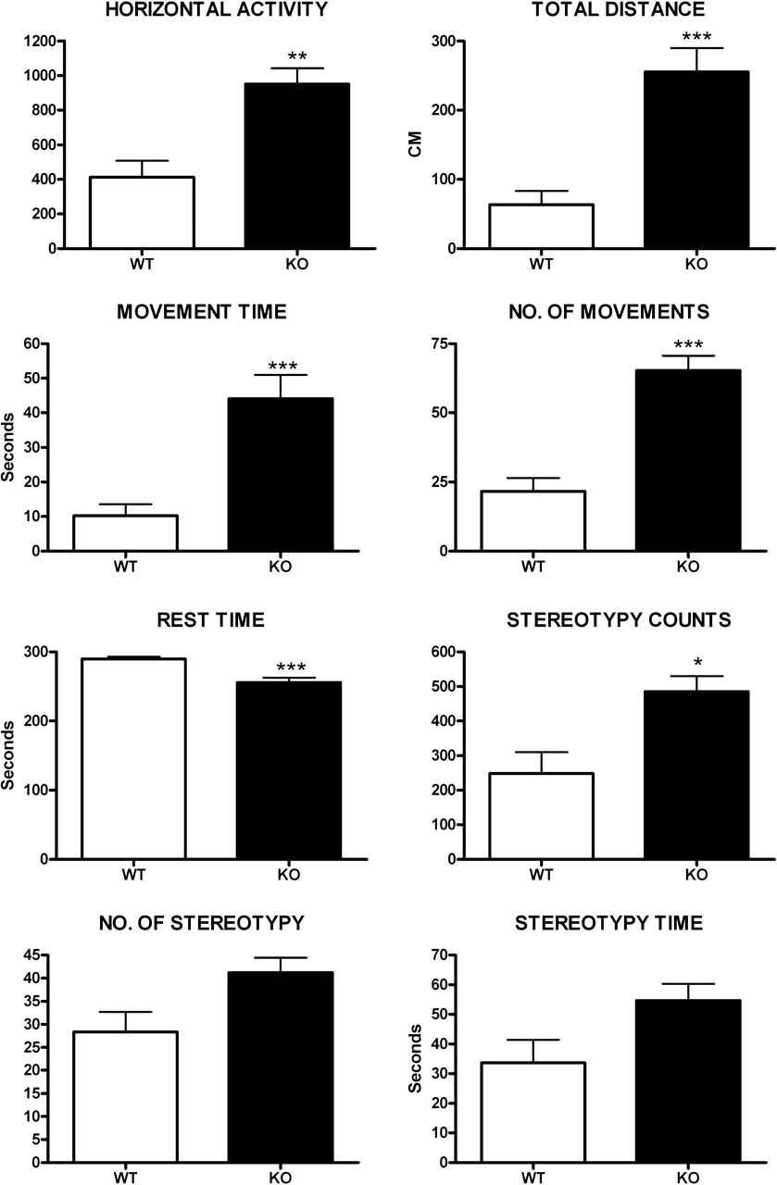
Figure 3. Motor activity of Sca2^{−/−} mice is increased at age 3 months. Open-field test of spontaneous ...
Notes:
Figure 3. Motor activity of Sca2−/− mice is increased at age 3 months. Open-field test of spontaneous locomotor activity showed significant increases for the following parameters: horizontal activity, total distance, time of movement, number of movements and stereotypy counts. A trend of increase was observed for the number of stereotypies and stereotypy time. In contrast, the animals’ rest time was decreased. This indicates that the gain in body weight is not due to reduced energy expenditure by a decrease in movements. (Animals used at 3 months age: 8 WT and 5 KO; animals at 6 months age: 10 WT and 10 KO) (*P < 0.05; **P < 0.01; ***P < 0.005).
Unless provided in the caption above, the following copyright applies to the content of this slide: © The Author 2008. Published by Oxford University Press. All rights reserved. For Permissions, please email: journals.permissions@oxfordjournals.org

Slide 4
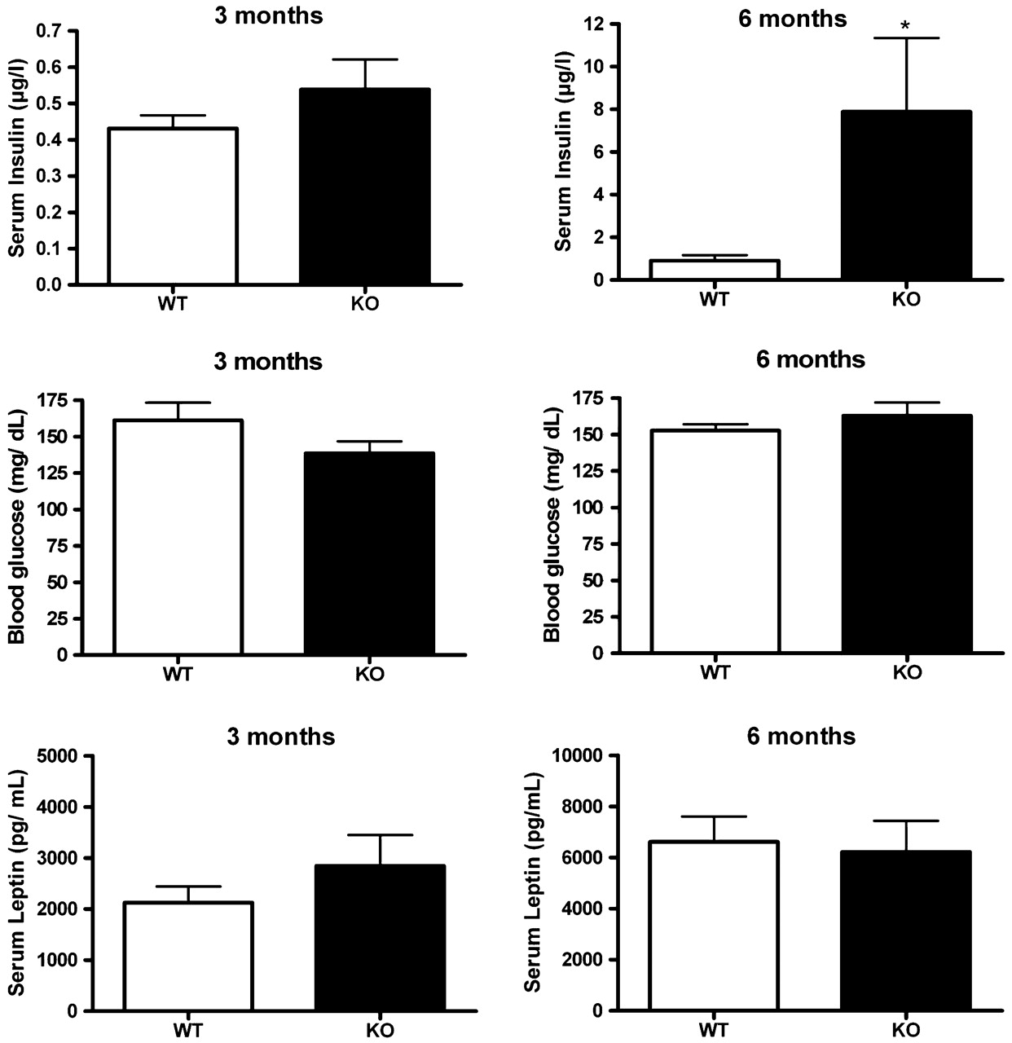
Figure 4. Insulin in the blood serum is increased at age 6 months. Sca2^{−/−} animals presented a tendency ...
Notes:
Figure 4. Insulin in the blood serum is increased at age 6 months. Sca2−/− animals presented a tendency toward elevated serum insulin levels at age 3 months and significantly elevated levels at age 6 months. In contrast, the blood levels of glucose and leptin were unchanged. (Animals used for glucose analysis at 3 months age: 10 WT and 10 KO; at 6 months age: 11 WT and 10 KO; animals used for insulin analysis at 3 months age: 7 WT and 6 KO; at 6 months: 8 WT and 5 KO; animals used for leptin analysis at 3 months age: 4 WT and 5 KO; at 6 months: 7 WT and 5 KO). (*P < 0.05; **P < 0.01; ***P < 0.005).
Unless provided in the caption above, the following copyright applies to the content of this slide: © The Author 2008. Published by Oxford University Press. All rights reserved. For Permissions, please email: journals.permissions@oxfordjournals.org

Slide 5
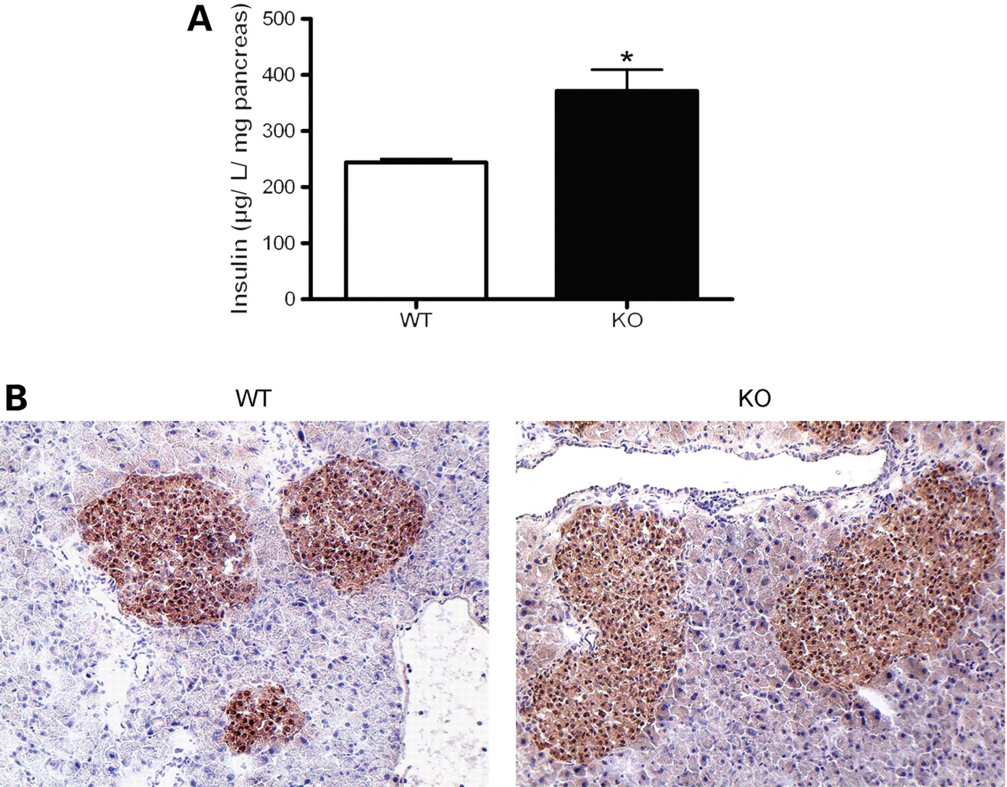
Figure 5. Pancreatic tissue at age 6 months shows increased insulin production without inflammatory infiltrations. (A) ...
Notes:
Figure 5. Pancreatic tissue at age 6 months shows increased insulin production without inflammatory infiltrations. (A) Measurement of total insulin at its production site in pancreatic tissue of 6 months old mice showed a significant elevation. (B) Immunohistochemical detection of insulin in pancreatic tissue of Sca2−/− mice showed hyperplasia of insulin-positive β-cells without evidence of inflammatory infiltration or destruction (*P < 0.05).
Unless provided in the caption above, the following copyright applies to the content of this slide: © The Author 2008. Published by Oxford University Press. All rights reserved. For Permissions, please email: journals.permissions@oxfordjournals.org

Slide 6
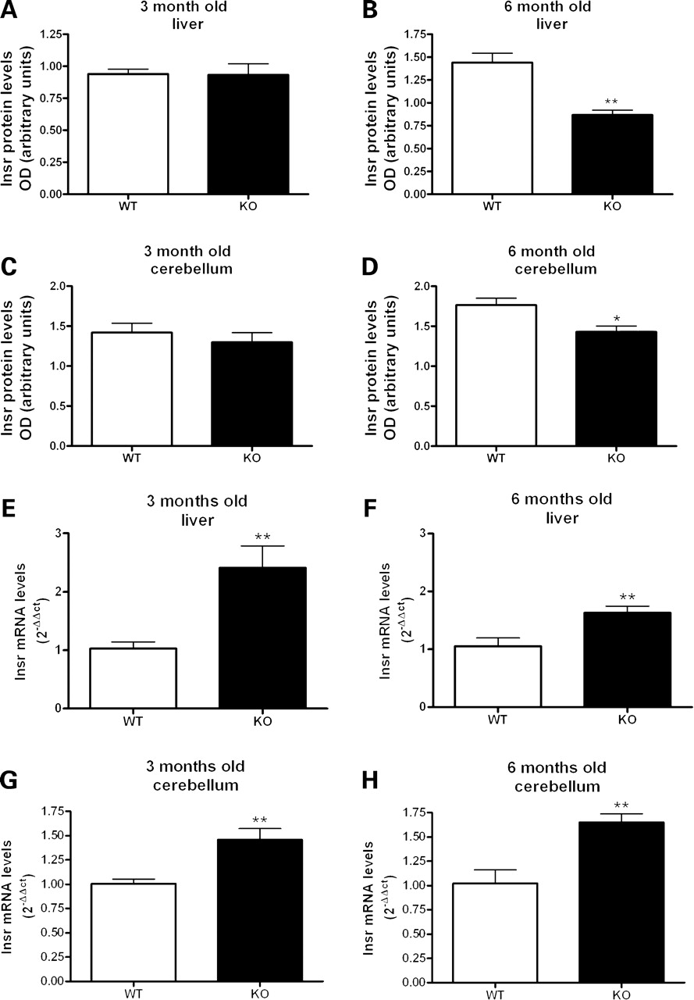
Figure 6. Insulin receptor protein levels are decreased at age 6 months in liver and cerebellum, while Insr mRNA levels ...
Notes:
Figure 6. Insulin receptor protein levels are decreased at age 6 months in liver and cerebellum, while Insr mRNA levels are increased already at 3 months. Densitometry analysis of western blots detecting insulin receptor levels versus loading control (β-actin and α-tubulin) at 3 and 6 months in liver (A) and (B), respectively and cerebellum (C) and (D), respectively. Insr mRNA levels as determined by qRT–PCR at 3 and 6 months in liver (E) and (F) and cerebellum (G) and (H). (Number of animals used for each genotype and each age: n = 4) (*P < 0.05; **P < 0.01).
Unless provided in the caption above, the following copyright applies to the content of this slide: © The Author 2008. Published by Oxford University Press. All rights reserved. For Permissions, please email: journals.permissions@oxfordjournals.org

Slide 7
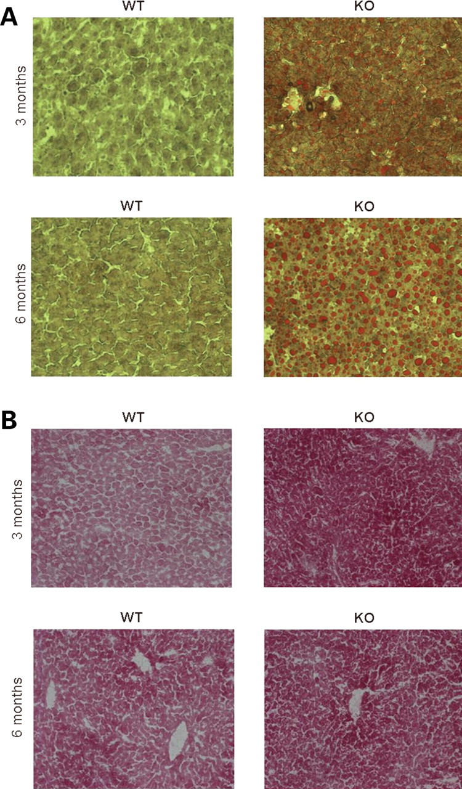
Figure 7. Liver tissue shows lipid droplet accumulation and enhanced glycogen deposition at ages 3 and 6 months. (A) ...
Notes:
Figure 7. Liver tissue shows lipid droplet accumulation and enhanced glycogen deposition at ages 3 and 6 months. (A) Oil Red O staining demonstrated the accumulation of lipid droplets in Sca2−/− liver with marked progression over time. (B) PAS-staining demonstrated increased glycogen storage in Sca2−/− liver already at age 3 months.
Unless provided in the caption above, the following copyright applies to the content of this slide: © The Author 2008. Published by Oxford University Press. All rights reserved. For Permissions, please email: journals.permissions@oxfordjournals.org

Slide 8
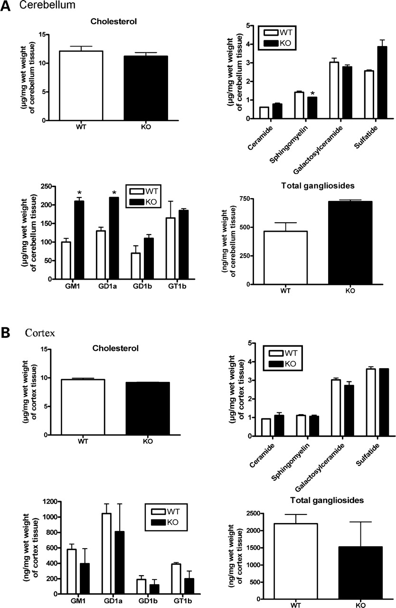
Figure 8. Brain thin layer lipid chromatography analysis demonstrates specific alterations in the cerebellum regarding ...
Notes:
Figure 8. Brain thin layer lipid chromatography analysis demonstrates specific alterations in the cerebellum regarding the sphingomyelin cycle and the ganglioside pathway. Brain lipid analyses were performed in 3-month-old cerebellum (A) and neocortex (B). (*P < 0.05).
Unless provided in the caption above, the following copyright applies to the content of this slide: © The Author 2008. Published by Oxford University Press. All rights reserved. For Permissions, please email: journals.permissions@oxfordjournals.org

Slide 9
Figure 9. Increased levels of BLBP in Sca2^{−/−} cerebellum. Densitometry analysis of western blots detecting ...
Notes:
Figure 9. Increased levels of BLBP in Sca2−/− cerebellum. Densitometry analysis of western blots detecting BLBP levels versus loading control (GAPDH) at 3 and 6 months in cerebellum. (Number of animals used for each genotype and each age: n = 4) (*P < 0.05; **P < 0.01).
Unless provided in the caption above, the following copyright applies to the content of this slide: © The Author 2008. Published by Oxford University Press. All rights reserved. For Permissions, please email: journals.permissions@oxfordjournals.org

Slide 10
Figure 10. Fertility problems of Sca2^{−/−} mice. Offspring in Sca2^{−/−} inbreeding is reduced in ...
Notes:
Figure 10. Fertility problems of Sca2−/− mice. Offspring in Sca2−/− inbreeding is reduced in comparison with WT. Sca2−/− inbreeding resulted in significantly fewer litters (A) and pups per litter (B). (*P < 0.05; **P < 0.01).
Unless provided in the caption above, the following copyright applies to the content of this slide: © The Author 2008. Published by Oxford University Press. All rights reserved. For Permissions, please email: journals.permissions@oxfordjournals.org

