Slide 1
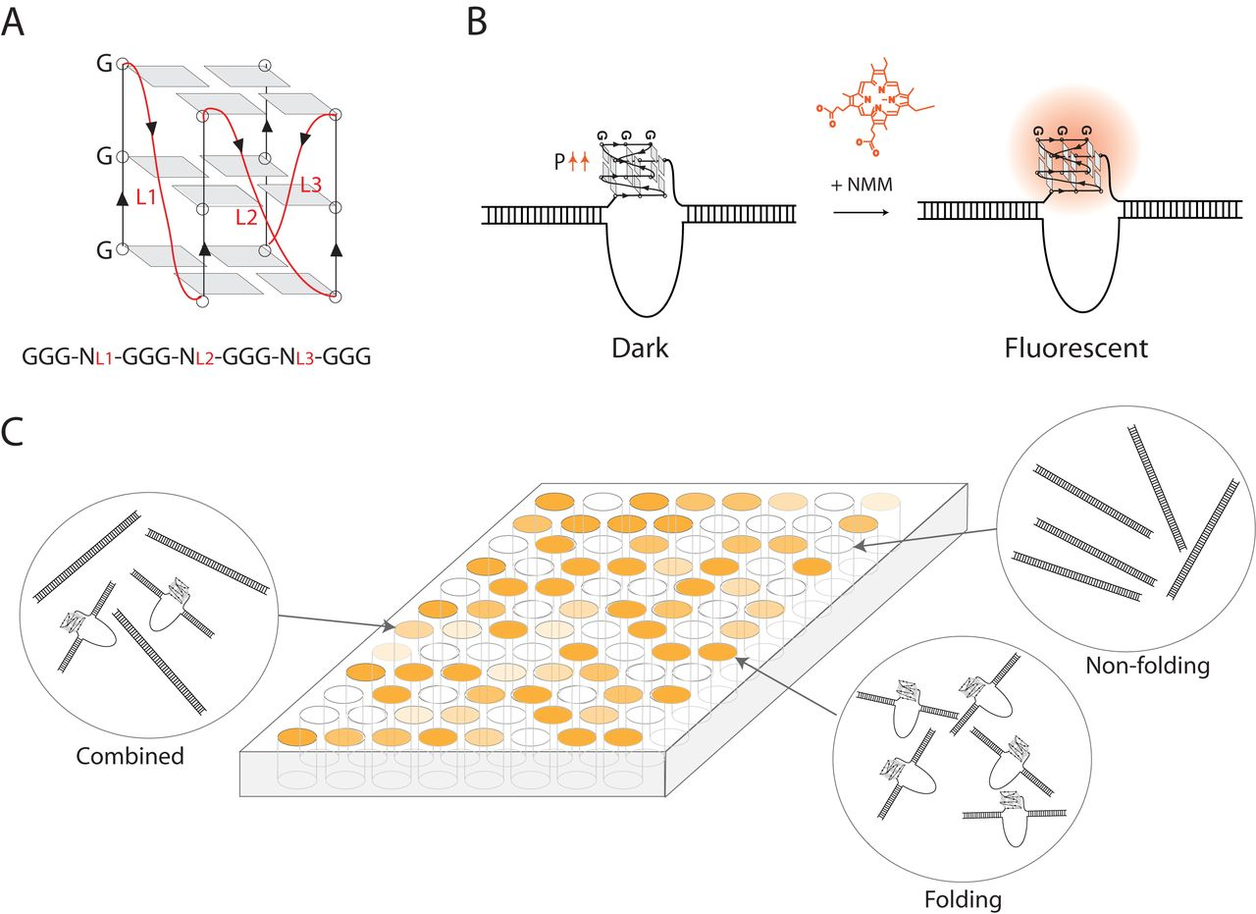
Figure 1. An overview of G-quadruplex structure and the NMM technique. (A) A schematic of a parallel GQ structure is ...
Notes:
Figure 1. An overview of G-quadruplex structure and the NMM technique. (A) A schematic of a parallel GQ structure is depicted. The guanine–guanine Hoogsteen base pairing between each guanine triplet is shown for the sequence $GGG{N_{L1}}GGG{N_{L2}}GGG{N_{L3}}GGG$, where N denotes the nucleotide component and L1, L2, L3 are the three loop lengths. (B) GQ folding propensity is investigated through an induced fluorescence based assay. The molecule NMM shows a specific increase in fluorescence signal upon binding to a parallel GQ sequence. (C) A plate is filled with strong folding sequences in high intensity, combined folding and nonfolding sequences in a lower intensity, and nonfolding sequences in low intensity.
Unless provided in the caption above, the following copyright applies to the content of this slide: © The Author(s) 2016. Published by Oxford University Press on behalf of Nucleic Acids Research.This is an Open Access article distributed under the terms of the Creative Commons Attribution License (http://creativecommons.org/licenses/by-nc/4.0/), which permits non-commercial re-use, distribution, and reproduction in any medium, provided the original work is properly cited. For commercial re-use, please contact journals.permissions@oup.com

Slide 2
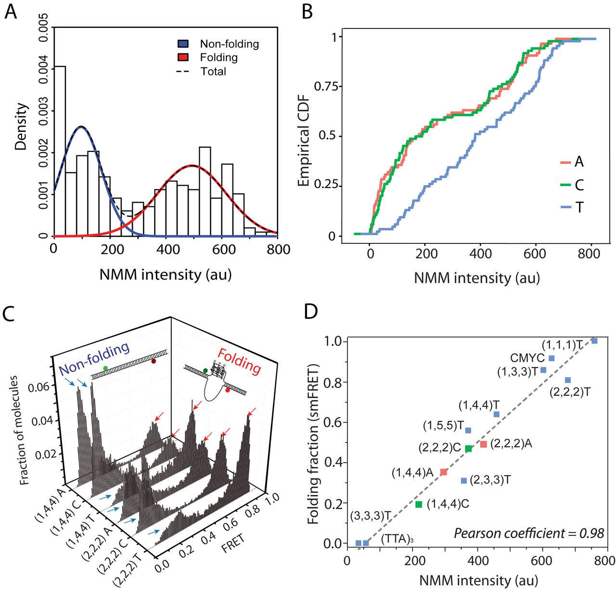
Figure 2. Pilot study of NMM fluorescence data points and relationship with smFRET scores. (A) The population of 246 ...
Notes:
Figure 2. Pilot study of NMM fluorescence data points and relationship with smFRET scores. (A) The population of 246 sequences is separated into nonfolding (blue) and folding (red) classes via the Gaussian mixture model. Dotted line shows the marginal (total) distribution of NMM intensities in the fitted mixture model. (B) The empirical cumulative distribution functions (CDF) are plotted for three nucleotides, A (red), C (green) and T (blue). (C) GQ folding percentage is verified through smFRET analysis for the loop lengths (1,4,4) and (2,2,2) in all three bases, where (L1, L2, L3) denotes the three loop lengths. High FRET populations (>0.7) correspond to GQ folding, while low FRET populations (<0.3) represent nonfolding sequences. (D) The graph shows the linear relationship between NMM intensity (x-axis) and GQ folding percentage (y-axis) for a wide range of 13 sequences that are composed of A (red), C (green) and T (blue). Pearson coefficient of 0.98 indicates a strong correlation between the two measurements.
Unless provided in the caption above, the following copyright applies to the content of this slide: © The Author(s) 2016. Published by Oxford University Press on behalf of Nucleic Acids Research.This is an Open Access article distributed under the terms of the Creative Commons Attribution License (http://creativecommons.org/licenses/by-nc/4.0/), which permits non-commercial re-use, distribution, and reproduction in any medium, provided the original work is properly cited. For commercial re-use, please contact journals.permissions@oup.com

Slide 3
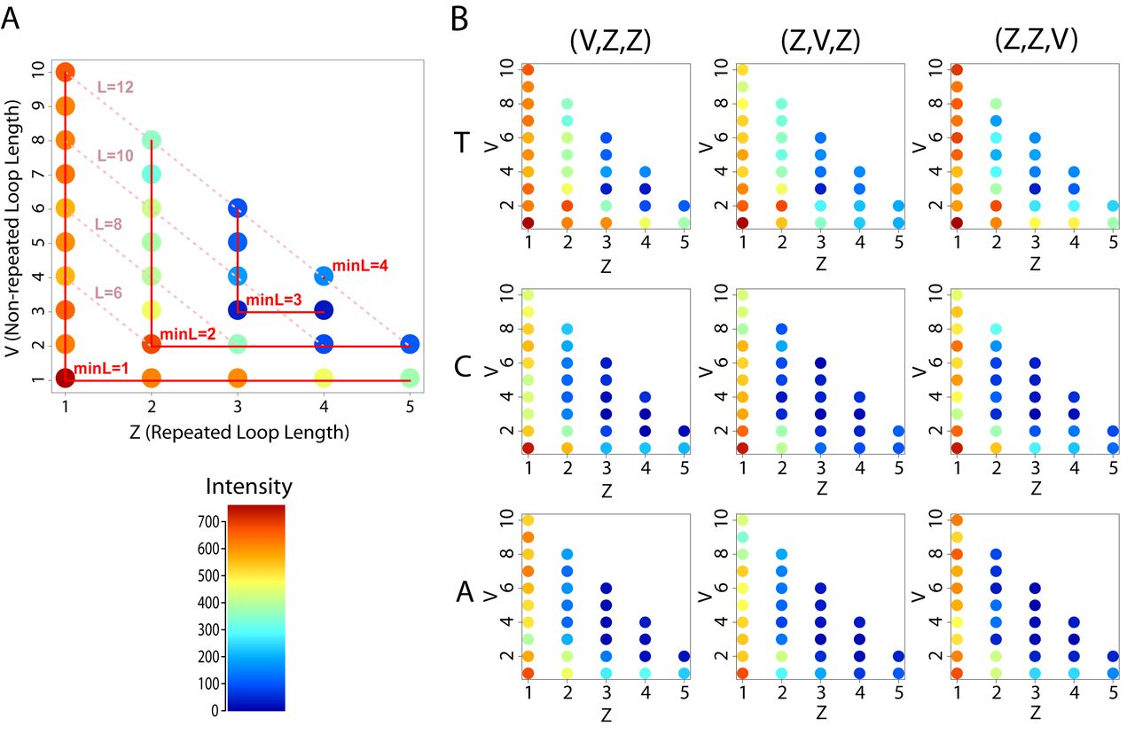
Figure 3. Visualization of the NMM intensity data used in pilot study. (A) Intensities of 30 data points are plotted ...
Notes:
Figure 3. Visualization of the NMM intensity data used in pilot study. (A) Intensities of 30 data points are plotted for nucleotide T and permutation (V, Z, Z), where Z (x-axis) is the repeated loop length and V (y-axis) is the remaining length. The minimum (minL) and sum (L) of three loop lengths are indicated in red and pink lines, respectively, and each data point is colored according to the intensity color bar plotted in the bottom. (B) Intensities of all 246 sequences used for our pilot study are plotted, in nine subgraphs that have similar structure as Figure 3A. Rows indicate N = T, C or A, in order, and columns indicate the three possible permutations for each Z and V, e.g., (V, Z, Z), (Z, V, Z) and (Z, Z, V).
Unless provided in the caption above, the following copyright applies to the content of this slide: © The Author(s) 2016. Published by Oxford University Press on behalf of Nucleic Acids Research.This is an Open Access article distributed under the terms of the Creative Commons Attribution License (http://creativecommons.org/licenses/by-nc/4.0/), which permits non-commercial re-use, distribution, and reproduction in any medium, provided the original work is properly cited. For commercial re-use, please contact journals.permissions@oup.com

Slide 4
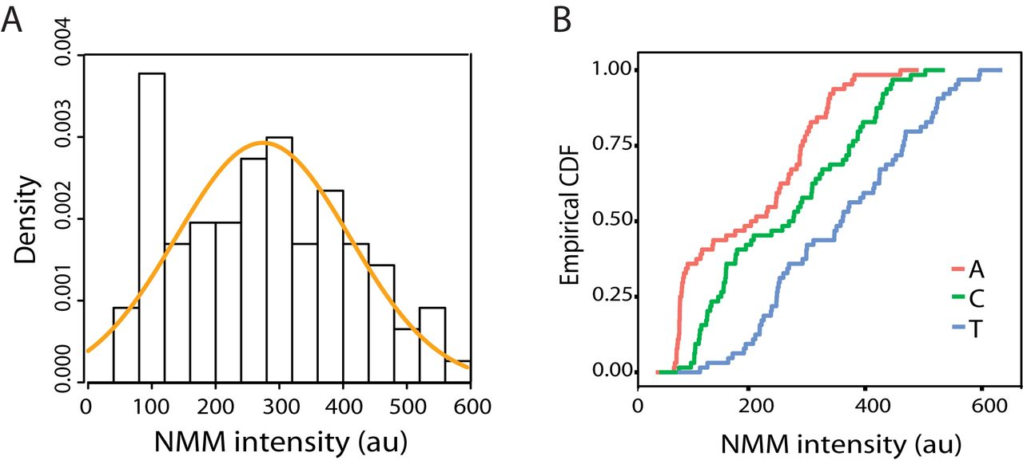
Figure 4. Overview of new set of 192 sequences tested. (A) The density of the new set is plotted and the Gaussian ...
Notes:
Figure 4. Overview of new set of 192 sequences tested. (A) The density of the new set is plotted and the Gaussian distribution is overlaid in orange, where mean and variance are calculated from the 192 intensity values. (B) The empirical cumulative distribution functions (CDF) are plotted for sequences in A (red), C (green) and T (blue).
Unless provided in the caption above, the following copyright applies to the content of this slide: © The Author(s) 2016. Published by Oxford University Press on behalf of Nucleic Acids Research.This is an Open Access article distributed under the terms of the Creative Commons Attribution License (http://creativecommons.org/licenses/by-nc/4.0/), which permits non-commercial re-use, distribution, and reproduction in any medium, provided the original work is properly cited. For commercial re-use, please contact journals.permissions@oup.com

Slide 5
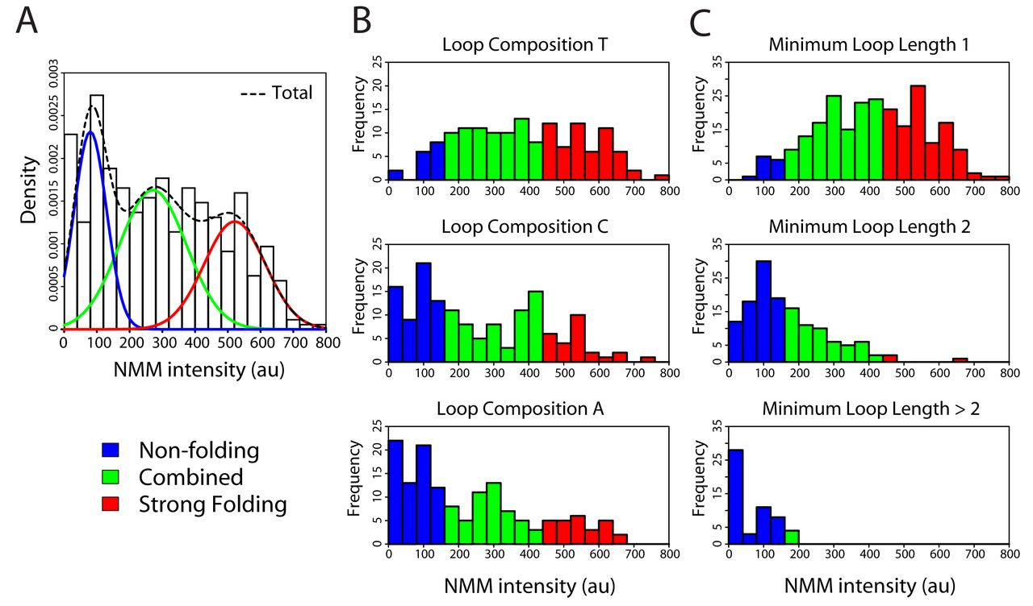
Figure 5. Histograms of 438 comprehensive NMM fluorescence data points. (A) The density of NMM intensities is plotted ...
Notes:
Figure 5. Histograms of 438 comprehensive NMM fluorescence data points. (A) The density of NMM intensities is plotted and the Gaussian mixture model separates the population into three separate classes: nonfolding (blue), combined (green) and strong folding GQs (red). Dotted line shows the marginal distribution of NMM intensities in the fitted mixture model. (B) Three independent histograms of the NMM intensities are provided for each loop composition T, C and A. Bars are colored according to their GQ classification from Figure 5A: blue if intensity < 151, green if 151 < intensity 412. (C) Histograms of the NMM intensities are provided for sequences with minimum loop length 1, 2 and greater than 2 and the bars are colored according to the GQ class that they belong to.
Unless provided in the caption above, the following copyright applies to the content of this slide: © The Author(s) 2016. Published by Oxford University Press on behalf of Nucleic Acids Research.This is an Open Access article distributed under the terms of the Creative Commons Attribution License (http://creativecommons.org/licenses/by-nc/4.0/), which permits non-commercial re-use, distribution, and reproduction in any medium, provided the original work is properly cited. For commercial re-use, please contact journals.permissions@oup.com

