Slide 1
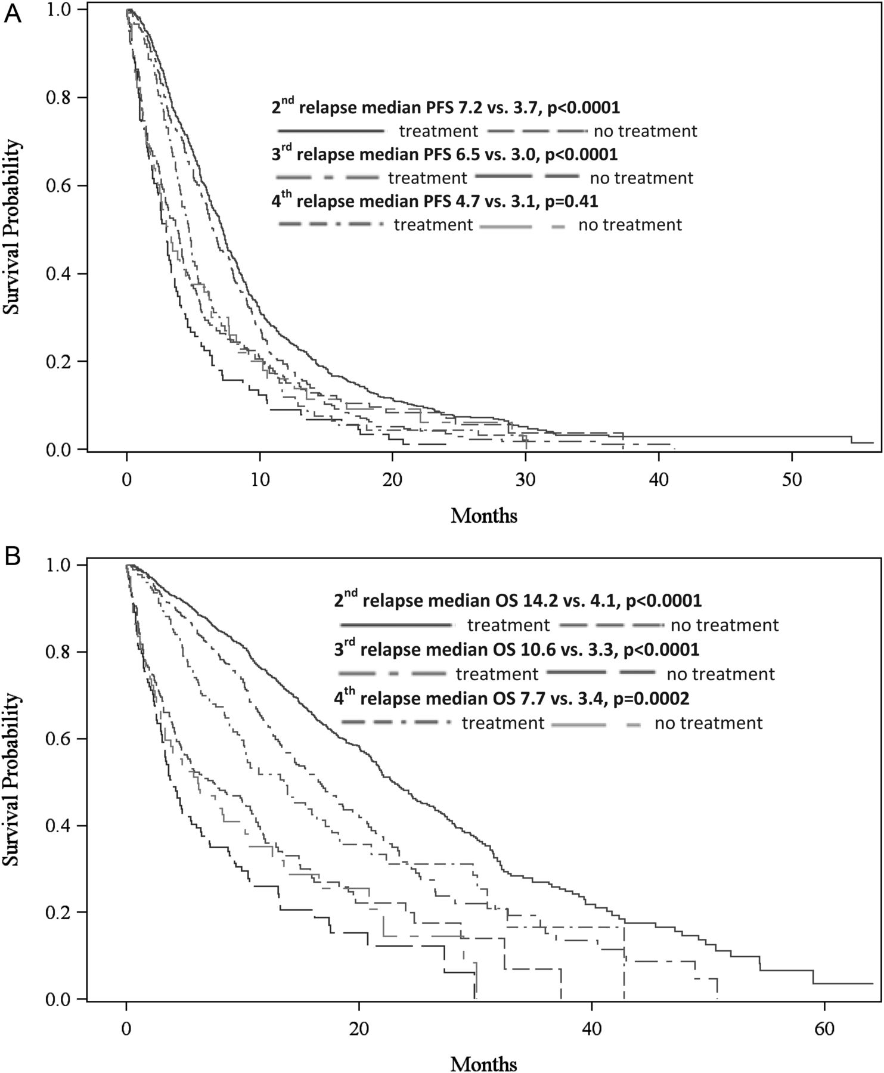
Figure 3. Kaplan–Meier analyses of progression-free survival (PFS) and overall survival (OS) depending on subsequent ...
Notes:
Figure 3. Kaplan–Meier analyses of progression-free survival (PFS) and overall survival (OS) depending on subsequent relapse according to treatment decision at relapse. Panel A shows PFS after relapse 2–4 stratified by the patients that did receive relapse treatment and the patients that did not receive treatment anymore. Panel B shows corresponding OS.
Unless provided in the caption above, the following copyright applies to the content of this slide: © The Author 2012. Published by Oxford University Press on behalf of the European Society for Medical Oncology. All rights reserved. For permissions, please email: journals.permissions@oup.com.

Slide 2
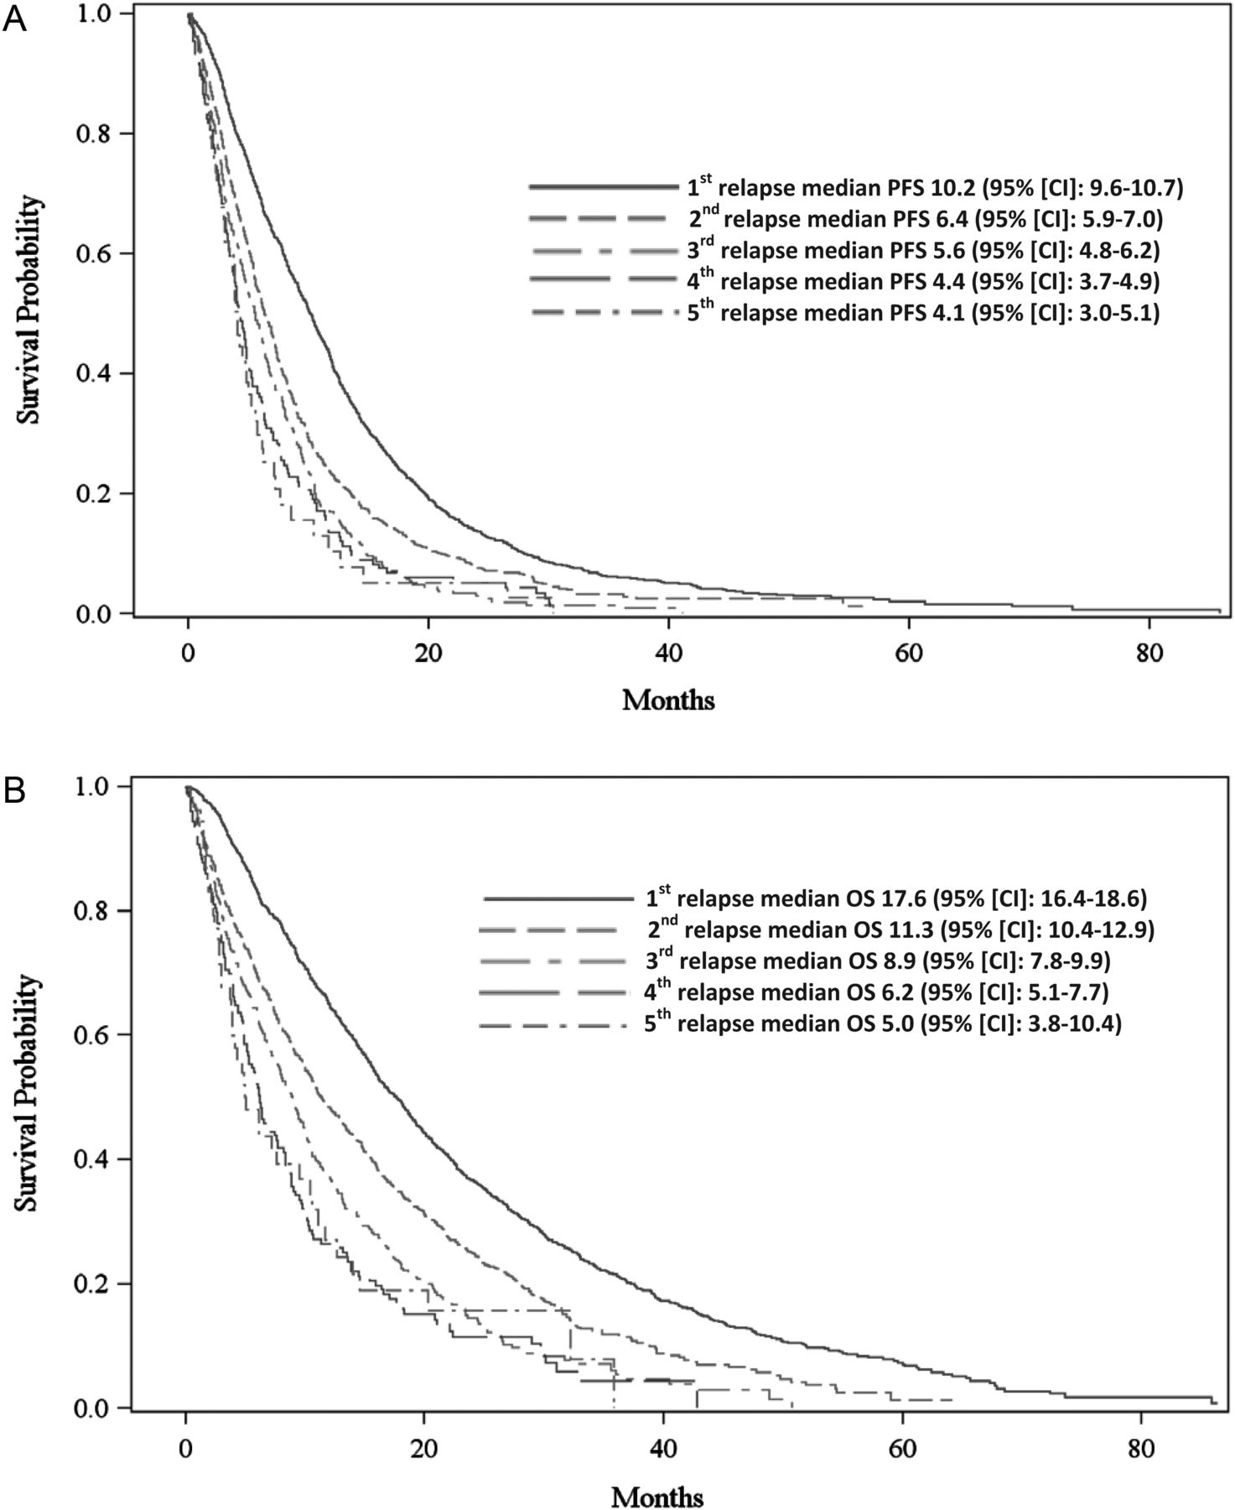
Figure 2. Kaplan–Meier analyses of progression-free survival (PFS) and overall survival (OS) were carried out in the ...
Notes:
Figure 2. Kaplan–Meier analyses of progression-free survival (PFS) and overall survival (OS) were carried out in the whole patients’ cohort depending on subsequent relapse. Panel A shows PFS after relapse 1–5. Panel B shows OS after relapse 1–5.
Unless provided in the caption above, the following copyright applies to the content of this slide: © The Author 2012. Published by Oxford University Press on behalf of the European Society for Medical Oncology. All rights reserved. For permissions, please email: journals.permissions@oup.com.

Slide 3
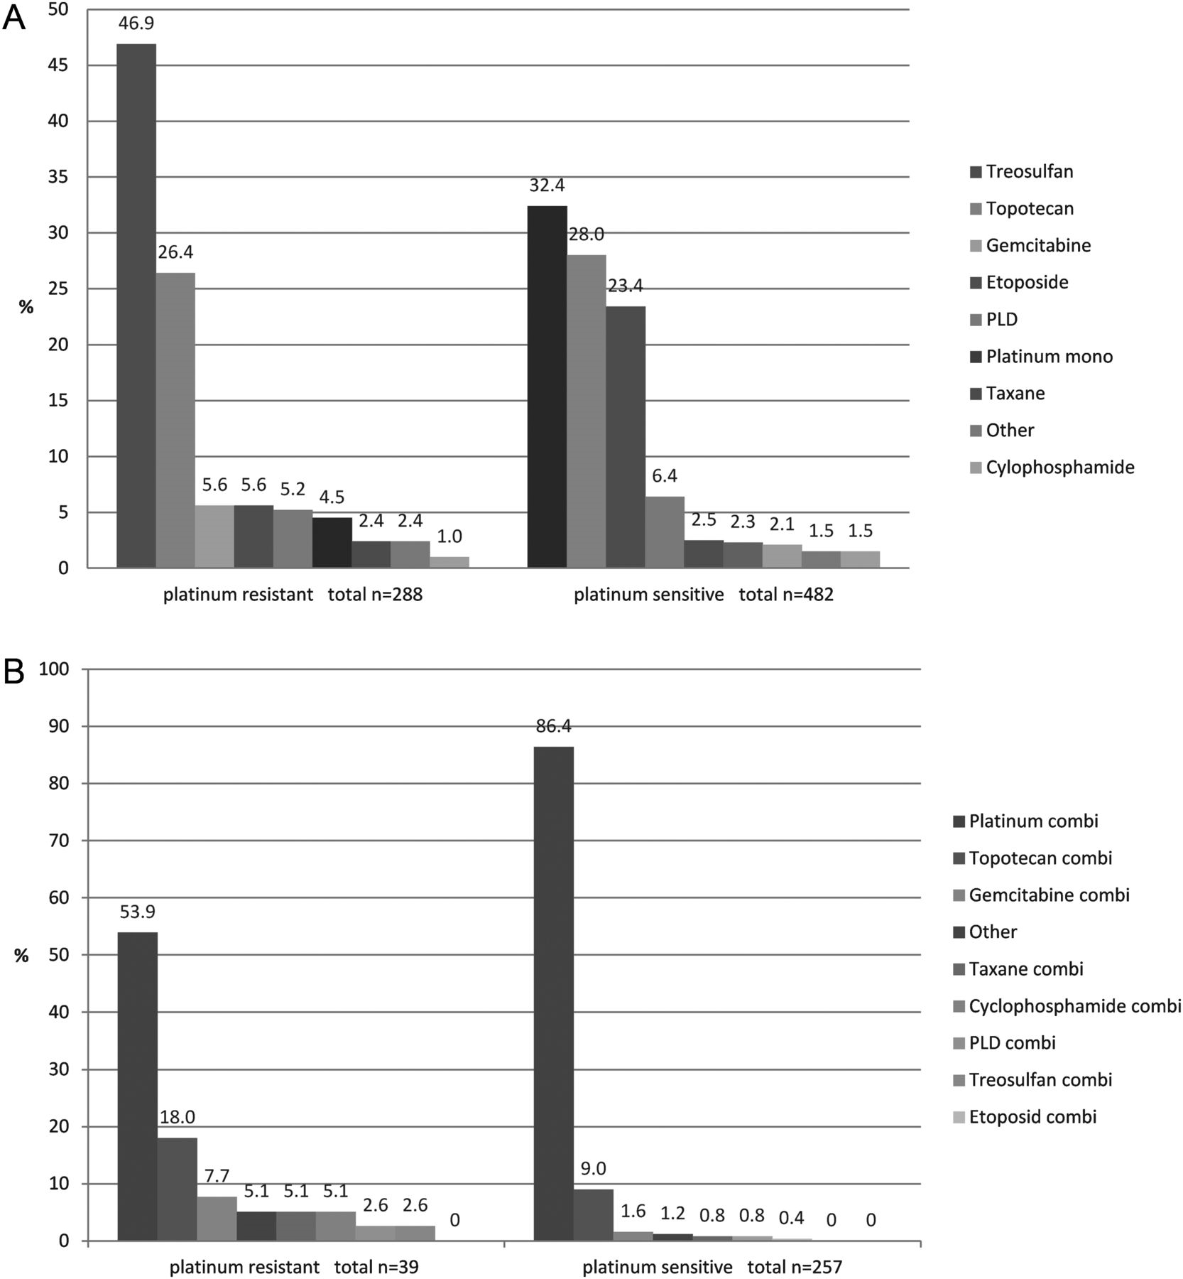
Figure 1. Distribution of (A) mono- and (B) polychemotherpeutic regimens according to platinum sensitivity.
Notes:
Figure 1. Distribution of (A) mono- and (B) polychemotherpeutic regimens according to platinum sensitivity.
Unless provided in the caption above, the following copyright applies to the content of this slide: © The Author 2012. Published by Oxford University Press on behalf of the European Society for Medical Oncology. All rights reserved. For permissions, please email: journals.permissions@oup.com.

