Slide 1
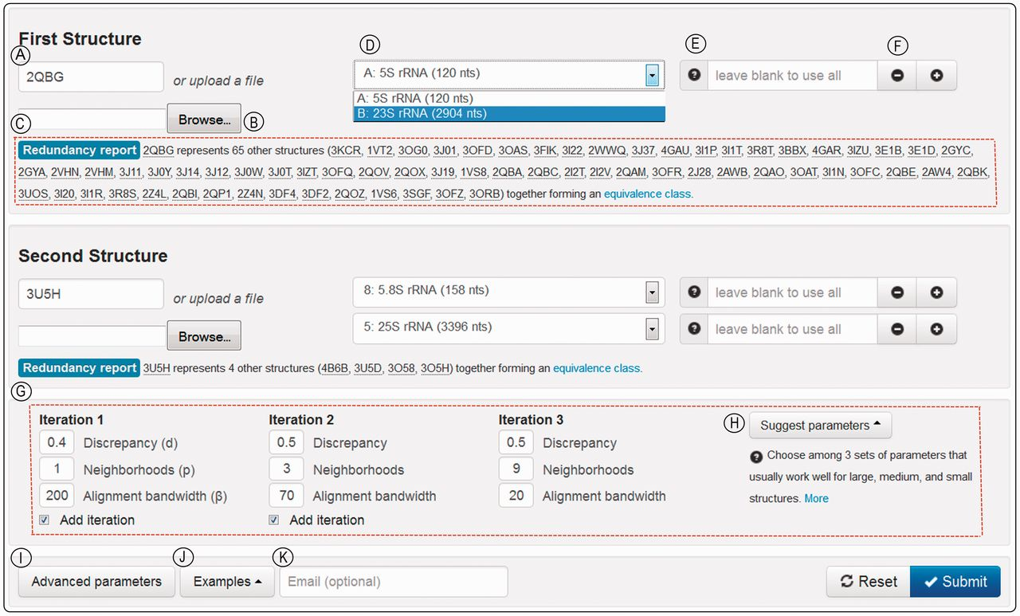
Figure 1. R3D Align web page for user input. Encircled capital letters label features. (A) Text box to specify the PDB ...
Notes:
Figure 1. R3D Align web page for user input. Encircled capital letters label features. (A) Text box to specify the PDB code of the first structure to align; optionally, (B) shows where the user can upload a PDB-formatted file. (C) On entry of a PDB code, users are provided the redundancy report for the chosen structure, identifying the PDB code of the file that represents the structure class. (D) When users enter a PDB code, they are provided a drop-down list from which to select among the chains in the file. (E) Text box that allows users to restrict attention to one or more ranges of nucleotide numbers within the chain. The question mark by (E) explains how to enter nucleotide ranges. (F) The plus and minus signs allow users to add or remove sequence fragments. (G) The advanced parameter input box, hidden by default, is made visible by clicking the ‘Advanced Parameters’ button (I) and is initially populated with default parameters that work reasonably well for structures of all sizes. Optionally, the ‘Suggest parameters’ button (H) suggests parameters more efficient based on the size of the input structures. (J) The ‘Examples’ button provides complete input specifications for sample ribosomal alignments. (K) The user may provide an email address to be notified when the job is completed and receive the URL of the results page.
Unless provided in the caption above, the following copyright applies to the content of this slide: © The Author(s) 2013. Published by Oxford University Press.This is an Open Access article distributed under the terms of the Creative Commons Attribution License (http://creativecommons.org/licenses/by/3.0/), which permits unrestricted reuse, distribution, and reproduction in any medium, provided the original work is properly cited.

Slide 2
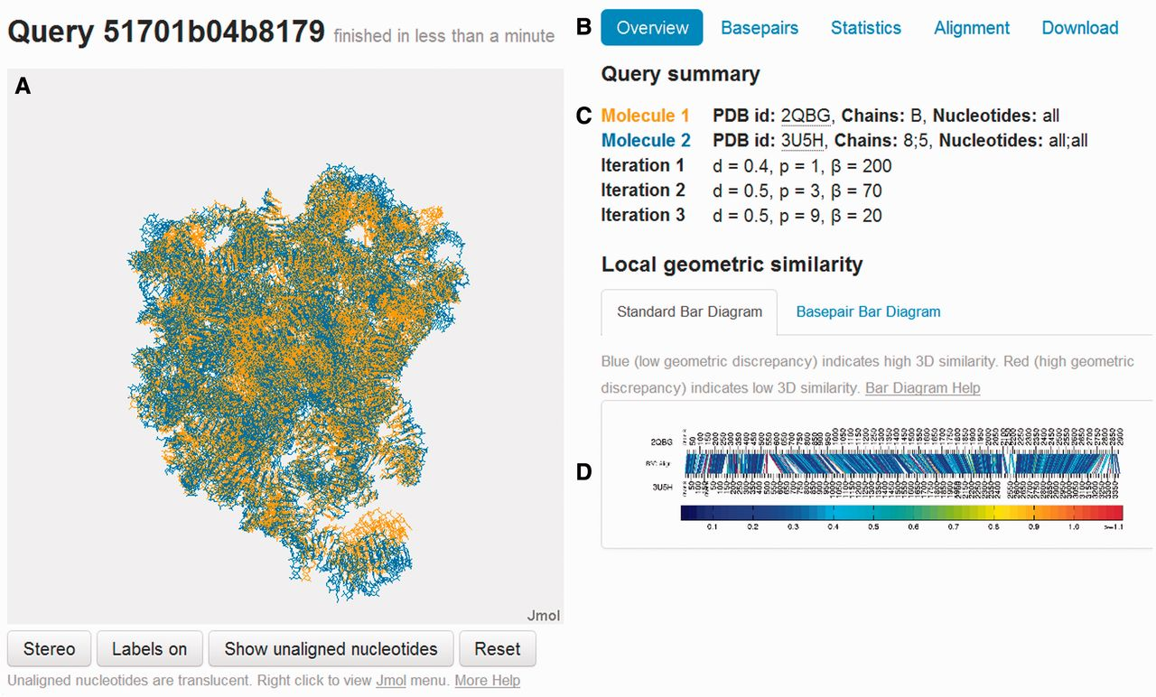
Figure 2. R3D Align Results page. Labels in encircled capital letters indicate the following features. (A) Jmol applet ...
Notes:
Figure 2. R3D Align Results page. Labels in encircled capital letters indicate the following features. (A) Jmol applet displaying the rigid-body superposition of the two aligned structures. (B) Tabs from which a variety of displays of the alignment can be accessed. (C) Input parameters for the alignment. (D) Bar Diagram accessible with the Overview tab.
Unless provided in the caption above, the following copyright applies to the content of this slide: © The Author(s) 2013. Published by Oxford University Press.This is an Open Access article distributed under the terms of the Creative Commons Attribution License (http://creativecommons.org/licenses/by/3.0/), which permits unrestricted reuse, distribution, and reproduction in any medium, provided the original work is properly cited.

Slide 3
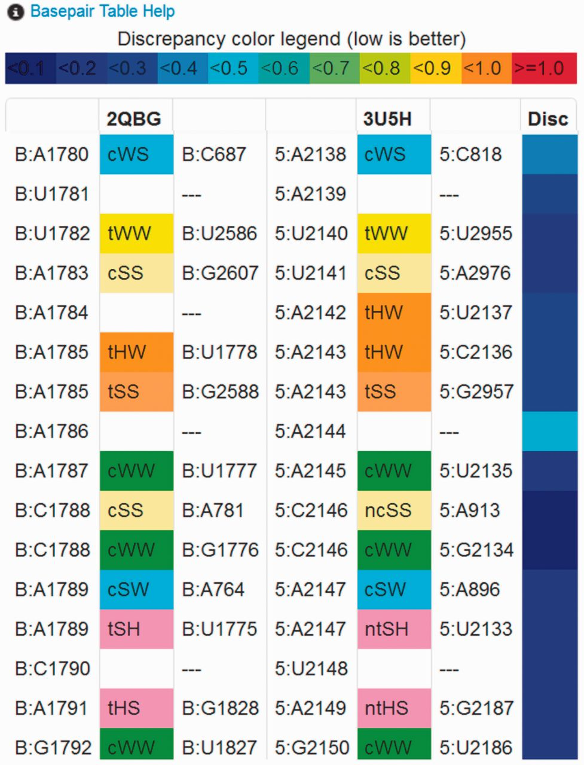
Figure 3. Sample Output: Basepair Table. The Basepair Table, accessible under the Basepairs tab (Figure 2B), lists all ...
Notes:
Figure 3. Sample Output: Basepair Table. The Basepair Table, accessible under the Basepairs tab (Figure 2B), lists all the nucleotides and annotated basepairs of the two aligned structures sequentially. Columns 1–3 list nucleotides and pairs of the first aligned structure (chain:base_type nt_number) and columns 4–6, those of the second. Nucleotides and basepairs that are aligned by R3D Align appear in the same row. Basepair types (26) are listed in columns 2 and 5 and are color coded to facilitate visual comparison of local basepair correspondences. When one structure has a basepair aligned with two non-basepairing nucleotides in the other structure, another pairwise interaction type may be listed. ‘Near’ basepair annotations are prefixed with ‘n’ and colored in the same way as the corresponding pairs. Stacking interactions are prefixed by ‘s’. Column 7 indicates the local geometric discrepancy for the nucleotides in Columns 1 and 4, as calculated for the Bar Diagrams.
Unless provided in the caption above, the following copyright applies to the content of this slide: © The Author(s) 2013. Published by Oxford University Press.This is an Open Access article distributed under the terms of the Creative Commons Attribution License (http://creativecommons.org/licenses/by/3.0/), which permits unrestricted reuse, distribution, and reproduction in any medium, provided the original work is properly cited.

Slide 4
Figure 4. Comparison of alignments of good, medium and low quality models to the experimentally determined structure, ...
Notes:
Figure 4. Comparison of alignments of good, medium and low quality models to the experimentally determined structure, using the R3D Align Basepair Bar Diagram. Aligned nucleotides are indicated by straight colored lines linking the two nucleotide sequences, color coded by geometric discrepancy. The arcs above and below correspond to basepairs in the first and the second structures, respectively. Nested cWW basepairs belonging to the 2D structure are colored royal blue. Non-nested cWW basepairs, forming pseudoknots, when present, are colored red. Nested non-cWW basepairs, belonging to hairpin and internal loops, are colored light blue, and non-nested non-cWW pairs, forming tertiary contacts, are colored green. (A) 3D alignment of two versions of the same experimentally determined 3D structure representing the solution for Challenge 3 of the RNAPuzzles competition (28). (B) 3D alignment of lowest RMSD structure (below) with an experimentally determined structure (above). (C) 3D alignment of highest RMSD structure (below) with an experimentally determined structure (above). Both predicted structures lack most of the non-Watson–Crick basepairs observed experimentally. These diagrams can be accessed online using the URLs listed in Supplementary Table S1.
Unless provided in the caption above, the following copyright applies to the content of this slide: © The Author(s) 2013. Published by Oxford University Press.This is an Open Access article distributed under the terms of the Creative Commons Attribution License (http://creativecommons.org/licenses/by/3.0/), which permits unrestricted reuse, distribution, and reproduction in any medium, provided the original work is properly cited.

