Slide 1
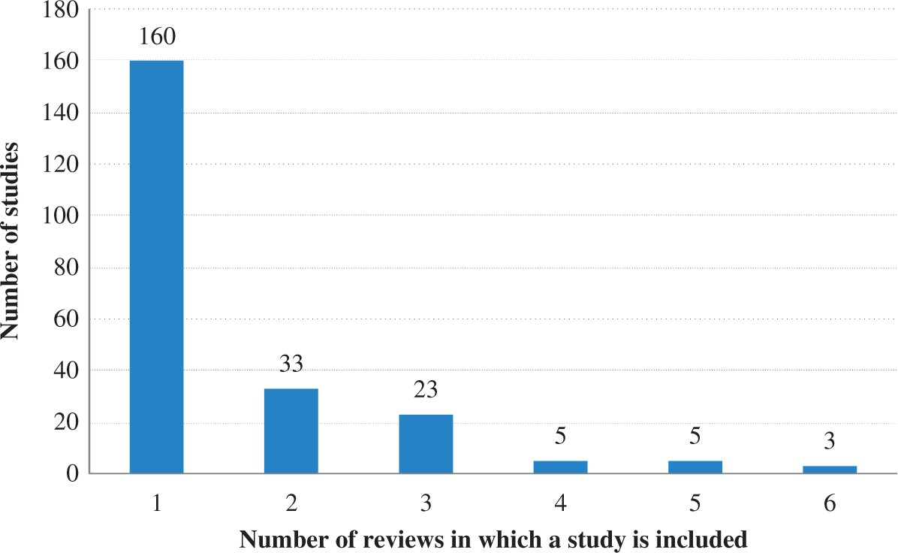
Figure 1. Distribution of Learning Studies Across Reviews. Note: The total number of learning studies is 229.
Notes:
Figure 1. Distribution of Learning Studies Across Reviews. Note: The total number of learning studies is 229.
Unless provided in the caption above, the following copyright applies to the content of this slide: © The Author 2016. Published by Oxford University Press on behalf of the International Bank for Reconstruction and Development / THE WORLD BANK. All rights reserved. For Permissions, please e-mail: journals.permissions@oup.com

