Slide 1
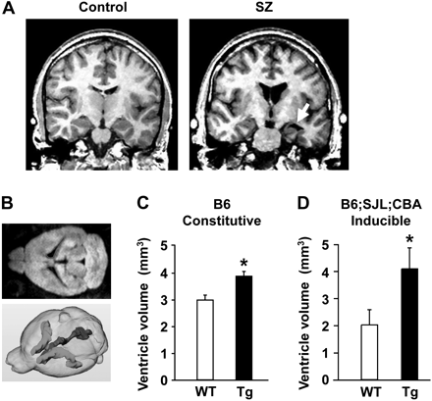
Fig. 1. In Vivo Magnetic Resonance Imaging Demonstrating Enlarged Lateral Ventricles in Both Patients With ...
Notes:
Fig. 1. In Vivo Magnetic Resonance Imaging Demonstrating Enlarged Lateral Ventricles in Both Patients With Schizophrenia and Mouse Models for Schizophrenia. A, Schizophrenia patients: shrinkage in the left temporal horn is detected (white arrow). B–D, mouse models for schizophrenia: a representative 2-dimensional image with the lateral ventricles (top in B) and a 3-dimensional construction (bottom in B). Enlarged lateral ventricles in transgenic mice expressing a truncated, dominant-negative form of DISC1 (C, conventional model in the C57 black strain; D, inducible model in a mixed genetic background). (A, reprinted with permission from The New England Journal of Medicine; 1992; B, top panel, and C, adapted from Proceedings of National Academy of Sciences United States of America; B, bottom panel, and D, reprinted by permission from Molecular Psychiatry; 2007.
Unless provided in the caption above, the following copyright applies to the content of this slide: © The Author 2009. Published by Oxford University Press on behalf of the Maryland Psychiatric Research Center. All rights reserved. For permissions, please email: journals.permissions@oxfordjournals.org.

Slide 2
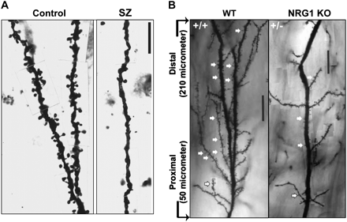
Fig. 2. Decrease in Dendritic Spine Density in Both (A) Patients With Schizophrenia (Prefrontal Cortex) and (B) A ...
Notes:
Fig. 2. Decrease in Dendritic Spine Density in Both (A) Patients With Schizophrenia (Prefrontal Cortex) and (B) A Mouse Model for Schizophrenia (Neuregulin-1 Type III Knockout Mice Compared With Wild-Type Animals in Hippocampus). (A, Adapted from Archives of General Psychiatry; 57:65–73; B, with permission from Chen et al73Journal of Neuroscience; 2008).
Unless provided in the caption above, the following copyright applies to the content of this slide: © The Author 2009. Published by Oxford University Press on behalf of the Maryland Psychiatric Research Center. All rights reserved. For permissions, please email: journals.permissions@oxfordjournals.org.

Slide 3
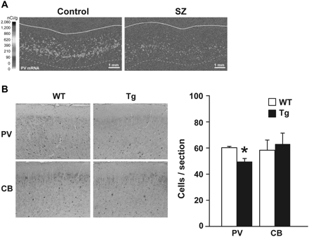
Fig. 3. Decrease in the Level of Parvalbumin (PV) Expression in the Prefrontal Cortex, Observed Both in (A) ...
Notes:
Fig. 3. Decrease in the Level of Parvalbumin (PV) Expression in the Prefrontal Cortex, Observed Both in (A) Schizophrenia Patients (mRNA Level) and (B) A Mouse Model for Schizophrenia (disrupted in schizophrenia-1 [DISC1] Transgenic Mice Expressing the Truncated, Dominant-Negative Form of “DISC1”). There was decrease in PV staining but not in calbindin (CB) staining. A, reprinted by permission from Nature Reviews Neuroscience31; 2005. B, adapted from Proceedings of the National Academy of Sciences United States of America.81
Unless provided in the caption above, the following copyright applies to the content of this slide: © The Author 2009. Published by Oxford University Press on behalf of the Maryland Psychiatric Research Center. All rights reserved. For permissions, please email: journals.permissions@oxfordjournals.org.

