Slide 1
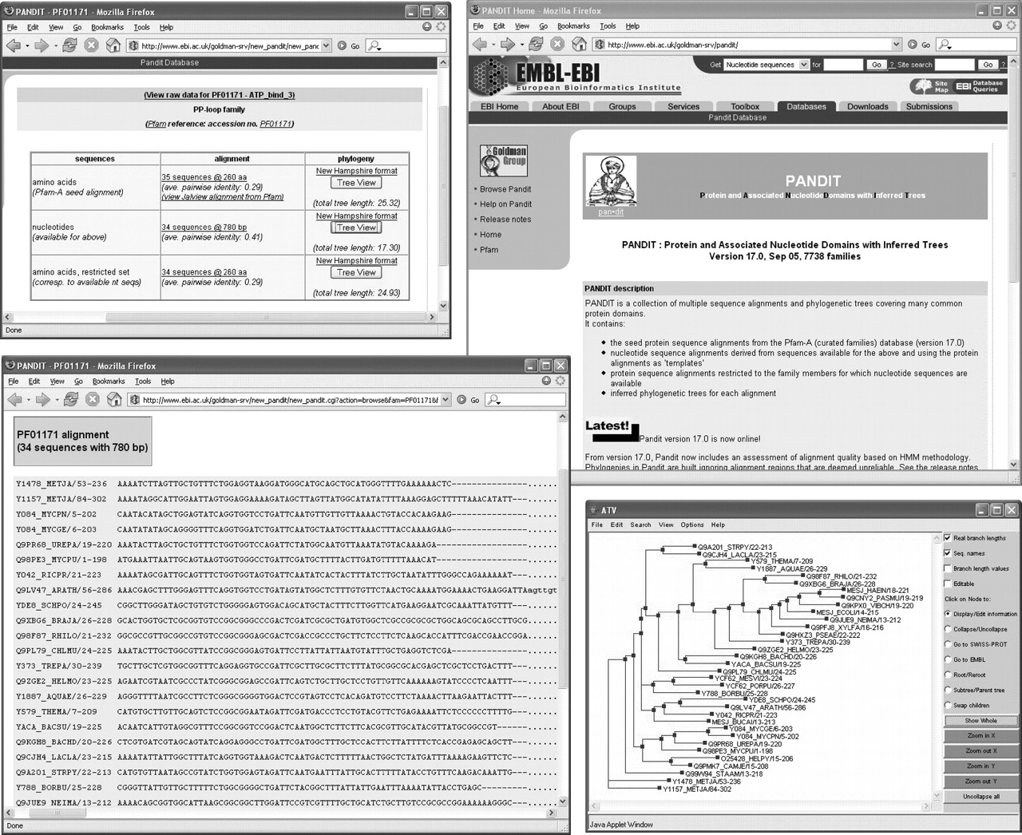
Figure 1 Example of the contents of the PANDIT website, including (anticlockwise from top right) the homepage, the ...
Notes:
Figure 1 Example of the contents of the PANDIT website, including (anticlockwise from top right) the homepage, the page describing the data available for PF01171 (PP-loop family), the nucleotide sequence alignment for PF01171 and its associated phylogenetic tree.
Unless provided in the caption above, the following copyright applies to the content of this slide: © The Author 2006. Published by Oxford University Press. All rights reserved The online version of this article has been published under an open access model. Users are entitled to use, reproduce, disseminate, or display the open access version of this article for non-commercial purposes provided that: the original authorship is properly and fully attributed; the Journal and Oxford University Press are attributed as the original place of publication with the correct citation details given; if an article is subsequently reproduced or disseminated not in its entirety but only in part or as a derivative work this must be clearly indicated. For commercial re-use, please contact journals.permissions@oxfordjournals.org

