Slide 1
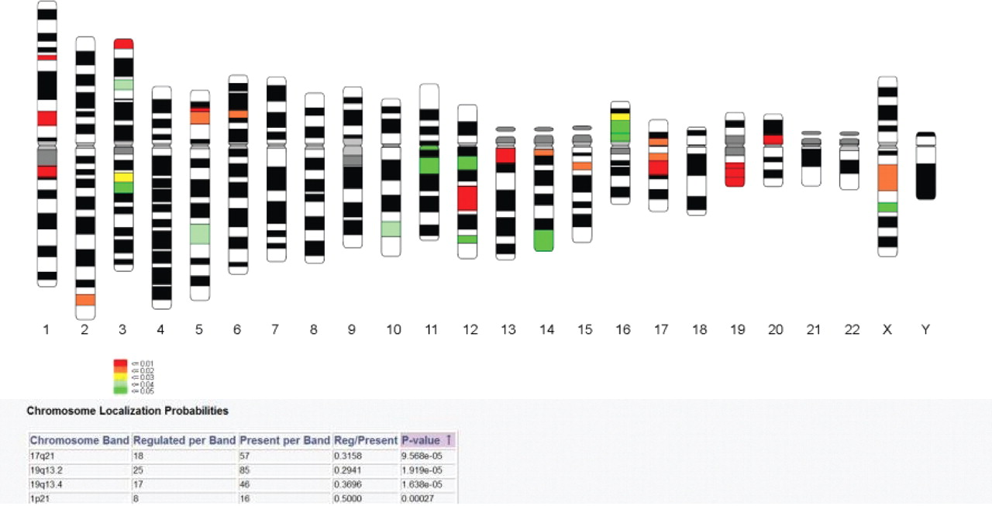
Fig. 1 Probabilities of co-localization of regulated genes plotted onto a human karyogram. Chromosomal regions are ...
Notes:
Fig. 1 Probabilities of co-localization of regulated genes plotted onto a human karyogram. Chromosomal regions are colored according to decreasing probability of co-localization by chance. The table underneath the karyogram displays the chromosome regions where probabilities have been calculated along with the number of features both in the selected set and whole population present in these regions.
Unless provided in the caption above, the following copyright applies to the content of this slide: © The Author 2005. Published by Oxford University Press. All rights reserved. For Permissions, please email: journals.permissions@oxfordjournals.org

