Slide 1
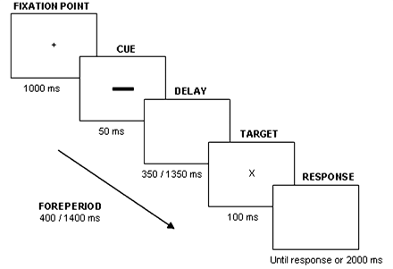
Figure 1 Sequence of events on a trial.
Notes:
Figure 1 Sequence of events on a trial.
Unless provided in the caption above, the following copyright applies to the content of this slide: © The Author (2010). Published by Oxford University Press on behalf of the Guarantors of Brain. All rights reserved. For Permissions, please email: journals.permissions@oxfordjournals.org

Slide 2
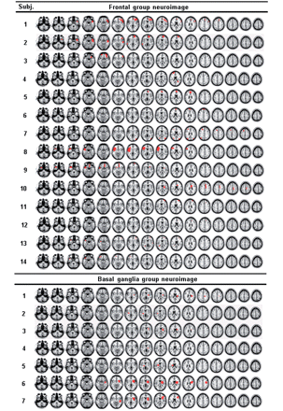
Figure 2 Magnetic resonance images in 7 mm slices for each patient group. All the images were drawn with MRIcroN ...
Notes:
Figure 2 Magnetic resonance images in 7 mm slices for each patient group. All the images were drawn with MRIcroN software. The left hemisphere is represented at the left side of the images and vice versa.
Unless provided in the caption above, the following copyright applies to the content of this slide: © The Author (2010). Published by Oxford University Press on behalf of the Guarantors of Brain. All rights reserved. For Permissions, please email: journals.permissions@oxfordjournals.org

Slide 3
Figure 3 (A) Temporal orienting effect in control, basal ganglia and frontal groups. The temporal orienting effect ...
Notes:
Figure 3 (A) Temporal orienting effect in control, basal ganglia and frontal groups. The temporal orienting effect (faster reaction times in valid versus invalid trials) was significantly smaller for the frontal group as compared to both control and basal ganglia groups. (B) The temporal orienting effect in subgroups of left (n = 5) versus right (n = 6) prefrontal patients. Only the left prefrontal group shows the temporal orienting effect. Error bars represent the standard error of the mean.
Unless provided in the caption above, the following copyright applies to the content of this slide: © The Author (2010). Published by Oxford University Press on behalf of the Guarantors of Brain. All rights reserved. For Permissions, please email: journals.permissions@oxfordjournals.org

Slide 4
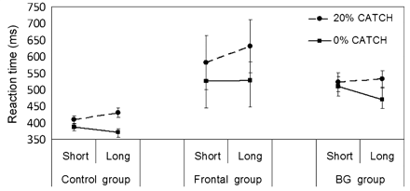
Figure 4 Foreperiod effect in control, basal ganglia and frontal groups. The effect is usually observed as a ...
Notes:
Figure 4 Foreperiod effect in control, basal ganglia and frontal groups. The effect is usually observed as a significant reaction time decrease in the long foreperiod compared with the short one, when the target always occurred (0% catch). In this condition, both control and basal ganglia groups show the foreperiod effect, whereas the frontal group does not show it. However, in the 20% catch trials condition, a reaction time increase in the long foreperiod is observed compared with the short one. In this case, all the groups show this reaction time slowing. Error bars represent the standard error of the mean.
Unless provided in the caption above, the following copyright applies to the content of this slide: © The Author (2010). Published by Oxford University Press on behalf of the Guarantors of Brain. All rights reserved. For Permissions, please email: journals.permissions@oxfordjournals.org

Slide 5
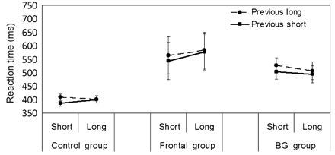
Figure 5 Sequential effects in control, basal ganglia and frontal groups. This effect may be observed as a reaction ...
Notes:
Figure 5 Sequential effects in control, basal ganglia and frontal groups. This effect may be observed as a reaction time decrease in the current short foreperiod when the previous foreperiod was short instead of long. All the groups show the typical pattern of sequential effects. Error bars represent the standard error of the mean.
Unless provided in the caption above, the following copyright applies to the content of this slide: © The Author (2010). Published by Oxford University Press on behalf of the Guarantors of Brain. All rights reserved. For Permissions, please email: journals.permissions@oxfordjournals.org

