Slide 1
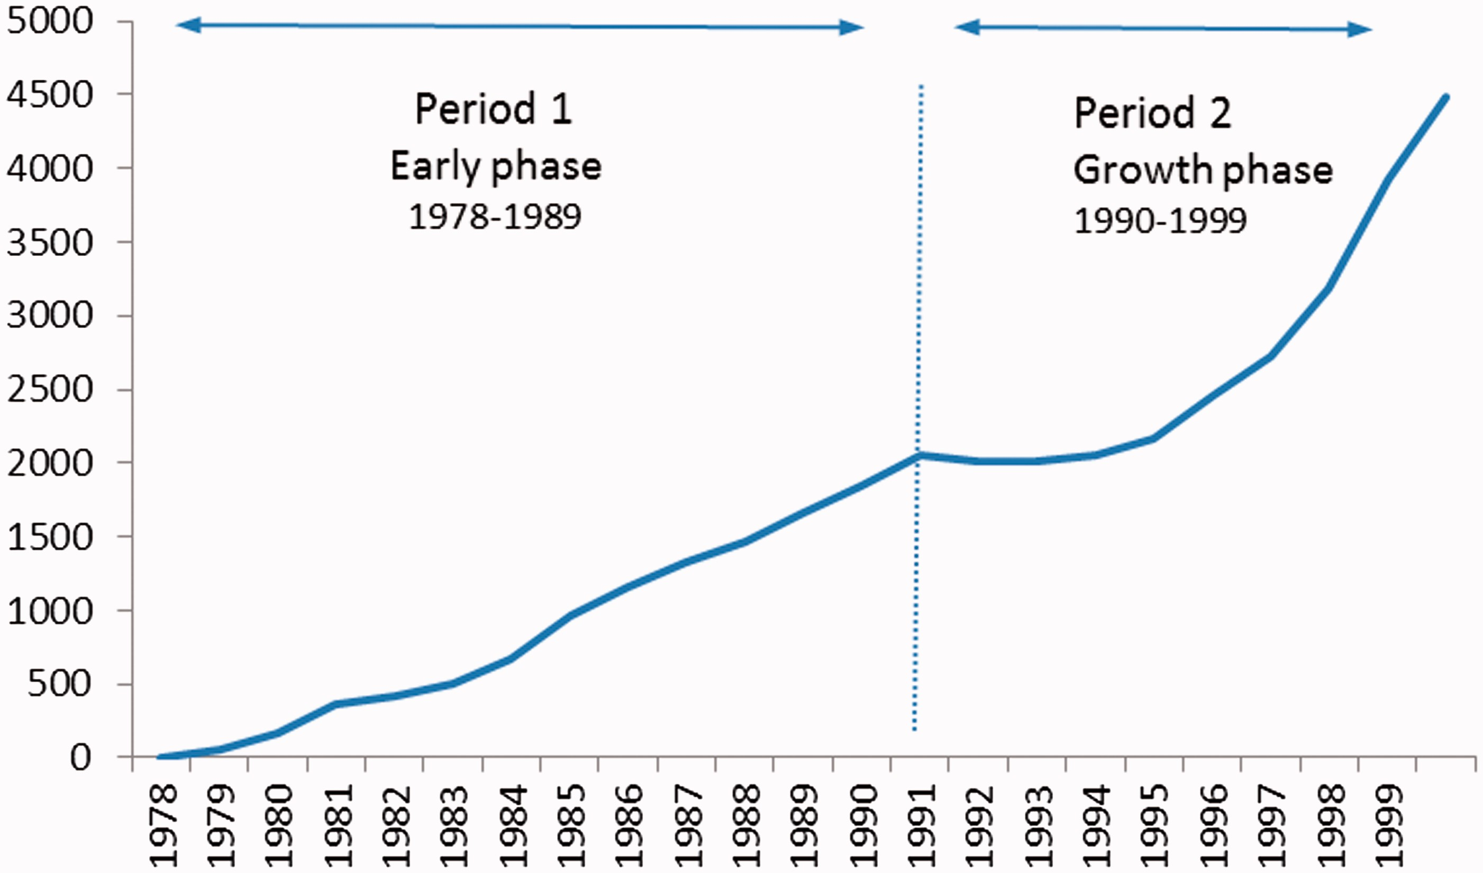
Figure 1. Evolution of patenting in the field of biotechnology (EPO Patents, period 1978–1999, worldwide)
Notes:
Figure 1. Evolution of patenting in the field of biotechnology (EPO Patents, period 1978–1999, worldwide)
Unless provided in the caption above, the following copyright applies to the content of this slide: © The Author 2016. Published by Oxford University Press on behalf of Associazione ICC. All rights reserved.

Slide 2
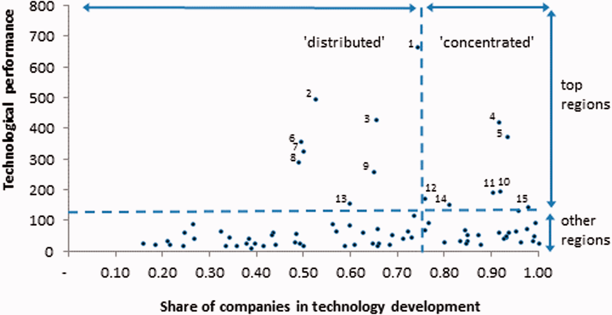
Figure 2. The technological performance of regions and the share of biotech technology development activities ...
Notes:
Figure 2. The technological performance of regions and the share of biotech technology development activities undertaken by private firms (period 1992–1997, 78 biotech regions). Notes. The top 15 leading regions in biotech technology development over the period 1992–1997 are 1. North California, USA; 2. Massachusetts, USA; 3. South California, USA; 4. Tokyo-TO, Japan; 5. New Jersey, USA; 6. New York, USA; 7. Île-de-France, France; 8. Maryland, USA; 9. Pennsylvania, USA; 10. Denmark; 11. Osaka-FU, Japan; 12. Karlsruhe, Germany; 13. Inner London, UK; 14. Illinois, USA; 15. Nordwestschweiz, Switzerland.
Unless provided in the caption above, the following copyright applies to the content of this slide: © The Author 2016. Published by Oxford University Press on behalf of Associazione ICC. All rights reserved.

