Slide 1
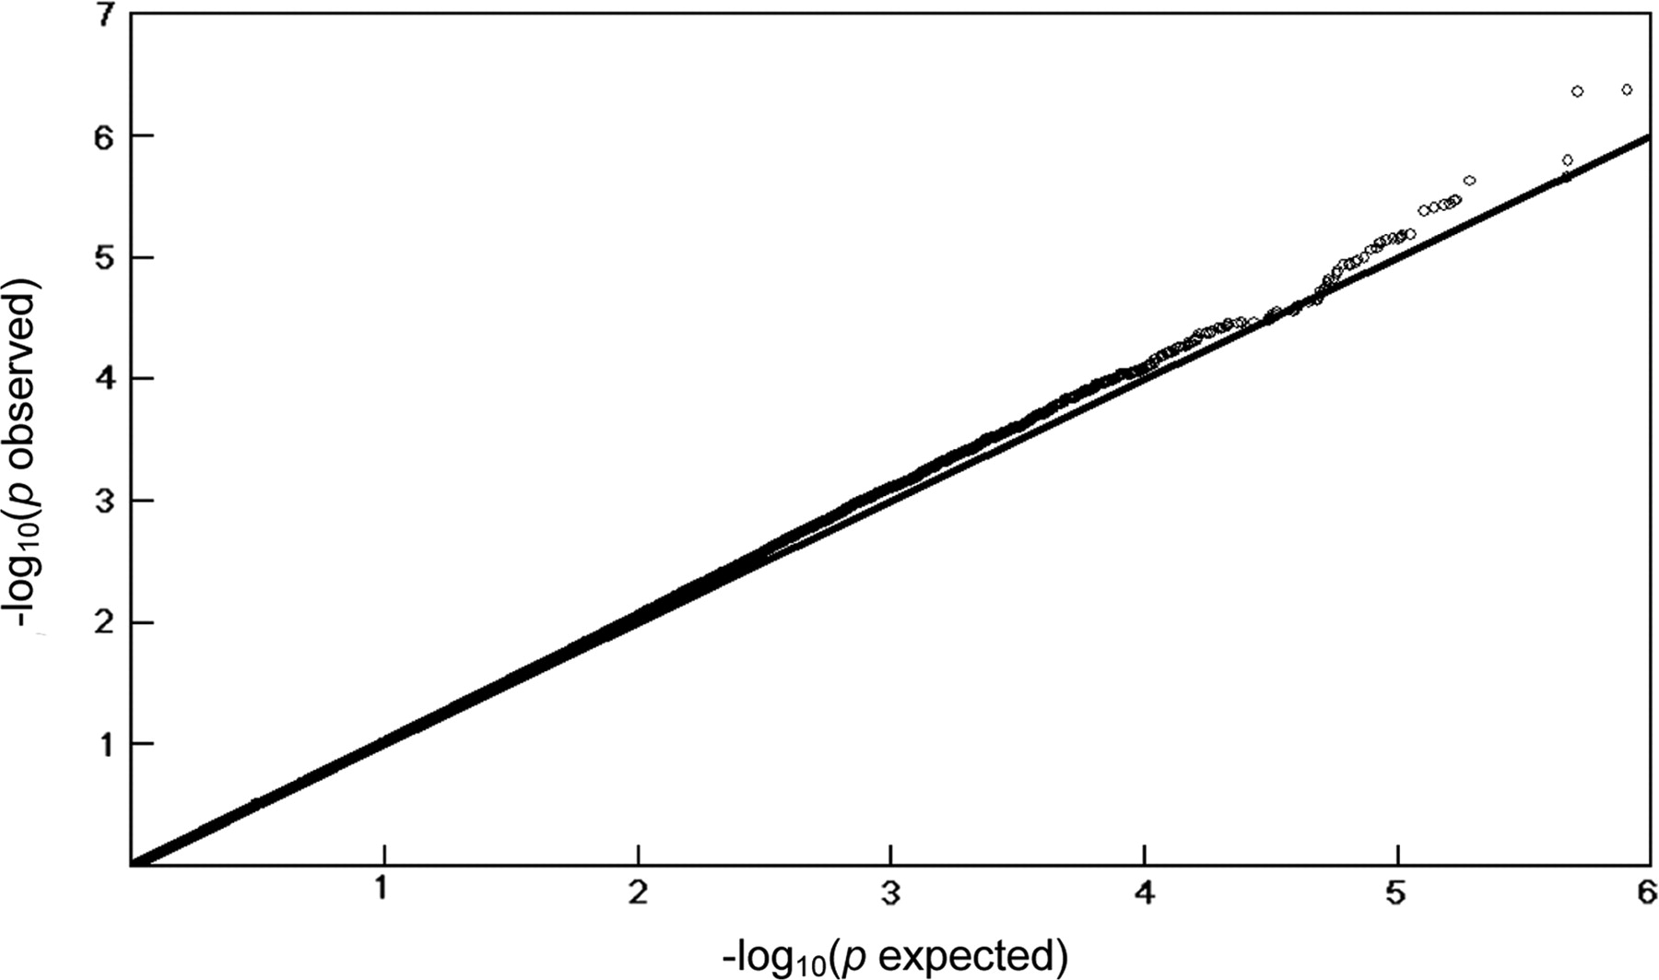
Figure 1. Quantile–quantile (Q–Q) plot for stature. From the Q–Q plot, the observed P -values for stature match the ...
Notes:
Figure 1. Quantile–quantile (Q–Q) plot for stature. From the Q–Q plot, the observed P -values for stature match the expected P -values under the null distributions over the range of (1<−log 10 ( p ) < 4.0). Furthermore, an excess of low P -values is observed above 4.0 of −log 10 ( p ) for stature.
Unless provided in the caption above, the following copyright applies to the content of this slide: © The Author 2008. Published by Oxford University Press. All rights reserved. For Permissions, please email: journals.permissions@oxfordjournals.org

Slide 2
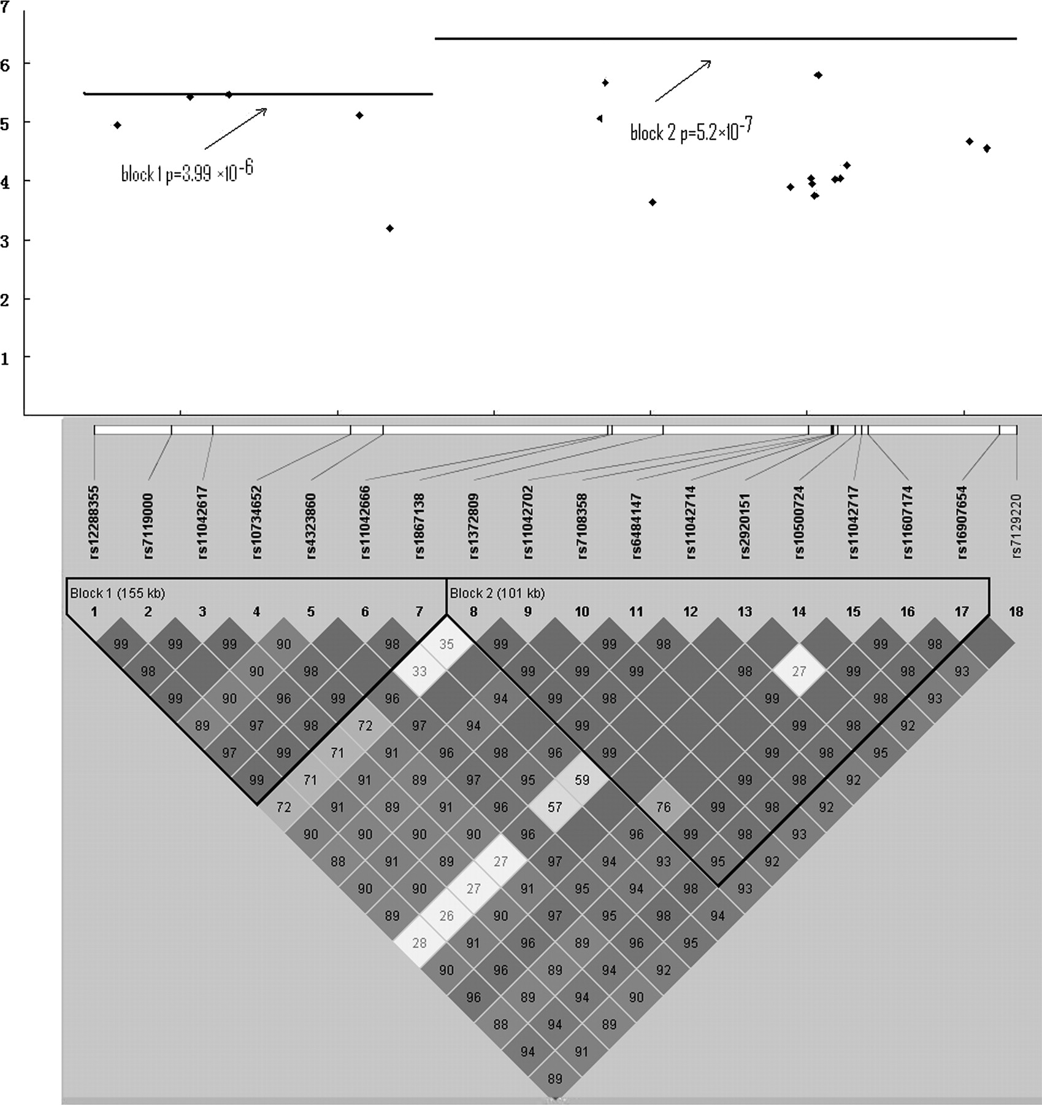
Figure 2. Association of SNP group 1 with stature in the region of the SBF2 gene. Notes: (1) The Y axis is the ...
Notes:
Figure 2. Association of SNP group 1 with stature in the region of the SBF2 gene. Notes: (1) The Y axis is the negative Log 10p values. (2) The LD between two SNPs is standardized D’ (D/D max ). (3) In each block, the LD signal is very strong.
Unless provided in the caption above, the following copyright applies to the content of this slide: © The Author 2008. Published by Oxford University Press. All rights reserved. For Permissions, please email: journals.permissions@oxfordjournals.org

Slide 3
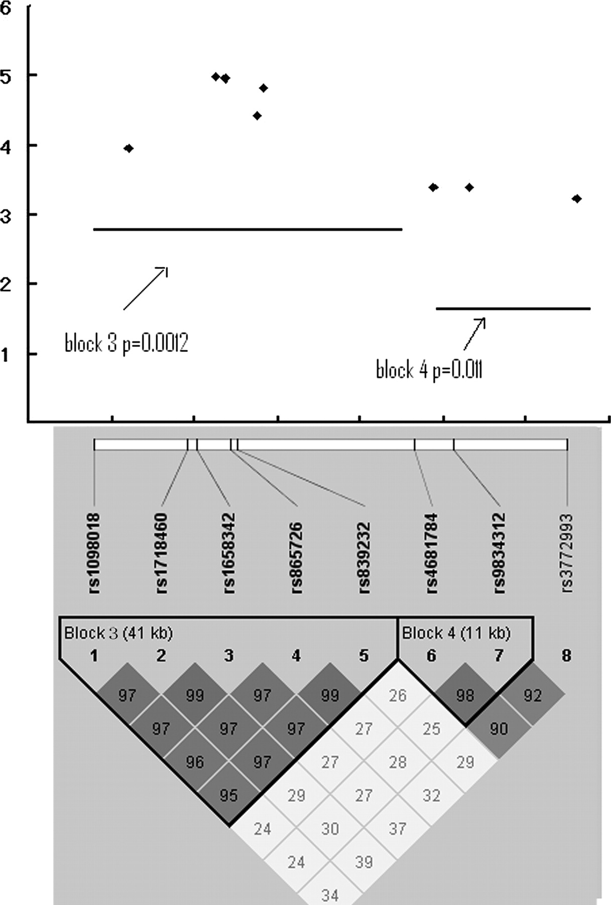
Figure 3. Association of SNP group 2 with stature in the region of the FLNB gene. See notes of Figure 2 .
Notes:
Figure 3. Association of SNP group 2 with stature in the region of the FLNB gene. See notes of Figure 2 .
Unless provided in the caption above, the following copyright applies to the content of this slide: © The Author 2008. Published by Oxford University Press. All rights reserved. For Permissions, please email: journals.permissions@oxfordjournals.org

Slide 4
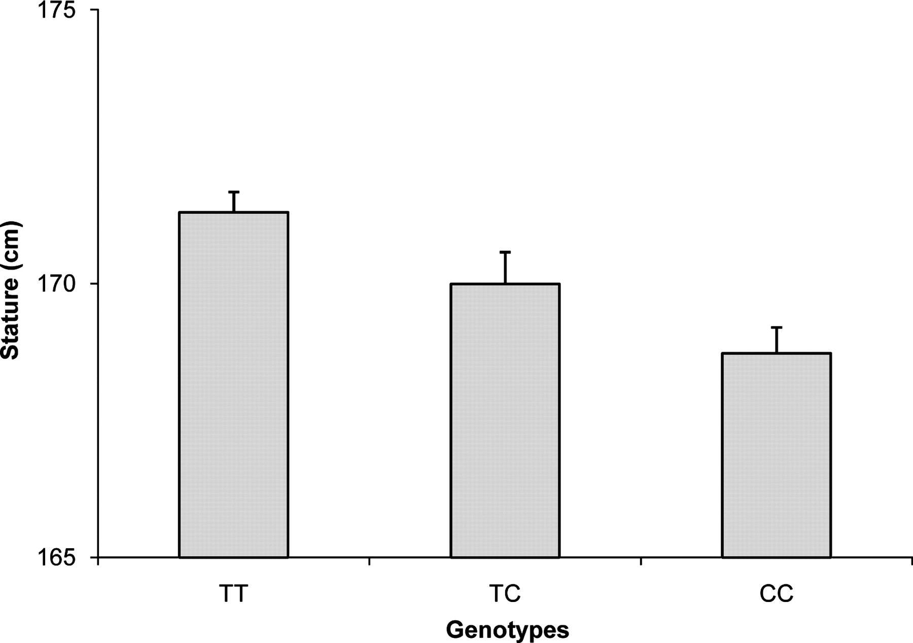
Figure 4. Distribution of stature in different genotype groups of rs1867138 in Caucasians for the GWAS study. Note: ...
Notes:
Figure 4. Distribution of stature in different genotype groups of rs1867138 in Caucasians for the GWAS study. Note: mean (SE).
Unless provided in the caption above, the following copyright applies to the content of this slide: © The Author 2008. Published by Oxford University Press. All rights reserved. For Permissions, please email: journals.permissions@oxfordjournals.org

