Slide 1
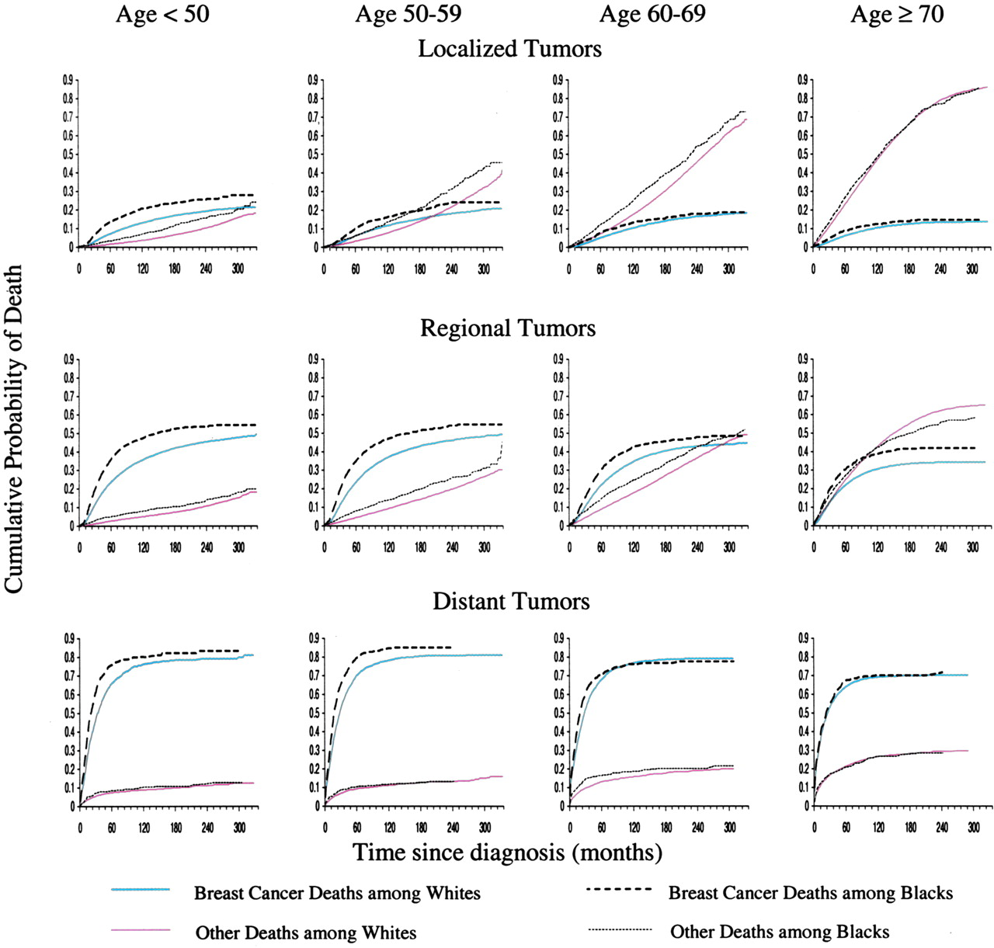
Fig. 1. Cumulative probability of death from breast cancer and other causes according to stage, race, and age at ...
Notes:
Fig. 1. Cumulative probability of death from breast cancer and other causes according to stage, race, and age at diagnosis (in years), Surveillance, Epidemiology, and End Results (SEER) Program, 1973–2000.
Unless provided in the caption above, the following copyright applies to the content of this slide: © Oxford University Press

Slide 2
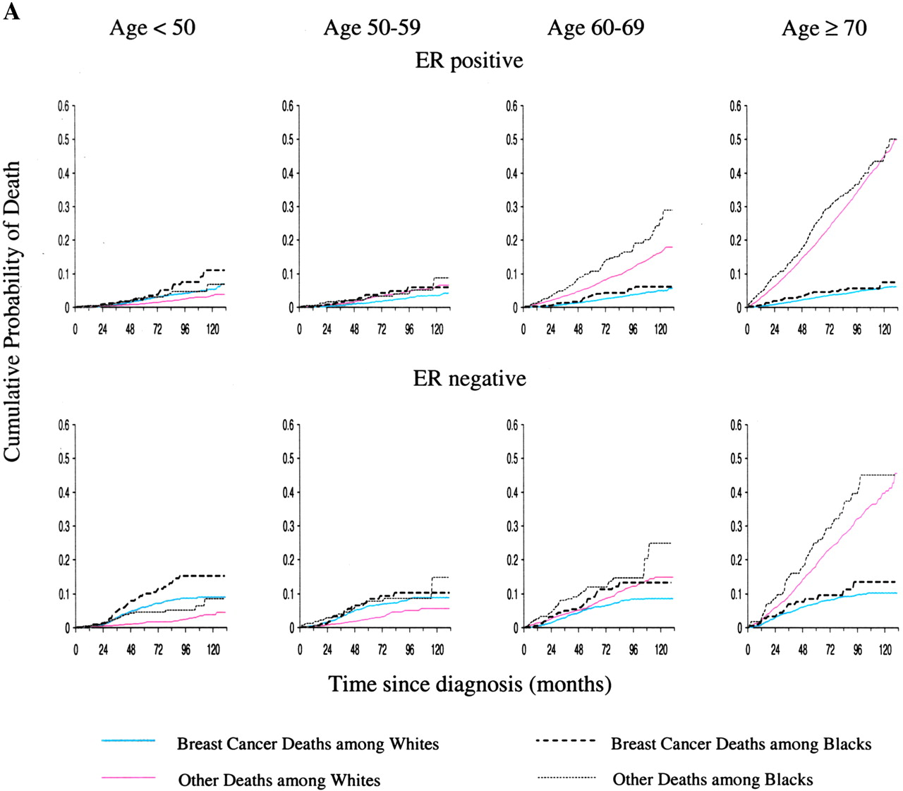
Fig. 2. Cumulative probability of death from breast cancer and other causes among breast cancer cases with localized ...
Notes:
Fig. 2. Cumulative probability of death from breast cancer and other causes among breast cancer cases with localized disease according to estrogen receptor (ER) status, race, and age at diagnosis (in years), Surveillance, Epidemiology, and End Results (SEER) Program, 1990–2000. A ) Tumors 2 cm or less in diameter. B ) Tumors more than 2 cm in diameter.
Unless provided in the caption above, the following copyright applies to the content of this slide: © Oxford University Press

Slide 3
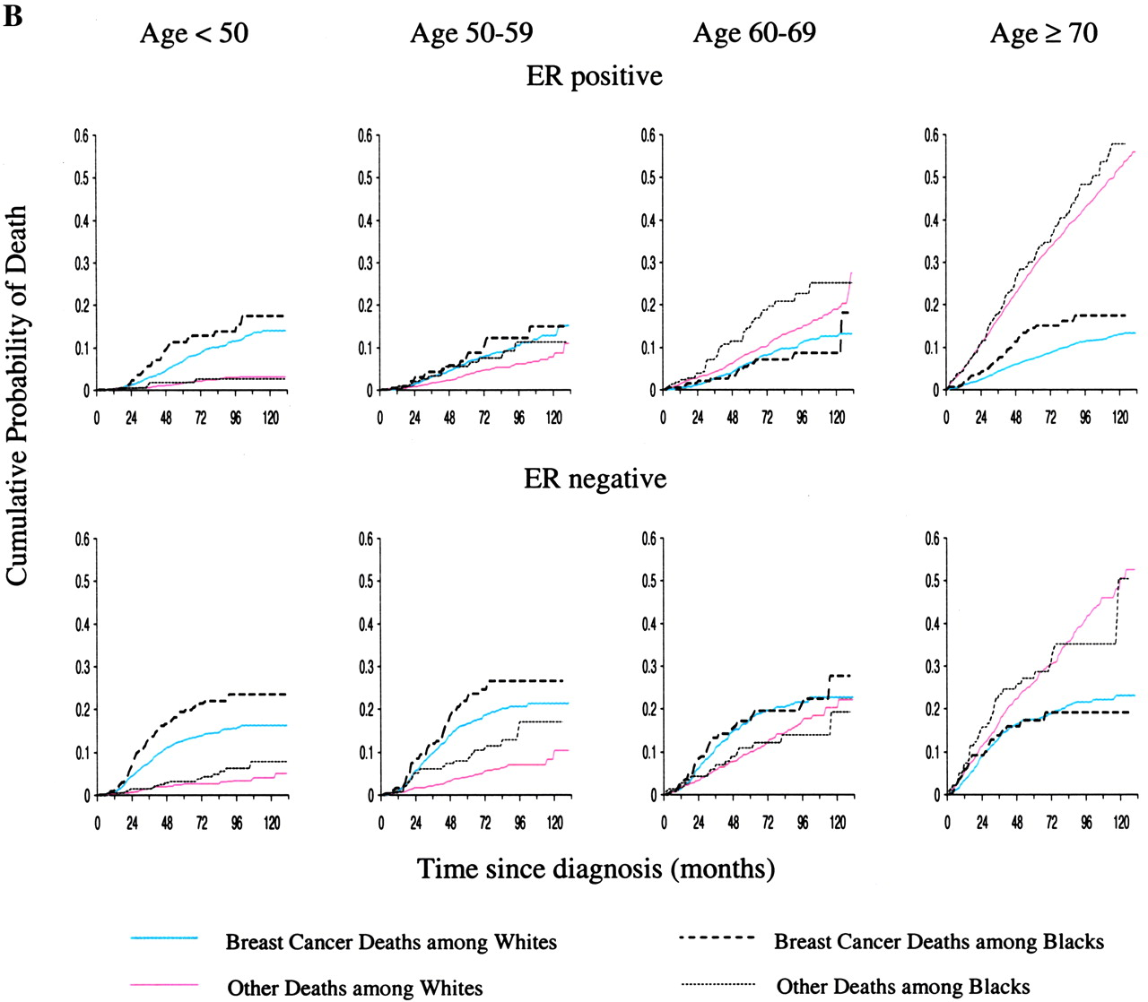
Fig. 2. Cumulative probability of death from breast cancer and other causes among breast cancer cases with localized ...
Notes:
Fig. 2. Cumulative probability of death from breast cancer and other causes among breast cancer cases with localized disease according to estrogen receptor (ER) status, race, and age at diagnosis (in years), Surveillance, Epidemiology, and End Results (SEER) Program, 1990–2000. A ) Tumors 2 cm or less in diameter. B ) Tumors more than 2 cm in diameter.
Unless provided in the caption above, the following copyright applies to the content of this slide: © Oxford University Press

Slide 4
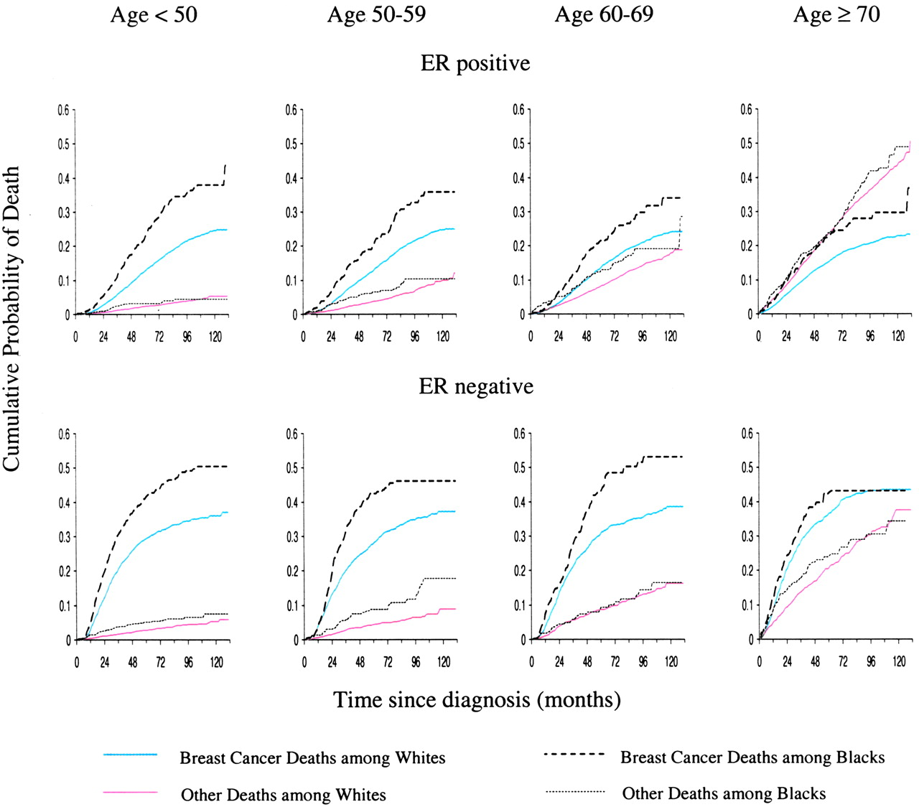
Fig. 3. Cumulative probability of death from breast cancer and other causes among breast cancer cases with regional ...
Notes:
Fig. 3. Cumulative probability of death from breast cancer and other causes among breast cancer cases with regional disease according to estrogen receptor (ER) status, race, and age at diagnosis (in years), Surveillance, Epidemiology, and End Results (SEER) Program, 1990–2000.
Unless provided in the caption above, the following copyright applies to the content of this slide: © Oxford University Press

