Slide 1
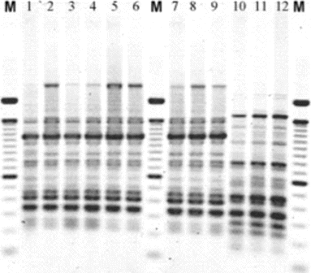
Figure 1 Agarose gel of enterobacterial repetitive intergenic consensus polymerase chain reaction patterns from ...
Notes:
Figure 1 Agarose gel of enterobacterial repetitive intergenic consensus polymerase chain reaction patterns from Escherichia coli. Lanes marked M contain a molecular weight marker. Lanes 1–9, isolates from 1 individual; lanes 10–12, isolates from a different woman.
Unless provided in the caption above, the following copyright applies to the content of this slide: © 2009 by the Infectious Diseases Society of America

Slide 2
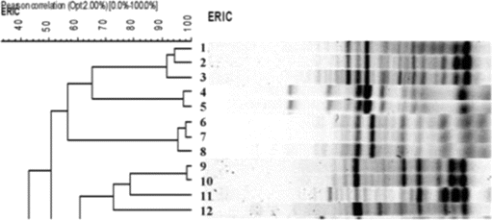
Figure 2 Dendogram showing grouping of isolates according to similarity in banding pattern of samples from 5 women ...
Notes:
Figure 2 Dendogram showing grouping of isolates according to similarity in banding pattern of samples from 5 women using the unweighted pair group method with arithmetic averages of BioNumerics software. Lanes 1–3, samples from person 1; lane 4, sample from person 2; lane 5, sample from person 3; lanes 6–8, samples from person 4; lanes 9–12, samples from the fifth person. ERIC, enterobacterial repetitive intergenic consensus sequence.
Unless provided in the caption above, the following copyright applies to the content of this slide: © 2009 by the Infectious Diseases Society of America

Slide 3
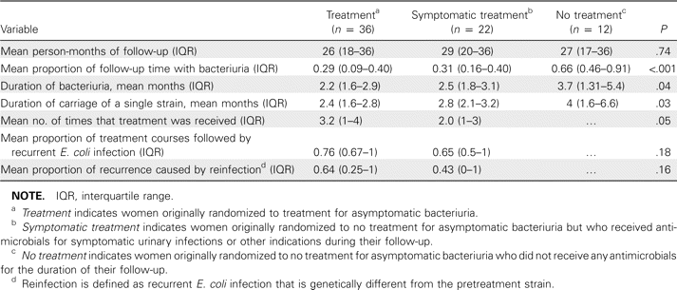
Table 1 Escherichia coli Bacteriuria, Strain Carriage, and Recurrent Infection among Diabetic Women with Asymptomatic ...
Notes:
Table 1 Escherichia coli Bacteriuria, Strain Carriage, and Recurrent Infection among Diabetic Women with Asymptomatic Bacteriuria by Treatment Received
Unless provided in the caption above, the following copyright applies to the content of this slide: © 2009 by the Infectious Diseases Society of America

Slide 4
Table 2 Comparison of the Frequency of Escherichia coli Virulence Genes Seen in Diabetic Women with Asymptomatic ...
Notes:
Table 2 Comparison of the Frequency of Escherichia coli Virulence Genes Seen in Diabetic Women with Asymptomatic Bacteriuria with E. coli Isolates from Various Other Collections
Unless provided in the caption above, the following copyright applies to the content of this slide: © 2009 by the Infectious Diseases Society of America

