Slide 1
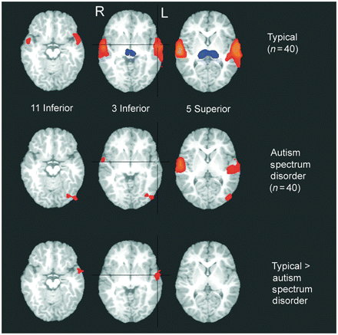
Figure 1 Clusters of significant response to all speech stimuli in the typically developing (n = 40) and autism ...
Notes:
Figure 1 Clusters of significant response to all speech stimuli in the typically developing (n = 40) and autism spectrum disorder (n = 40) groups, and clusters of significant difference in brain response between groups. Colours indicate relative strength and direction of the effect size (η2) [for individual group maps, positive values (warm colours) indicate greater brain response to speech compared with non-stimulation; and negative values (cool colours) indicate lower brain response to speech compared with non-stimulation in individual group maps; for group comparison map, positive values (warm colours) indicate greater brain response in the typically developing compared with autism spectrum disorder group]. R = right; L = left.
Unless provided in the caption above, the following copyright applies to the content of this slide: © The Author (2012). Published by Oxford University Press on behalf of the Guarantors of Brain.This is an Open Access article distributed under the terms of the Creative Commons Attribution Non-Commercial License (http://creativecommons.org/licenses/by-nc/3.0/), which permits non-commercial re-use, distribution, and reproduction in any medium, provided the original work is properly cited. For commercial re-use, please contact journals.permissions@oup.com

Slide 2
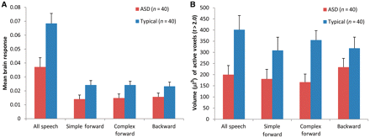
Figure 2 Graphs of amplitude (mean fit coefficient) (A) and extent (volume in µl of active voxels with t > 2.0) (B) of ...
Notes:
Figure 2 Graphs of amplitude (mean fit coefficient) (A) and extent (volume in µl of active voxels with t > 2.0) (B) of brain response within the cluster of significant group difference in brain response to all speech in the left hemisphere superior temporal gyrus. Values are shown for all speech (used to identify the significant cluster) and separately for the component conditions. Mean values for the autism spectrum disorder (ASD) group are shown in red and those for the typically developing group are shown in blue. Error bars indicate the standard error of the mean.
Unless provided in the caption above, the following copyright applies to the content of this slide: © The Author (2012). Published by Oxford University Press on behalf of the Guarantors of Brain.This is an Open Access article distributed under the terms of the Creative Commons Attribution Non-Commercial License (http://creativecommons.org/licenses/by-nc/3.0/), which permits non-commercial re-use, distribution, and reproduction in any medium, provided the original work is properly cited. For commercial re-use, please contact journals.permissions@oup.com

Slide 3
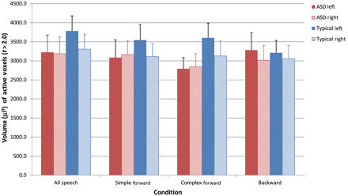
Figure 3 Graph of extent (volume in µl of active voxels with t > 2.0) of brain response within each hemisphere of the ...
Notes:
Figure 3 Graph of extent (volume in µl of active voxels with t > 2.0) of brain response within each hemisphere of the entire superior temporal gyrus anatomical region of interest. Values are shown for all speech and separately for the component conditions. Mean values for the autism spectrum disorder (ASD) group are shown in red for left hemisphere and pink for right hemisphere, and those for the typically developing group are shown in blue for the left hemisphere and light blue for the right hemisphere. Error bars indicate the standard error of the mean.
Unless provided in the caption above, the following copyright applies to the content of this slide: © The Author (2012). Published by Oxford University Press on behalf of the Guarantors of Brain.This is an Open Access article distributed under the terms of the Creative Commons Attribution Non-Commercial License (http://creativecommons.org/licenses/by-nc/3.0/), which permits non-commercial re-use, distribution, and reproduction in any medium, provided the original work is properly cited. For commercial re-use, please contact journals.permissions@oup.com

Slide 4
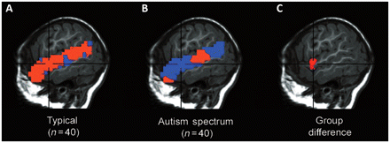
Figure 4 (A and B) Voxel-based within-group laterality score maps during the forward speech condition (expressed as ...
Notes:
Figure 4 (A and B) Voxel-based within-group laterality score maps during the forward speech condition (expressed as signed η2 effect size values; warm colours = left greater than right; cool colours = right greater than left) for typically developing and autism spectrum disorder groups in the superior temporal gyrus (shown at 51 left/right). (C) Group difference map showing the cluster of significant difference in laterality between groups, with more left-lateralized values in the typically developing compared with autism spectrum disorder group [36 voxels (each with t = 1.66, Pone-tailed = 0.05), superior temporal gyrus-wide P < 0.05, with a peak at 50 left, 5 posterior and 4 superior].
Unless provided in the caption above, the following copyright applies to the content of this slide: © The Author (2012). Published by Oxford University Press on behalf of the Guarantors of Brain.This is an Open Access article distributed under the terms of the Creative Commons Attribution Non-Commercial License (http://creativecommons.org/licenses/by-nc/3.0/), which permits non-commercial re-use, distribution, and reproduction in any medium, provided the original work is properly cited. For commercial re-use, please contact journals.permissions@oup.com

