Slide 1
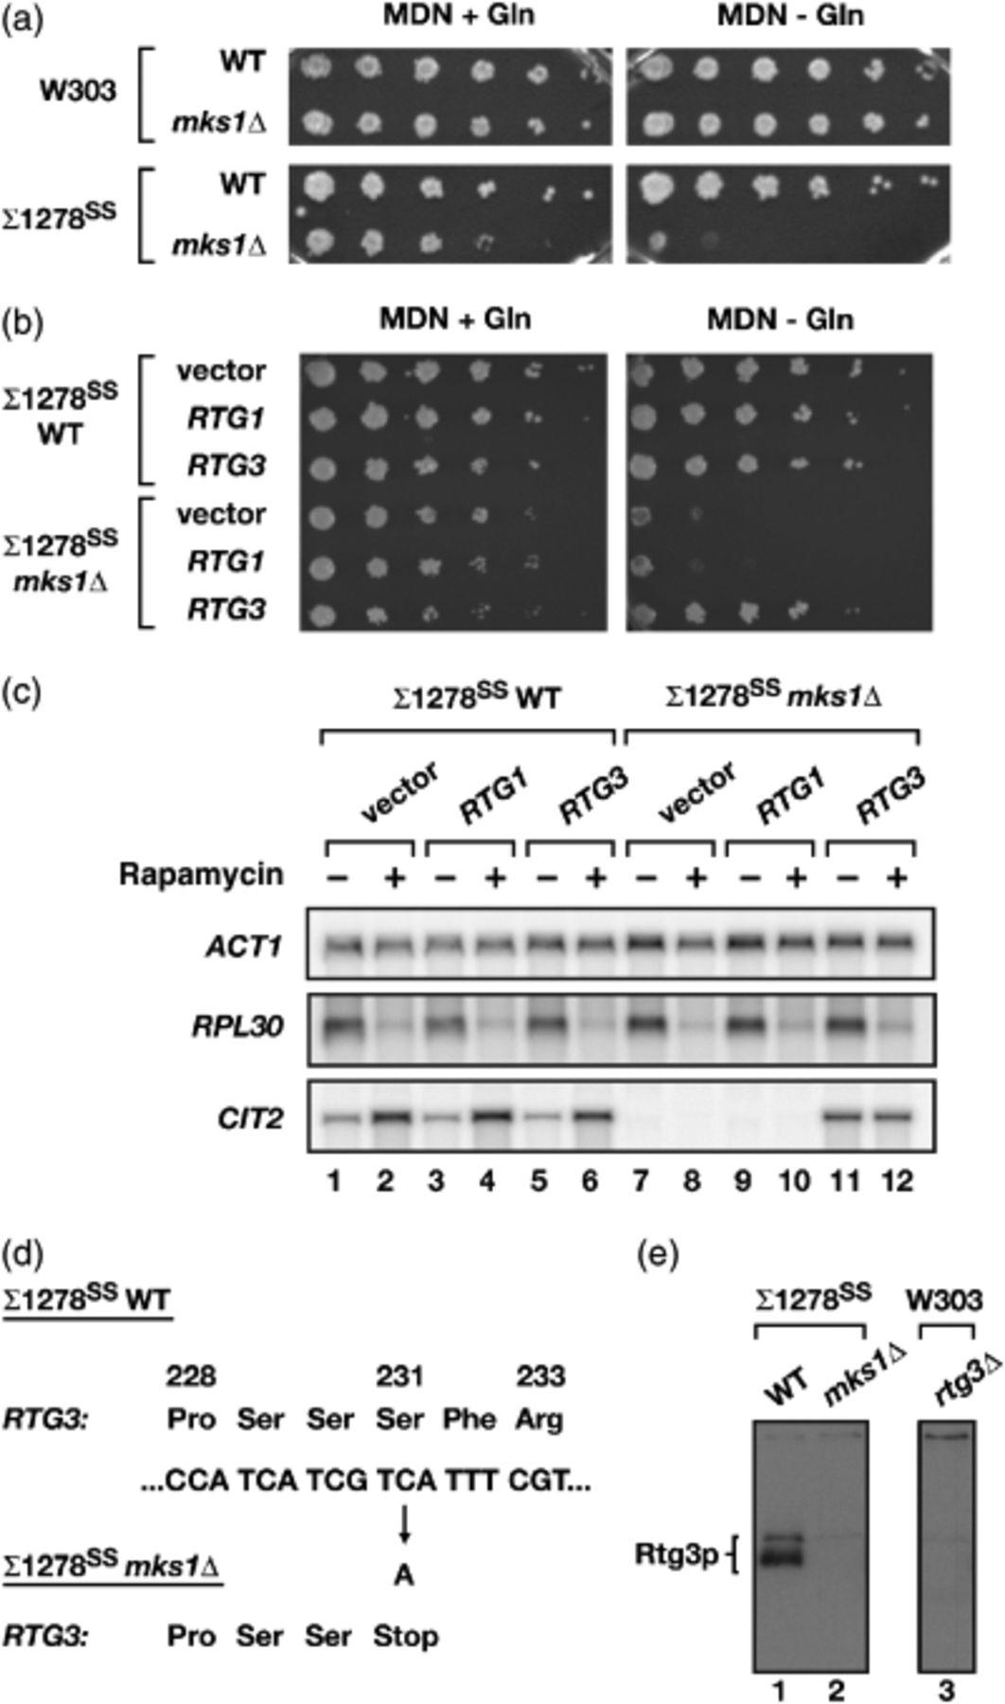
1 Determining the molecular basis for the glutamine auxotrophy of Σ1278^{SS}mks1Δ. (a) Serial dilutions ...
Notes:
1 Determining the molecular basis for the glutamine auxotrophy of Σ1278SSmks1Δ. (a) Serial dilutions of wild-type (WT) and mks1Δ strains in both the W303a and Σ1278SS strain backgrounds on MDN or MDN+Gln agar plates. Agar plates contained the following auxotrophic supplements: 0.006% adenine sulfate, 0.003% uracil, 0.008% leucine, 0.006% histidine and 0.005% tryptophan. (b) Σ1278SS WT and Σ1278SSmks1Δ were transformed with a control vector (pRS315) or with plasmids that expressed either RTG1 (pPL135) or RTG3 (pPL136). Cells were grown in SCD media lacking leucine, and serial dilutions were plated onto MDN or MDN+Gln agar plates. Agar plates contained the following auxotrophic supplements: 0.006% adenine sulfate, 0.003% uracil, 0.006% histidine and 0.008% tryptophan. (c) Northern blot analysis of Σ1278SS and Σ1278SSmks1Δ transformed with plasmids described in (b). Cells were grown to mid-log phase (0.5 OD600 mL−1) in SCD media lacking leucine and were treated with rapamycin (0.2 μg mL−1 final concentration) for 30 min, where indicated. Cells were harvested and processed for Northern blot analysis, probing for the specified mRNAs. (d) Sequence analysis of RTG3 in Σ1278SS WT vs. Σ1278SSmks1Δ reveals the presence of a nonsense mutation at codon Ser 231 in Σ1278SSmks1Δ. (e) Western blot analysis of endogenous Rtg3p in strains Σ1278SS and Σ1278SSmks1Δ and, for comparison, an rtg3Δ strain (PLY186). Cells were grown to mid-log phase (0.5 OD600 mL−1) in YPD media followed by western blot analysis, using polyclonal anti-Rtg3p antiserum.
Unless provided in the caption above, the following copyright applies to the content of this slide: © 2005 Federation of European Microbiological Societies Published by Blackwell Publishing Ltd. All rights reserved

Slide 2
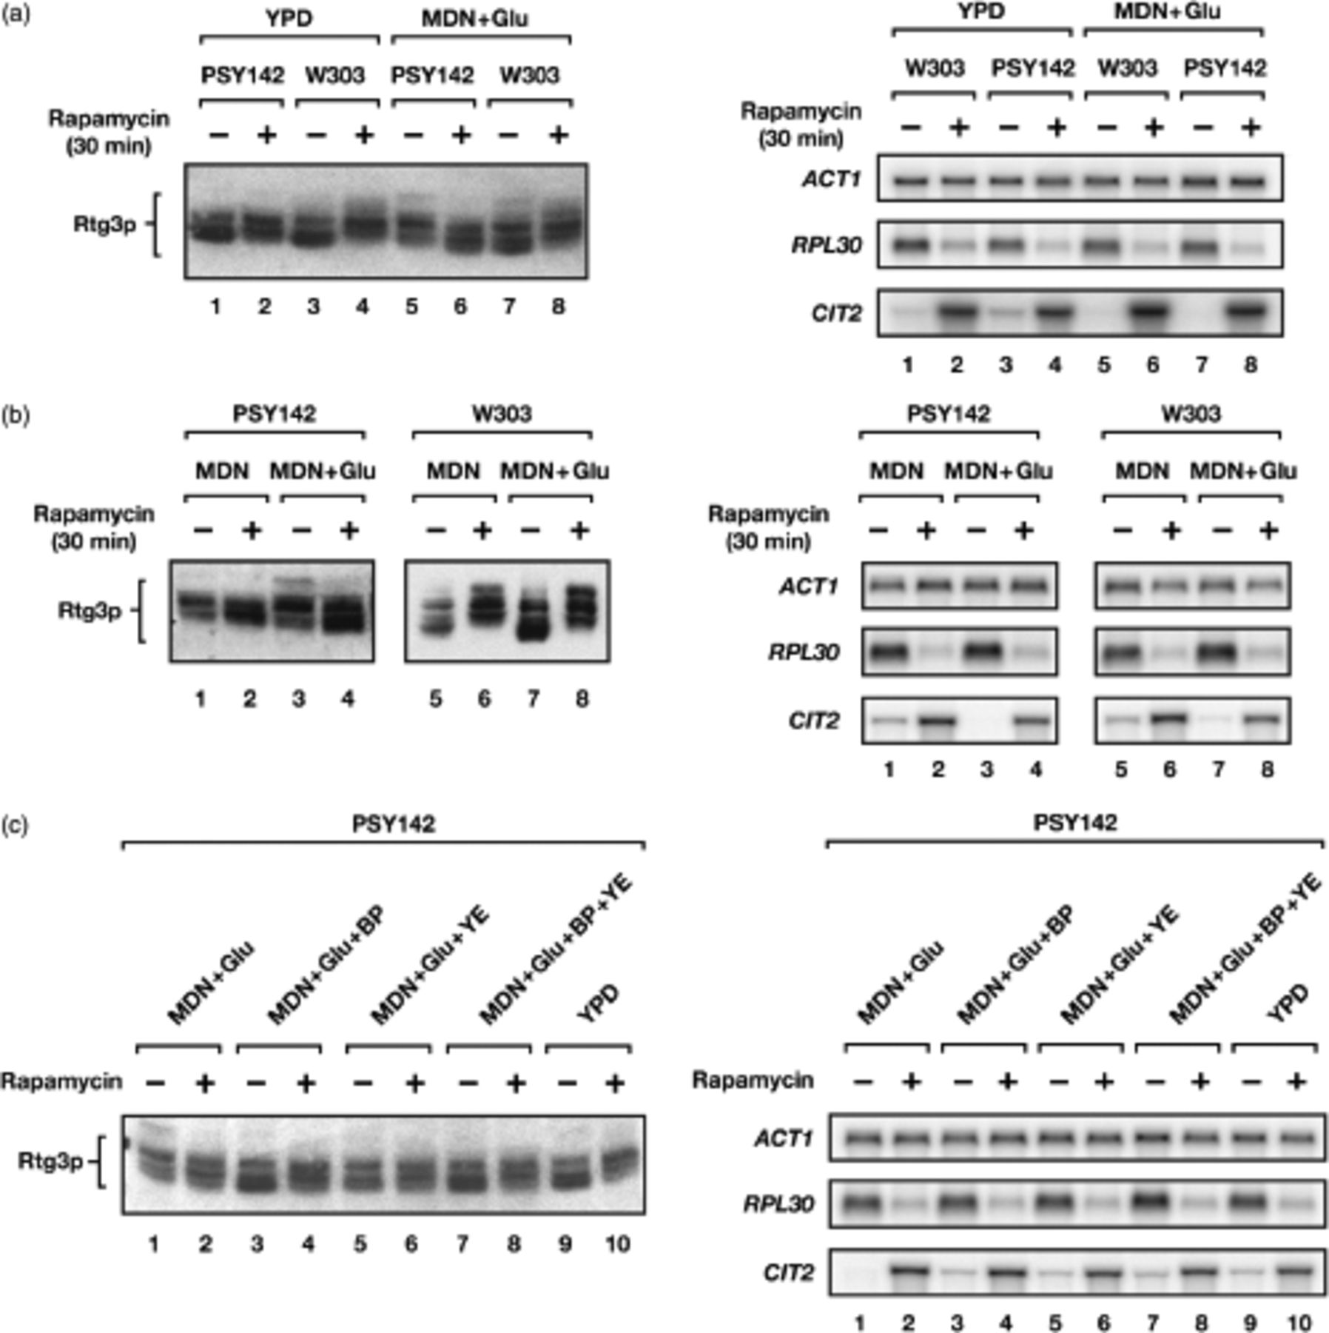
2 Comparison of Rtg3p phosphorylation in strains W303 and PSY142. (a) and (b) Western-blot analysis of Rtg3p ...
Notes:
2 Comparison of Rtg3p phosphorylation in strains W303 and PSY142. (a) and (b) Western-blot analysis of Rtg3p (left-hand panels) and Northern blot analysis of ACT1, RPL30 and CIT2 (right-hand panels) in W303a vs. PSY142. In (a), strains were grown to mid-log phase (0.5 OD600 mL−1) in either YPD or MDN+Glu media and, where indicated, treated with rapamycin (0.2 μg mL−1 final concentration) for 30 min. In (b), strains were grown to mid-log phase (0.5 OD600 mL−1) in either MDN or MDN+Glu media and, where indicated, treated with rapamycin (0.2 μg mL−1 final concentration) for 30 min. (c) Western blot analysis of Rtg3p (left-hand panel) and Northern blot analysis of ACT1, RPL30 and CIT2 (right-hand panels) in PSY142 grown under different media conditions. Cells were grown to mid-log phase (0.5 OD600 mL−1) in the specified media and, where indicated, treated with rapamycin (0.2 μg mL−1 final concentration) for 30 min. YE denotes addition of 1% yeast extract and BP denotes addition of 2% bactopeptone. In (a–c), MDN and MDN+Glu media contained the following auxotrophic supplements: 0.006% adenine sulfate, 0.003% uracil, 0.008% leucine, 0.006% histidine, 0.003% lysine and 0.005% tryptophan.
Unless provided in the caption above, the following copyright applies to the content of this slide: © 2005 Federation of European Microbiological Societies Published by Blackwell Publishing Ltd. All rights reserved

Slide 3
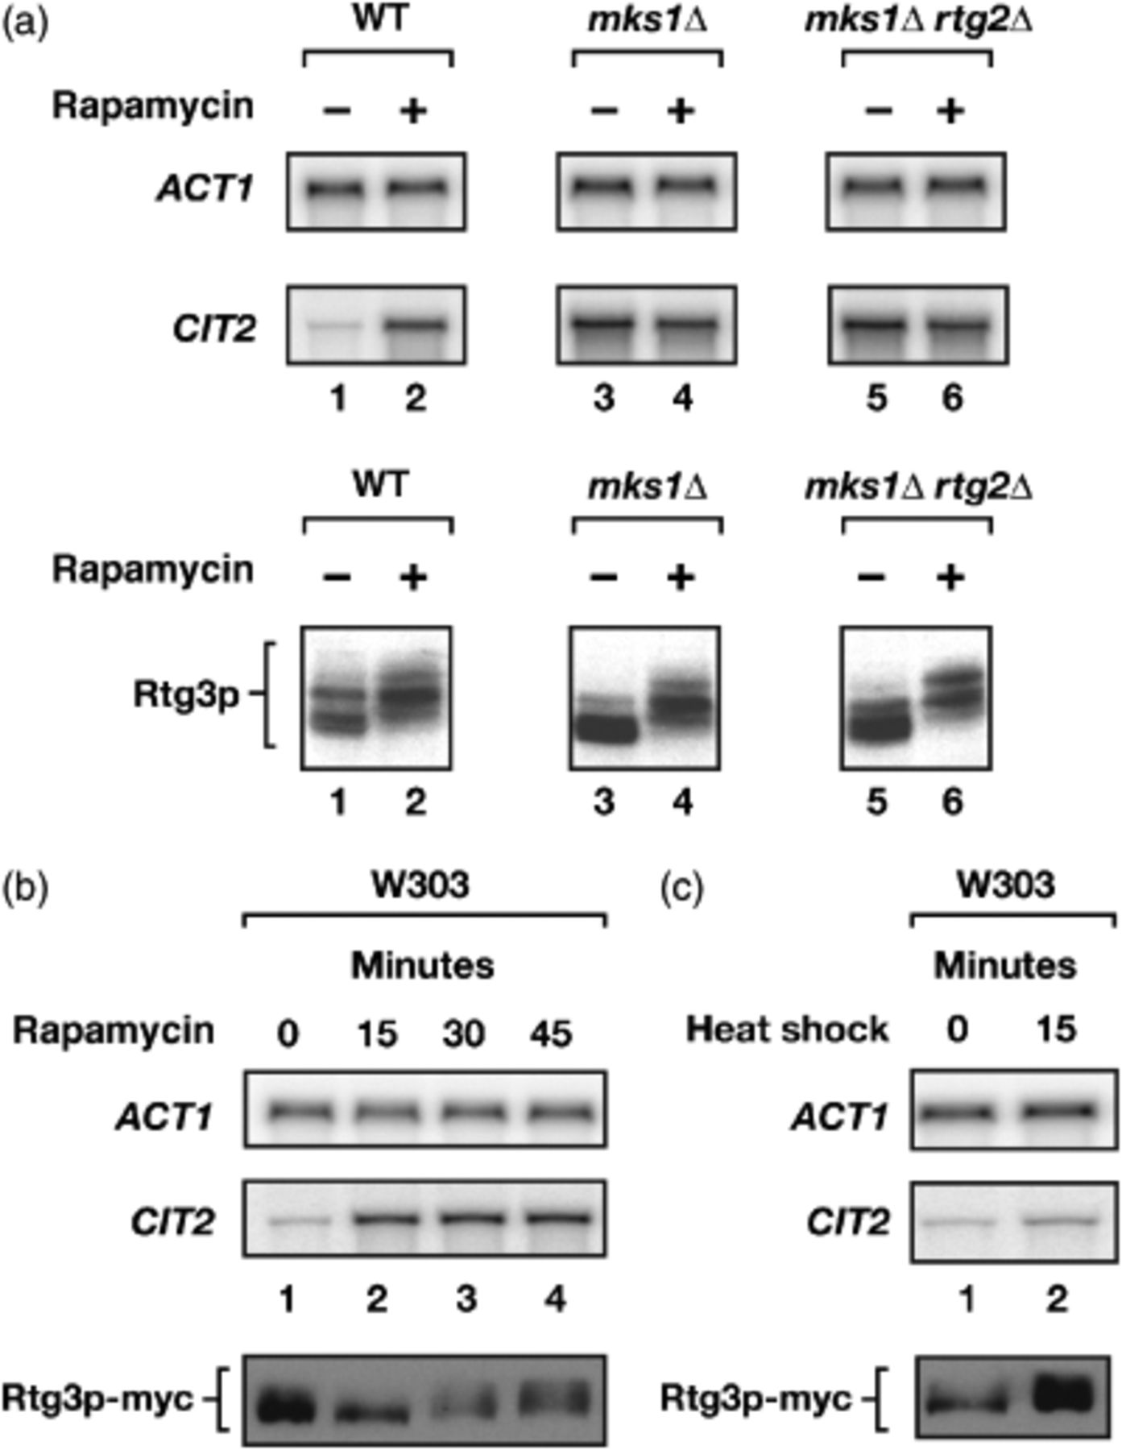
3 Further characterization of Rtg3p phosphorylation in wild-type and mutant W303 strains. (a) Northern blot ...
Notes:
3 Further characterization of Rtg3p phosphorylation in wild-type and mutant W303 strains. (a) Northern blot analysis of ACT1 and CIT2 (upper panels) and western blot analysis of Rtg3p (lower panels) in WT, mks1Δand mks1Δrtg2Δ, all in the W303 background. Cells were grown to mid-log phase (0.5 OD600 mL−1) in YPD and, where indicated, treated with rapamycin (0.2 μg mL−1 final concentration) for 30 min. (b) Northern blot analysis of ACT1 and CIT2 (upper panels) and western blot analysis of Myc epitope-tagged Rtg3p (lower panel) during a time course of rapamycin treatment. Cells were grown to mid-log phase (0.6 OD600 mL−1) in YPD+Gln and treated with rapamycin for the time indicated. (c) Northern blot analysis of ACT1 and CIT2 (upper panels) and western blot analysis of Myc epitope-tagged Rtg3p (lower panel) before and after 15 min of heat shock. Cells were grown to mid-log phase (0.6 OD600 mL−1) in YPD+Gln at 25°C and either harvested immediately or combined with prewarmed media and incubated at 37°C for 15 min prior to harvesting. In (a–c), following harvesting, cells were prepared for Northern or western blot analysis, as indicated.
Unless provided in the caption above, the following copyright applies to the content of this slide: © 2005 Federation of European Microbiological Societies Published by Blackwell Publishing Ltd. All rights reserved

