Slide 1
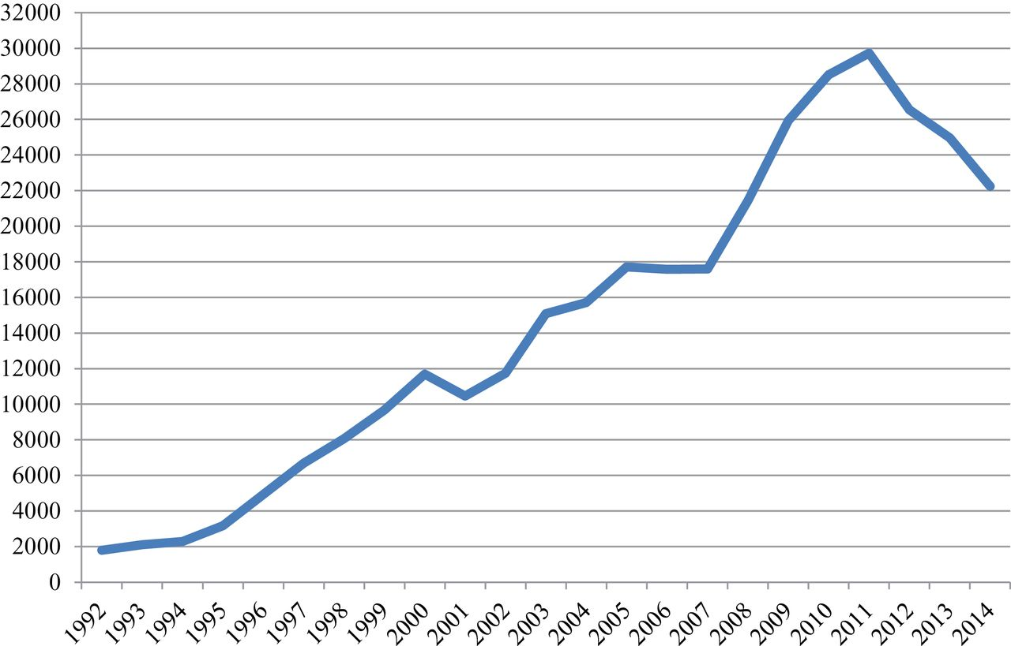
Fig. 1 US immigration convictions, 1992–2014. Note: This figure does not include the petty offence convictions that ...
Notes:
Fig. 1 US immigration convictions, 1992–2014. Note: This figure does not include the petty offence convictions that likely total upwards of 60,000 annually since Operation Streamline became established in multiple sites.
Unless provided in the caption above, the following copyright applies to the content of this slide: © The Author 2015. Published by Oxford University Press on behalf of the Centre for Crime and Justice Studies (ISTD). All rights reserved. For permissions, please e-mail: journals.permissions@oup.com

Slide 2
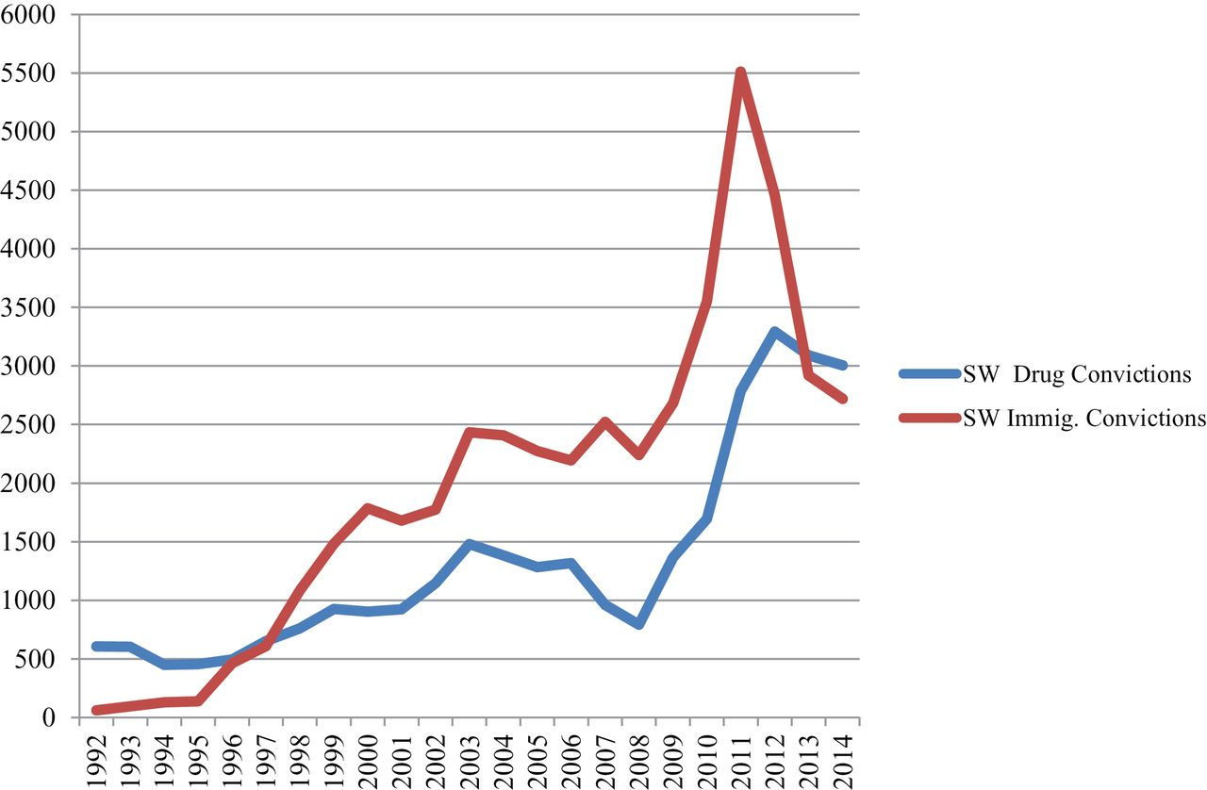
Fig. 2 Southwestern drug and immigration convictions, 1992–2014.
Notes:
Fig. 2 Southwestern drug and immigration convictions, 1992–2014.
Unless provided in the caption above, the following copyright applies to the content of this slide: © The Author 2015. Published by Oxford University Press on behalf of the Centre for Crime and Justice Studies (ISTD). All rights reserved. For permissions, please e-mail: journals.permissions@oup.com

Slide 3
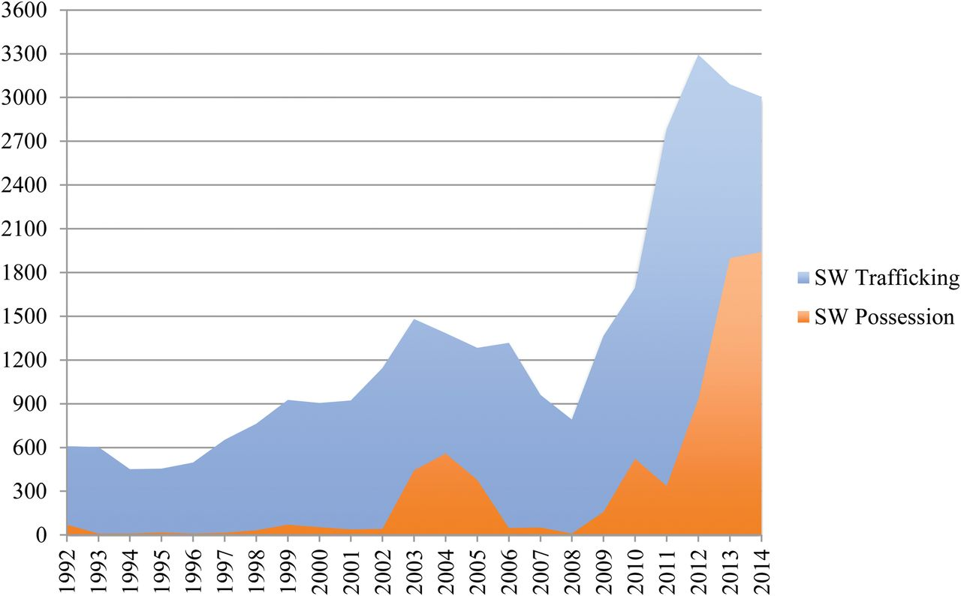
Fig. 3 Drug trafficking and possession convictions in Southwestern District, 1992–2014.
Notes:
Fig. 3 Drug trafficking and possession convictions in Southwestern District, 1992–2014.
Unless provided in the caption above, the following copyright applies to the content of this slide: © The Author 2015. Published by Oxford University Press on behalf of the Centre for Crime and Justice Studies (ISTD). All rights reserved. For permissions, please e-mail: journals.permissions@oup.com

