Slide 1
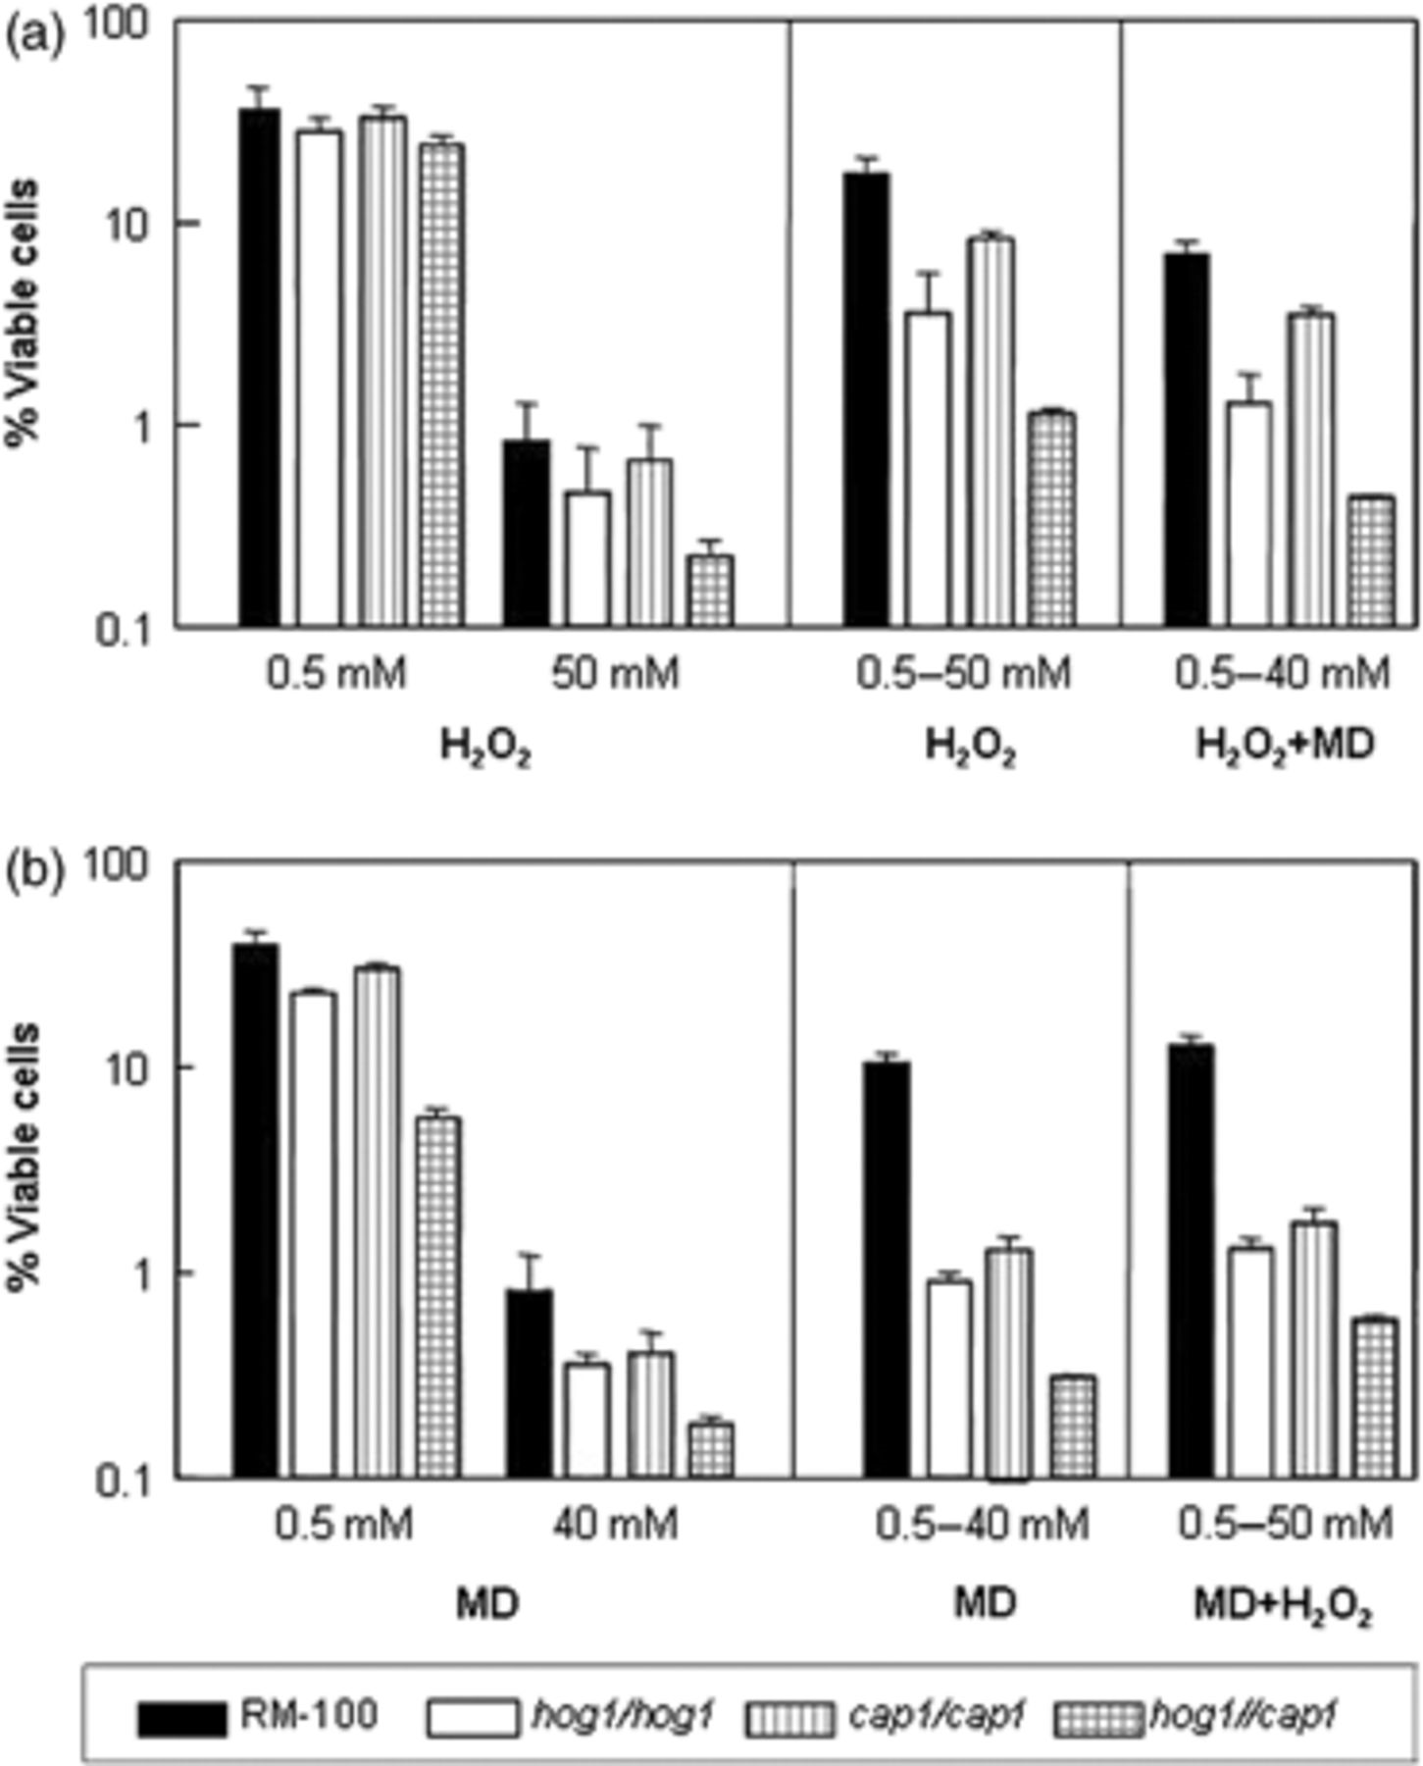
1 Percentage of cell survival in Candida albicans hog1 and cap1 mutants after oxidative stress exposure, as ...
Notes:
1 Percentage of cell survival in Candida albicans hog1 and cap1 mutants after oxidative stress exposure, as well as during the adaptive oxidative response and during cross-tolerance. Cultures of the indicated strains were grown in YPD liquid medium at 37°C until they reached the exponential phase (OD600 nm=0.8–1.0). Identical samples were directly exposed for 60 min with gentle or acute doses of H2O2 (a) or menadione (MD) (b). Another sample was preincubated with 0.5 mM of either oxidant for 60 min and immediately challenged with the fungicidal concentration of the same compound, namely 50 mM H2O2 (a) or 40 mM MD (b), for the same time. Finally, a third sample was pretreated with 0.5 mM H2O2, followed by 40 mM MD (a) or with 0.5 mM MD, followed by 50 mM H2O2 (b). Aliquots were taken and appropriately diluted and spread on solid YPD in triplicate. Viability data were normalized to a control measurement (100%). The experiment was repeated twice in triplicate, with consistent results, and the values shown are the mean ± SD.
Unless provided in the caption above, the following copyright applies to the content of this slide: © 2010 Federation of European Microbiological Societies. Published by Blackwell Publishing Ltd. All rights reserved

Slide 2
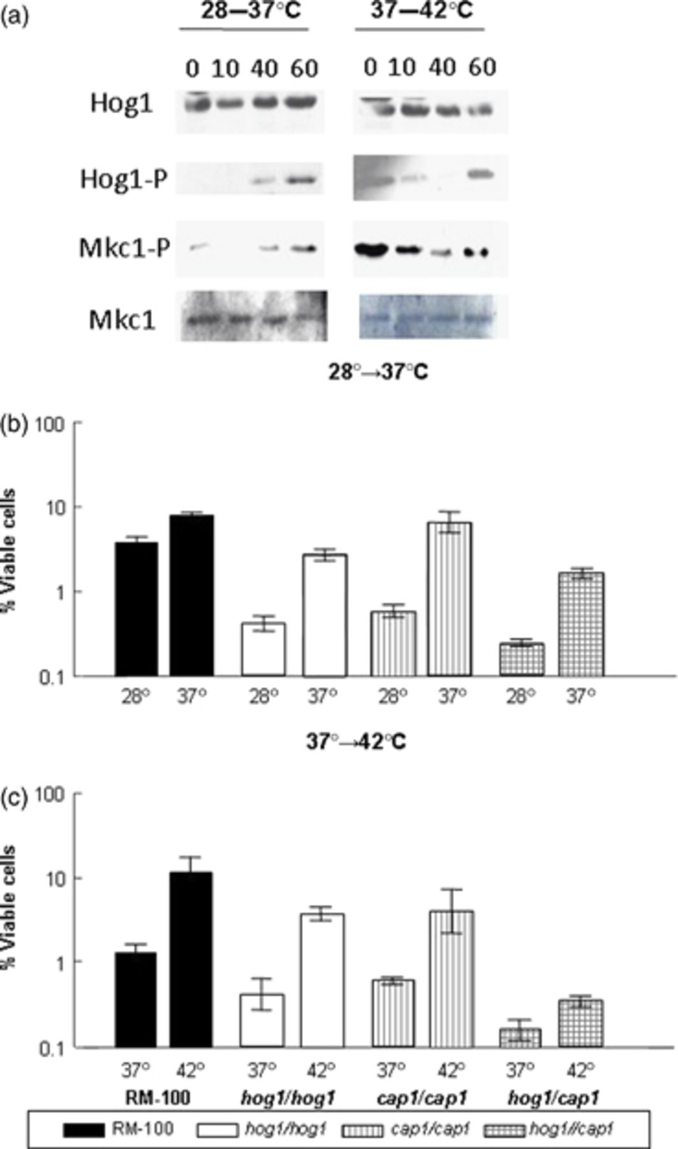
2 An upshift in the incubation temperature leads to MAPK kinase phosphorylation (a) as well as to an increase ...
Notes:
2 An upshift in the incubation temperature leads to MAPK kinase phosphorylation (a) as well as to an increase in cell survival (cross-tolerance) to oxidative stress (b, c) in Candida albicans. (a) Cultures of the parental strain RM100 growing logarithmically at 28 or 37°C were transferred to 37 or 42°C, respectively. Samples were taken 0, 10, 40 and 60 min after the thermal transfer and processed for an immune-blot assay as indicated in Materials and methods. Hog1-P and Mkc1-P represent the phosphorylated form of these MAPKs. YPD-grown cultures of the strains under study were incubated at 28°C (b) or 37°C (c). When they reached the mid-log phase (OD600 nm=0.8), an aliquot was transferred from 28 to 37°C (b) or from 37 to 42°C (c) for 60 min. After returning to the initial temperature, an acute oxidative challenge (50 mM H2O2) was applied to both heat-shocked and control samples. For other details, see Fig. 1.
Unless provided in the caption above, the following copyright applies to the content of this slide: © 2010 Federation of European Microbiological Societies. Published by Blackwell Publishing Ltd. All rights reserved

Slide 3
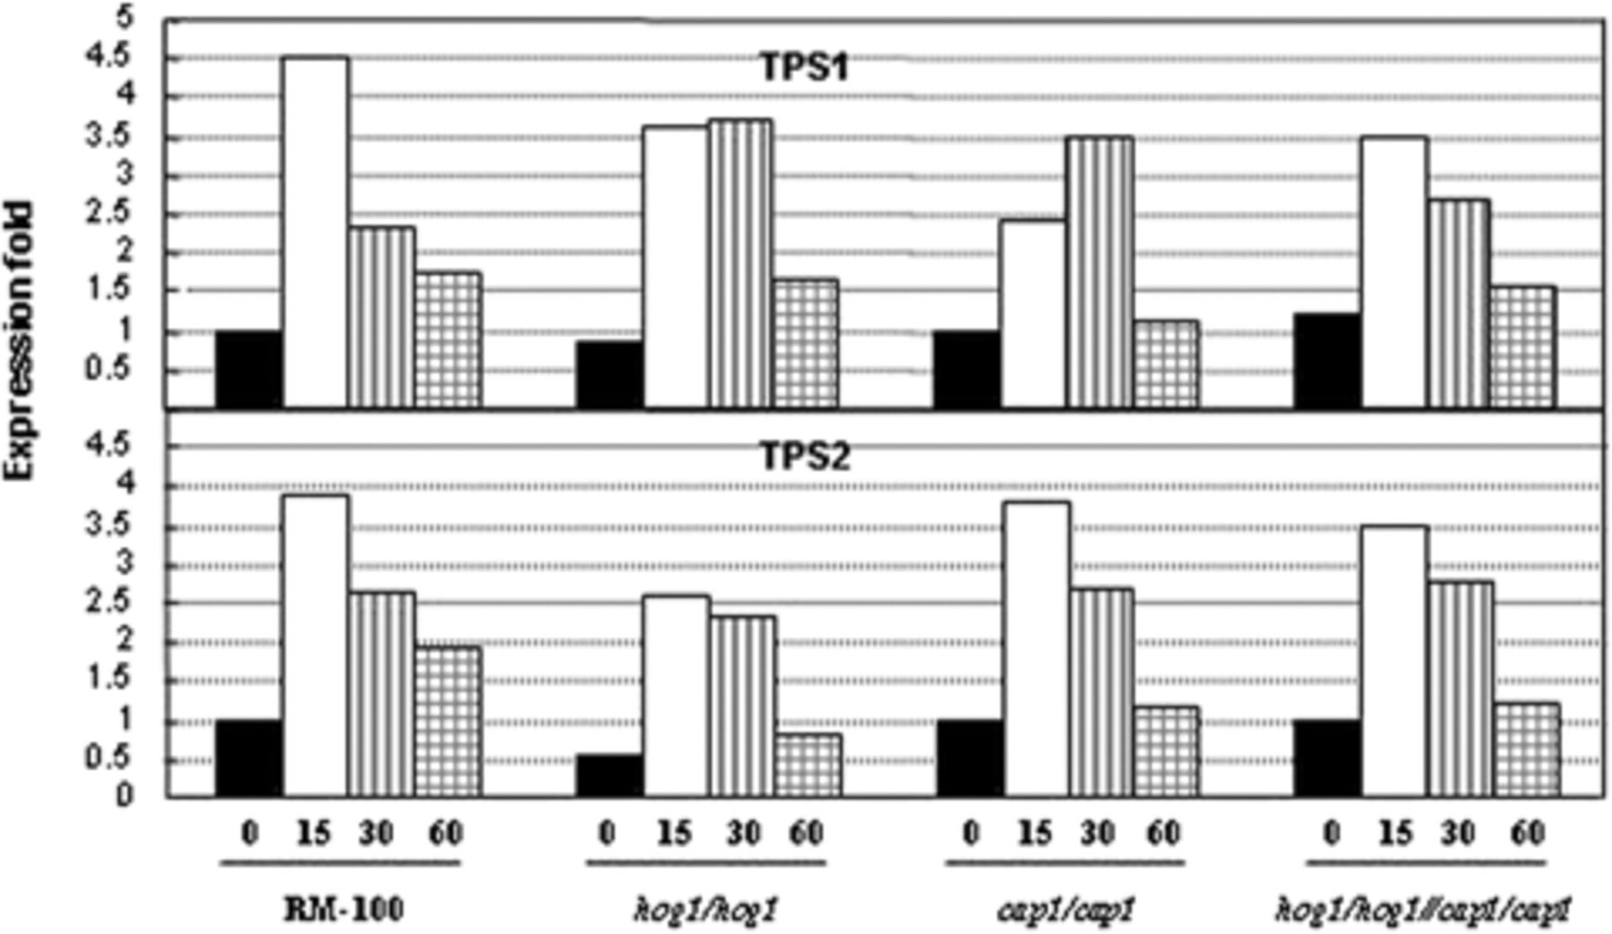
3 H₂O₂-induced mRNA expression of the trehalose biosynthetic genes is independent of Hog1 ...
Notes:
3 H2O2-induced mRNA expression of the trehalose biosynthetic genes is independent of Hog1 and Cap1. Exponential YPD-grown cells of the referred strains at 37°C were treated with 5 mM H2O2 for the indicated times. After extraction of total RNA, 2 μg was reverse transcribed and real-time q-PCR was performed using specific primers for TPS1 (upper panel) and TPS2 (lower panel). A value of 1 was assigned to the level recorded in untreated cells. For other details, see Materials and methods. Similar results were obtained in an independent experiment.
Unless provided in the caption above, the following copyright applies to the content of this slide: © 2010 Federation of European Microbiological Societies. Published by Blackwell Publishing Ltd. All rights reserved

Slide 4
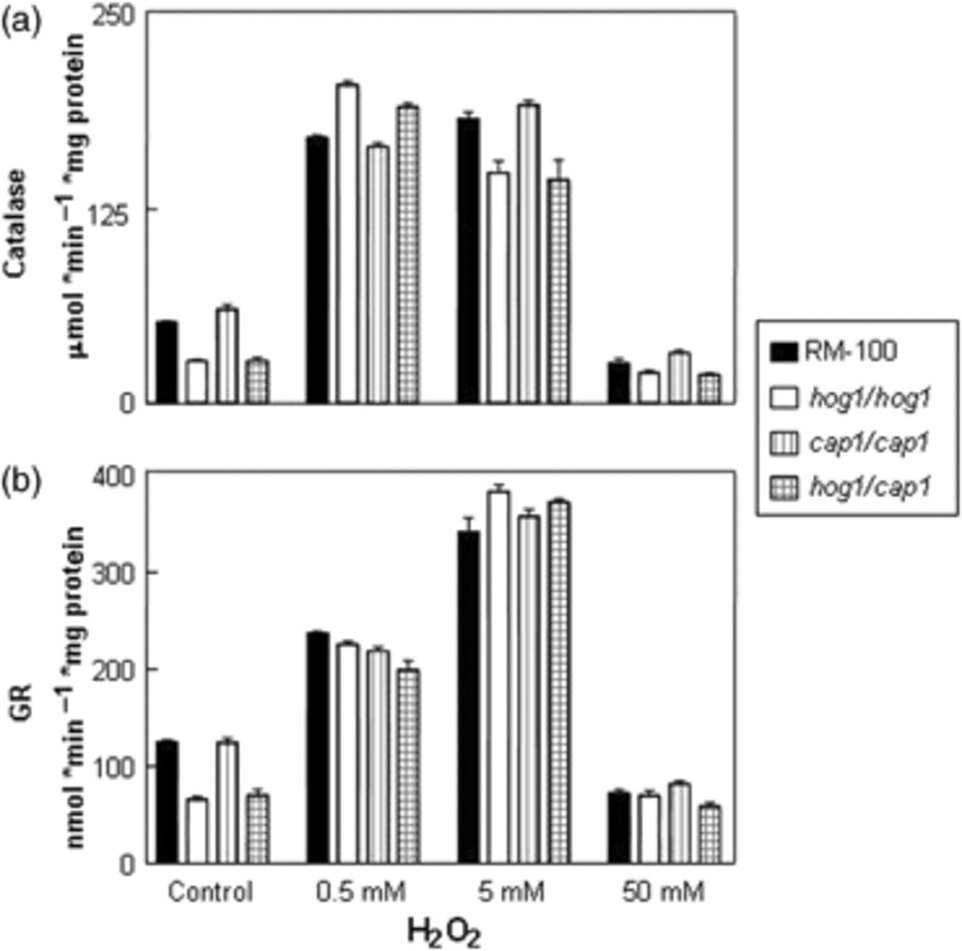
4 Effect of external addition of different doses of H₂O₂ for 60 min on the levels of ...
Notes:
4 Effect of external addition of different doses of H2O2 for 60 min on the levels of catalase (a) and GR (b) activities in Candida albicans. Mid-log cultures of the parental strain RM100, hog1 and cap1 mutants were taken and processed as described in Materials and methods. Activity data are expressed with respect to an untreated control. Values represent the means ± SD of three determinations.
Unless provided in the caption above, the following copyright applies to the content of this slide: © 2010 Federation of European Microbiological Societies. Published by Blackwell Publishing Ltd. All rights reserved

Slide 5
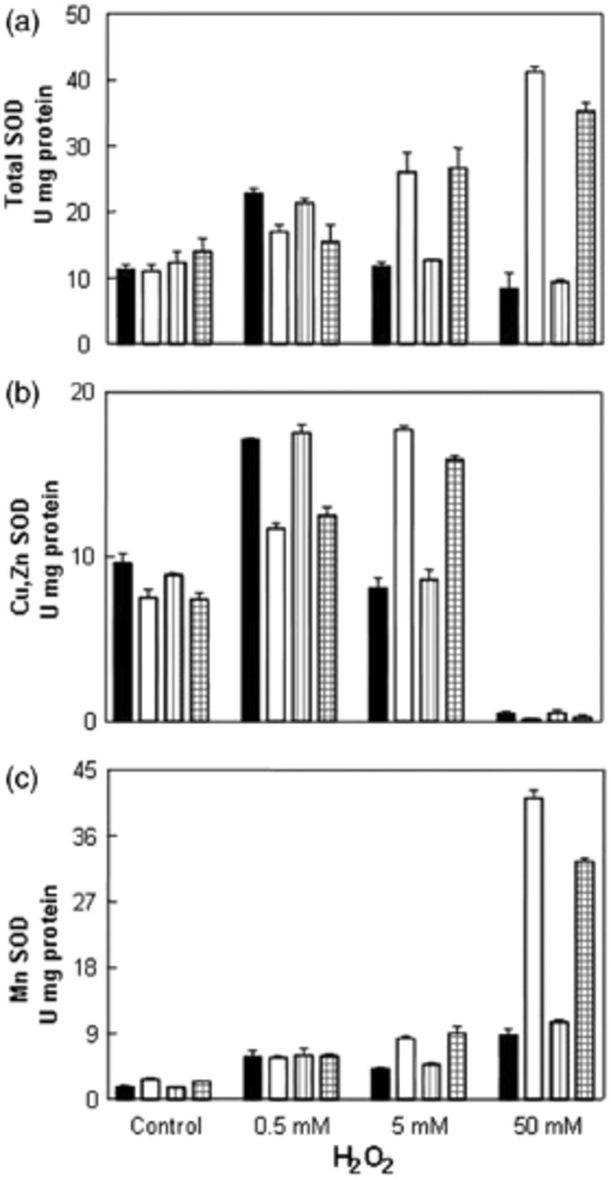
5 Changes in the total SOD activity (a), Cu,Zn isozyme (b) and Mn-SOD isozyme (c) in Candida albicans Hog1- and ...
Notes:
5 Changes in the total SOD activity (a), Cu,Zn isozyme (b) and Mn-SOD isozyme (c) in Candida albicans Hog1- and Cap1-deficient mutants subjected to oxidative stress with low and high H2O2 concentrations. The three enzymatic activities were determined simultaneously in the same sample following the reported protocols. For other details, see Fig. 4.
Unless provided in the caption above, the following copyright applies to the content of this slide: © 2010 Federation of European Microbiological Societies. Published by Blackwell Publishing Ltd. All rights reserved

