Slide 1
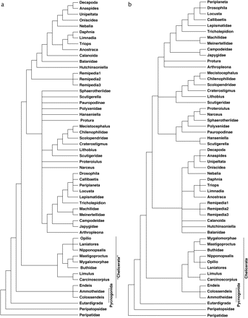
FIG. 1.— Bayesian cladograms of arthropod data with chelicerate and pycnogonid taxa marked: (a) T_{t} with ...
Notes:
FIG. 1.— Bayesian cladograms of arthropod data with chelicerate and pycnogonid taxa marked: (a) Tt with –log likelihood of 773.02908, (b) Tc with −log likelihood of the best binary resolution 773.38128
Unless provided in the caption above, the following copyright applies to the content of this slide: © The Author 2007. Published by Oxford University Press on behalf of the Society for Molecular Biology and Evolution. All rights reserved. For permissions, please e-mail: journals.permissions@oxfordjournals.org

Slide 2
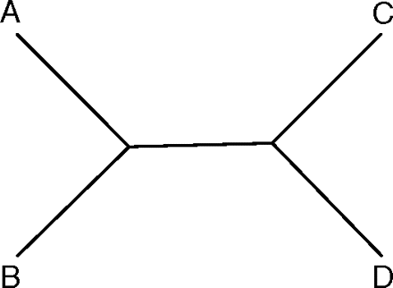
FIG. 2.— Maximum posterior probability (0.5) cladogram of data from table 1 under the NCM (Tuffley and Steel, 1997) ...
Notes:
FIG. 2.— Maximum posterior probability (0.5) cladogram of data from table 1 under the NCM (Tuffley and Steel, 1997) model of substitution. The 2 alternate cladograms have posterior probabilities of 0.25.
Unless provided in the caption above, the following copyright applies to the content of this slide: © The Author 2007. Published by Oxford University Press on behalf of the Society for Molecular Biology and Evolution. All rights reserved. For permissions, please e-mail: journals.permissions@oxfordjournals.org

Slide 3
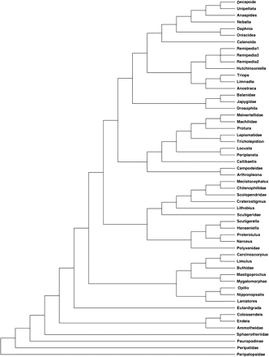
FIG. 3.— Arthropod cladogram with maximum posterior probability using morphologically estimated prior probabilities ...
Notes:
FIG. 3.— Arthropod cladogram with maximum posterior probability using morphologically estimated prior probabilities (under NCM) and molecular likelihood values calculated via the methods in Wheeler (2006).
Unless provided in the caption above, the following copyright applies to the content of this slide: © The Author 2007. Published by Oxford University Press on behalf of the Society for Molecular Biology and Evolution. All rights reserved. For permissions, please e-mail: journals.permissions@oxfordjournals.org

