Slide 1
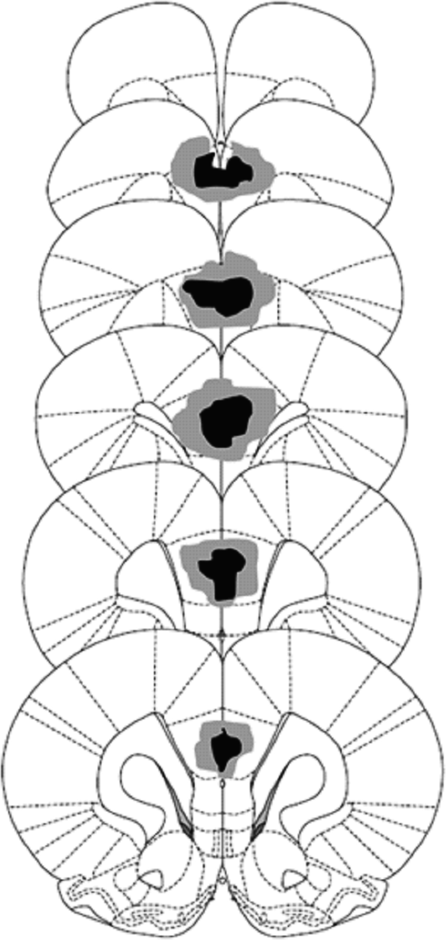
Figure 1. Schematic representations of excitotoxic lesions of the PL cortex for Experiments 1, 2, and 3. Coronal ...
Notes:
Figure 1. Schematic representations of excitotoxic lesions of the PL cortex for Experiments 1, 2, and 3. Coronal sections are taken from the following points on the anteroposterior plane beginning at top: +5.64, +5.16, +4.68, +4.20, +3.24, and +2.52 mm anterior to bregma (Paxinos and Watson 1998).
Unless provided in the caption above, the following copyright applies to the content of this slide: © The Author 2012. Published by Oxford University Press. All rights reserved. For Permissions, please e-mail: journals.permissions@oup.com

Slide 2
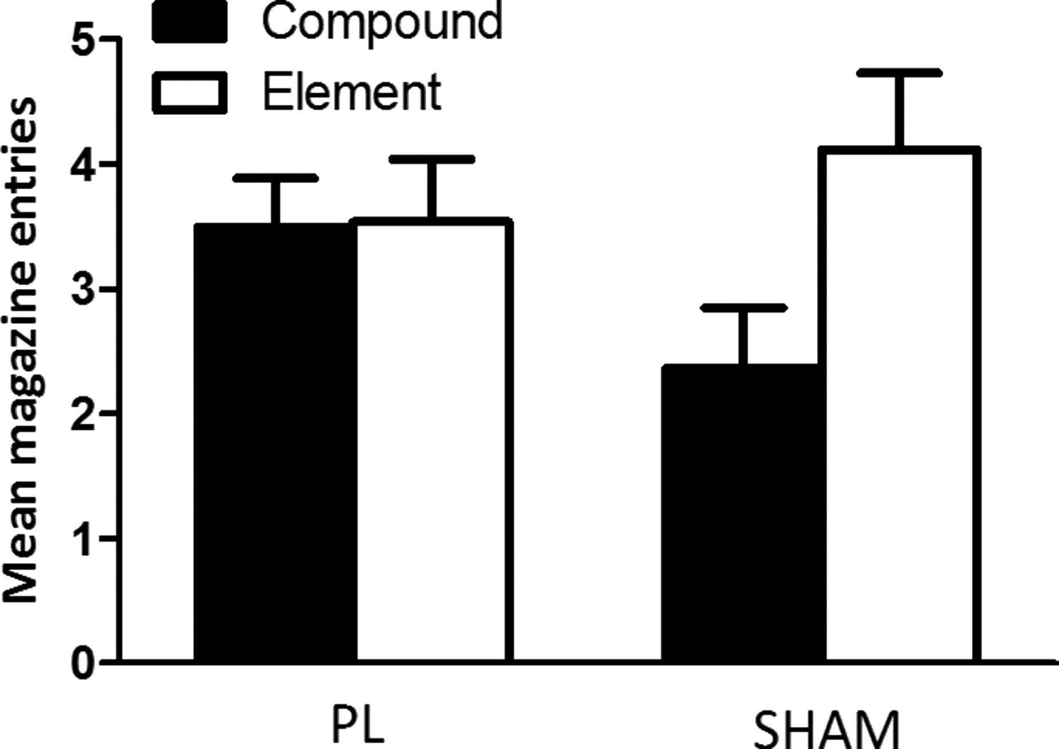
Figure 2. Effects of lesions of the PL cortex on overshadowing. Rates of responding are represented as the antilog of ...
Notes:
Figure 2. Effects of lesions of the PL cortex on overshadowing. Rates of responding are represented as the antilog of the mean number of magazine entries during CS presentations under extinction (±SEM). Sham-lesioned animals demonstrated lower levels of responding to stimuli conditioned in compound compared with those conditioned alone, indicative of an overshadowing effect. PL-lesioned animals did not show this effect, responding at a similar level to stimuli conditioning in compound and alone.
Unless provided in the caption above, the following copyright applies to the content of this slide: © The Author 2012. Published by Oxford University Press. All rights reserved. For Permissions, please e-mail: journals.permissions@oup.com

Slide 3
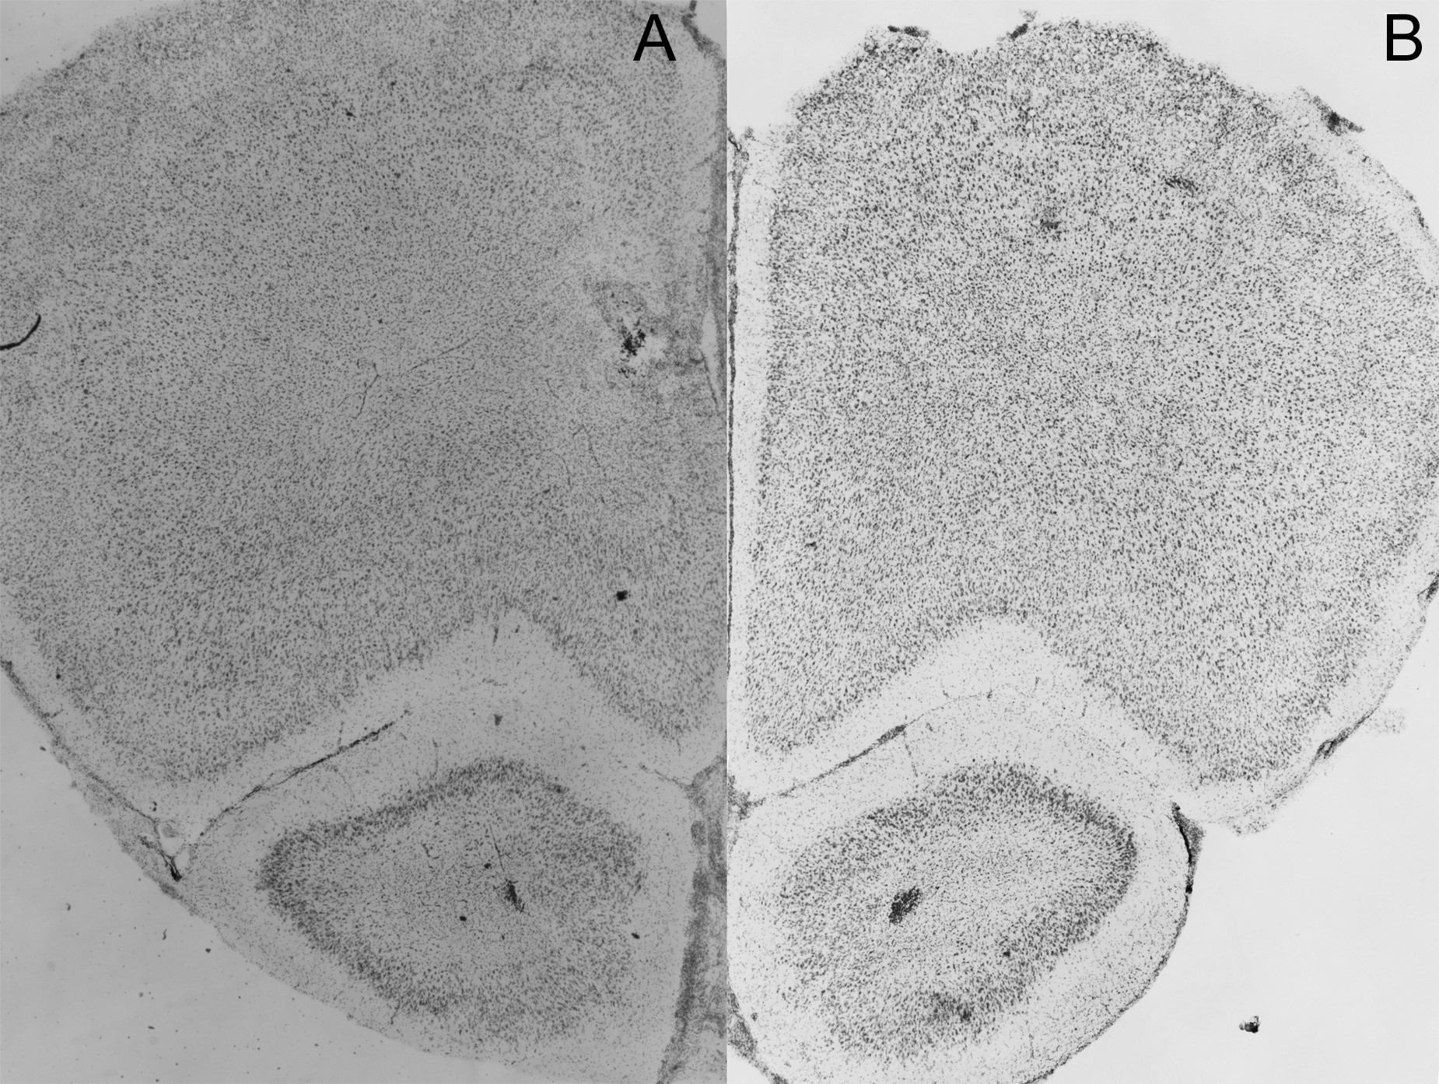
Figure 3. Photomicrographs showing cresyl violet-stained coronal sections through the PL cortex (approximately +4.20 mm ...
Notes:
Figure 3. Photomicrographs showing cresyl violet-stained coronal sections through the PL cortex (approximately +4.20 mm anterior to bregma) (A) PL lesion (B) Sham lesion.
Unless provided in the caption above, the following copyright applies to the content of this slide: © The Author 2012. Published by Oxford University Press. All rights reserved. For Permissions, please e-mail: journals.permissions@oup.com

Slide 4
Figure 4. Effects of lesions of the PL cortex on the exhibition of blocking and the down-regulation of attention toward ...
Notes:
Figure 4. Effects of lesions of the PL cortex on the exhibition of blocking and the down-regulation of attention toward the blocked cue. (A) Rates of responding are represented as the antilog of the mean number of magazine entries (±SEM) made across 2 presentations of both (B and D). Animals in both groups demonstrated greater levels of responding to stimulus D relative to stimulus B. (B) mean number of magazine entries (±SEM) made across 2 sessions of post-test conditioning with the blocked cue. PL-lesioned animals demonstrated faster acquisition to the blocked cue relative to sham-lesioned animals.
Unless provided in the caption above, the following copyright applies to the content of this slide: © The Author 2012. Published by Oxford University Press. All rights reserved. For Permissions, please e-mail: journals.permissions@oup.com

Slide 5
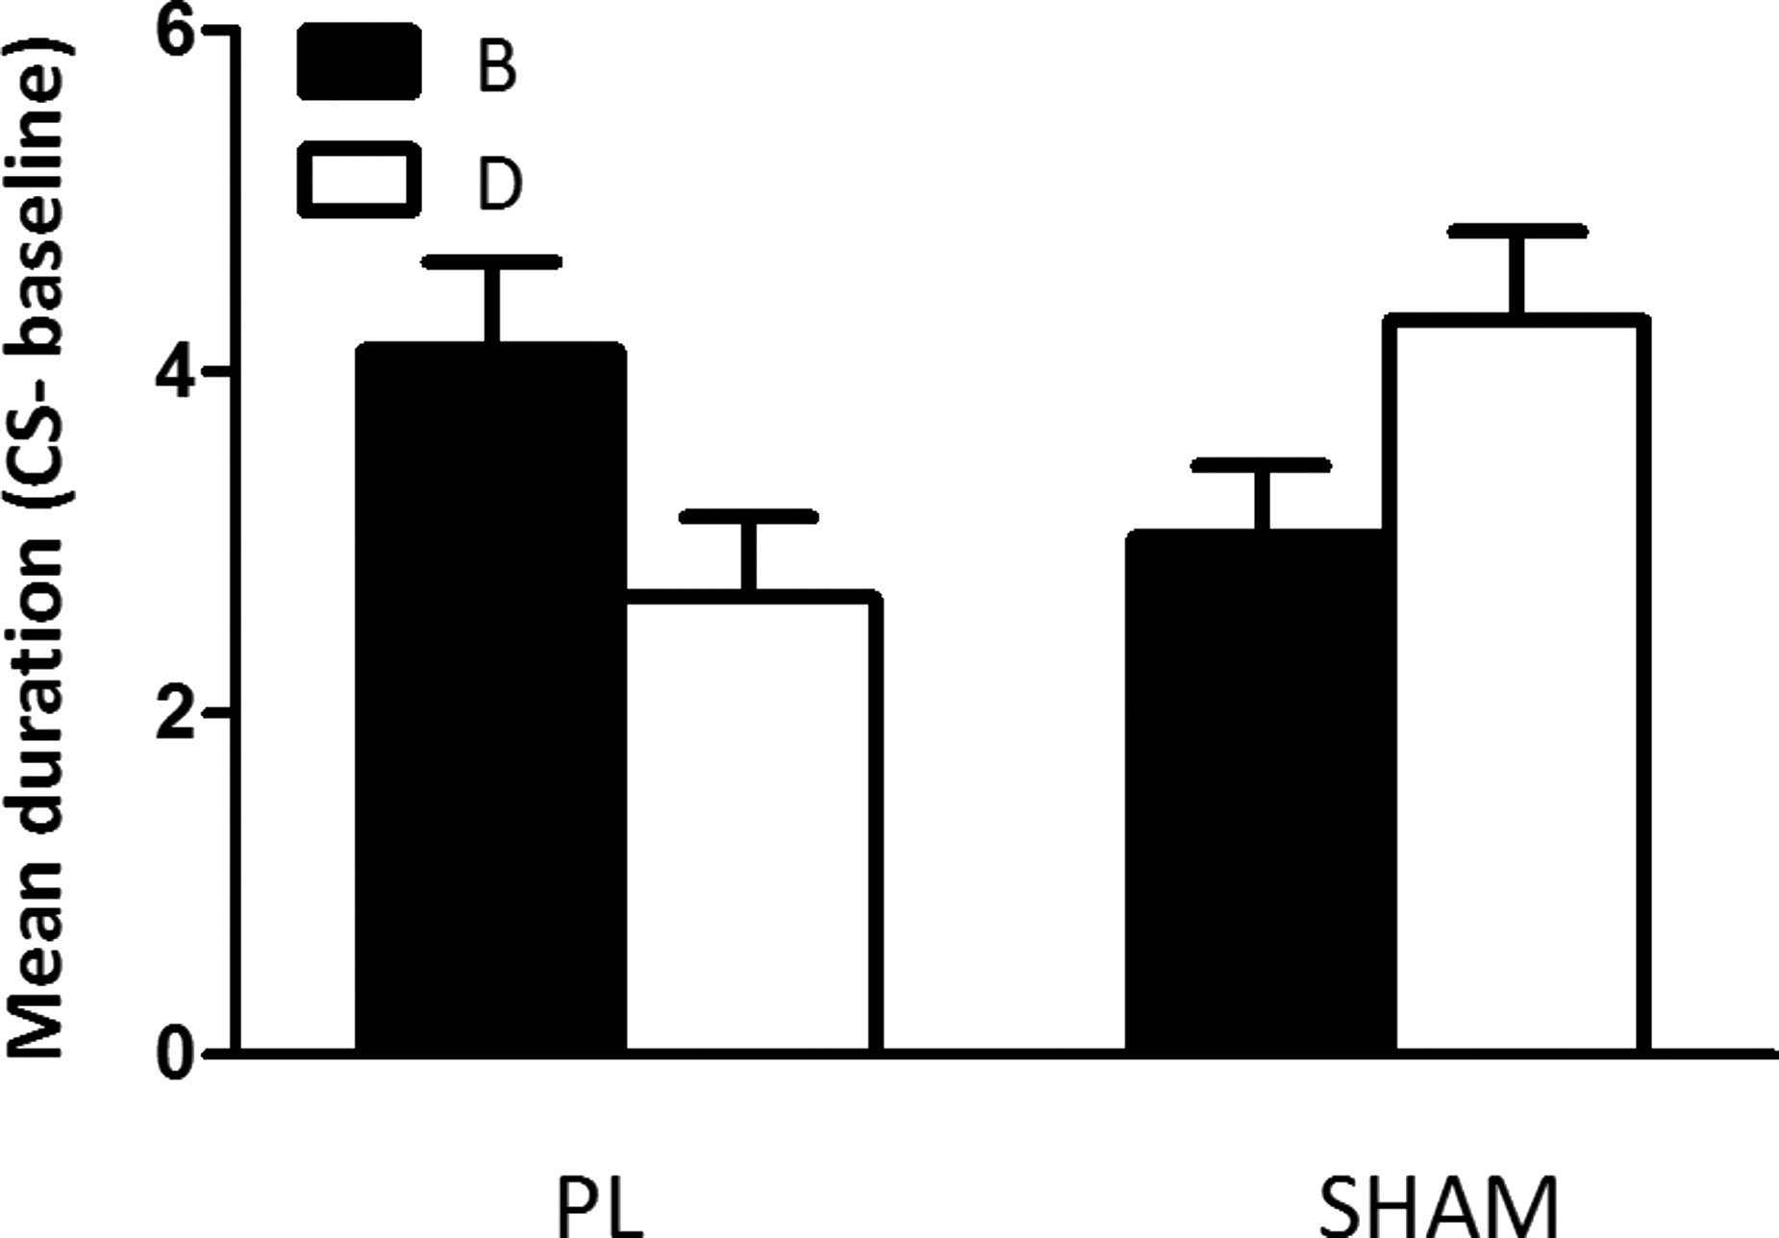
Figure 5. Effects of lesions of the PL cortex on unblocking. Data are represented as the mean duration spent in the ...
Notes:
Figure 5. Effects of lesions of the PL cortex on unblocking. Data are represented as the mean duration spent in the magzine relative to the baseline preCS period across the 2 test sessions. Sham-lesioned animals responded significantly more to stimulus D relative to stimulus B, demonstrating a down-regulation of attention toward the blocked cue during blocking. PL-lesioned animals did not demonstrate this effect, trending toward responding more to stimulus B relative to stimulus D.
Unless provided in the caption above, the following copyright applies to the content of this slide: © The Author 2012. Published by Oxford University Press. All rights reserved. For Permissions, please e-mail: journals.permissions@oup.com

