Slide 1
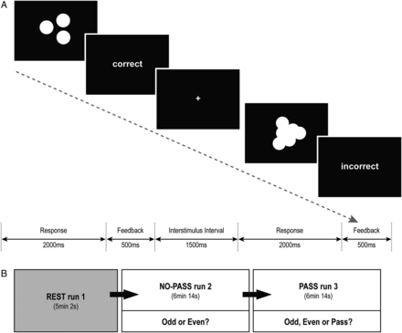
Figure 1. Odd-Even-Pass Task. (A) The task consisted of 2 conditions: a certain condition, in which the participants ...
Notes:
Figure 1. Odd-Even-Pass Task. (A) The task consisted of 2 conditions: a certain condition, in which the participants could easily estimate the correct answer; and an uncertain condition, in which the coins were overlapped and the borders were blurred so the participants could only make a guess. (B) Each participant underwent 3 serial runs: REST run 1, NO-PASS run 2, and PASS run 3. The task runs were repeated in the same manner with the exception that NO-PASS run2 allowed only 2 response options (Odd or Even), whereas PASS run 3 provided 3 response options (Odd, Even, or Pass).
Unless provided in the caption above, the following copyright applies to the content of this slide: © The Author 2013. Published by Oxford University Press. All rights reserved. For Permissions, please e-mail: journals.permissions@oup.com

Slide 2
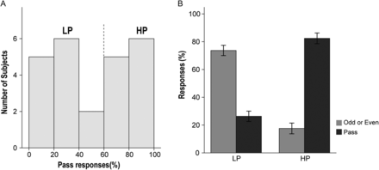
Figure 2. Percentage of Pass responses. (A) The distribution of percentage of Pass responses demonstrated a bimodal ...
Notes:
Figure 2. Percentage of Pass responses. (A) The distribution of percentage of Pass responses demonstrated a bimodal distribution, which divided the participants into 2 groups: the HP group (n = 12) and the LP group (n = 12). (B) The mean percentage of Pass responses of the HP group was significantly higher than that of the LP group (t = 11.199, P < 0.001). (Sidebars represent ±1 standard error).
Unless provided in the caption above, the following copyright applies to the content of this slide: © The Author 2013. Published by Oxford University Press. All rights reserved. For Permissions, please e-mail: journals.permissions@oup.com

Slide 3
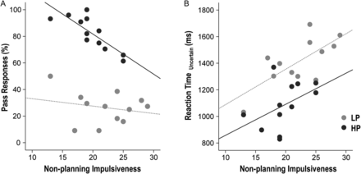
Figure 3. Correlation between impulsivity and task performance. During PASS run 3, the percentage of Pass responses ...
Notes:
Figure 3. Correlation between impulsivity and task performance. During PASS run 3, the percentage of Pass responses demonstrated a negative correlation with nonplanning impulsiveness within the HP group (r = −0.819, P = 0.001), but not within the LP group (r = −0.221, P = 0.490; Fig. 3A). During Pass run 3, slower RTs in uncertain trials correlated with nonplanning impulsiveness within the LP group (r = 0.709, P = 0.010) but not within the HP group (r = 460, P = 0.132; Fig. 3B).
Unless provided in the caption above, the following copyright applies to the content of this slide: © The Author 2013. Published by Oxford University Press. All rights reserved. For Permissions, please e-mail: journals.permissions@oup.com

Slide 4
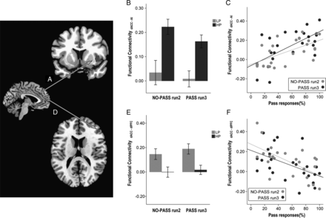
Figure 4. Correlation between task-activated functional connectivity and task performance. Synchronous activity between ...
Notes:
Figure 4. Correlation between task-activated functional connectivity and task performance. Synchronous activity between dACC and the right anterior insula (AI, A) was stronger in the HP group compared to the LP group (B; F1,22 = 23.908, P = 0.001). Stronger synchronous activity between dACC and the right AI, both in NO-PASS run 2 and PASS run 3, predicted greater use of Pass in PASS run 3 (C). By contrast, synchronous activity between dACC and the dorsolateral prefrontal cortex (DLPFC, D) was stronger in the LP group compared to the HP group (E; F1,22 = 17.436, P = 0.001) and stronger synchronous activity between dACC and the right DLPFC, both in NO-PASS run 2 and PASS run 3, predicted less use of Pass in PASS run 3 (F). (Sidebars represent ±1 standard error).
Unless provided in the caption above, the following copyright applies to the content of this slide: © The Author 2013. Published by Oxford University Press. All rights reserved. For Permissions, please e-mail: journals.permissions@oup.com

Slide 5
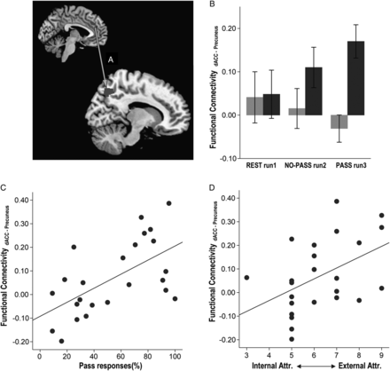
Figure 5. Correlation between task-activated functional connectivity, task performance, and subject attribution. ...
Notes:
Figure 5. Correlation between task-activated functional connectivity, task performance, and subject attribution. Synchronous activity between the dACC and the right precuneus (A) was stronger in the HP group compared to the LP group (F1,21 = 6.534, P = 0.018; B). Stronger dACC-precuneus synchrony correlated with higher use of Pass (C) and higher attribution to external factors of uncertainty (D). (Sidebars represent ±1 standard error).
Unless provided in the caption above, the following copyright applies to the content of this slide: © The Author 2013. Published by Oxford University Press. All rights reserved. For Permissions, please e-mail: journals.permissions@oup.com

Slide 6
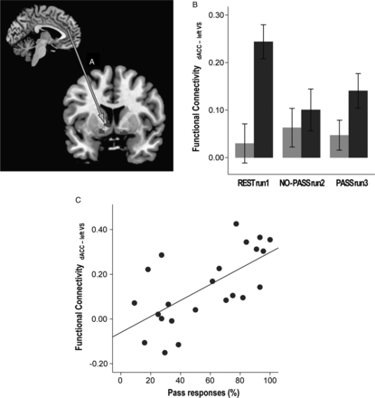
Figure 6. Correlation between resting-state functional connectivity, task performance, and impulsivity. The synchronous ...
Notes:
Figure 6. Correlation between resting-state functional connectivity, task performance, and impulsivity. The synchronous activity between dACC and the left ventral striatum (VS; A) was stronger in the HP group compared to the LP group (F1,21 = 7.739, P = 0.011; B). Stronger resting-state dACC-VS synchrony correlated with greater use of Pass in PASS run 3 (C). (Sidebars represent ±1 standard error).
Unless provided in the caption above, the following copyright applies to the content of this slide: © The Author 2013. Published by Oxford University Press. All rights reserved. For Permissions, please e-mail: journals.permissions@oup.com

Slide 7
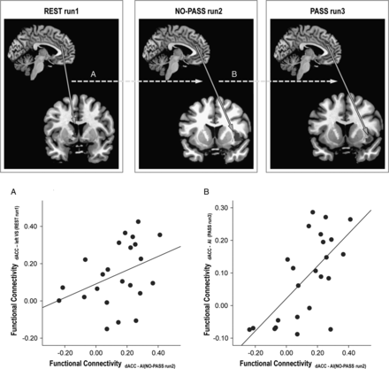
Figure 7. Correlation between resting-state and task-activated functional connectivity. Stronger resting-state ...
Notes:
Figure 7. Correlation between resting-state and task-activated functional connectivity. Stronger resting-state functional connectivity between the dACC and the left ventral striatum (VS) predicted stronger dACC-AI synchrony in NO-PASS run 2 (A). In the same way, stronger dACC-AI synchrony in NO-PASS run 2 predicted stronger dACC-AI synchrony in PASS run 3 (B).
Unless provided in the caption above, the following copyright applies to the content of this slide: © The Author 2013. Published by Oxford University Press. All rights reserved. For Permissions, please e-mail: journals.permissions@oup.com

