Slide 1
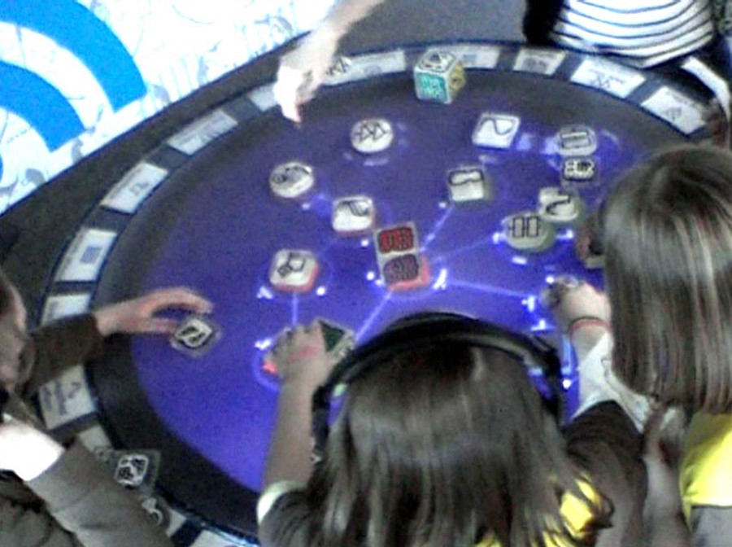
Figure 1. Visitors interacting with the Reactable at the Winchester Science Centre.
Notes:
Figure 1. Visitors interacting with the Reactable at the Winchester Science Centre.
Unless provided in the caption above, the following copyright applies to the content of this slide: © The Author 2016. Published by Oxford University Press on behalf of The British Computer Society. All rights reserved. For Permissions, please email: journals.permissions@oup.com

Slide 2
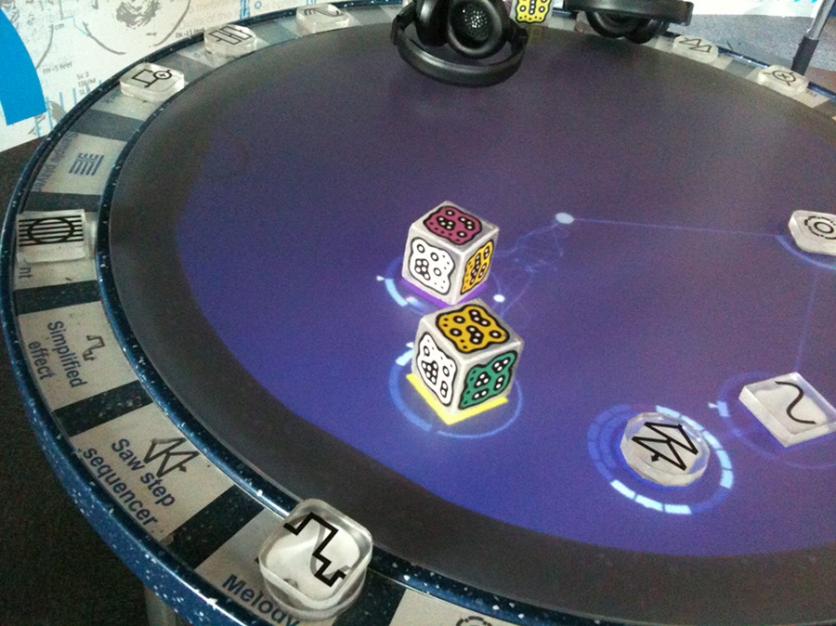
Figure 2. The Reactable Experience at WSC.
Notes:
Figure 2. The Reactable Experience at WSC.
Unless provided in the caption above, the following copyright applies to the content of this slide: © The Author 2016. Published by Oxford University Press on behalf of The British Computer Society. All rights reserved. For Permissions, please email: journals.permissions@oup.com

Slide 3
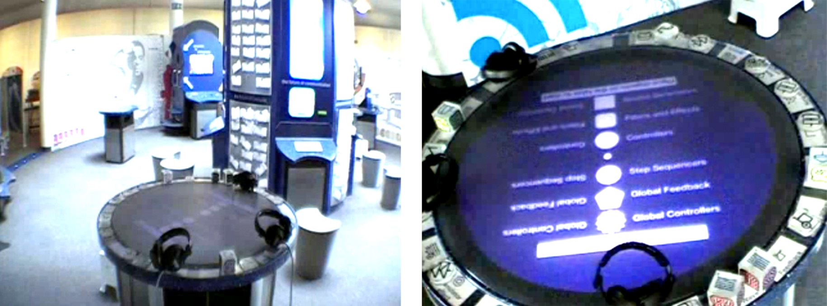
Figure 3. Left: camera general view. Right: camera close-up view.
Notes:
Figure 3. Left: camera general view. Right: camera close-up view.
Unless provided in the caption above, the following copyright applies to the content of this slide: © The Author 2016. Published by Oxford University Press on behalf of The British Computer Society. All rights reserved. For Permissions, please email: journals.permissions@oup.com

Slide 4
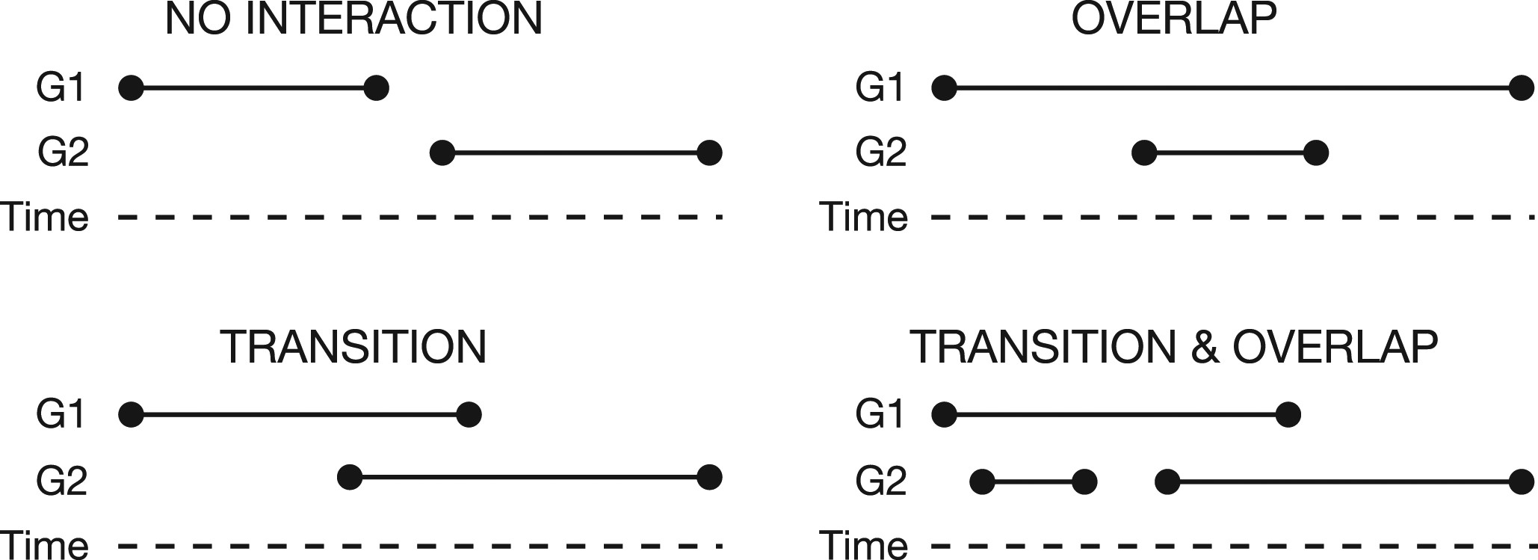
Figure 4. Cross-group interaction: transitions and overlaps.
Notes:
Figure 4. Cross-group interaction: transitions and overlaps.
Unless provided in the caption above, the following copyright applies to the content of this slide: © The Author 2016. Published by Oxford University Press on behalf of The British Computer Society. All rights reserved. For Permissions, please email: journals.permissions@oup.com

Slide 5
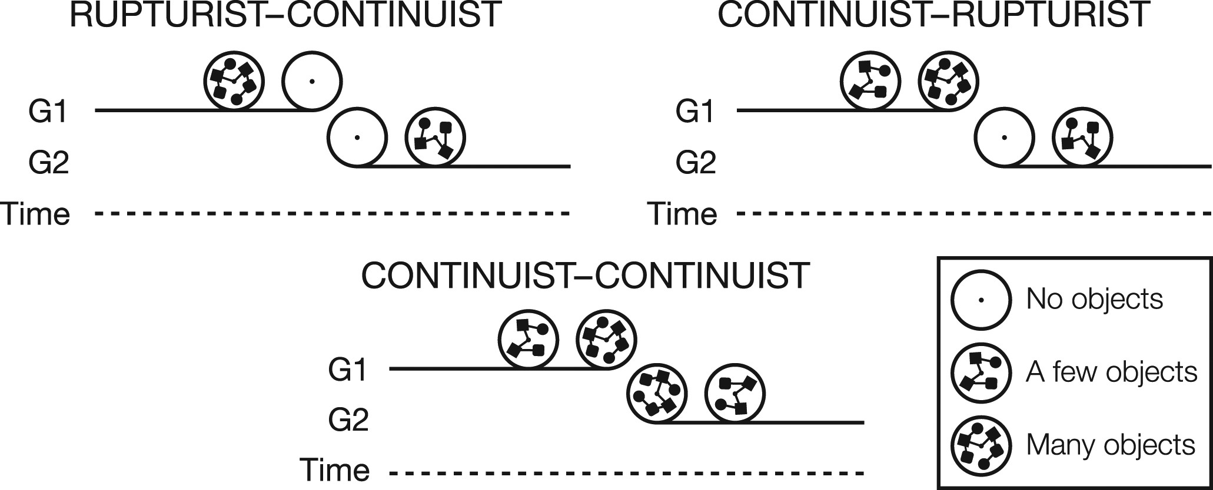
Figure 5. Cross-group interaction: continuist vs rupturist.
Notes:
Figure 5. Cross-group interaction: continuist vs rupturist.
Unless provided in the caption above, the following copyright applies to the content of this slide: © The Author 2016. Published by Oxford University Press on behalf of The British Computer Society. All rights reserved. For Permissions, please email: journals.permissions@oup.com

Slide 6
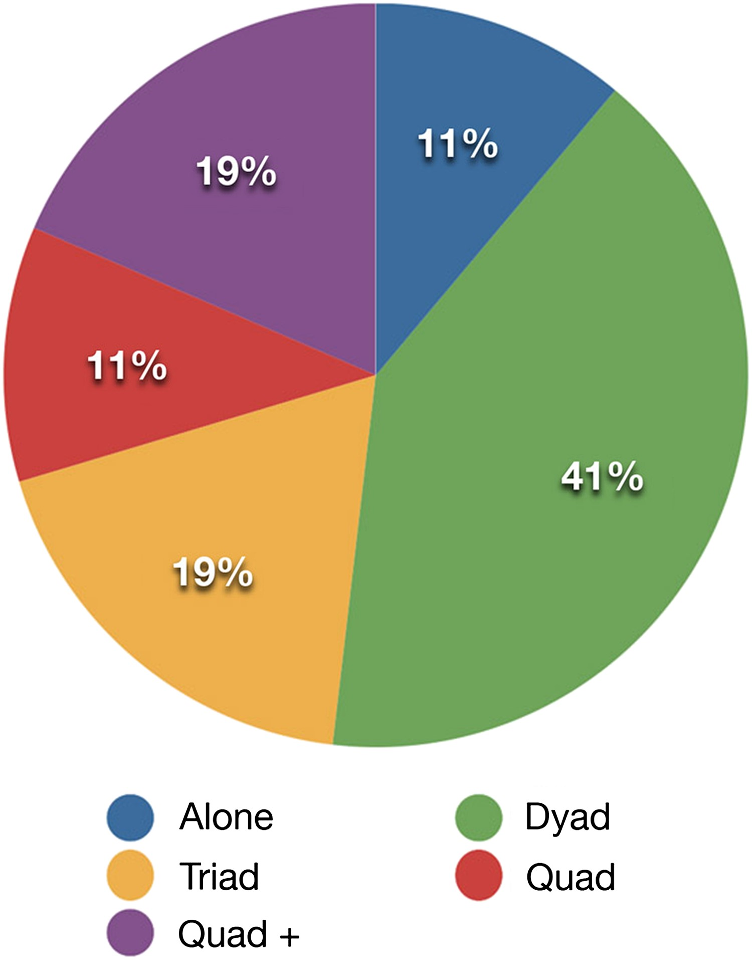
Figure 6. Pie chart: percentage of group sizes.
Notes:
Figure 6. Pie chart: percentage of group sizes.
Unless provided in the caption above, the following copyright applies to the content of this slide: © The Author 2016. Published by Oxford University Press on behalf of The British Computer Society. All rights reserved. For Permissions, please email: journals.permissions@oup.com

Slide 7
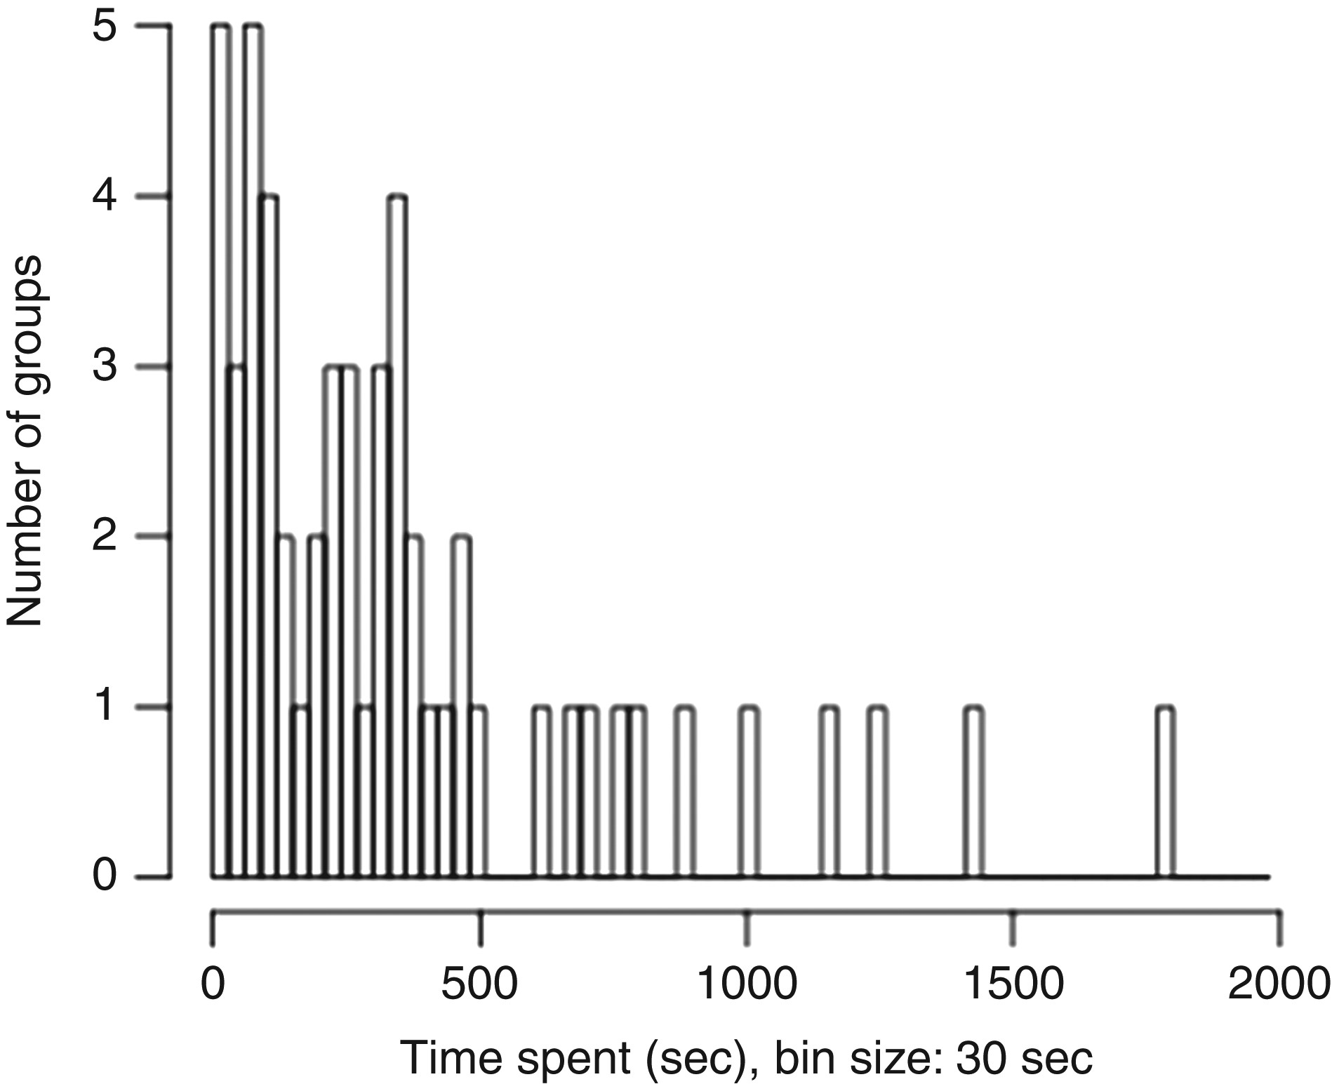
Figure 7. Histogram: distribution of time spent by groups.
Notes:
Figure 7. Histogram: distribution of time spent by groups.
Unless provided in the caption above, the following copyright applies to the content of this slide: © The Author 2016. Published by Oxford University Press on behalf of The British Computer Society. All rights reserved. For Permissions, please email: journals.permissions@oup.com

Slide 8
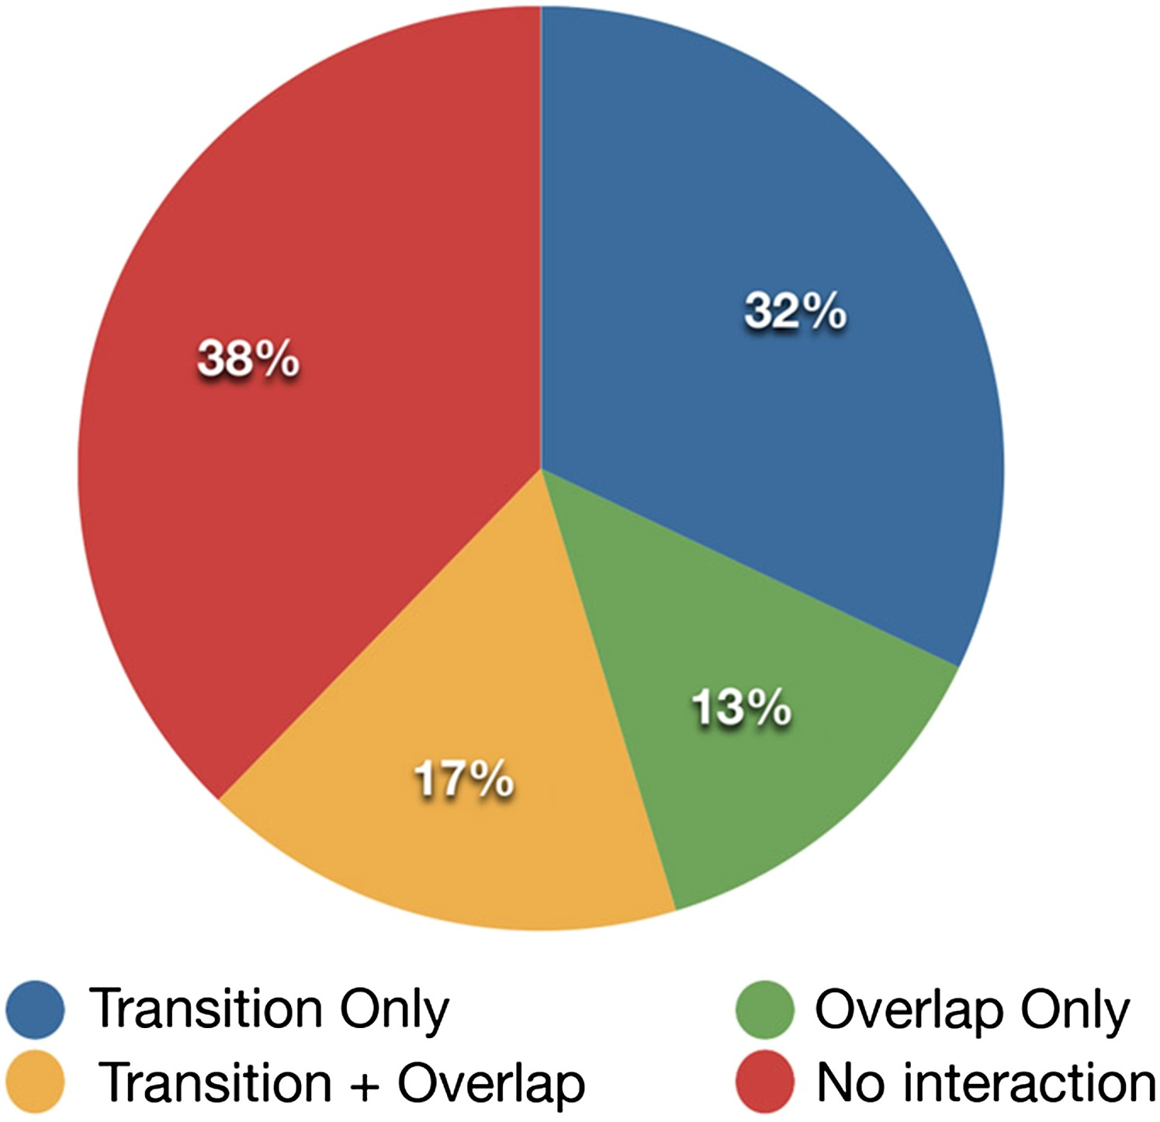
Figure 8. Pie chart: percentage of transitions and overlaps.
Notes:
Figure 8. Pie chart: percentage of transitions and overlaps.
Unless provided in the caption above, the following copyright applies to the content of this slide: © The Author 2016. Published by Oxford University Press on behalf of The British Computer Society. All rights reserved. For Permissions, please email: journals.permissions@oup.com

Slide 9
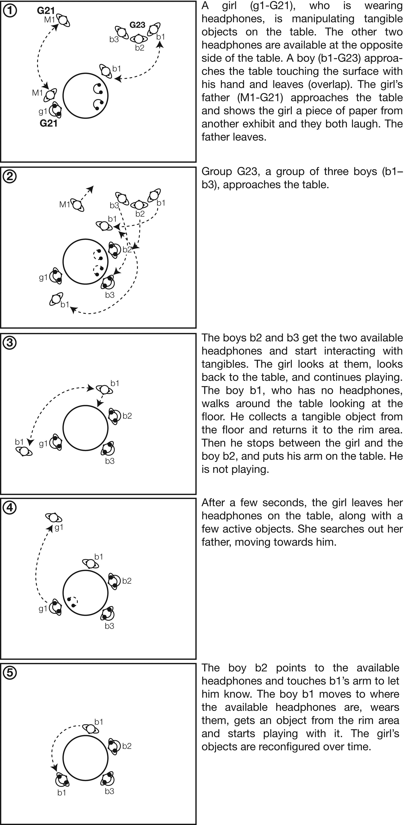
Figure 9. Vignette 1: A fluid transition (G21 and G23). Duration: 2 minutes 56 seconds.
Notes:
Figure 9. Vignette 1: A fluid transition (G21 and G23). Duration: 2 minutes 56 seconds.
Unless provided in the caption above, the following copyright applies to the content of this slide: © The Author 2016. Published by Oxford University Press on behalf of The British Computer Society. All rights reserved. For Permissions, please email: journals.permissions@oup.com

Slide 10
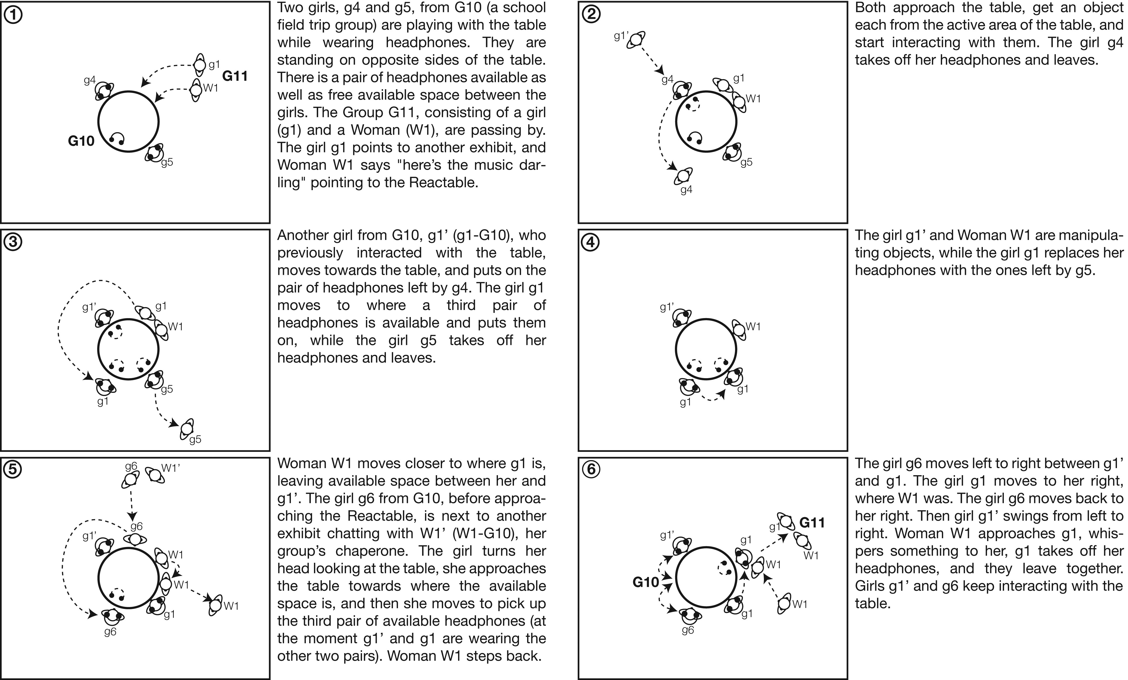
Figure 10. Vignette 2: A smooth overlap (G10 and G11). Duration: 38 seconds.
Notes:
Figure 10. Vignette 2: A smooth overlap (G10 and G11). Duration: 38 seconds.
Unless provided in the caption above, the following copyright applies to the content of this slide: © The Author 2016. Published by Oxford University Press on behalf of The British Computer Society. All rights reserved. For Permissions, please email: journals.permissions@oup.com

Slide 11
Figure 11. Comparative numbers of continuist vs rupturist approaches.
Notes:
Figure 11. Comparative numbers of continuist vs rupturist approaches.
Unless provided in the caption above, the following copyright applies to the content of this slide: © The Author 2016. Published by Oxford University Press on behalf of The British Computer Society. All rights reserved. For Permissions, please email: journals.permissions@oup.com

Slide 12
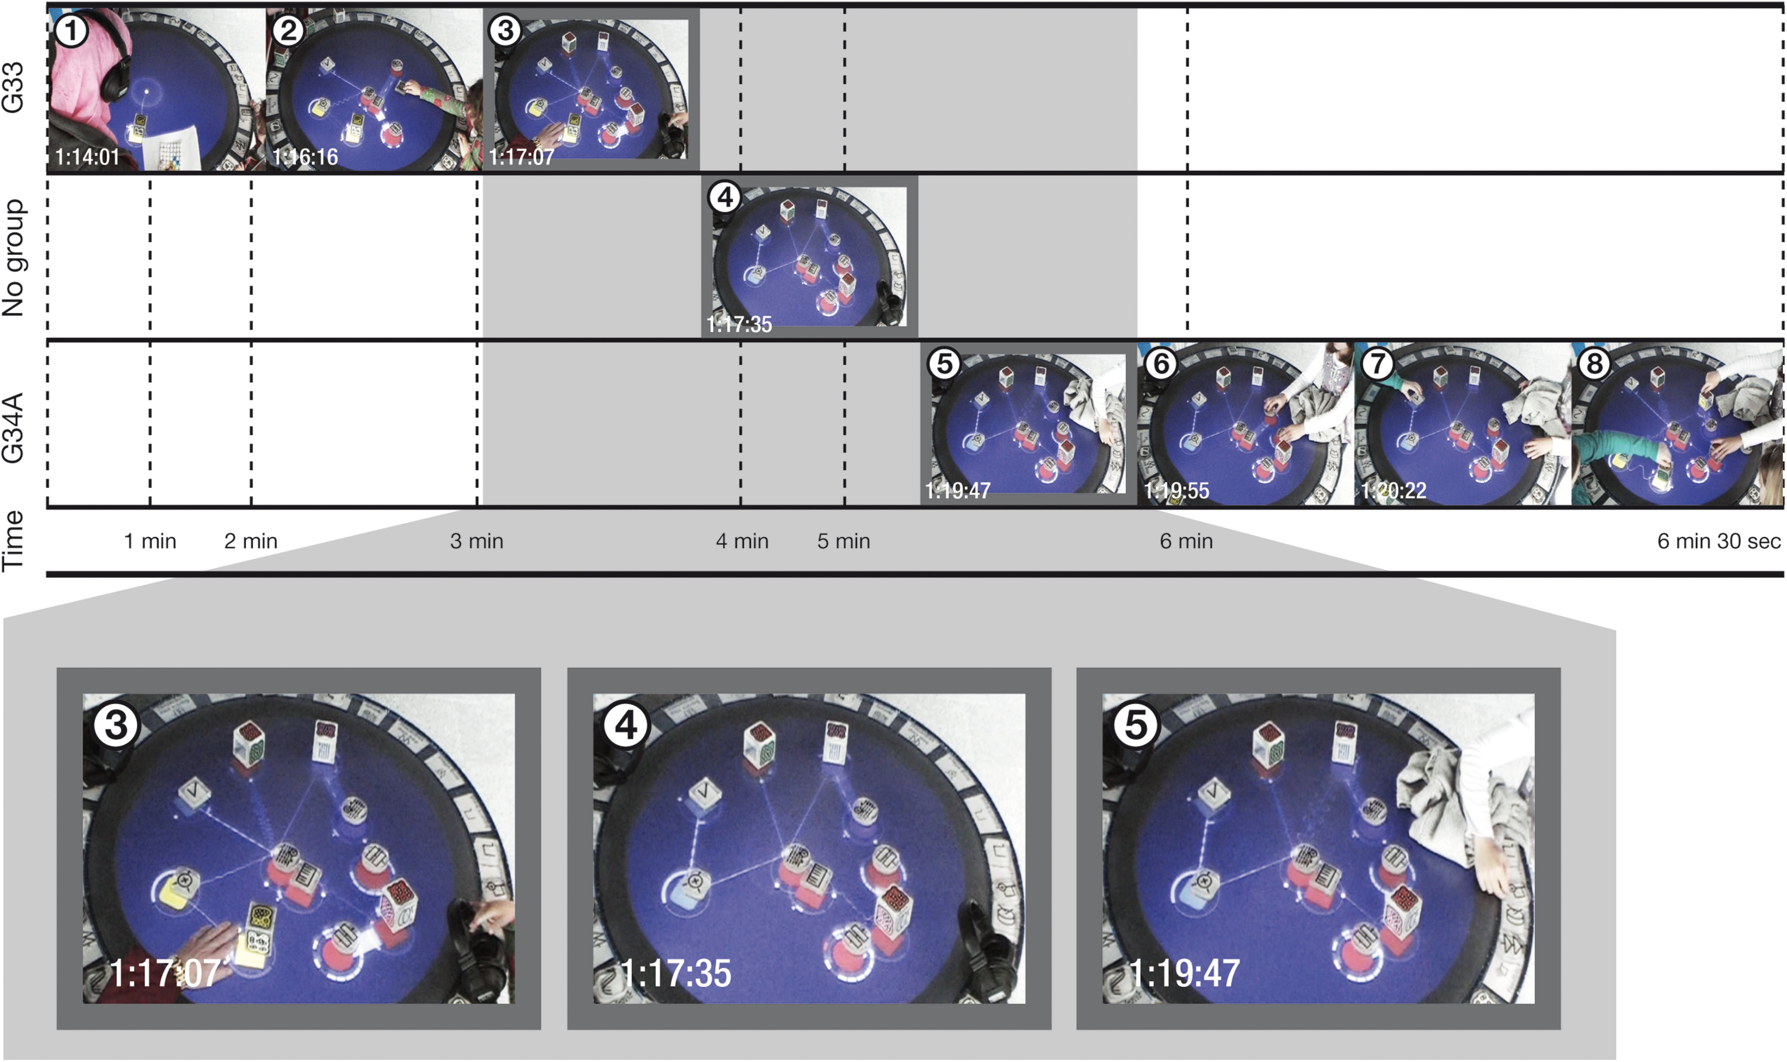
Figure 12. Vignette 3: Asynchronous continuist–continuist interaction (G33 and G34A). Duration: 6 minutes 32 seconds.
Notes:
Figure 12. Vignette 3: Asynchronous continuist–continuist interaction (G33 and G34A). Duration: 6 minutes 32 seconds.
Unless provided in the caption above, the following copyright applies to the content of this slide: © The Author 2016. Published by Oxford University Press on behalf of The British Computer Society. All rights reserved. For Permissions, please email: journals.permissions@oup.com

Slide 13
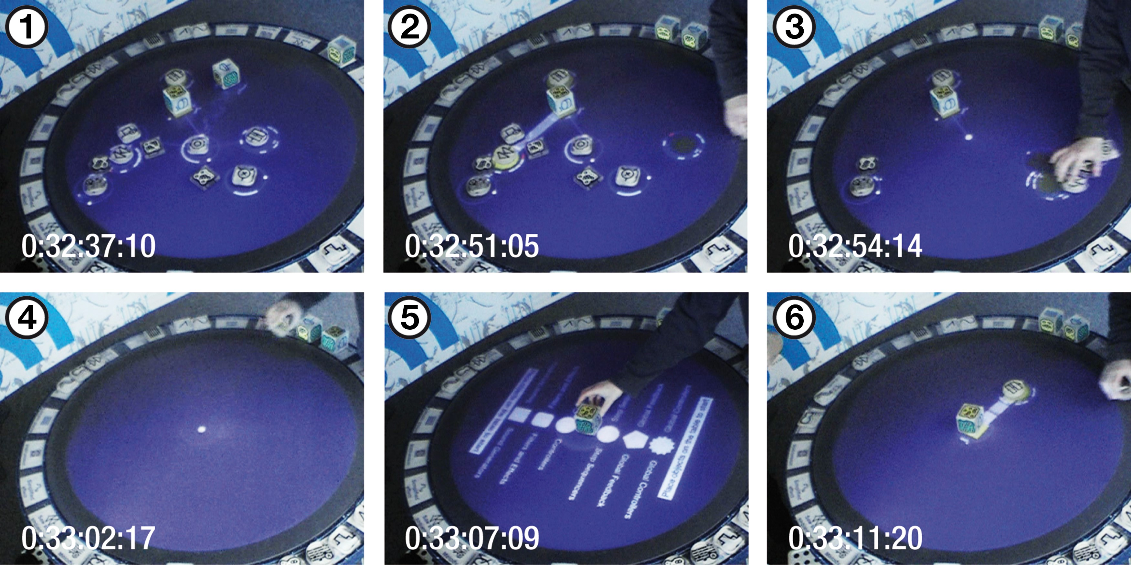
Figure 13. Vignette 4: Asynchronous continuist–rupturist interaction (G52). Duration: 34 seconds.
Notes:
Figure 13. Vignette 4: Asynchronous continuist–rupturist interaction (G52). Duration: 34 seconds.
Unless provided in the caption above, the following copyright applies to the content of this slide: © The Author 2016. Published by Oxford University Press on behalf of The British Computer Society. All rights reserved. For Permissions, please email: journals.permissions@oup.com

