Slide 1
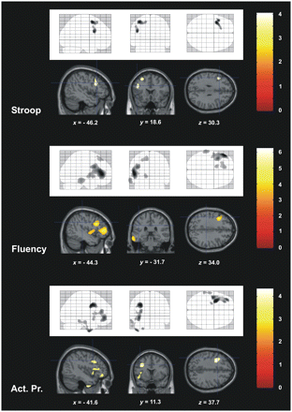
Figure 1 Correlation between reductions in brain glucose utilization and executive dysfunctions—Stroop Test (Stroop), ...
Notes:
Figure 1 Correlation between reductions in brain glucose utilization and executive dysfunctions—Stroop Test (Stroop), Category Fluency (Fluency) and subtest Action Program (Act. Pr.) of the BADS. Brain sections (location illustrated by crosshairs) visualize relevant neural clusters. Age as covariate. P < 0.001 uncorrected. Left is left. Colour scales represent t-values.
Unless provided in the caption above, the following copyright applies to the content of this slide: © The Author (2011). Published by Oxford University Press on behalf of the Guarantors of Brain.This is an Open Access article distributed under the terms of the Creative Commons Attribution Non-Commercial License (http://creativecommons.org/licenses/by-nc/3.0), which permits unrestricted non-commercial use, distribution, and reproduction in any medium, provided the original work is properly cited.

Slide 2
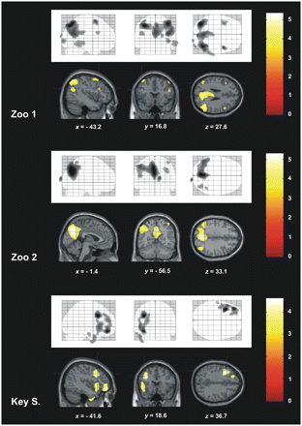
Figure 2 Correlation between reductions in brain glucose utilization and executive dysfunctions—Subtests Zoo Map (Zoo; ...
Notes:
Figure 2 Correlation between reductions in brain glucose utilization and executive dysfunctions—Subtests Zoo Map (Zoo; Part 1 and 2) and Key Search (Key S.) of the BADS. Brain sections (location illustrated by crosshairs) visualize relevant neural clusters. Age as covariate. P < 0.001 uncorrected. Left is left. Colour scales represent t-values.
Unless provided in the caption above, the following copyright applies to the content of this slide: © The Author (2011). Published by Oxford University Press on behalf of the Guarantors of Brain.This is an Open Access article distributed under the terms of the Creative Commons Attribution Non-Commercial License (http://creativecommons.org/licenses/by-nc/3.0), which permits unrestricted non-commercial use, distribution, and reproduction in any medium, provided the original work is properly cited.

Slide 3
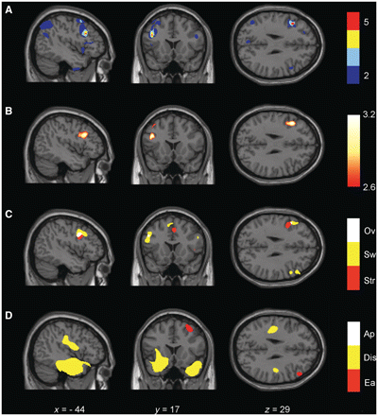
Figure 3 Conjunction analyses. Brain regions that showed consistently reduced glucose metabolism in association with ...
Notes:
Figure 3 Conjunction analyses. Brain regions that showed consistently reduced glucose metabolism in association with executive deficits. (A) Overlap of t-maps of all five tests. Maximum is located in the vicinity of the inferior frontal junction area (i.e. in this region, t-values of all statistical tests are significant with voxelwise P < 0.001). Scale represents number of overlapping tests. (B) Minimum z-score for all five executive function tests which corresponds to a conjunction analysis in the sense of a logical ‘AND’. Maximum of the resulting map of z-values is again located in the vicinity of the inferior frontal junction. (C) Results of the meta-analysis of studies investigating Stroop (Str) and Switch (Sw) tasks with functional MRI transformed into the MNI space using the unified segmentation approach (Ov = overlap; Derrfuss et al., 2005). (D) Results of our previous study with exactly the same cohort investigating the neural correlates of behavioural disorders in dementia—correlation between reduced glucose metabolism and apathy (Ap), disinhibition (Dis) and eating disorders (Ea) (Schroeter et al., 2011).
Unless provided in the caption above, the following copyright applies to the content of this slide: © The Author (2011). Published by Oxford University Press on behalf of the Guarantors of Brain.This is an Open Access article distributed under the terms of the Creative Commons Attribution Non-Commercial License (http://creativecommons.org/licenses/by-nc/3.0), which permits unrestricted non-commercial use, distribution, and reproduction in any medium, provided the original work is properly cited.

Slide 4
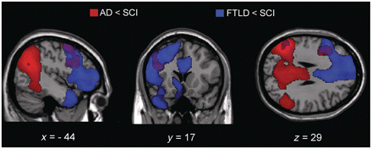
Figure 4 Group comparison—brain regions that showed reduced glucose metabolism in Alzheimer's disease (AD, red) and ...
Notes:
Figure 4 Group comparison—brain regions that showed reduced glucose metabolism in Alzheimer's disease (AD, red) and frontotemporal lobar degeneration (FTLD, blue) in comparison with subjects with subjective cognitive impairment (SCI). Overlap (purple) includes the left inferior frontal junction area. Age as covariate, P < 0.001 uncorrected, extent threshold of 30 voxels. Left is left. Note that coordinates in MNI space are identical to Fig. 3.
Unless provided in the caption above, the following copyright applies to the content of this slide: © The Author (2011). Published by Oxford University Press on behalf of the Guarantors of Brain.This is an Open Access article distributed under the terms of the Creative Commons Attribution Non-Commercial License (http://creativecommons.org/licenses/by-nc/3.0), which permits unrestricted non-commercial use, distribution, and reproduction in any medium, provided the original work is properly cited.

