Slide 1
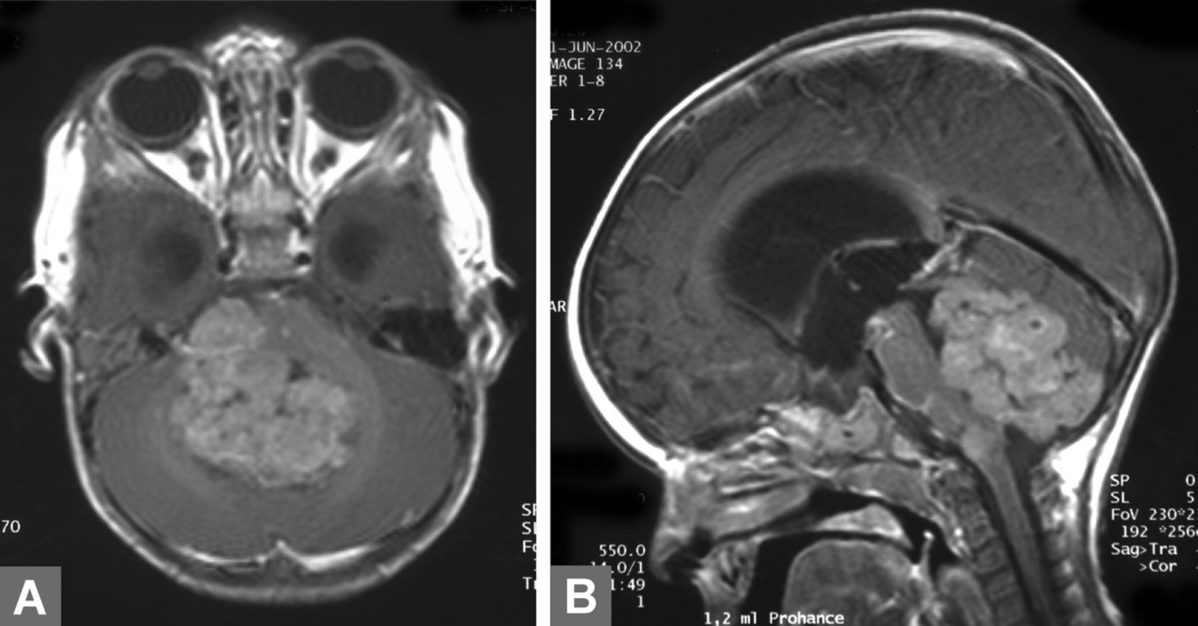
FIGURE 1. Preoperative magnetic resonance imaging of Patient 2 shows a large cerebellar tumor with irregular contrast ...
Notes:
FIGURE 1. Preoperative magnetic resonance imaging of Patient 2 shows a large cerebellar tumor with irregular contrast enhancement on T2-weighted transverse (A) and sagittal (B) planes.
Unless provided in the caption above, the following copyright applies to the content of this slide: Copyright © 2009 by the American Association of Neuropathologists, Inc.

Slide 2
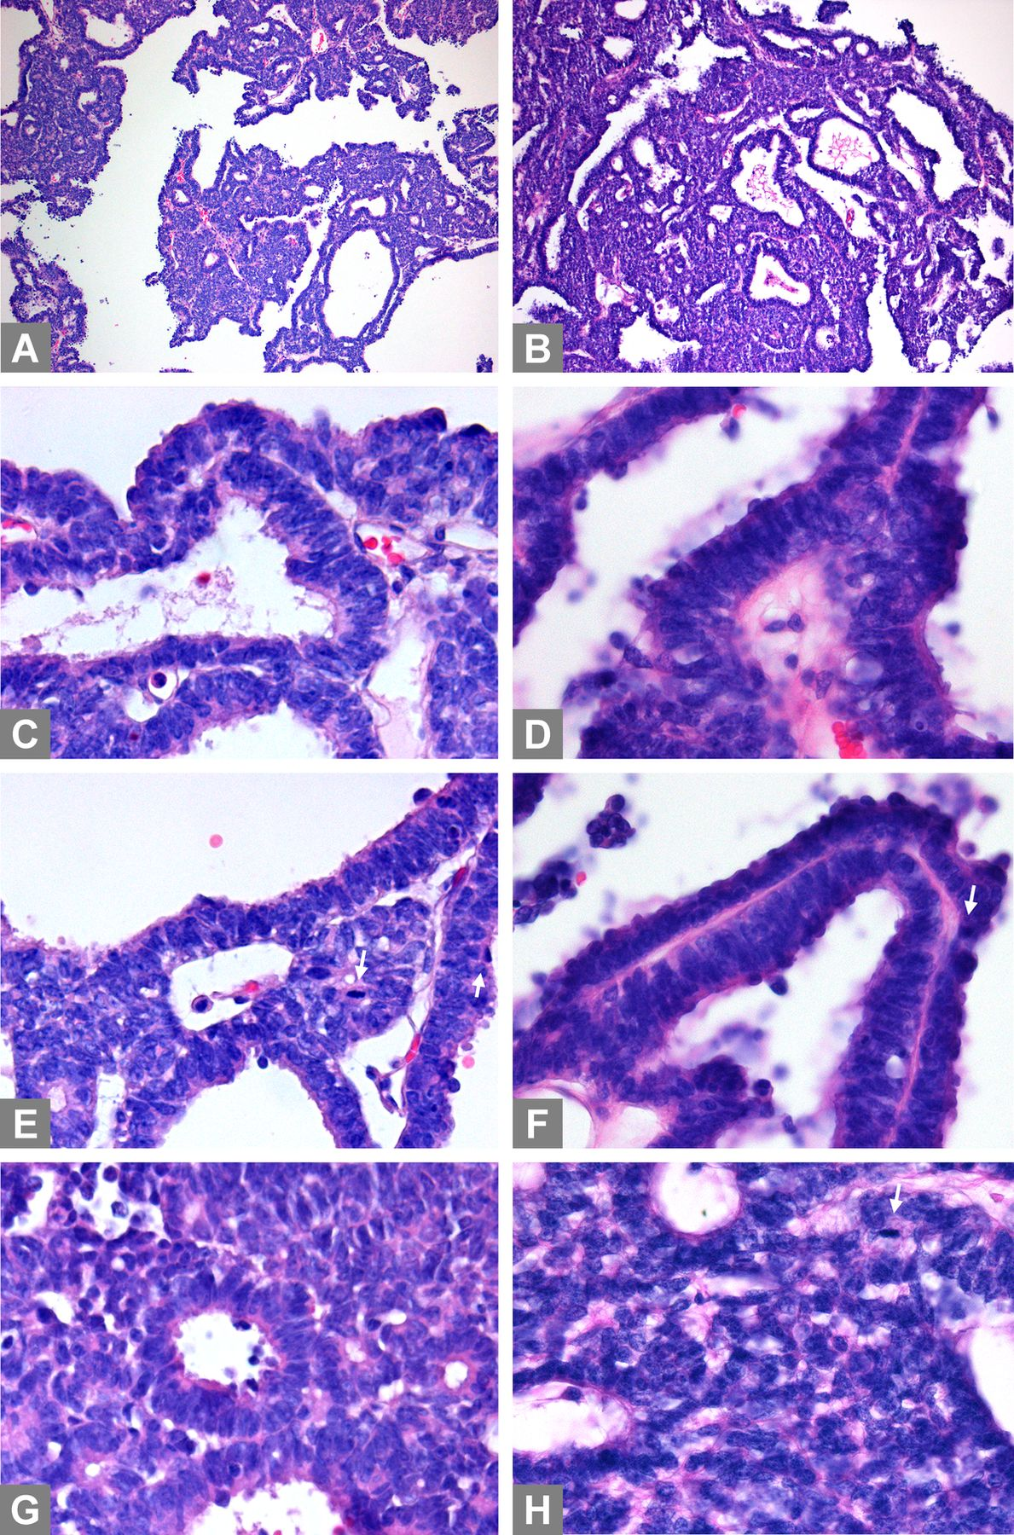
FIGURE 2. Histological findings in Patient 1 (A, C, E, G) and Patient 2 (B, D, F, H). (A, B) Low-power view ...
Notes:
FIGURE 2. Histological findings in Patient 1 (A, C, E, G) and Patient 2 (B, D, F, H). (A, B) Low-power view demonstrates cribriform strands, trabeculae-forming surfaces, and more compact areas. (C-F) Higher magnification demonstrates well-defined surfaces of the tumor strands; the cells have elongated nuclei. (G, H) Rosette formations are seen in compact areas in both cases. Mitotic figures (arrows) are indicated in (E, F, and H). Original magnification: (A, B) 100×; (C-H) 400×.
Unless provided in the caption above, the following copyright applies to the content of this slide: Copyright © 2009 by the American Association of Neuropathologists, Inc.

Slide 3
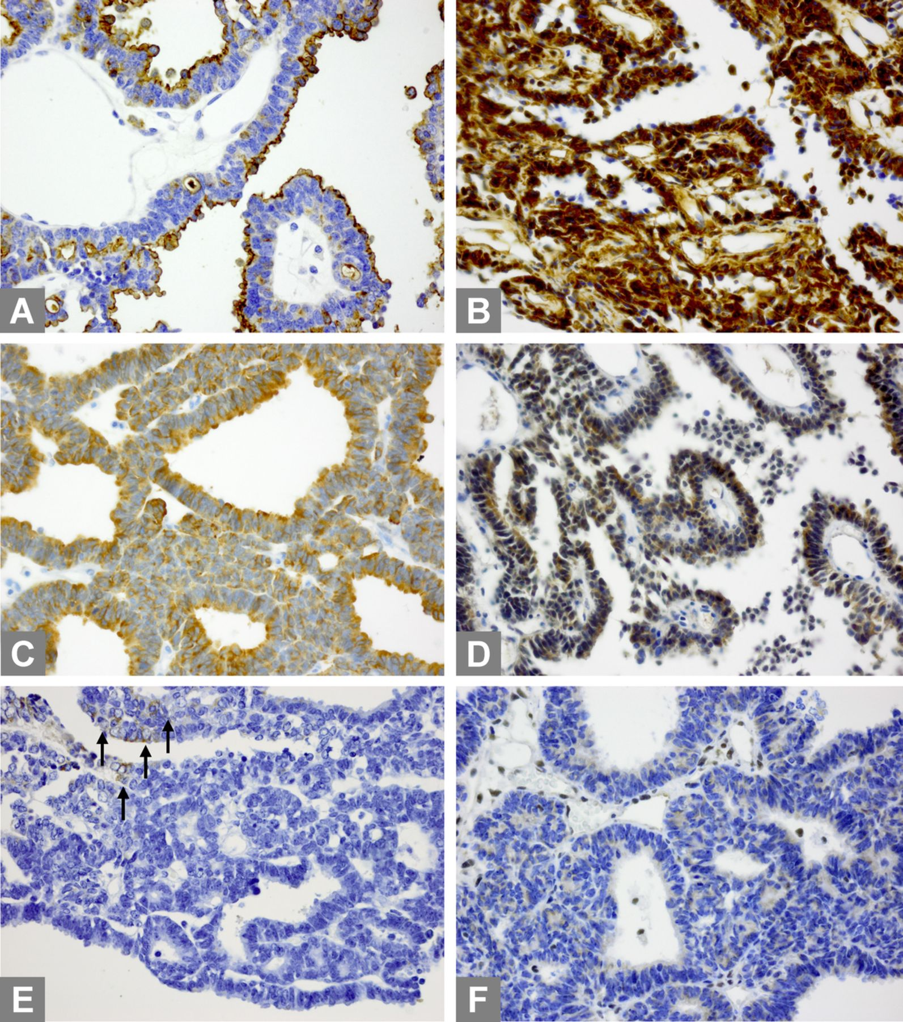
FIGURE 3. Immunohistochemical staining for epithelial membrane antigen (EMA) (A), vimentin (B), microtubule-associated ...
Notes:
FIGURE 3. Immunohistochemical staining for epithelial membrane antigen (EMA) (A), vimentin (B), microtubule-associated protein 2C (MAP2C) (C), synaptophysin (D), cytokeratins (E), and INI1 protein (F). There is EMA staining of surfaces and positive staining of the tumor cells for MAP2C and synaptophysin. Staining for cytokeratins is only focal (arrows in [E]). Nuclear INI1 staining is absent in the tumor cells but is present in the nuclei of vascular cells (internal positive control). Original magnification: 400×.
Unless provided in the caption above, the following copyright applies to the content of this slide: Copyright © 2009 by the American Association of Neuropathologists, Inc.

