Slide 1
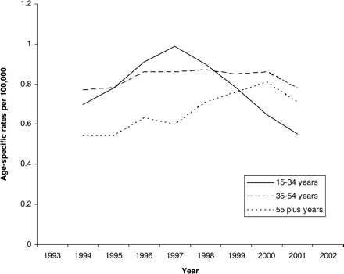
Figure 3. Suicide involving co-proxamol poisoning 1993–2002. Age-specific rates in males, 3-year moving averages. ...
Notes:
Figure 3. Suicide involving co-proxamol poisoning 1993–2002. Age-specific rates in males, 3-year moving averages. Office for National Statistics, drug-related poisoning database: suicides and deaths from undetermined cause in England and Wales where co-proxamol was mentioned on the death certificate.
Unless provided in the caption above, the following copyright applies to the content of this slide: The Author 2005. Published by Oxford University Press on behalf of the Association of Physicians. All rights reserved. For Permissions, please email: journals.permissions@oupjournals.org

Slide 2
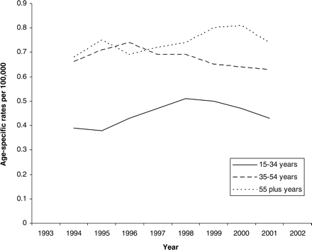
Figure 2. Suicide involving co-proxamol poisoning 1993–2002. Age-specific rates in females, 3-year moving averages. ...
Notes:
Figure 2. Suicide involving co-proxamol poisoning 1993–2002. Age-specific rates in females, 3-year moving averages. Office for National Statistics, drug-related poisoning database: suicides and deaths from undetermined cause in England and Wales where co-proxamol was mentioned on the death certificate.
Unless provided in the caption above, the following copyright applies to the content of this slide: The Author 2005. Published by Oxford University Press on behalf of the Association of Physicians. All rights reserved. For Permissions, please email: journals.permissions@oupjournals.org

Slide 3
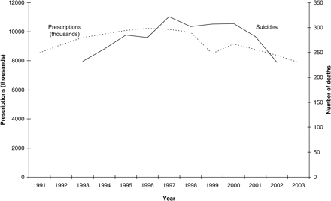
Figure 1. Co-proxamol prescriptions (England 1991–2003*) and suicides involving co-proxamol (England and Wales ...
Notes:
Figure 1. Co-proxamol prescriptions (England 1991–2003*) and suicides involving co-proxamol (England and Wales 1993–2002**). *Prescription Statistics, Department of Health: Prescription Cost Analysis data, co-proxamol prescriptions dispensed in the community. **Office for National Statistics, drug-related poisoning database: suicides and deaths from undetermined cause in England and Wales where co-proxamol was mentioned on the death certificate.
Unless provided in the caption above, the following copyright applies to the content of this slide: The Author 2005. Published by Oxford University Press on behalf of the Association of Physicians. All rights reserved. For Permissions, please email: journals.permissions@oupjournals.org

