Slide 1
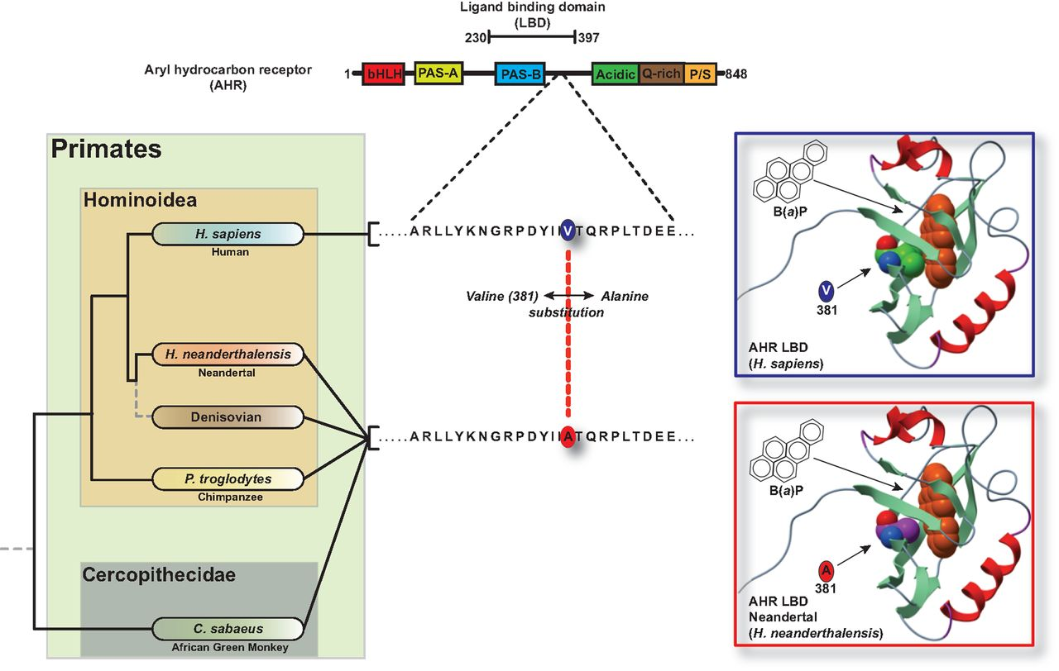
Fig. 1. Human AHR ligand-binding domain segregates from other primates through a single amino acid substitution. (A) ...
Notes:
Fig. 1. Human AHR ligand-binding domain segregates from other primates through a single amino acid substitution. (A) Map of AHR functional domains and the single amino acid variation in the human AHR relative to other Hominoidea. (B) Homology modeling of the orientation of benzo(a)pyrene in the ligand binding pocket of the human and Neandertal AHR.
Unless provided in the caption above, the following copyright applies to the content of this slide: © The Author 2016. Published by Oxford University Press on behalf of the Society for Molecular Biology and Evolution. All rights reserved. For permissions, please e-mail: journals.permissions@oup.com

Slide 2
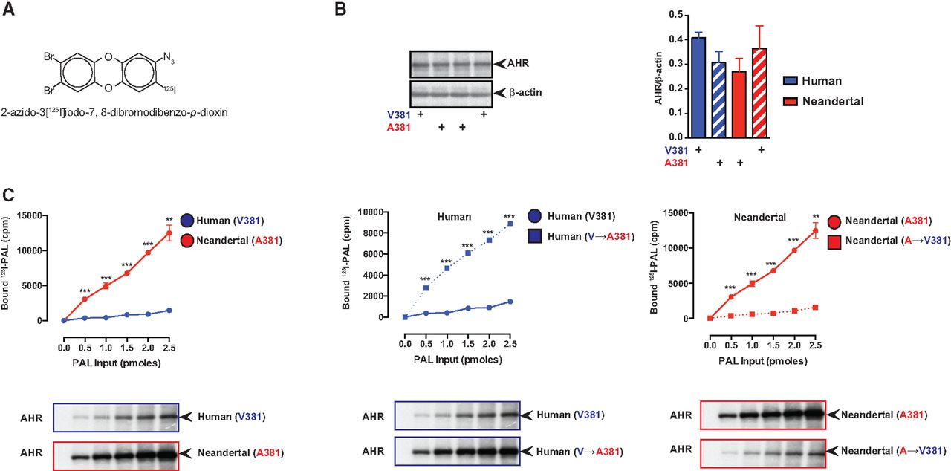
Fig. 2. Neandertal AHR exhibits enhanced dioxin analog binding relative to the human AHR. (A) AHR expression in COS1 ...
Notes:
Fig. 2. Neandertal AHR exhibits enhanced dioxin analog binding relative to the human AHR. (A) AHR expression in COS1 cells was measured by western blot analysis. (B) Structure of the photoaffinity ligand. (C) COS1 cells transiently expressing either the Neandertal or human AHR were incubated with increasing concentration of 2-azido-3-[125I]iodo-7,8-dibromodibenzo-p-dioxin (PAL), exposed to UV light and cellular extracts analyzed by SDS-PAGE. Radioactive AHR bands were excised and the amount of radioactivity quantitated.
Unless provided in the caption above, the following copyright applies to the content of this slide: © The Author 2016. Published by Oxford University Press on behalf of the Society for Molecular Biology and Evolution. All rights reserved. For permissions, please e-mail: journals.permissions@oup.com

Slide 3
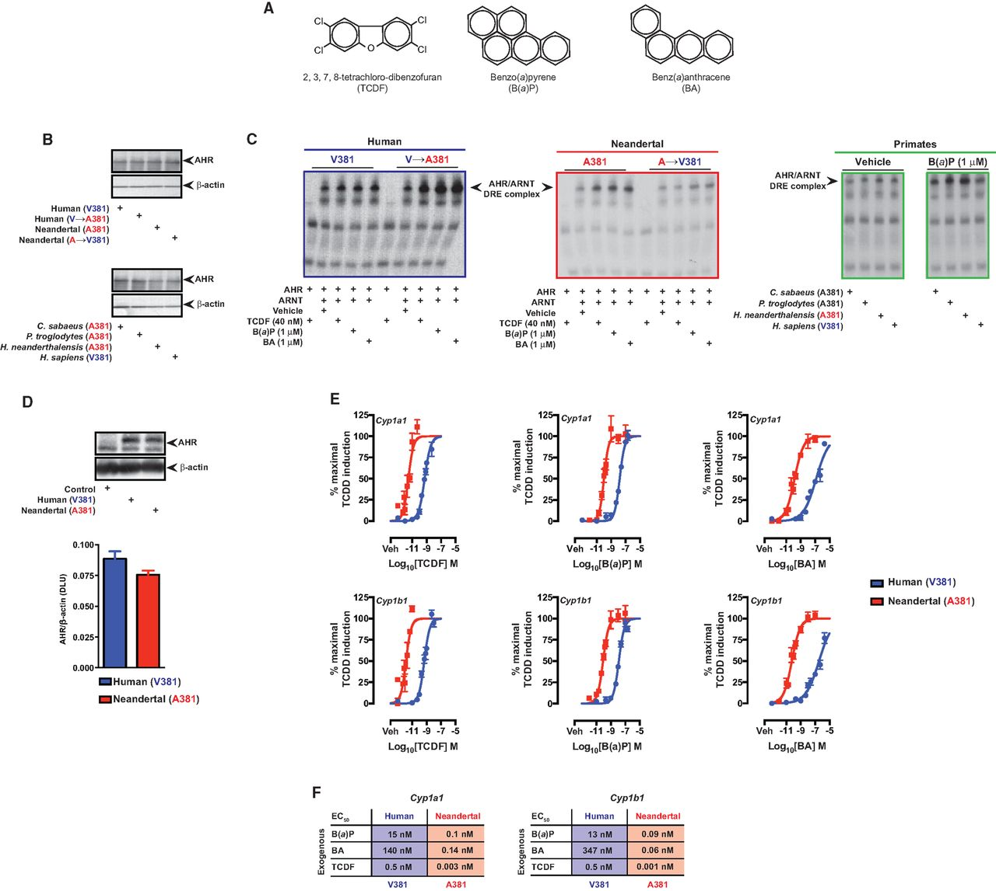
Fig. 3. Comparative analysis of PAH mediated DNA binding potential and transcriptional activity of the Neandertal and ...
Notes:
Fig. 3. Comparative analysis of PAH mediated DNA binding potential and transcriptional activity of the Neandertal and human AHR. (A) Structures of AHR ligands tested. (B) AHR expression in in vitro translations was measured by western blot analysis. (C) In vitro translated AHR from the appropriate species and ARNT were utilized in electrophoretic mobility shift assays to assess AHR ligand-mediated AHR/ARNT/DNA complex formation. (D) AHR expression in transfected BP8 cells was measured by western blot analysis. (E) Dose-dependent induction of Cyp1a1 and Cyp1b1 expression mediated by the Neandertal or human AHR in transfected BP8 cells. (F) Summary of the EC50 values for the dose-response experiments in panel C.
Unless provided in the caption above, the following copyright applies to the content of this slide: © The Author 2016. Published by Oxford University Press on behalf of the Society for Molecular Biology and Evolution. All rights reserved. For permissions, please e-mail: journals.permissions@oup.com

Slide 4
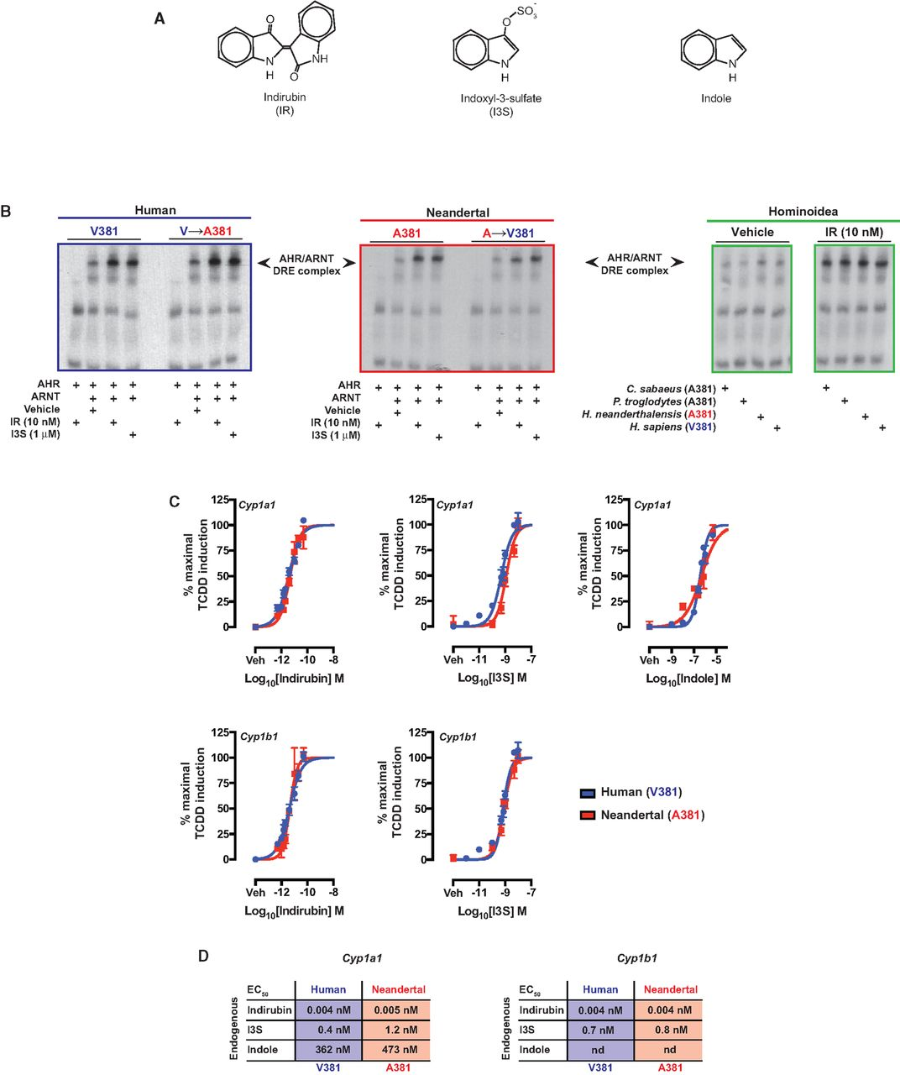
Fig. 4. Comparative analysis of endogenous ligand mediated DNA binding potential and transcriptional activity of the ...
Notes:
Fig. 4. Comparative analysis of endogenous ligand mediated DNA binding potential and transcriptional activity of the Neandertal and human AHR. (A) Structures of AHR ligands tested. (B) In vitro translated AHR from the appropriate species and ARNT were utilized in electrophoretic mobility shift assays to assess AHR ligand-mediated AHR/ARNT/DNA complex formation. (C) Dose-dependent induction of Cyp1a1 and Cyp1b1 expression mediated by the Neandertal or human AHR in transfected BP8 cells. (D) Summary of the EC50 values for the dose-response experiments in panel C.
Unless provided in the caption above, the following copyright applies to the content of this slide: © The Author 2016. Published by Oxford University Press on behalf of the Society for Molecular Biology and Evolution. All rights reserved. For permissions, please e-mail: journals.permissions@oup.com

