Slide 1
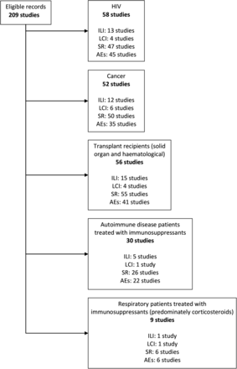
Figure 1. Studies identified by etiology of immunocompromise and research question. Subtotals do not add up to 209 ...
Notes:
Figure 1. Studies identified by etiology of immunocompromise and research question. Subtotals do not add up to 209 because 3 studies recruited multiple groups of immunocompromised patients; 7 studies on “other” causes of immunocompromise are not shown. Abbreviations: AE, adverse events; HIV, human immunodeficiency virus; ILI, influenza-like illness; LCI, laboratory confirmed influenza; SR, serological response.
Unless provided in the caption above, the following copyright applies to the content of this slide: © The Author 2012. Published by Oxford University Press on behalf of the Infectious Diseases Society of America. All rights reserved. For Permissions, please e-mail: journals.permissions@oup.com

Slide 2
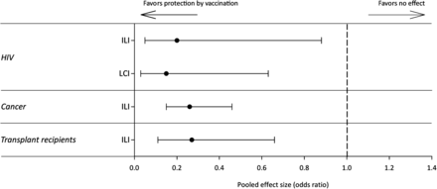
Figure 2. Selected meta-analysis results of influenza-like illness (ILI) and laboratory-confirmed influenza (LCI) by ...
Notes:
Figure 2. Selected meta-analysis results of influenza-like illness (ILI) and laboratory-confirmed influenza (LCI) by etiology of immunocompromise. Results represent odds of ILI and LCI compared with placebo or no vaccination; error bars show 95% confidence interval around pooled effect size. Abbreviation: HIV, human immunodeficiency virus.
Unless provided in the caption above, the following copyright applies to the content of this slide: © The Author 2012. Published by Oxford University Press on behalf of the Infectious Diseases Society of America. All rights reserved. For Permissions, please e-mail: journals.permissions@oup.com

Slide 3
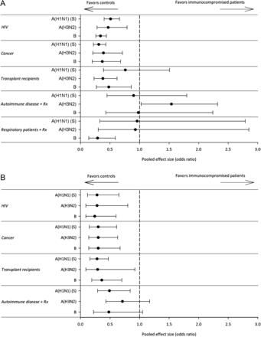
Figure 3. Selected meta-analysis results of serological outcome measures by etiology of immunocompromise. A, Odds of ...
Notes:
Figure 3. Selected meta-analysis results of serological outcome measures by etiology of immunocompromise. A, Odds of seroconversion with ≥4 fold rise in hemagglutination inhibition titer after vaccination, compared with vaccinated immunocompetent controls. B, Odds of seroprotection with ≥1:40 hemagglutination inhibition titer after vaccination, compared with vaccinated immunocompetent controls; error bars show 95% confidence interval around pooled effect size. Abbreviations: HIV, human immunodeficiency virus; Rx, treated with immunosuppressants.
Unless provided in the caption above, the following copyright applies to the content of this slide: © The Author 2012. Published by Oxford University Press on behalf of the Infectious Diseases Society of America. All rights reserved. For Permissions, please e-mail: journals.permissions@oup.com

