Slide 1
Figure 1 Timeline
Notes:
Figure 1 Timeline
Unless provided in the caption above, the following copyright applies to the content of this slide: © The Author 2012. Published by Oxford University Press on behalf of The Review of Economic Studies Limited.

Slide 2
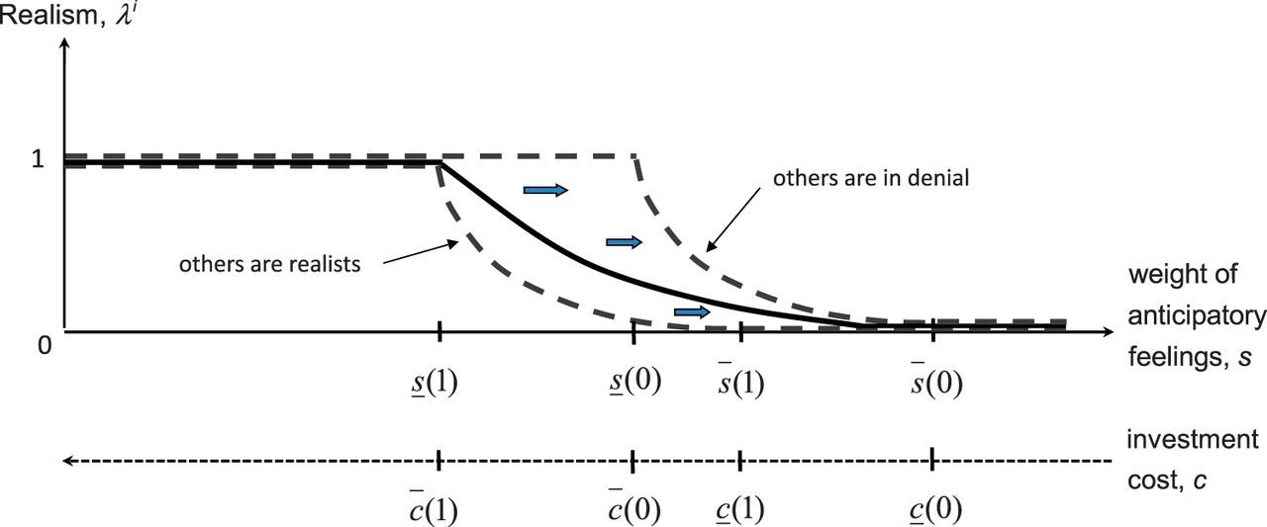
Figure 2 Group morale (θ_{L} > 0). The dashed lines give agent i's optimal awareness λ^{i} when others ...
Notes:
Figure 2 Group morale (θL > 0). The dashed lines give agent i's optimal awareness λi when others are realists (λj = 1) or deniers (λj = 0); arrows indicate the shift between the two. The solid line defines the social equilibrium
Unless provided in the caption above, the following copyright applies to the content of this slide: © The Author 2012. Published by Oxford University Press on behalf of The Review of Economic Studies Limited.

Slide 3
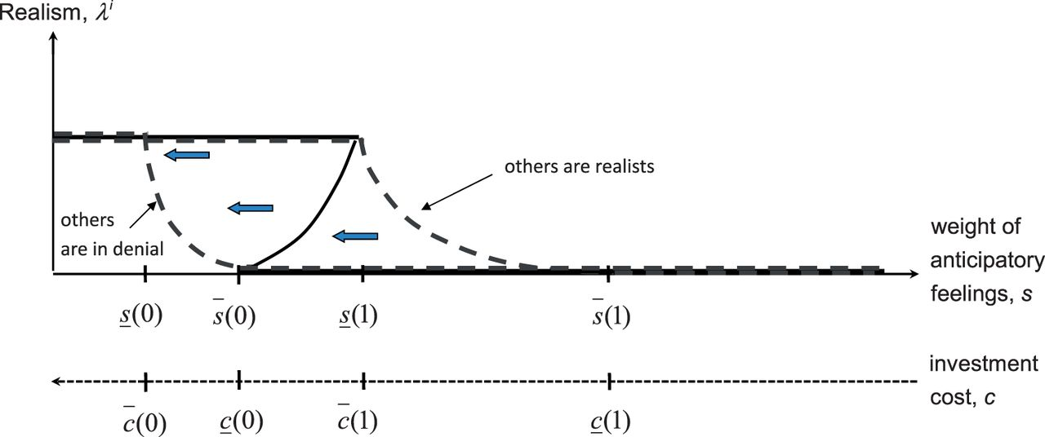
Figure 3 Groupthink (θ_{L} < 0). The dashed lines give agent i's optimal awareness λ^{i} when others ...
Notes:
Figure 3 Groupthink (θL < 0). The dashed lines give agent i's optimal awareness λi when others are realists (λj = 1) or deniers (λj = 0); arrows indicate the shift between the two. The solid lines define the social equilibria
Unless provided in the caption above, the following copyright applies to the content of this slide: © The Author 2012. Published by Oxford University Press on behalf of The Review of Economic Studies Limited.

Slide 4
Figure 6 The market game
Notes:
Figure 6 The market game
Unless provided in the caption above, the following copyright applies to the content of this slide: © The Author 2012. Published by Oxford University Press on behalf of The Review of Economic Studies Limited.

Slide 5
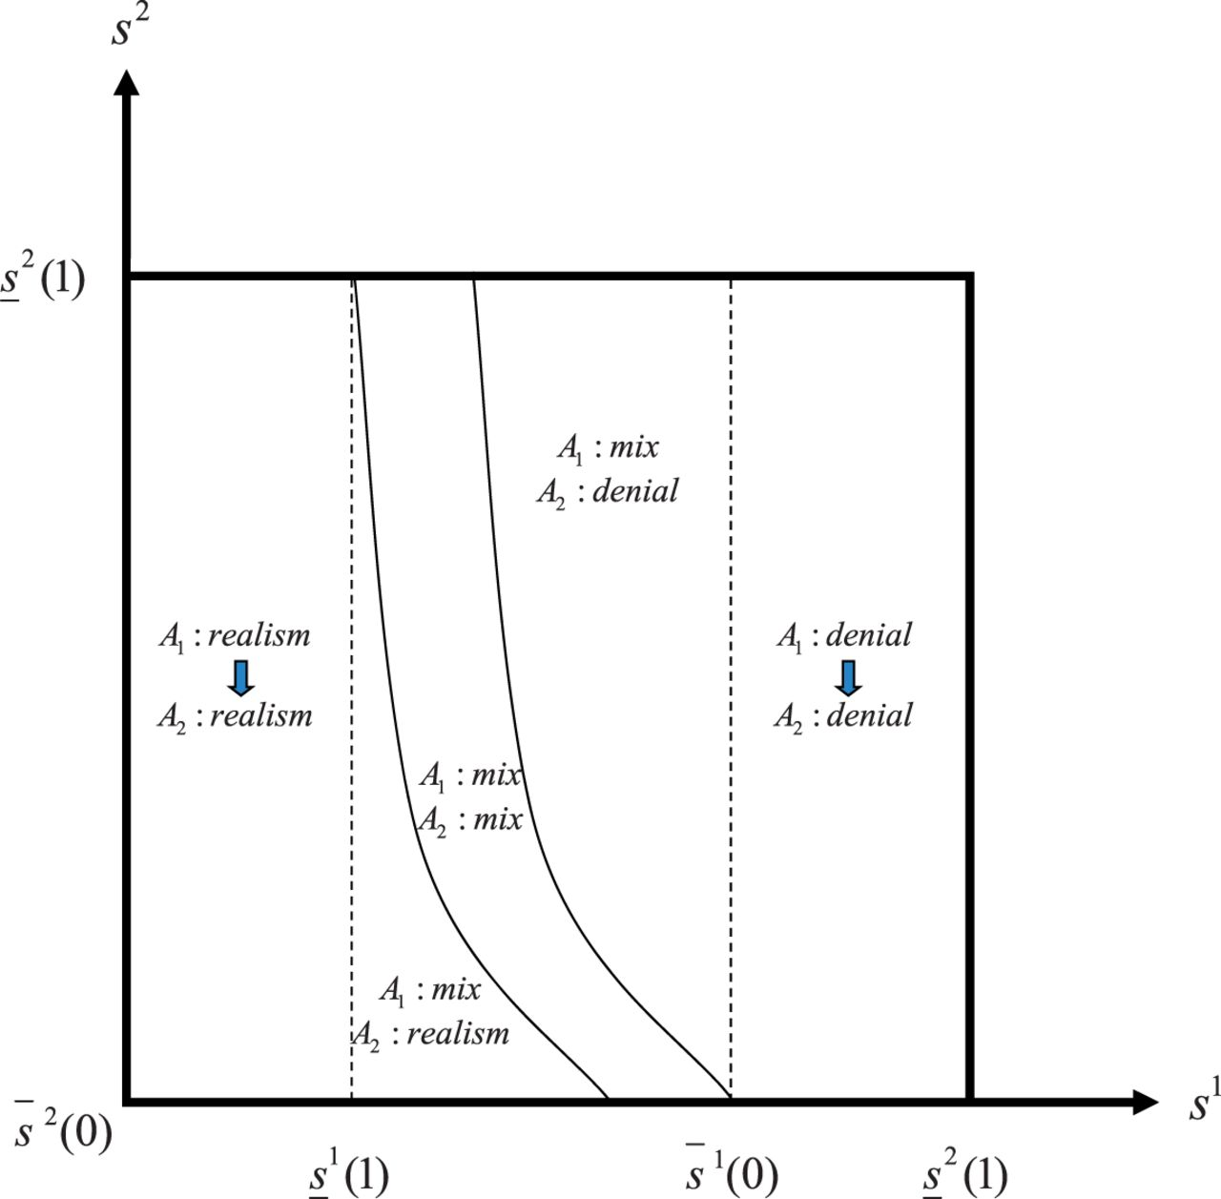
Figure 4 “Trickle down” of realism and denial in a hierarchy. The equilibrium strategies of manager (A₁) ...
Notes:
Figure 4 “Trickle down” of realism and denial in a hierarchy. The equilibrium strategies of manager (A1) and worker(s) (A2) are indicated in each region, with the arrows illustrating complete top-down determination
Unless provided in the caption above, the following copyright applies to the content of this slide: © The Author 2012. Published by Oxford University Press on behalf of The Review of Economic Studies Limited.

Slide 6
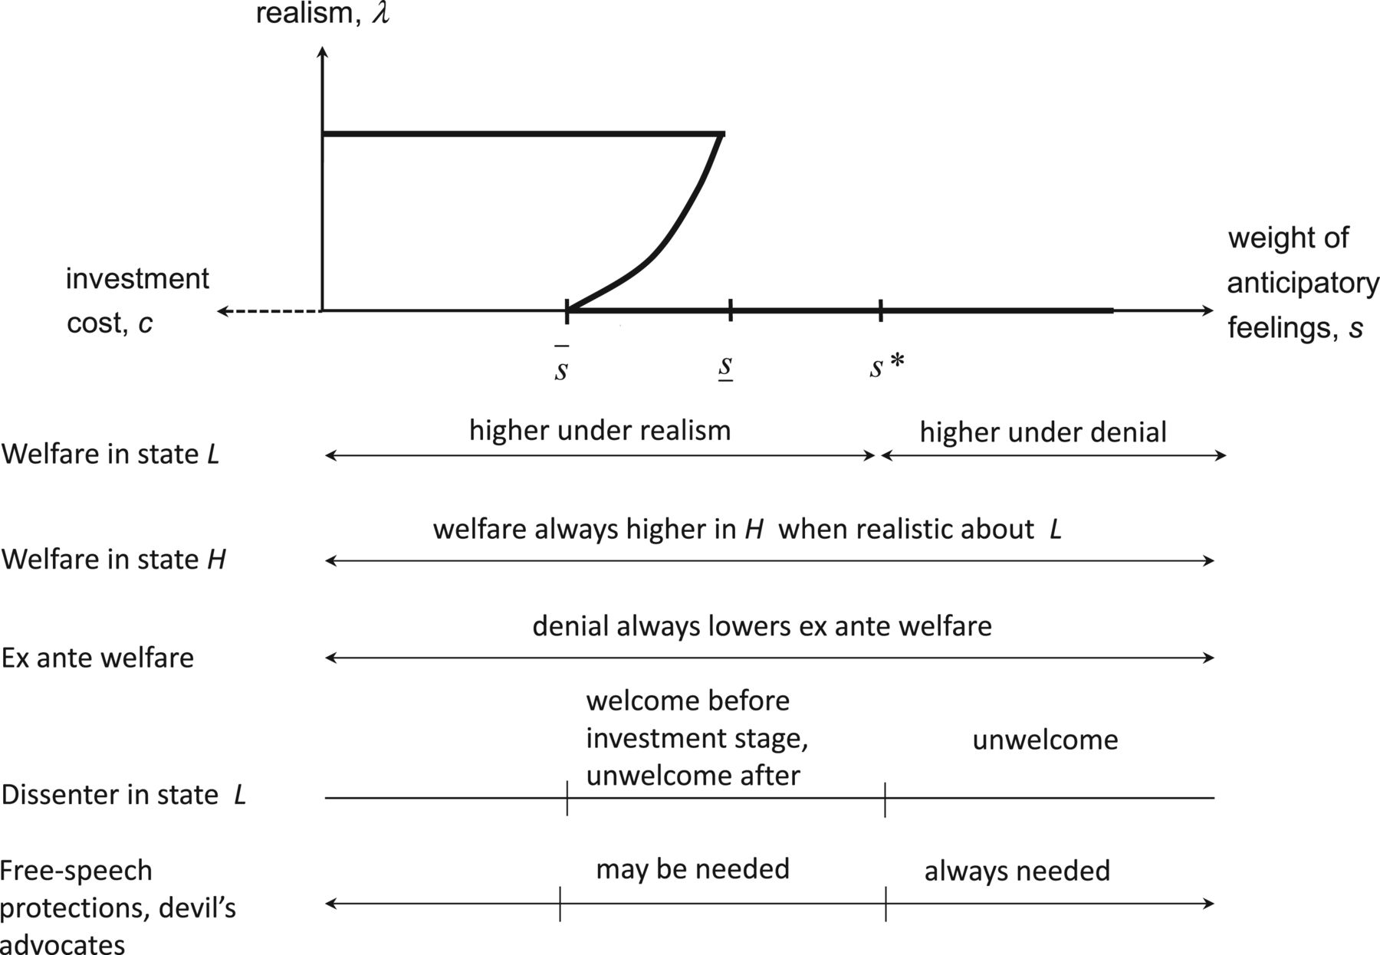
Figure 5 Welfare and dissenting speech (groupthink case)
Notes:
Figure 5 Welfare and dissenting speech (groupthink case)
Unless provided in the caption above, the following copyright applies to the content of this slide: © The Author 2012. Published by Oxford University Press on behalf of The Review of Economic Studies Limited.

Slide 7
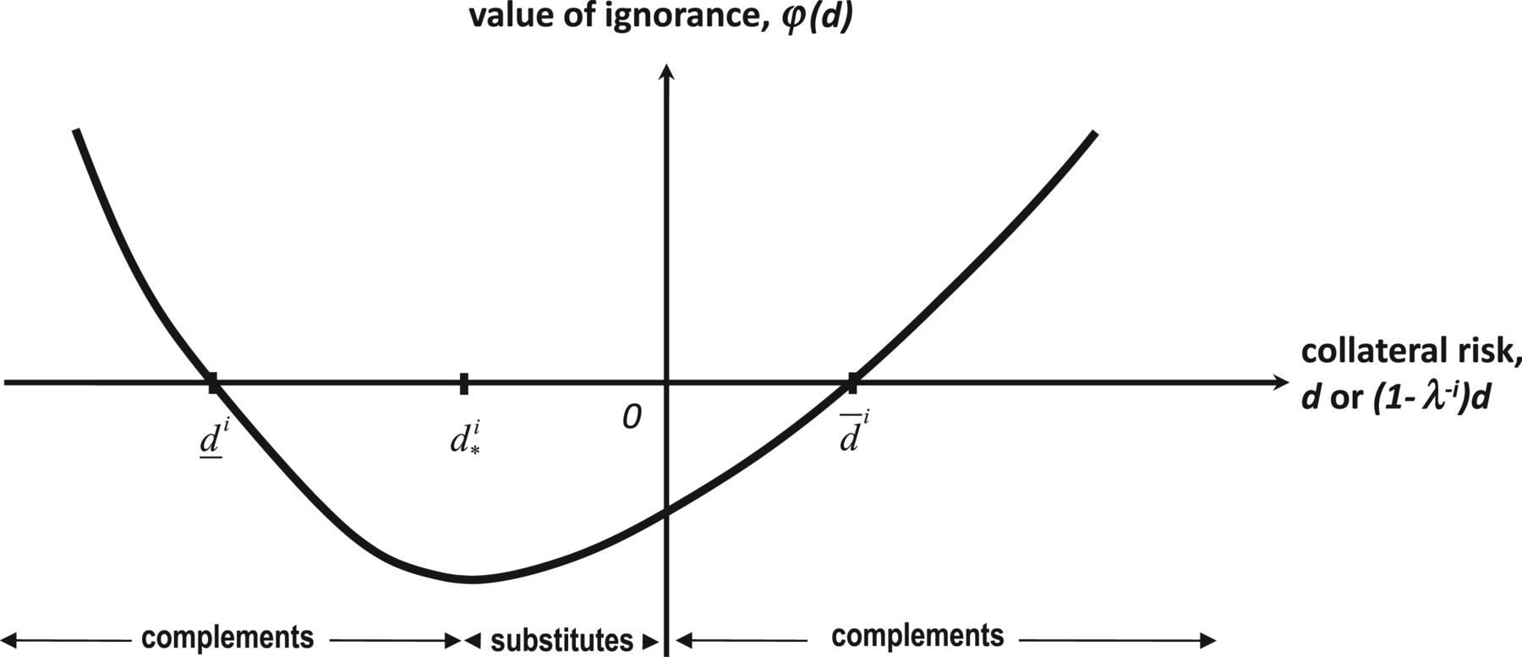
Figure 7 Collateral risk and informational decisions
Notes:
Figure 7 Collateral risk and informational decisions
Unless provided in the caption above, the following copyright applies to the content of this slide: © The Author 2012. Published by Oxford University Press on behalf of The Review of Economic Studies Limited.

